Slide 1
Research Proposal
Measuring Food Waste in Prince George Restaurant: Volume, Model, and Effects Akihiko Mori, MA NRES UNBC

Slide 2
Introduction

Slide 3
Introduction
Food Loss and Waste (FLW) happens everywhere.
One-third of food is lost or wasted around the world[1].
Around 1.3 billion tons of FWL is generated annually, and the rate is projected to grow by 44% per year by 2025[2].
Canada creates about 35 million tons and the largest waste generator per capita in western countries in 2016[3].
Canada’s avoidable FLW is 49.5 million CAD[4].

Slide 4
Introduction
In BC, 40% of the waste to landfills is organic waste, the majority is produced from domestic waste[5].
Recent huge discoveries in the food waste research focus on waste generated by households:[6,7,8,9] (Aschemann-Witzel et al., 2015; Lusk & Ellison, 2017; Nahman et al., 2012; Von Massow et al., 2019).
Limited number of studies done on the food supply side.
Even little esimations of FLW in food service industry.

Slide 5
Introduction
Research Questions
What is the average volume of food that is wasted during processing and consumption in restaurants?
What is the extent of food wastage in Japanese restaurants in Prince George?
What are the main factors contributing to food loss and waste?
To what extent is a social or environmental impact from food loss waste generated by a single restaurant?
What approaches are Japanese restaurant operators taking to reduce food waste generation?

Slide 6
Literature Review

Slide 7
Literature Review
Organizations | Definition
Food Loss by FAO | harvest/slaughter/catch
Food Waste by FAO | retail/ consumption
Food Waste by EU | Food removed from FSC
Food Loss by US | unused product from agri
Food Waste by US | Subcomponent of FL
Definition of FLW
No universally accepted definitions of FLW

Slide 8
[10]

Slide 9
Literature Review
1 | 2 | 3 | 4 | 5
Production | Handling | Process | Distribution | Consumption
<— | — | FLW | — | —>
<— | FL | —> | <— | FW —>
Definition of FLW

Slide 10
Organizations | FL | FW | Subset
FAO | First 3 stages | Last 2 stages | X
EU | None | All | X
US | All | Last 2 stages | O

Slide 11
Literature Review
 | Edible | Inedible
Solid | FL | FW
Liquid | FW | X
Definition of FLW

Slide 12
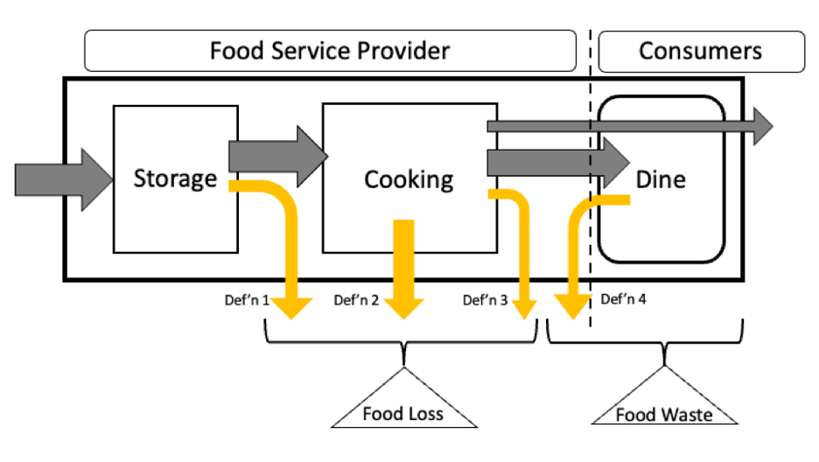
Literature Review
Definition of FLW
Food Loss: generated by provider
Food Waste: generated by consumers
Flow of FLW

Slide 13
Literature Review
Method | Note
1.Self-report | individuals report FLW
 | low cost but high dropouts
2.Survey | collect FLW by interview or questionnaire
 | cost-effective but not accurate
3.Composition | sample and analysis at lab
 | need special knowledge and equipment
4.Mass balance | material flow analysis
 | limitation in waste factor assumptions
5.Direct weight | directly measure FLW
 | most accurate but high cost
Five Measurements of FLW

Slide 14
Literature Review
Statistic Model
Multiple Linear Regression
Ad: Simple and interpretable
Disad: Not suitable to time series
Disad: Stationary and Spurious
Bayesian Modelling
Ad: Flexible and adaptable to time series data
Disad: No appropriate result in some cases

Slide 15
Literature Review
Effects of Food Loss and Waste
Economic Loss:
labour, material resources, time, and energy
Environmental Impacts:
water pollution, deforestation, soil erosion, and GHG
Reducing FLW can mitigate these economic and environmental impacts. Through better supply chain management, reducing consumer food waste, and increasing food recovery.

Slide 16
Literature Review
Hypotheses
Estimate average FLW
Any patterns between FLW and business operations
Any patterns between FLW and weather conditions
Estimate economic and environmental impacts

Slide 17
Methods

Slide 18
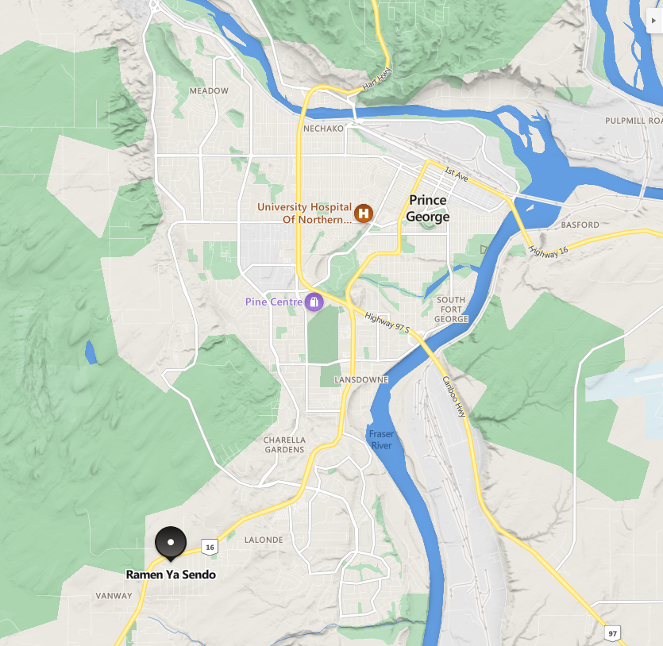
Methods
Study Area
Japanese restaurant located a suburban area of Prince George
lunch and dinner for three hours each
six days of a week: from Tuesday to Sunday
Research Location Site

Slide 19
Methods
Busket for Food Loss | Busket and Strainer for Food Waste
Sample Collection

Slide 20
Methods
Sample Size
Power analysis, 95% CI and 10% margin of error with most conservative estimate says 97 samples
Rule-of-thumb, one in ten rule suggests 100 observations with 10 predictors[11]
Green’s rule states 130 samples with 10 predictors[12]

Slide 21
Methods
Variables | Note
1.Food Loss | Daily disposed food by kitchen
2.Liquid Food Waste | Daily disposed liquid food by customers
3.Solid Food Waste | Daily disposed solid food by customers
4.Number of Customers | Daily Number of dine-in customers
5.Sales | Daily sales
6.Liquor | Daily Number of liquors sold
7.Takeouts | Daily Number of takeout sold
8.Orders | Daily Number of orders sold
9.Temperature | Hourly mean temperature each day
10.Humidity | Hourly mean humidity each day
11.Precipitation | Precipitation each day
Variables

Slide 22
Methods
Multiple Linear Regression Model (additive)
$$\begin{matrix}Y & =Xβ+ε \\ ε_{i} & \overset{\text{i}\text{.}\text{i}\text{.}\text{d}\text{.}}{∼}N\left(μ=0,σ^{2}\right).\end{matrix}$$
Baysian Modelling
$$\begin{matrix}Y & =Xβ_{i}+ε \\ β_{i} & ∼N\left(β_{i−1},σ_{β}^{2}\right) \\ ε_{i} & ∼N\left(0,σ_{y}^{2}\right).\end{matrix}$$

Slide 23
Expected Results

Slide 24
Expected Results
Expected Results
Estimations of FLW in a restaurant
Patterns of FLW
Implications of FLW reduction

Slide 25
Expected Results
Food Waste per Week of Day | Food Loss and Waste Trend
Current Progress
From Sept. 16, four months.
Collected over 100 samples.
Basic analysis (Histogram, Time series plots)

Slide 26
Expected Results
TODO
Develop potential causes of FLW (Weather and Calendar Effects)
Calculate the average rate of food loss and waste
Estimate econbomic and environmental effects

Slide 27
Acknowledgements

Slide 28
Acknowledgements
I would like to express my gratitude to my supervisor, Dr. Balbinder Deo, and to the committee member for his support and encouragement in my initial thesis development. I would also like to thank the University of Northern British Columbia and Prince George for allowing me an opportunity to pursue graduate studies.

Slide 29
References

Slide 30
References
[1] Gustavsson, J. (Ed.). (2011). Global food losses and food waste: extent, causes and prevention; study conducted for the International Congress Save Food! at Interpack 2011, [16 - 17 May], Düsseldorf, Germany. Food and Agriculture Organization of the United Nations. [2] Blakeney, M. (2019). Food loss and food waste: Causes and solutions. [3] National Zero Waste Council. (2016). A tax incentive to prevent food waste in Canada. NZWC. Retrieved October 12, 2021, from http://www.nzwc.ca/Documents/NZWC- TaxIncentiveBackgrounder.pdf. [4] Gooch, M., Bucknell, D., LaPlain, D., Dent, B., Whitehead, P., Felfel, A., Nikkel, L., & Maguire, M. (2019). The avoidable crisis of food waste: Technical report. Value Chain Management International and Second Harvest, Ontario, Canada, 122. [5] Retrieved on August 20, 2022 from: https://www2.gov.bc.ca/gov/content/environment/waste-management/food-and-organic-waste/prevent- food-waste [6] Aschemann-Witzel, J., de Hooge, I., Amani, P., Bech-Larsen, T., & Oostindjer, M. (2015). Consumer-related food waste: Causes and potential for action. Sustainability (Switzerland), 7(6), 6457–6477. [7] Lusk, J. L., & Ellison, B. (2017). A note on modelling household food waste behaviour. Applied Economics Letters, 24(16), 1199–1202. [8] Nahman, A., de Lange, W., Oelofse, S., & Godfrey, L. (2012). The costs of household food waste in South Africa. Waste Management, 32(11), 2147–2153. [9] Von Massow, M., Parizeau, K., Gallant, M., Wickson, M., Haines, J., Ma, D. W. L., Wallace, A., Carroll, N., & Duncan, A. M. (2019). Valuing the multiple impacts of household food waste. Frontiers in Nutrition, 6, 143. [10] [11] Harrell, F. E., Lee, K. L., Califf, R. M., Pryor, D. B., & Rosati, R. A. (1984). Regression modelling strategies for improved prognostic prediction. Statistics in Medicine, 3(2), 143–152. https://doi.org/10.1002/sim.4780030207\ [12]

