Slide 1
Practical UML Tutorial
A Hands-On Introduction for Developers
HO Tuong Vinh (IFI)
email: htvinh@ifi.edu.vn
inspired from a Togethersoft’s tutorial

Slide 2
Object-Oriented Software Development
The heart of object-oriented problem solving is the construction of a model
The model abstracts the essential details of the underlying problem from its usually complicated real world
Several modeling tools are wrapped under the heading of the UML, which stands for Unified Modeling Language

Slide 3
Object-Oriented Problem Solving
It all begins with the construction of a model
A model is an abstraction of the underlying problem
The domain is the actual world from which the problem comes
Models consist of objects that interact by sending each other messages
Think of an object as "alive." Objects have things they know (attributes) and things they can do (behaviors or operations). The values of an object's attributes determine its state
Classes are the "blueprints" for objects. A class wraps attributes (data) and behaviors (methods or functions) into a single distinct entity. Objects are instances of classes

Slide 4
This tutorial is to present
important highlights
of the UML

Slide 5

What is the UML
Unified Modeling Language
An industry standard design notation for:
    Expressing software architecture
    Expressing software dynamics and behavior
    Documenting software deployment
OMG standard
The de-facto industry standard today
The UML supports both Process and Architecture

Slide 6
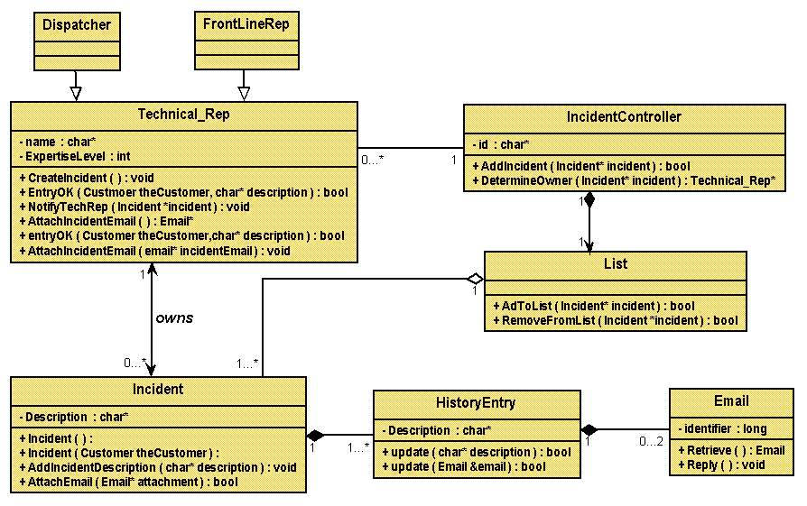
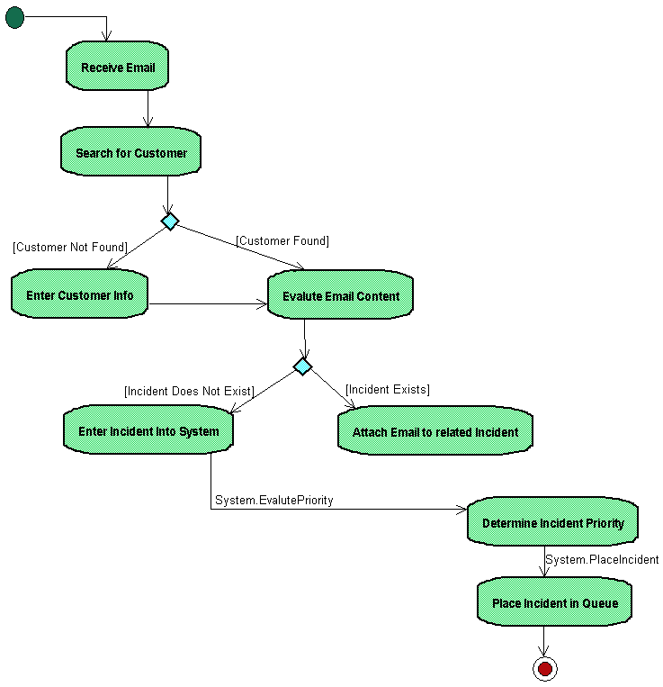
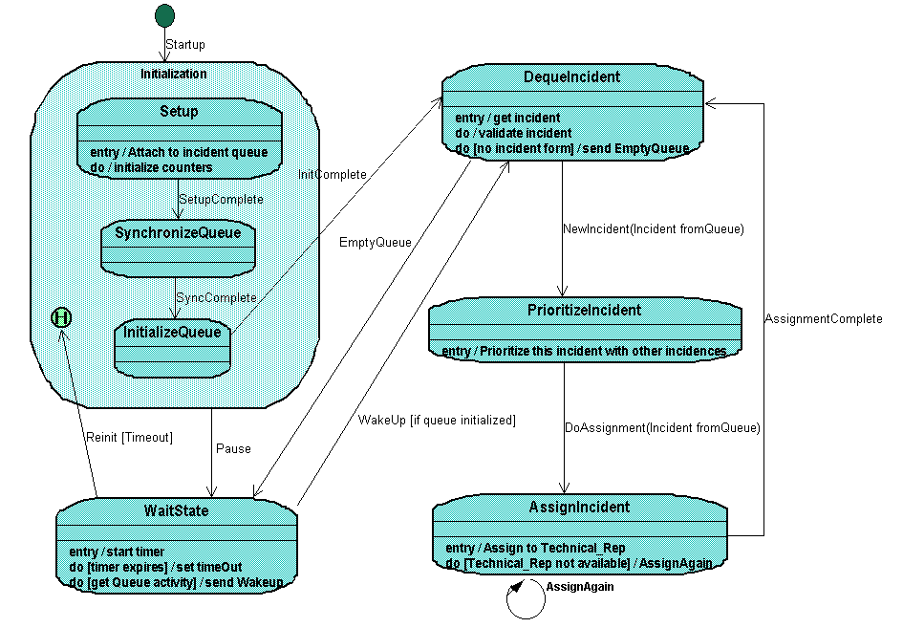
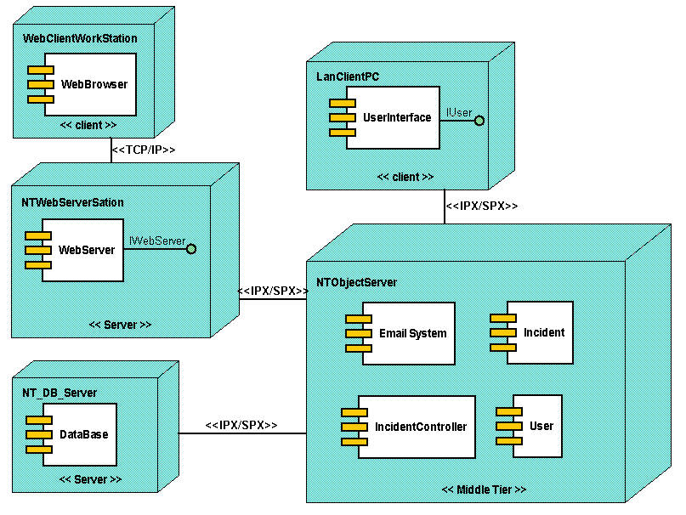
UML Architecture Support
4 + 1 View Model of Architecture
Design View
Implementation View
Class & Object Diagrams
Interaction Diagrams
Statechart Diagram
Activity Diagram
Component Diagram
Interaction Diagrams
Statechart Diagram
Activity Diagram
Use Case View
Use Case Diagram
Interaction Diagrams
Statechart Diagram
Activity Diagram
Class & Object Diagrams
Interaction Diagrams
Statechart Diagram
Activity Diagram
Deployment Diagram
Interaction Diagrams
Statechart Diagram
Activity Diagram
Process View
Deployment View
Reprinted from The Unified Modeling Language Users Guide

Slide 7
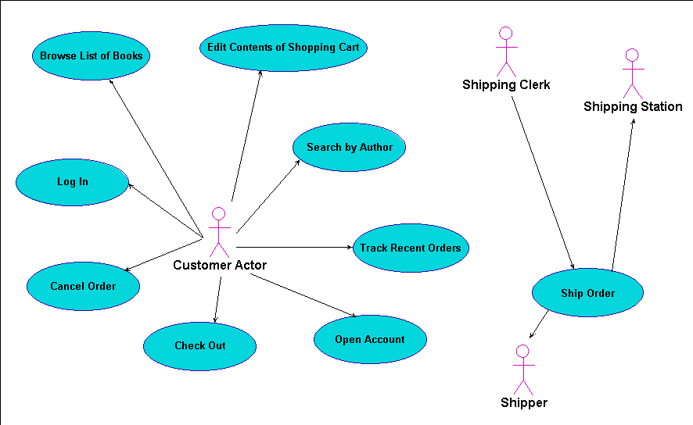
Architecture
Use Case View
  encompasses the use cases that describe the behavior of the system
  does not specify the organization of the software system
  does specify the forces that shape the system’s architecture
  static aspects are captured in Use Case diagrams
  dynamic aspects are captured in Interaction (Sequence and Collaboration), Statechart and Activity diagrams
[See picture]

Slide 8
The Internet Bookstore Example

Slide 9
Architecture
Design View
  classes, interfaces and collaborations that form the vocabulary of the problem and its solution
  supports the functional requirements of the system
  static aspects are captured in Class and Object diagrams
  dynamic aspects are captured in Interaction, Statechart and Activity diagrams
[See picture]

Slide 11
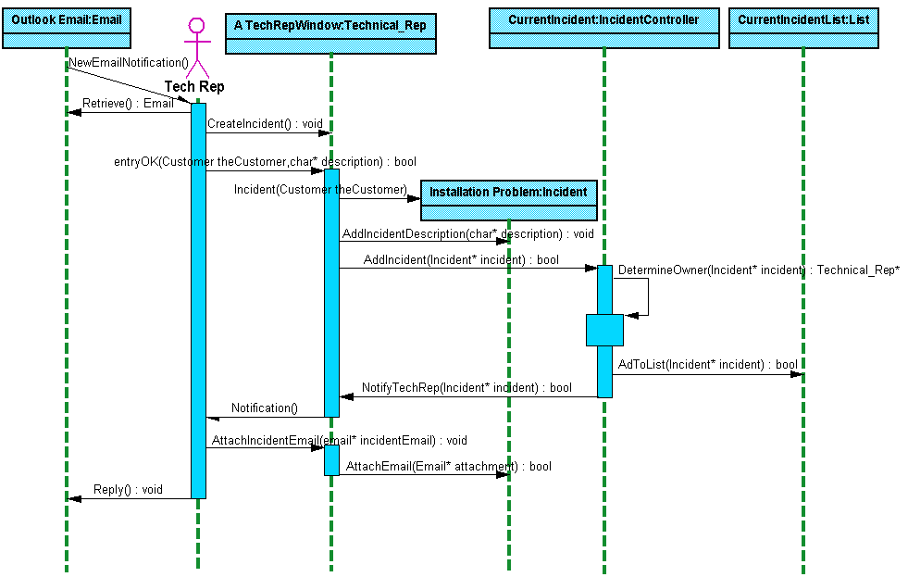
Architecture
Process View
  threads and processes that form the system’s concurrency and synchronization mechanisms
  addresses performance, reliability, scalability and throughput of the system
  static and dynamic aspects are captured as with the Design View with a focus on active classes that represent the processes and threads
[See picture]

Slide 13
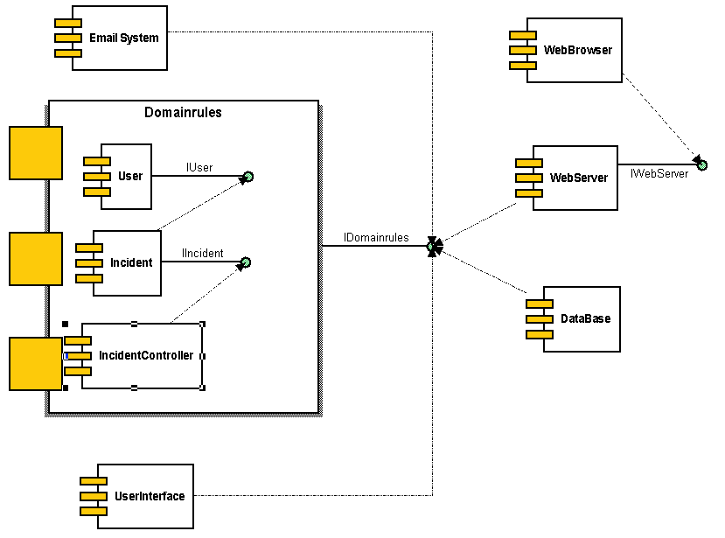
Architecture
Implementation View
  the components and files used to assemble the system
  primarily addresses the configuration management of the system’s releases
  static aspects are captured in Component diagrams
  dynamic aspects are captured in Interaction, Statechart and Activity diagrams
[See picture]

Slide 14
Architecture
Deployment View
  the nodes that form the system’s hardware topology
  addresses the distribution, delivery and installation of the system
  static aspects captured in Deployment diagrams
  dynamic aspects captured in Interaction, Statechart and Activity diagrams
[See picture]

Slide 16
History of UML
Industrialization
Standardization
Unification
Fragmentation
June `99
OMG accepts the UML as the official
industrial standard for software modeling
notations on 17th Nov. ‘97
Submission to OMG, Sept ‘97
Submission to OMG, Jan ‘97
Beta Version OOPSLA ‘96
WWW-June ‘96
OOPSLA ‘95
UML 1.3
UML 1.1
Public
Feedback
UML 1.0
UML 0.9
Unified Method 0.8
Booch’93
OMT-2
“Method Wars”
Various Methods
Booch’91
OMT-1
OOSE

Slide 17
UML Notation
At the center of the UML are its 9 different kinds of modeling diagrams:
1 Use case diagrams
2 Class diagrams
3 Object diagrams
4 Sequence diagrams
5 Collaboration diagrams
6 Statechart diagrams
7 Activity diagrams
8 Component diagrams
9 Deployment diagrams

Slide 18
Use Case diagrams
Use case diagrams describe what a system does from the standpoint of an external observer
The emphasis is on WHAT a system does rather than HOW
Use case diagrams are closely connected to scenarios. A scenario is an example of what happens when someone interacts with the system

Slide 19
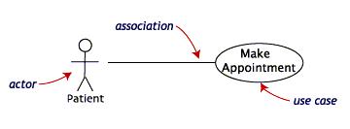
Use Case diagrams
The connection between actor and use case is a communication association
Here is a scenario for a medical clinic
An actor is who or what initiates the events involved in that
task. Actors are simply roles that people or objects play
"A patient calls the clinic to make an appointment for a yearly checkup. The receptionist finds the nearest empty time slot in the appointment book and schedules the appointment for that time slot. "
A use case is a summary of scenarios for a single task or goal

Slide 20
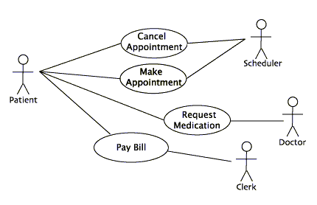
Use Case diagrams
Actors are stick figures
Communications are lines that link actors to use cases
Use cases are ovals
A use case diagram is a collection of actors, use cases, and their communications
A
single use case can have multiple actors
Example of the use cases for the medical clinic

Slide 21
Use Case diagrams
Use case diagrams are helpful in 3 areas:
determining features (requirements). New use cases often generate new requirements as the system is analyzed and the design takes shape
communicating with clients. Their notational simplicity makes use case diagrams a good way for developers to communicate with clients
generating test cases. The collection of scenarios for a use case may suggest a suite of test cases for those scenarios
More on Use Case
To Class diagrams

Slide 22
Use Case diagrams ……more details
Use case diagrams give an outsider's view of a system
Every use case diagram has actors, use cases, and communications
A simple use case diagram can be expanded with additional features to display more information:
system boundaries
generalizations
includes
extensions

Slide 23
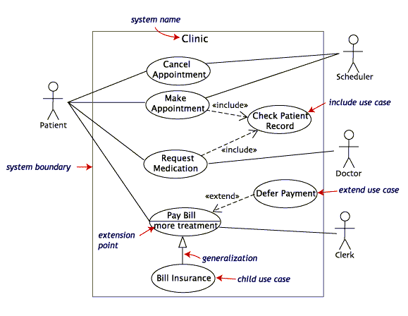
Include relationships factor use cases into additional ones. Includes are especially helpful when the same use case can be factored out of two different use cases.
Use Case diagrams ……more details
An extend relationship indicates that one use case is a variation of another. Extend notation is
a dotted line, labeled <<extend>>, and with an arrow toward the base case. The extension point,
which determines when the extended case is appropriate, is written inside the base case.
Both Make Appointment and Request Medication include Check Patient Record as a subtask.
A use case generalization shows that one use case is simply a special kind of another. Generalization appears as a line with a triangular arrow head toward the
parent use case.
A system boundary rectangle separates the clinic system from the external actors
Pay Bill
is a parent use case and Bill Insurance is the child. A child can be substituted for its parent
whenever necessary.
In the diagram, include notation is a dotted line beginning at base use case ending with an arrows pointing to the
include use case. The dotted line is labeled <<include>>.
Example of the use cases for the medical clinic, expanded

Slide 24
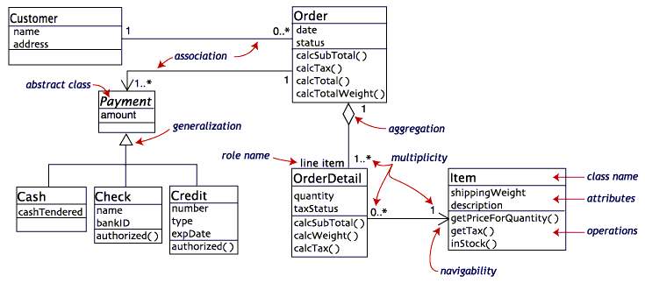
Class diagrams
A navigability arrow on an association shows which direction the association can be traversed or queried. An OrderDetail can be queried about its Item, but not the other way around. The arrow also lets you know who "owns" the association's implementation; in this case, OrderDetail has an Item.
The multiplicity of an association end is the number of possible instances of the class associated with a single instance of the other end. Multiplicities are single numbers or ranges of numbers. In our example, there can be only one Customer for each Order, but a Customer can have any number of Orders.
generalization -- an inheritance link indicating one class is a superclass of the other. A generalization has a triangle pointing to the superclass. Payment is a superclass of Cash, Check, & Credit.
A Class diagram gives an overview of a system by showing its classes and the relationships among them. Class diagrams are static-- they display what interacts but not what happens when they do interact
The central class is the Order. Associated with it are the Customer making the purchase and the Payment. A Payment is one of three kinds: Cash, Check, or Credit. The order contains OrderDetails (line items), each with its associated Item.
Association -- a relationship between instances of the two classes. There is an association between two classes if an instance of one class must know about the other in order to perform its work. In a diagram, an association is a link connecting two classes.
The UML class notation is a rectangle divided into three parts: class name, attributes, and operations. Names of abstract classes, such as Payment, are in italics. Relationships between classes are the connecting links.
aggregation -- an association in which one class belongs to a collection. An aggregation has a diamond end pointing to the part containing the whole. In our diagram, Order has a collection of OrderDetails.
This class diagram models a customer order from a retail catalog

Slide 25
Class diagrams ……more details
All class diagrams have classes, links, & multiplicities. But a class diagram can show even more information :
compositions
class member visibility and scope
dependencies and constraints
interfaces
More on Class diagram
To Object diagrams

Slide 26
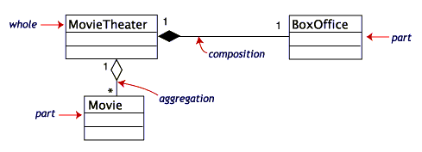
Class diagrams ……more details
Composition and aggregation
Associations in which an object is part of a whole are aggregations. Composition is a strong association in which the part can belong to only one whole -- the part cannot exist without the whole. Composition is denoted by a filled diamond at the whole end.
This diagram shows that a BoxOffice belongs to exactly one movieTheater. Destroy the MovieTheater and the BoxOffice goes away! The collection of Movies is not so closely bound to the MovieTheater.

Slide 27
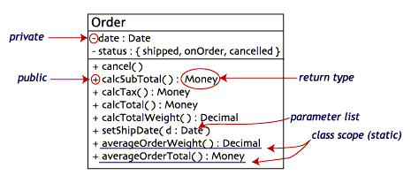
Class diagrams ……more details
Class information: visibility and scope
The class notation is a 3-piece rectangle with the class name, attributes, and operations. Attributes and operations can be labeled according to access and scope.
Static members are underlined. Instance members are not.
Access specifiers appear in front of each member: + public, - private, # protected

Slide 28
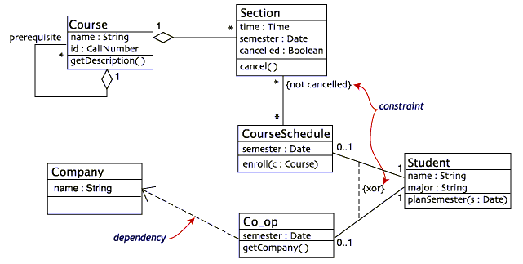
Class diagrams ……more details
Dependencies and constraints
A dependency is a relation between two classes in which a change in one may force changes in the other. Dependencies are drawn as dotted lines.
A constraint is a condition that every implementation of the design must satisfy. They are written in curly braces { }.
Co_op depends on Company. If you decide to modify Company, you may have to change Co_op too.
The {not cancelled} says that a Section can be part of a CourseSchedule only if it is not canceled. The {xor} constraint says that a Student must have a CourseSchedule or a Co_op position but not both.

Slide 29
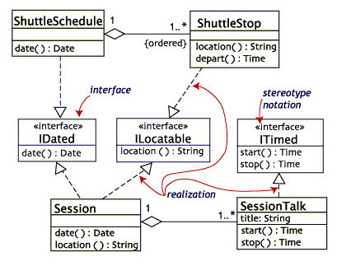
Class diagrams ……more details
Interfaces
This class diagram is a model of a professional conference. The classes of interest to the conference are SessionTalk, which is a single presentation, and Session, which is a one-day collection of related SessionTalks. The ShuttleSchedule with its list of ShuttleStops is important to the attendees staying at remote hotels. The diagram has one constraint, that the
ShuttleStops are ordered.
An interface is a set of operation signatures. In C++, interfaces are implemented as abstract classes with only pure virtual members. in Java, they're implemented directly.
There are three interfaces in the diagram: IDated, ILocatable, and ITimed. The names of
interfaces typically begin with the letter I. A class, such as ShuttleStop, with operations matching those in an interface, such as ILocatable, is a realization of the interface.

Slide 30
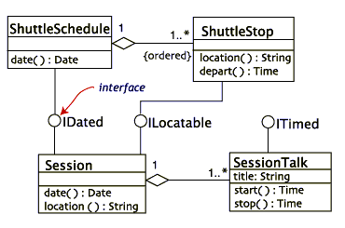
Class diagrams ……more details
Interfaces
There are two acceptable notations for interfaces in the UML. The first is illustrated as before. The second uses the lollipop or pushpin notation.

Slide 31
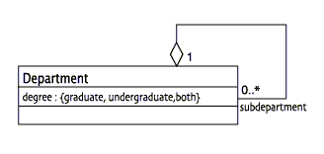
Object diagrams
Object diagrams show instances instead of classes. They are useful for explaining small pieces with complicated relationships, especially recursive relationships
This small class diagram shows that a university Department can contain lots of other Departments.

Slide 32
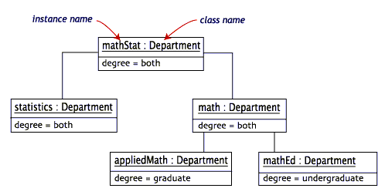
Object diagrams
Each rectangle in the object diagram corresponds to a single instance. Instance names are underlined in UML diagrams. Class or instance names may be omitted from object diagrams as
long as the diagram meaning is still clear.
The object diagram below instantiates the class diagram, replacing it by a concrete example.

Slide 33
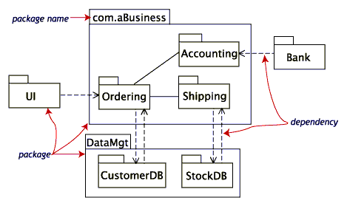
Package diagrams
To simplify complex class diagrams, you can group classes into packages. A package is a collection of logically related UML elements.
One package depends on another if
changes in the other could possibly force changes in the first.
This diagram is a business model in which the classes are grouped into packages.

Slide 34
Sequence diagrams
Class and object diagrams are static model views. Interaction diagrams are dynamic. They describe how objects collaborate
A sequence diagram is an interaction diagram that details how operations are carried out -- what messages are sent and when
Sequence diagrams are organized according to time. The time progresses as you go down the page
The objects involved in the operation are listed from left to right according to when they take part in the message sequence

Slide 35
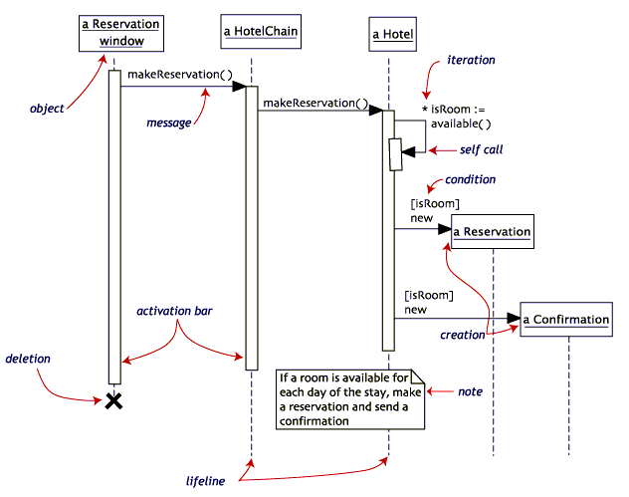
Sequence diagrams
If the Hotel has available
rooms, then it makes a Reservation and a Confirmation
The activation bar represents the duration of execution of the
message
The Reservation window sends a makeReservation() message to a HotelChain
The HotelChain then sends a makeReservation() message to a Hotel
Each arrow is
a message call
Each vertical dotted line is a lifeline, representing the time that an object exists
This is a sequence diagram for making a hotel reservation

Slide 36
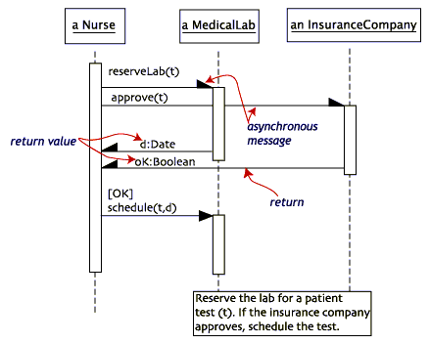
Sequence diagrams with asynchronous messages
A message is asynchronous if it allows its sender to send additional messages while the original is being processed. The timing of an asynchronous message is independent of the timing of the intervening messages
1. ask the MedicalLab to
reserve a date for the test
If the InsuranceCompany approves
the test, then the Nurse will schedule the test on the date supplied by the MedicalLab
The order in
which these messages are sent or completed is irrelevant
2. ask the InsuranceCompany to approve the test
The action of a nurse requesting a diagnostic test at a medical lab

Slide 37
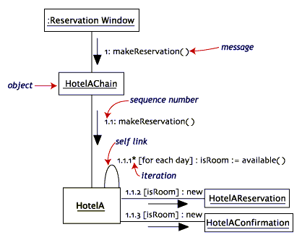
Collaboration diagrams
Collaboration diagrams are also interaction diagrams. They convey the same information as sequence diagrams, but they focus on object roles instead of the times that messages are sent.
Each message in a collaboration diagram has a sequence number. The top-level message is
numbered 1. Messages at the same level (sent during the same call) have the same decimal
prefix but suffixes of 1, 2, etc. according to when they occur.

Slide 38
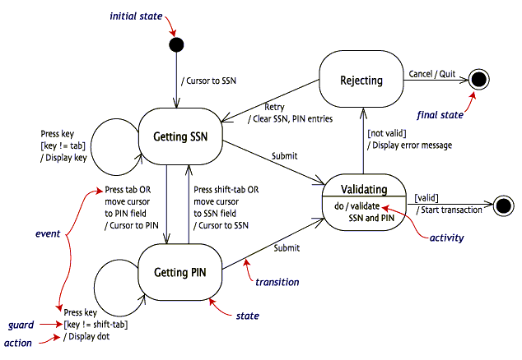
Statechart diagrams
Objects have behaviors and state. The state of an object depends on its current activity or condition. A statechart diagram shows the possible states of the object and the transitions that cause a change in state
This example diagram models the login part of an online banking system. Logging in consists of entering a valid social security number and personal id number, then submitting the information
for validation

Slide 39
Activity diagrams
An activity diagram is essentially a fancy flowchart
Activity diagrams and statechart diagrams are related
While a statechart diagram focuses attention on an object undergoing a process (or on a process as an object), an activity diagram focuses on the flow of activities involved in a single process.
The activity diagram shows the how those activities depend on one another

Slide 40
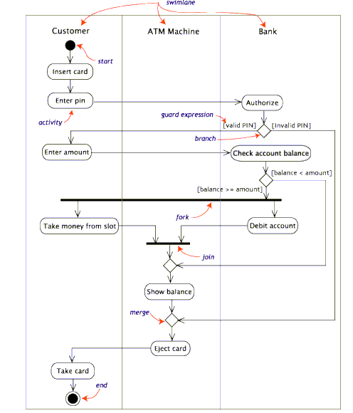
Activity diagrams
Activity diagrams can be divided into object swimlanes that determine which object is responsible for which activity. A single transition comes out of each activity, connecting it to the next activity.
Withdraw money from a bank account through an ATM

Slide 41
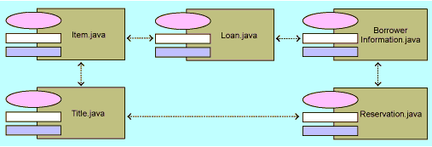
Component diagrams
A component is a code module. Component diagrams are physical analogs of class diagram.
An example of the components in a library application

Slide 42
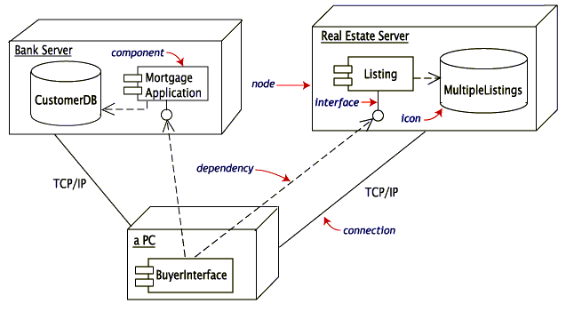
Deployment diagrams
Deployment diagrams show the physical configurations of software and hardware
This deployment diagram shows the relationships among software and hardware components involved in real estate transactions.

Slide 43
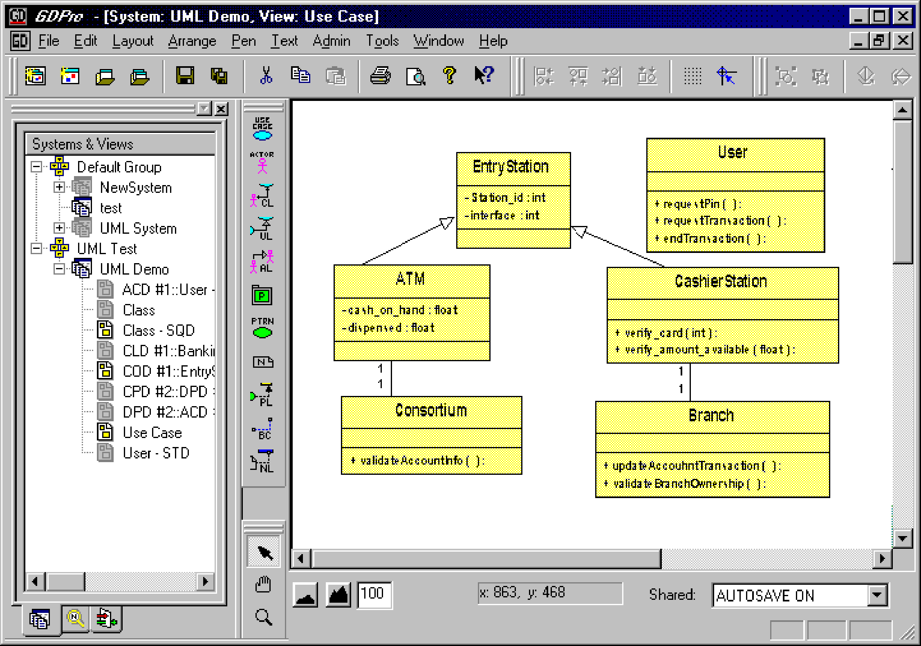
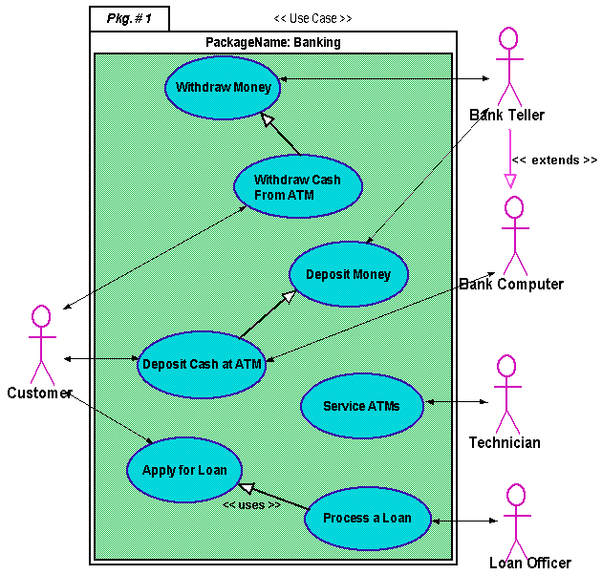
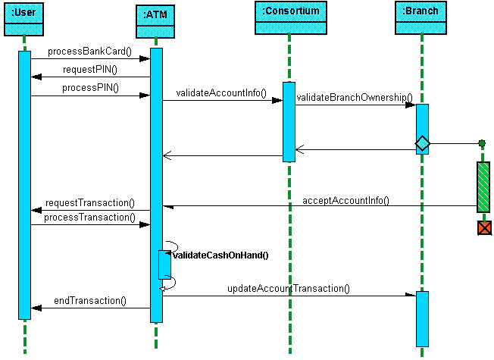
Most used UML Diagrams:
Class Diagram
Use-Case Diagram
Sequence Diagram

Slide 44
Acknowledgement
This tutorial used many materials from the following sources:
A Togethersoft’s tutorial on UML
A presentation on “Accelerating Java Development with the UML” from Embarcadero Technologies,Inc.
A presentation on “Internet Bookstore Example from workbook (Applying Use Case Driven Object Modeling)” from ICONIX Software Engineering, Inc..

Slide 45
Practical UML Tutorial
A Hands-On Introduction for Developers
HO Tuong Vinh (IFI)
email: htvinh@ifi.edu.vn

