Slide 1

Design Java App. with UML
A case study
Prepared by
HO Tuong Vinh (IFI)
email: htvinh@ifi.edu.vn
Adapted from the work of Erikkson & Penker

Slide 2
Objectives
How UML is used in the real world of software dev.
Analyze and describe the app in an analysis model with use cases and a domain analysis
Expand it into a Design model
Come to an Implementation model

Slide 3
OO Development Process
Requirements Specification
Analysis
Design
Implementation
Test

Slide 4
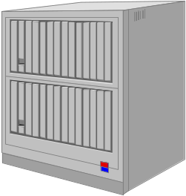


The Application
The application handles the borrowing and reserving of books and magazines in a library
LIBRARY
Librarian
SCM

Slide 5
Description of the application
The text of requirement specification:
It is a support system for a library
A library lends books & magazines to borrowers, who are registered in the system, as are the books & magazines
A library handles the purchase of new titles. Popular titles are bought in multiple copies. Old books & magazines are removed when they are out of date or in poor condition
The librarian is an employee of the library who interacts with the customers (borrowers) and whose work is supported by the system

Slide 6
Description of the application ….
The text of requirement specification: ….
A borrower can reserve a book or magazine that is not currently available in the library so that when it's returned or purchased by the library, that person is notified. The reservation is canceled when the borrower checks out the book or magazine or through an explicit canceling procedure.
The library can easily create, update, & delete information about the titles, borrowers, loans, & reservations in the system.
The system can run on all popular technical environments, including Unix, Windows, and OS/2, & has a modern graphical user interface (GUI).
The system is easy to extend with new functionality.

Slide 7
OO Development Process
Requirements Specification
Analysis
Design
Implementation
Test

Slide 8
Requirement Analysis
Figure out what the system will be used for and who
will be using it
These are the use cases and actors, respectively
The use cases describe what the library system provides in terms of functionality: the functional requirements of the system.
A use-case analysis involves reading and analyzing the specifications, as well as discussing the system with potential users (customers) of the system.

Slide 9
Results of the
Requirements Specification Phase
1
«UML»
Use Case Diagram
1
Use Case
Model
*
Description of Use Cases
Requirements
Model
1
Problem Domain
Model
1
«UML»
Class Diagram
*
UI Specification
1
Interface
Model
*
Spec. of System Interfaces

Slide 10
Requirement Analysis
The borrowers are the customers
The people who check out and reserve books and magazines,
although occasionally a librarian or another library may be a borrower
Actors
The librarians are the users
LIBRARY
Borrower
Librarian
SCM

Slide 11
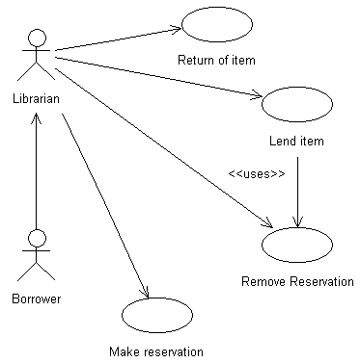
Requirement Analysis
Use Case
If the borrower has a reservation:
The title is identified
An available item of the title is identified
The borrower is identified
The library lends the corresponding item to the borrower
A new loan is registered and the reservation is removed (see use case Remove Reservation)
The borrower is not intended to directly interact with the system; the borrower's functions are done on behalf of the borrower by the librarian.
The borrower returns an item
The title is identified
The borrowed item of the title is identified
The loan is identified through the title and item
The corresponding loan is destroyed
If the borrower has no reservation:
A title is identified
An available item of the title is identified
The borrower is identified
The library lends the item to the borrower
A new loan is registered
A title is identified
The borrower is identified
A reservation is created with the specified title and borrower.
The borrower is identified
Identify the reserved title that no longer should be reserved.
The reservation is removed.

Slide 12
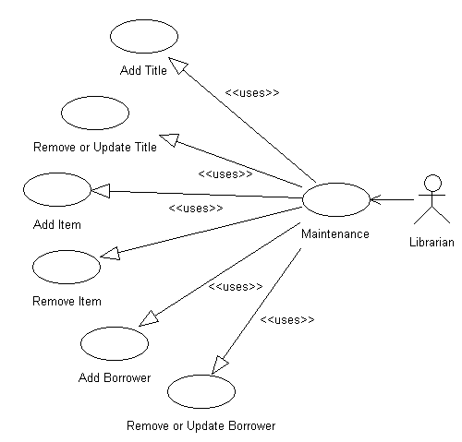
Adds a new title with the title, author and ISBN number to the system
Requirement Analysis
Use Case
The librarian maintains the system by adding and deleting titles, items and borrowers, and also performs the key functions such as lending and returning items, reserving titles, and giving out information about the data stored in the system. The functions are performed on behalf of the borrower actor.
The title of the item is identified.
The id of the item is requested
The item is found and removed from the system, along with any loans registrered on that item.

Slide 13
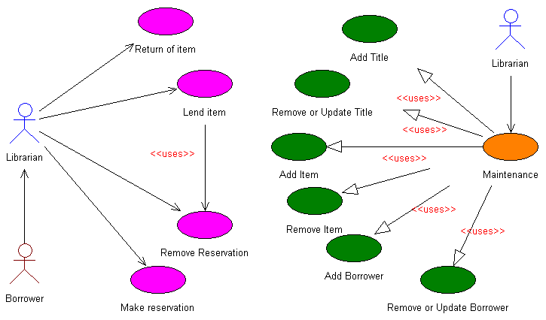
Requirement Analysis
Use Case
Library System

Slide 14
OO Development Process
Requirements Specification
Analysis
Design
Implementation
Test

Slide 15
Results of the Analysis Phase
1
Structure
Model
1
«UML»
Class Diagram
«UML»
Sequence Diagram
*
«UML»
Collaboration Diagram
*
Analysis Model
1
Behavior
Model
«UML»
Statechart Diagram
*
«UML»
Activity Diagram
*
Related to Requirement Specification phase

Slide 16
Results of the
Requirements Specification Phase
1
«UML»
Use Case Diagram
1
Use Case
Model
*
Description of Use Cases
Requirements
Model
1
Problem Domain
Model
1
«UML»
Class Diagram
*
UI Specification
1
Interface
Model
*
Spec. of System Interfaces

Slide 17
Analysis
Domain Analysis
An analysis also itemizes the domain (the key classes in the system)
To conduct a domain analysis, read the specifications and the use cases and look at which "concepts" should be handled by the system
Or organize a brainstorming session with users and domain experts to try to identify all the key concepts that must be handled, along with their relationships to each other.

Slide 18
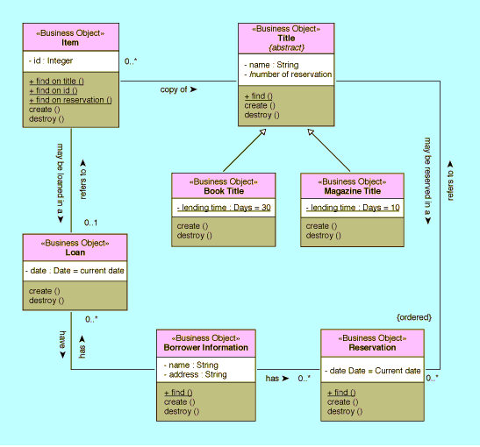
Analysis
Domain Class
The domain
classes are defined with the stereotype «Business Object», which is a user-defined stereotype specifying that
objects of the class are part of the key domain and should be stored persistently in the system.

Slide 19
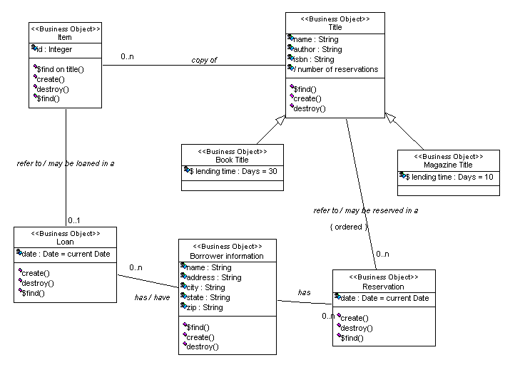

Slide 20
Analysis
Sequence diagram
Class and object diagrams are static model views
Interaction diagrams are dynamic. They describe how objects collaborate.
A sequence diagram is an interaction diagram that details how operations are carried out -- what messages are sent and when
Sequence diagrams are organized according to time. The time progresses as you go down the page
The objects involved in the operation are listed from left to right according to when they take part in the message sequence

Slide 21
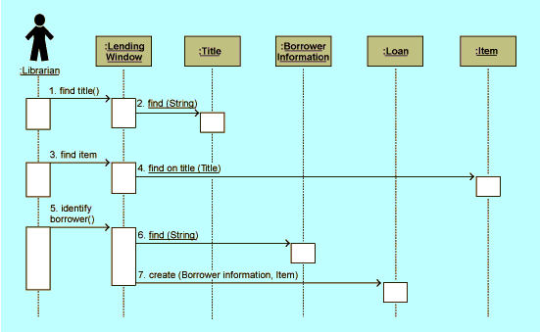
This sequence diagram shows the case for Lending when the borrower does not have a reservation for the title
Each vertical dotted line is a lifeline, representing the time that an object exists
Analysis
Each arrow is a message call. An arrow goes from the sender to the top of the activation bar of the message on the receiver's lifeline
Sequence diagram:
Use case Lend Item
The activation bar represents the duration of execution of the
message
the objects that are interacting
Time

Slide 22
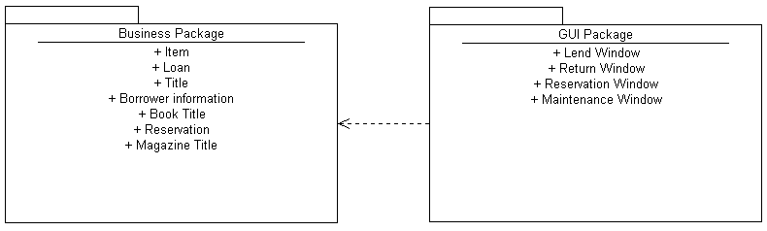
Analysis
User Interface (GUI)
To separate the window classes in the analysis from the domain classes, the window classes are grouped into a package named "GUI Package," and the domain classes are grouped into a package named "Business package."

Slide 23
OO Development Process
Requirements Specification
Analysis
Design
Implementation
Test

Slide 24
Design
Previous focus: WHAT is required from the system
New focus: HOW should the system fulfil these requirements
  implementation dependent decisions are made, constituting the basis for refining the analysis model
Architectural design
  decomposition of the system into parts and distribution thereof
  concurrency and real-time aspects
  persistency mechanisms
  ...
Detailed design
  completing the class diagram by means of impl.dep. concepts
  completing the class properties (e.g. visibilities)
  decomposing structures which cannot be implemented as such
  ...

Slide 25
Results of the Design Phase
1
«UML»
Component
Diagram
1
«UML»
Deployment
Diagram
Design Model
1
Structural
Model
Architectural
Description
1
1
Behavioral
Model

Slide 26
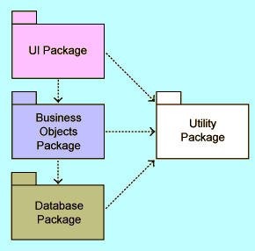
User-Interface Package. These classes are based on the Java AWT package, a standard library in Java for writing user-interface applications. This package cooperates with the Business-Objects package, which contains the classes where the data is actually stored. The UI package calls operations on the business objects to retrieve and insert data into them.
Utility Package. This contains services that are used in other packages in the system. Currently the ObjId class is the only one in the package. It is used to refer to persistent objects throughout the system including the User-Interface, Business-Object, and Database packages.
Design
Architectural Design
Business-Objects Package. This includes the domain classes from the analysis model such as BorrowerInformation, Title, Item, Loan, & so on. The design completely defines their operations & adds support for persistence. The business-object package cooperates with the database package in that all business-object classes must inherit from the Persistent class in the Database package.
Database Package. The Database package supplies services to other classes in the Business-Object
package so that they can be stored persistently. In the current version, the Persistent class will store objects of its subclasses to files in the file system.

Slide 27
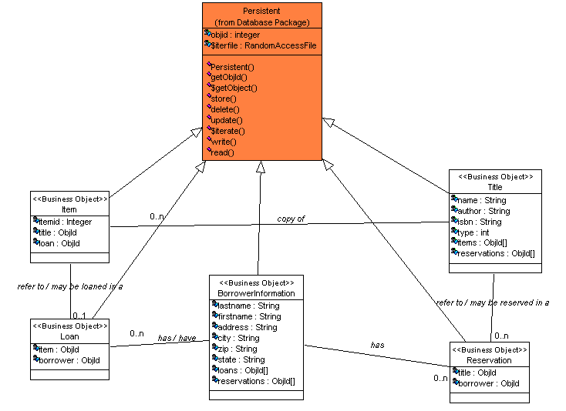
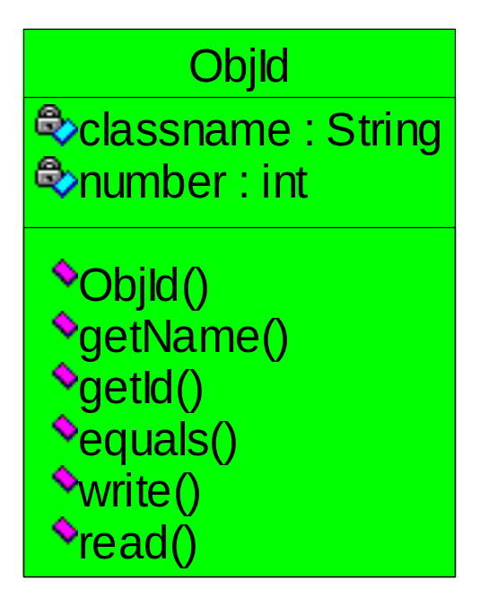
Business objects will be stored as files on the disk. Details about the storage are hidden from the application, which calls common operations such as store(), update(), delete(), and find(). These are part of a class called Persistent, which all classes that need persistent objects must inherit.
Detailed Design
The object id class, representing a reference (association) to a object in the system. The object id consists of the classname of the referenced class, and a unique id number. By passing the object id to the getObject operation in the Persistent class, the object will be read from persistent storage (file) and returned to the caller. Thus, object id is a easy mechanism to implement persistent object references.
Database Package
The Persistent class does simple object serialization storage to a file. Subclasses of the Persistent class only has to implement the operations write and read which writes and reads the attributes of the object to a file. The persistent class has operations for retrieving an object from an object id, getting the object id for an persistent object, and of course for storing, deleting, and updating an object.

Slide 28
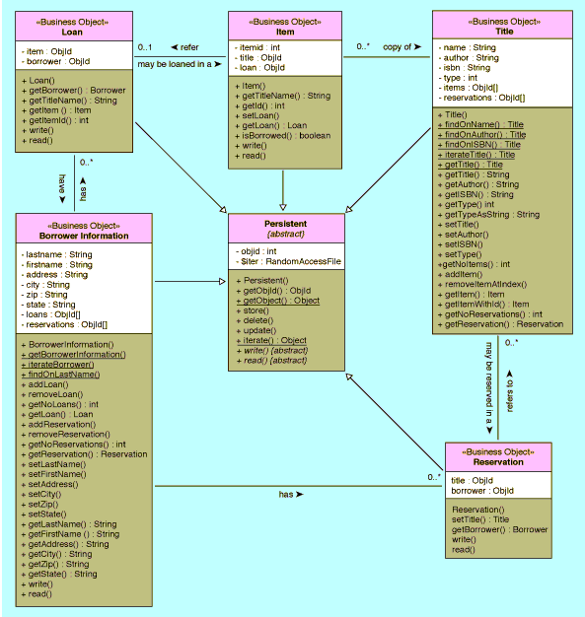
Business-Objects Package

Slide 29
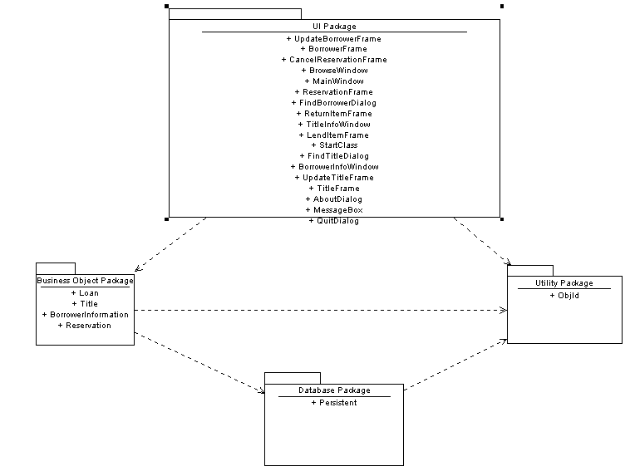
Architecture

Slide 30
User Interface Package
The User-Interface package is "on top" of the other packages
It presents the services and information in the system to a user
This package is based on the standard Java AWT (Abstract Window Toolkit) class
The dynamic models in the design model have been allocated to the GUI package, since all interactions with the user are initiated through the user interface

Slide 31
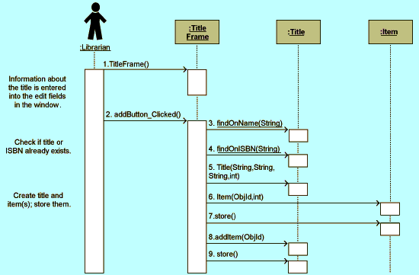
User Interface Package
Design sequence diagram for Add Title use case. The operations and signatures are exactly as they appear in the code

Slide 32
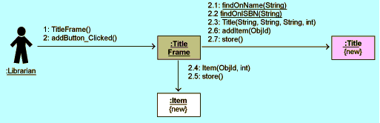
User Interface Package
Collaboration diagrams can be used as an alternative to sequence diagrams

Slide 33
User Interface Package
The user interface in the library application is based on the use cases, and has been divided into the following sections, each of which has been given a separate menu bar in the main window menu
Functions. Windows for the primary functions in the system, that is, lending and returning items and making reservations of titles
Information. Windows for viewing the information in the system, the collected information about titles and borrowers
Maintenance. Windows for maintaining the system, that is, adding, updating, and removing titles, borrowers, and items

Slide 34
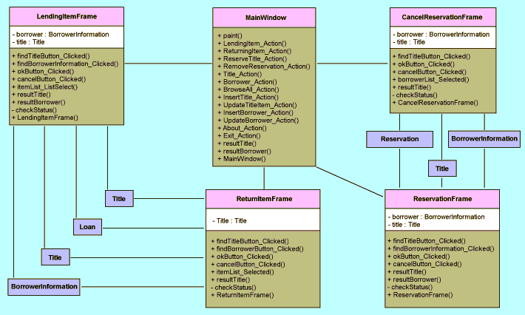
User Interface Package

Slide 35
OO Development Process
Requirements Specification
Analysis
Design
Implementation
Test

Slide 36
Implementation
Programming begins during the implementation phase
The requirements for this application specify that the system be able to run on a number of different processors and operating systems, so Java was chosen to implement the system
Java makes mapping the logical classes to the code components easy, because there is a one-to-one mapping of a class to a Java code file

Slide 37
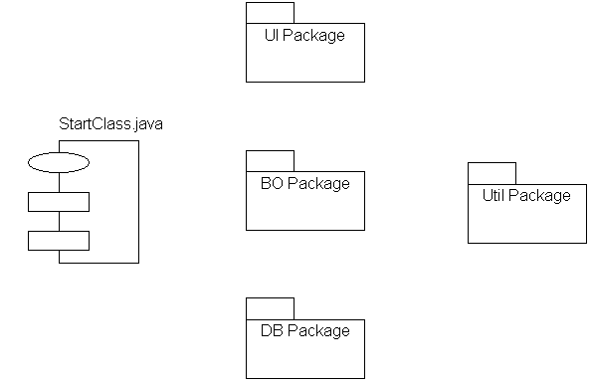
The StartClass.java component only contains the main operation used to start the system (emit the MainWindow object window)
The packages in the logical view are mapped to corresponding packages in the component view
The DB Package in the component view contains the components that implement the classes in the Database package in the logical view
Implementation
The Util Package in the component view contains the components that implement the classes in the Utility package in the logical view
The BO Package in the component view contains the components that implement the classes in the Business Object package in the logical view
The UI Package in the component view contains the components that implement the classes in the UI package in the logical view

Slide 38
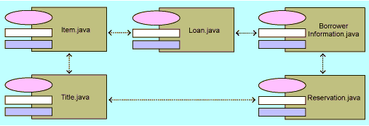
Implementation
Business-Object Package
The BO Package in the component view contains the components that implement the classes in the Business Object package in the logical view

Slide 39
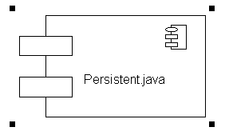
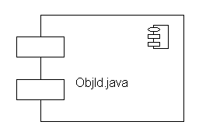
Implementation
Database Package
Utility Package

Slide 40
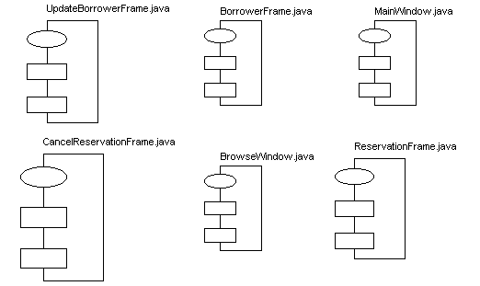
Implementation
User-Interface Package

Slide 41
Coding
For coding, the specifications were fetched from the following diagrams in the design model:
Class specifications: The specification of each class, showing in detail the necessary attributes and operations
Class diagrams: The class diagrams in which the class is present, showing its static structure and relationship to other classes
State diagram: A state diagram for the class, showing the possible states and the transitions that need to be handled (along with the operations that trigger the transitions)
Dynamic diagrams (sequence, collaboration, and activity) in which objects of the class are involved: Diagrams showing the implementation of a specific method in the class or how other objects are using objects of the class
Use-case diagrams and specifications: Diagrams that show the result of the system are used when the developer needs more information regarding how the system will be used (when the developer feels he or she is getting lost in details—losing sight of the overall context)

Slide 42
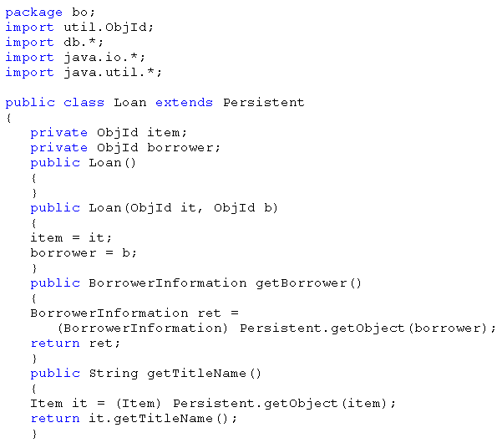
Code for Loan Class
Coding
Class Loan is a business-object class used for storing information about a loan. Most of the functionality is inherited from the Persistent class in the database package. The only attributes in the class are the object identifiers for the associations to the Item & BorrowerInformation class.

Slide 43
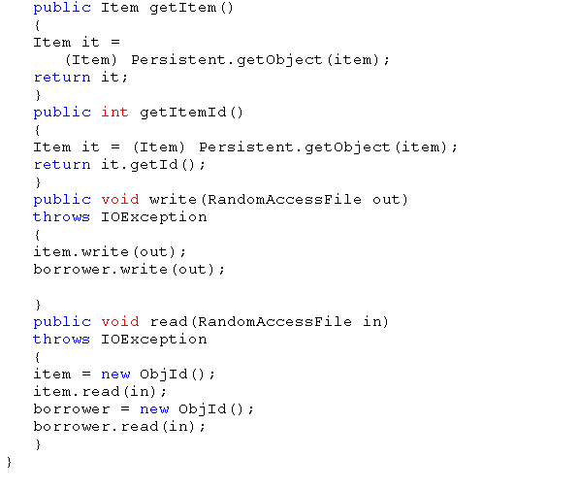
Coding
Code for Loan Class
And these association attributes are also stored in the write() and read() operations.

Slide 44
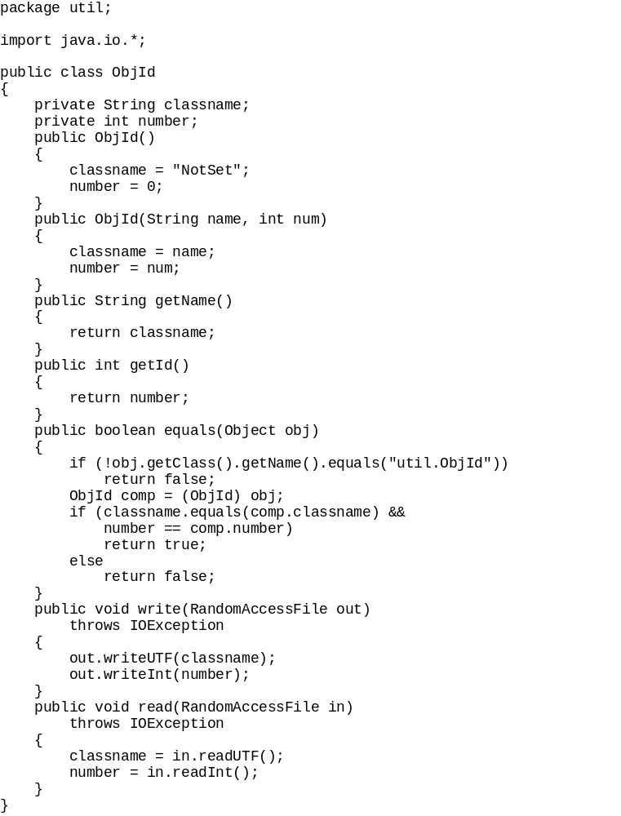
Coding
Code for ObjID Class

Slide 45
OO Development Process
Requirements Specification
Analysis
Design
Implementation
Test

Slide 46
Test
The usefulness of UML doesn't stop when coding ends
Use cases can be tried in the finished application to determine whether they were well supported, for example
Use cases can be used to create Test Cases

Slide 47
SUMMARY
The various parts of this case study were designed by a group of people who made every effort to work in the same manner they would have used on an actual project
Though the different phases and activities might seem separate and to have been conducted in a strict sequence, the work is more iterative in practice
The lessons and conclusions resulting from the design were fed back into the analysis model, and discoveries made in the implementation were updated and changed in the design model.
This is the normal way to build object-oriented systems

Slide 48
Design Java App. with UML
A case study
Prepared by
HO Tuong Vinh (IFI)
email: htvinh@ifi.edu.vn
This case study is excerpted from UML Toolkit, New York: Wiley & Sons, 1998

