Slide 1
Chapter 4: Data and Databases
DataType describes what a sequence of bits represents
Data = Bits (1/0) that represent Quantitative or Qualitative items
1-bit Boolean 1/0 =True/False =On/Off =Yes/No =Checked/Unchecked
8-bit Unsigned (0 to 255): 0000,0000₂ =0₁₀ 1 111,1111₂ =255₁₀
8-bit Signed (-127 to 128): 1000,0000₂ =-128₁₀ 1111,1111₂ =-1₁₀
8-bit Text ASCII: 0100,0001₂ ='A'_{ASCII} 0111,1010₂ ='z'_{ASCII}
16-bit Unsigned (0 to 65,535): 1000,0000,0000,0000₂ = 32,768₁₀
16-bit Signed (32,767 to -32,768): 1000,0000,0000,0000₂ = -32,768₁₀
16-bit Unicode: 0011,0000,0100,0010 ='あ' 0101,1100,0111,0001 ='山'
24-bit 3-Character String: 0100,0010,0110,1111,0110,0010 ="Bob”
24-bit Unsigned (0 to 16,777,216): 0100,0010,0110,1111,0110,0010 = 4,353,890
24-bit Color of one pixel: 0100,0010,0110,1111,0110,0010 =
Red Green Blue
32-bit Decimal (Floating Point) http://www.exploringbinary.com/floating-point-converter/
0100,0000,0100,1000,1111,0101,1100,0011₂ =3.14
Notes:
The chapter opening case discusses HP’s difficulties in collecting and tracking timely, consistent data from across the entire enterprise. This case illustrates some of the common challenges regarding data management that face numerous companies.
Ask students how HP’s data inconsistencies arose and what the effect of data inconsistency was.
As the text says “An effective information system provides users with accurate, timely, and relevant information.” Ask students to define and explain why these three characteristics (accurate, timely, relevant) are important.

Slide 2
Processing Data into Information
DataType provide a context for data as either
Quantitative data:
Integer
Floating Point
Qualitative data:
Characters
Text Strings
Boolean (True/False)
Images
Audio
Data processing creates information from data
Custom Programs writen in Java, Python, Ruby, R
Database Management Systems
Notes:
The chapter opening case discusses HP’s difficulties in collecting and tracking timely, consistent data from across the entire enterprise. This case illustrates some of the common challenges regarding data management that face numerous companies.
Ask students how HP’s data inconsistencies arose and what the effect of data inconsistency was.
As the text says “An effective information system provides users with accurate, timely, and relevant information.” Ask students to define and explain why these three characteristics (accurate, timely, relevant) are important.

Slide 3

Database Management System
Database
An organized collection of related data
All Data is described and associated with other data
Database Management System (DBMS)
Software that organizes data for fast & easy access
Desktop DBMS: Microsoft Access, LibreOffice Base
Enterprise DBMS: Oracle, Microsoft SQL Server, SAP
OpenSource WebServer DBMS: MySQL, PostgreSQL
Phone books, file cabinets, and rolodex card files are non-computer versions of a database
Notes:
The chapter opening case discusses HP’s difficulties in collecting and tracking timely, consistent data from across the entire enterprise. This case illustrates some of the common challenges regarding data management that face numerous companies.
Ask students how HP’s data inconsistencies arose and what the effect of data inconsistency was.
As the text says “An effective information system provides users with accurate, timely, and relevant information.” Ask students to define and explain why these three characteristics (accurate, timely, relevant) are important.

Slide 4
Database Provides Information
Information created from data
Timely relevant information key to decision making
Good decision making key to organization survival
Database Management System (DBMS)
Manages database structure -- tables and relationships
Controls access to data – Security
Contains query language – SQL
All data in Database should be related
Relational DBMS advantages
Integrated data (All items accessible)
Integrity (Accurate, up to date, no duplication)
Security Level Access
Easy Data Archive

Slide 5
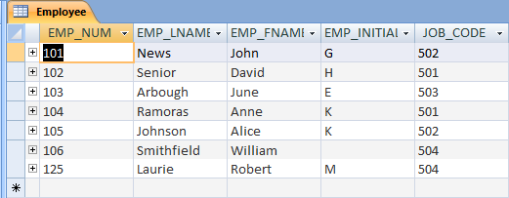
A Database Table
All data is organized into tables
Columns are the fields
Rows are the records
Table
Field
Record
Data Items
Notes:
6
6
6

Slide 6
Relational DB Model Terminology
Data Value or Data Items
Contents of a field contained in a record
“Raw Facts” that can be recognized
Field or Attribute or Property (Table Column)
Group of characters representing something with same data format
Record or Tuple (Table Row)
Collection of related fields
Table or Entity
Collection of related records and fields
Ordering of Columns and Rows is immaterial

Slide 7
Field Name and Data Type
Each Field must have a unique name in a table CustID LastName FirstName Address
Fields may contain one of several data types:
Character = descriptive data (text).
Numeric = numbers used for calculation
Date = Month Day Year and/or time
Logic = T/F, Y/N, Checked/Unchecked
Blob = Images, Audio, Video
Field width
maximum number of characters
Significant digits contained in the field

Slide 8
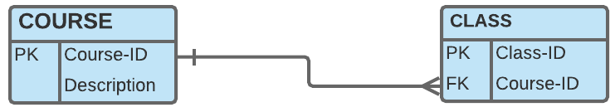
Conceptual Design
https://youtu.be/FpJXQG7EIcE
Conceptual design
Abstract model from Business Perspective
Entity Relationship Diagram (ERD) modeling
Define Relationships between Entities
Eliminate redundant database Entities
Identify Attributes and Key Attributes
Normalization
Minimize redundant data elements
Eliminate many-to-many relationships
This is CMIS320 with prerequisite <= CMIS102
Primary Key
Foreign Key
1
M
ERD Chen Style
COURSE
has
CLASS
ERD Crow Foot Style
Foreign Key
Primary Key
Notes:
8
This slide describes activities involved in designing a database. To create an efficient database, you must know what the relationships are among the various data elements, the types of data that will be stored, and how the organization will need to manage the data. Note that the conceptual database design is concerned with how the data elements will be grouped, what data in what tables will make the most efficient organizations.

Slide 9
Conceptual Design: Associate Entity
https://youtu.be/QpdhBUYk7Kk
Associate Entities
Used to decompose Many-to-Many relations to One-to-Many
Many-to-Many relations cause redundant data and anomalies
ERD Chen Style
STUDENT
M
enrolls
N
CLASS
ERD Crow Foot Style
Primary Key
1
M
Foreign Keys
M
1
Primary Key
ERD Chen Style Associative Entity
STUDENT
ENROLL
CLASS
ERD Crow Foot Associative Entity

Slide 10
Conceptual Design to Physical DBMS
Foreign Key
Foreign Key
Primary Key
1
M
M
1
Primary Key
STUDENT
ENROLL
CLASS
has
COURSE
M
1
Primary Key
Foreign Key

Slide 11
Asgn 2: ERD Chen Style
assigns
M
LABOR
M
1
M
M
requires
M
CUSTOMER
has
SERVICE
PART
M
1
assigns
TECHNICIAN
M
Service Labor
M
1
LABOR
1
1
M
1
M
Service Part
M
1
CUSTOMER
has
SERVICE
PART
M
1
assigns
TECHNICIAN

Slide 12
Asgn 2: ERD PK Arrow Reference
ERD created with PowerPoint Arrow points to 1 side of 1:M Relation ship
Service-Labor
Service-ID
Labor-ID
Labor-Hours
Labor
Labor-ID
Hourly-Rate
Customer
Cust-ID
…
Service
Service-ID
Cust-ID
Date
Tech-ID
Technician
Tech-ID
…
Service-Parts
Service-ID
Parts-ID
Qty
Parts
Part-ID
…

Slide 13
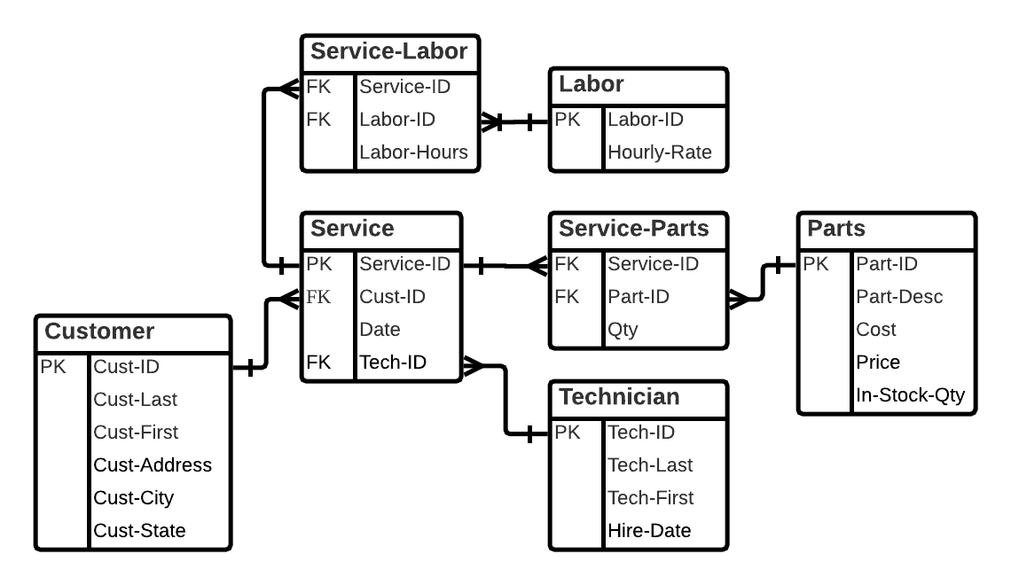
Asgn 2: ERD using Crow Foot Notation
Created using Blank ERD at LucidChart.com
https://youtu.be/-CuY5ADwn24

Slide 14
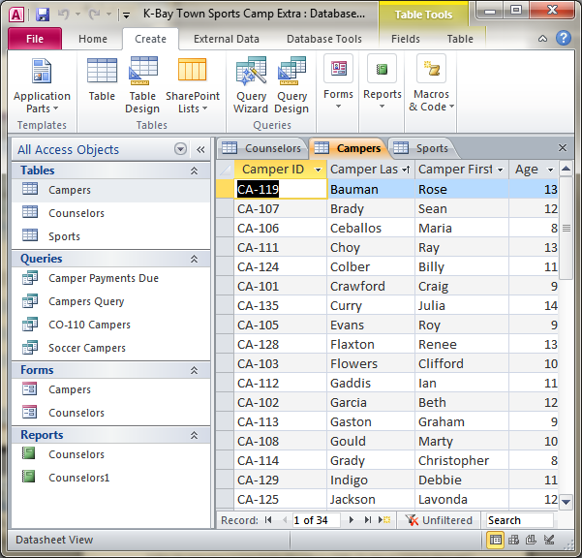
MS Access Navigation
Access Objects Provides interface to database components
Tables Containers for data
Forms Input one record
Reports Information output
Queries Ask?
Notes:
16
16

Slide 15
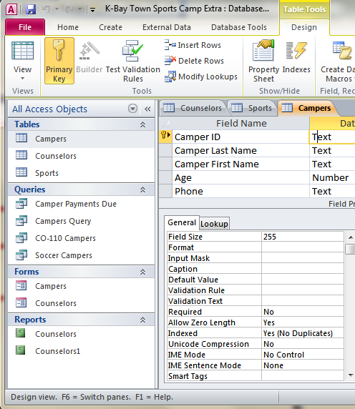
Table Design View
Design Field Structure
Table Name
Field Name
Data Types
Field Width
Data Dictionary: Contains data about each file in database and each field within those files
Notes:
16
16

Slide 16
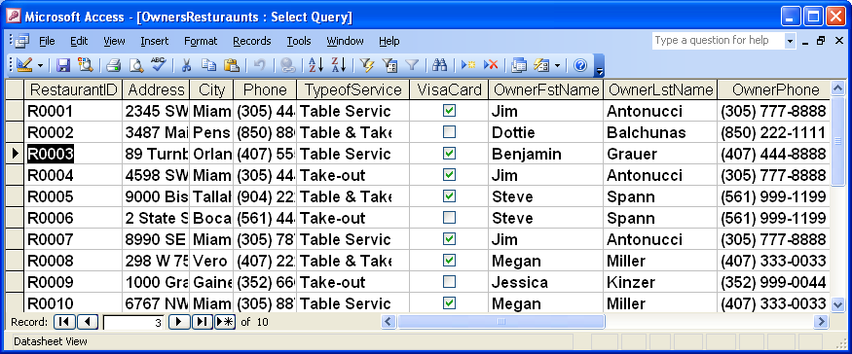
Database Table: Restaurants
Enter Record data items into each Field of the Table
Do you see any potential problems with this table?
Data Redundancy leads to Data Inconsistencies
Update Data Anomaly
Deletion Data Anomaly
Notes:
16
16

Slide 17
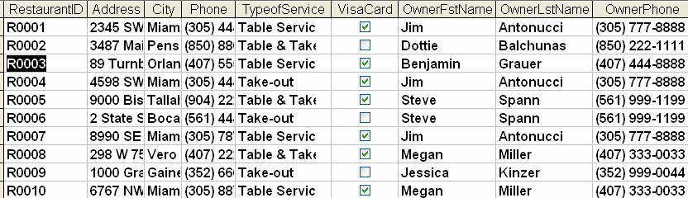
Normalization: Removing Data Redundancy
Remove any duplicate records
Determine Primary Key Fields: RestaurantID
Normalize to remove non key data dependencies
Notes:
16
16

Slide 18
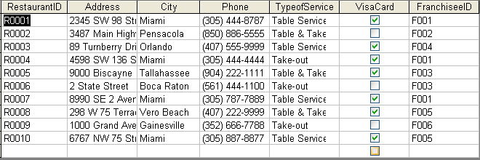
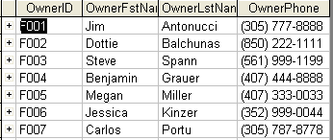
Normalization: Making a Better Database
Primary Key
Foreign Key
Data Redundancy
Eliminated
Notes:
16
16

Slide 19
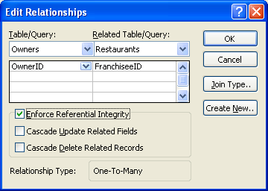
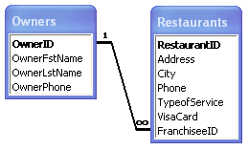
Enforcing Referential Integrity
Foreign key must match primary key values or be null value
Impossible to delete row whose primary key has matching foreign key values in other table
Primary Key
Foreign Key

Slide 20
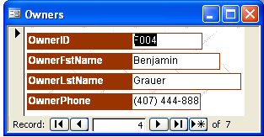
Database Form
Forms allow the user to enter or view fields for one record at a time
Forms can be attractively Formatted
Fields
Record Select
Go to First Record
Create New Record
Go to Next Record
Go to Last Record
Notes:
16
16

Slide 21
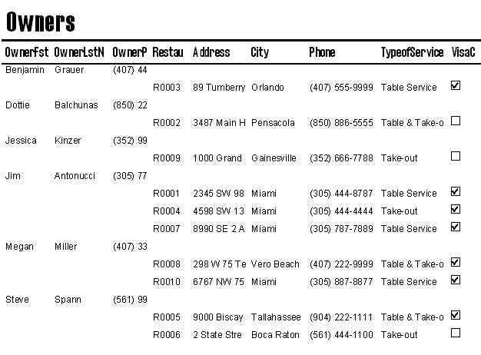
REPORTS: Information Output
You cannot enter data or edit data using reports.
Label
Unbound
Control
Textbox Bound Control
Notes:
14
14

Slide 22
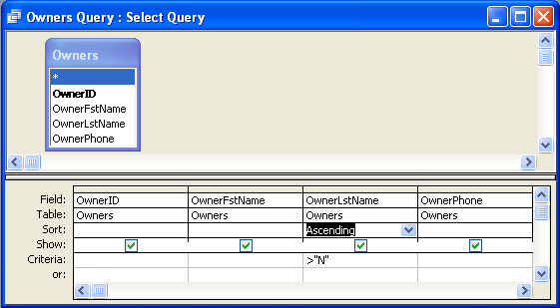
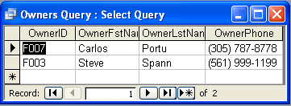
Query-by-Example Design View and SQL
Select Fields of each Table that will be Queried
Set Sort and Criteria to Query
SELECT *
FROM Owners
WHERE OwnerLstName>"N"
ORDER BY OwnerLstName;

Slide 23
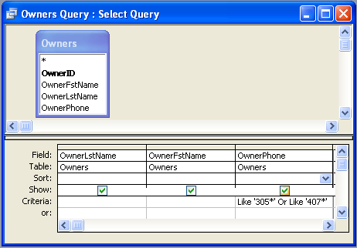
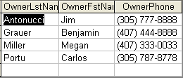
Query-by-Example Design View and SQL
Select Fields of each Table that will be Queried
Set Sort and Criteria to Query
SELECT OwnerLstName, OwnerFstName, OwnerPhone
FROM Owners
WHERE OwnerPhone Like '305*' Or OwnerPhone Like '407*';

Slide 24
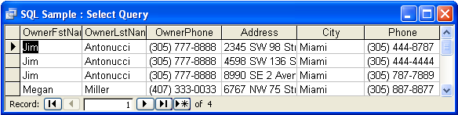
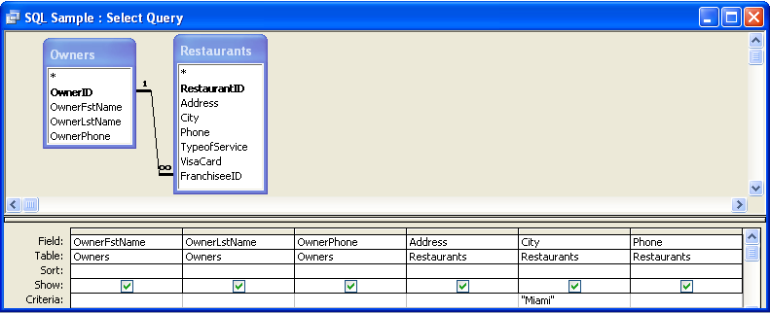
Query-by-Example Design View and SQL
SELECT Owners.OwnerFstName, Owners.OwnerLstName, Owners.OwnerPhone, Restaurants.Address, Restaurants.City, Restaurants.Phone
FROM Owners INNER JOIN Restaurants ON Owners.OwnerID = Restaurants.FranchiseeID
WHERE Restaurants.City="Miami";

Slide 25
Enterprise Databases
Large Databases
Commercial: Oracle, Microsoft, IBM, and Amazon
Open-source alternatives: MySQL and PostgreSQL
NoSQL (not only SQL) is “Big Data” alternative
Relational database model does not scale well
NoSQL database works with data in a looser way
More easily scaled on multiple servers worldwide
Google now offers the App Engine Datastore
Amazon DynamoDB
Big Data
Massively large data sets that are analysed
Amazon processes millions of customer transactions per hour
Notes:
25
This slide discusses how very large databases are used to produce valuable information for firms. The text give the example of how, by analyzing data from customer credit card purchases, Louise’s Trattoria, a Los Angeles restaurant chain, learned that quality was
more important than price for most of its customers, who were college educated and liked fine wine. The chain responded to this information by introducing vegetarian dishes, more seafood selections, and more expensive wines, raising sales by more than 10 percent.
This slide discusses the role of business intelligence in helping firm’s make better decisions. The text uses the example of Harrah’s Entertainment:
“For instance, Harrah’s Entertainment, the second-largest gambling company in its industry, continually analyzes data about its customers gathered when people play its slot machines or use Harrah’s casinos and hotels. Harrah’s marketing department uses this information to build a detailed gambling profile, based on a particular customer’s ongoing value to the company. This information guides management decisions about how to cultivate the most profitable customers, encourage those customers to spend more, and attract more customers with high revenue-generating potential. Business intelligence has improved Harrah’s profits so much that it has become the centerpiece of the firm’s business strategy.”

Slide 26
Data Warehouses
Data Warehouses are huge databases that store and manage data required to analyze historical and current transactions
Data access but not alterable (Read Only)
Data mart is subset of data warehouse often associated with a firm’s functional unit
ETL = Extraction-Transformation-Load data conversion
Notes:
26
This slide discusses how very large databases are used to produce valuable information for firms. The text give the example of how, by analyzing data from customer credit card purchases, Louise’s Trattoria, a Los Angeles restaurant chain, learned that quality was
more important than price for most of its customers, who were college educated and liked fine wine. The chain responded to this information by introducing vegetarian dishes, more seafood selections, and more expensive wines, raising sales by more than 10 percent.
This slide discusses the role of business intelligence in helping firm’s make better decisions. The text uses the example of Harrah’s Entertainment:
“For instance, Harrah’s Entertainment, the second-largest gambling company in its industry, continually analyzes data about its customers gathered when people play its slot machines or use Harrah’s casinos and hotels. Harrah’s marketing department uses this information to build a detailed gambling profile, based on a particular customer’s ongoing value to the company. This information guides management decisions about how to cultivate the most profitable customers, encourage those customers to spend more, and attract more customers with high revenue-generating potential. Business intelligence has improved Harrah’s profits so much that it has become the centerpiece of the firm’s business strategy.”

Slide 27
Data Mining
Process of analyzing data to make decisions
Find trends, patterns, and associations
Automating using Big Data from Data Warehouse
Test hypothesis like automatic market trading
Privacy concerns especially Artificial Intelligence
Business Intelligence and Analytics
Tools for consolidating, analyzing, and providing access to vast amounts of data to help users make queries to support better business decisions
Analysis to obtain a competitive advantage
Text Mining use email and other documents
Web Mining use World Wide Web sources
Notes:
27
This slide discusses how very large databases are used to produce valuable information for firms. The text give the example of how, by analyzing data from customer credit card purchases, Louise’s Trattoria, a Los Angeles restaurant chain, learned that quality was
more important than price for most of its customers, who were college educated and liked fine wine. The chain responded to this information by introducing vegetarian dishes, more seafood selections, and more expensive wines, raising sales by more than 10 percent.
This slide discusses the role of business intelligence in helping firm’s make better decisions. The text uses the example of Harrah’s Entertainment:
“For instance, Harrah’s Entertainment, the second-largest gambling company in its industry, continually analyzes data about its customers gathered when people play its slot machines or use Harrah’s casinos and hotels. Harrah’s marketing department uses this information to build a detailed gambling profile, based on a particular customer’s ongoing value to the company. This information guides management decisions about how to cultivate the most profitable customers, encourage those customers to spend more, and attract more customers with high revenue-generating potential. Business intelligence has improved Harrah’s profits so much that it has become the centerpiece of the firm’s business strategy.”

Slide 28
Videos to View
ERD Systems Analysis https://youtu.be/FpJXQG7EIcE
LucidChart.com ERD Tutorial - Part 1 https://youtu.be/QpdhBUYk7Kk
LucidChart.com ERD Tutorial - Part 2 https://youtu.be/-CuY5ADwn24
Real Data Warehouse? https://youtu.be/y5-3Pjbk8Zk
Benefits of a Data Warehouse https://youtu.be/KGHbY_Sales
SQL or MySQL vs NoSQL or MongoDB https://youtu.be/ZS_kXvOeQ5Y

