Slide 1
Training-free LLM-generated
Text Detection
Mining token probability sequences with Lastde and Lastde++
Method, experiments, robustness and limitations
Notes:
Suggested timing: 0:40
Introduce the paper and the central question: can a detector identify LLM-generated text without training a new classifier? The talk follows the paper from its probability-sequence observation through the method, experiments, robustness tests and limitations.
Sources:
- Xu et al., Training-free LLM-generated Text Detection by Mining Token Probability Sequences, ICLR 2025.

Slide 2
Research question and contributions
02
Given a text t, estimate whether an LLM generated it without training a detector.
TPS as a time series
Lastde
Lastde++
The method keeps local probability changes that global statistics discard.
Global log likelihood is combined with multiscale diversity entropy.
Conditional samples normalize the score with far fewer samples than Fast-DetectGPT.
The paper targets both white-box and black-box detection.
Notes:
Suggested timing: 1:05
State the task and the paper's three contributions. The authors treat token probabilities as a sequence, build Lastde from global and local statistics, and introduce Lastde++ to normalize scores using conditional samples. The paper evaluates both access to the true source model and the more realistic proxy-model setting.

Slide 3
White-box and black-box detection
03
White box
Black box
The detector accesses token probabilities from the actual source model. The same model generated and scores the text.
The source model is unavailable. An open proxy model estimates token probabilities. The paper uses GPT-J 6B by default.
Candidate text | token probabilities | detection score
Proxy mismatch makes black-box detection harder.
Notes:
Suggested timing: 1:00
Define the two regimes. White-box scoring uses the actual generator, while black-box scoring uses an accessible proxy. Proxy mismatch changes tokenization and probability estimates, so black-box results are lower and more variable.

Slide 4
Training-free detector landscape
04
Family | Signal | Training | Main concern
Likelihood and rank | Global token statistics | No | Local dynamics are lost
Perturbation and sampling | Distribution comparison | No | High computation cost
Lastde and Lastde++ | Global likelihood and local TPS dynamics | No | Proxy and length sensitivity
Lastde introduces a sequence statistic rather than a trained classifier.
Notes:
Suggested timing: 0:55
Place Lastde among training-free methods. Likelihood and rank methods compress the text into global statistics. Sampling methods compare a candidate with a reference distribution but can be expensive. Lastde adds local temporal structure from the token probability sequence.

Slide 5
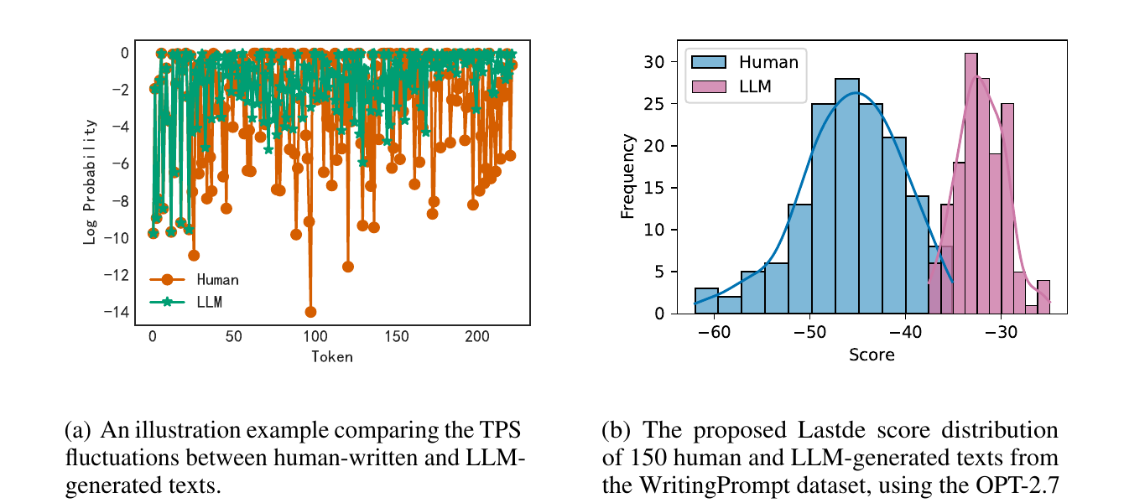
Token probability sequences
05
TPS
Token Probability Sequence
Human text shows deeper and more frequent low-probability valleys.
LLM text usually follows higher-probability choices and smoother local patterns.
The sequence shape carries information beyond the mean.
The separation is statistical and depends on the model and text.
Notes:
Suggested timing: 1:20
Explain TPS as the sequence of conditional probabilities assigned to observed tokens. Human writers choose surprising words more often, creating deeper valleys. LLM generation tends to favor probable tokens. The authors use local fluctuation patterns rather than relying only on the average probability.

Slide 6
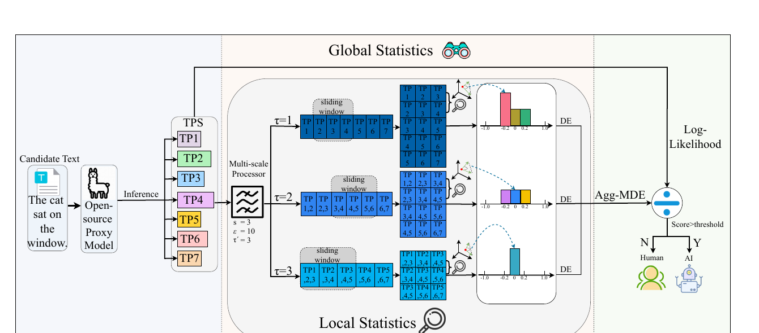
Lastde framework
06
1 TPS extraction
2 Multiscale dynamics
3 Likelihood fusion
4 Decision
Notes:
Suggested timing: 1:15
Give the full pipeline before the equations. The model extracts token log probabilities, creates representations at several scales, measures local segment relations, converts them into diversity entropy, and combines the local statistic with average log likelihood. Lastde++ adds sample normalization after this pipeline.

Slide 7
Local similarity and diversity entropy
07
1
2
3
4
Sliding windows
Cosine similarity
Discrete states
Diversity entropy
Create overlapping local vectors
Compare neighboring vectors
Map similarities into ε bins
Measure the state distribution
Higher entropy indicates richer local transitions.
Notes:
Suggested timing: 1:15
At each scale, overlapping windows form local vectors. Cosine similarity compares adjacent vectors. The method discretizes these similarity values, estimates state frequencies and computes normalized entropy. High entropy means a richer set of local transitions, while low entropy indicates concentrated or repetitive patterns.

Slide 8
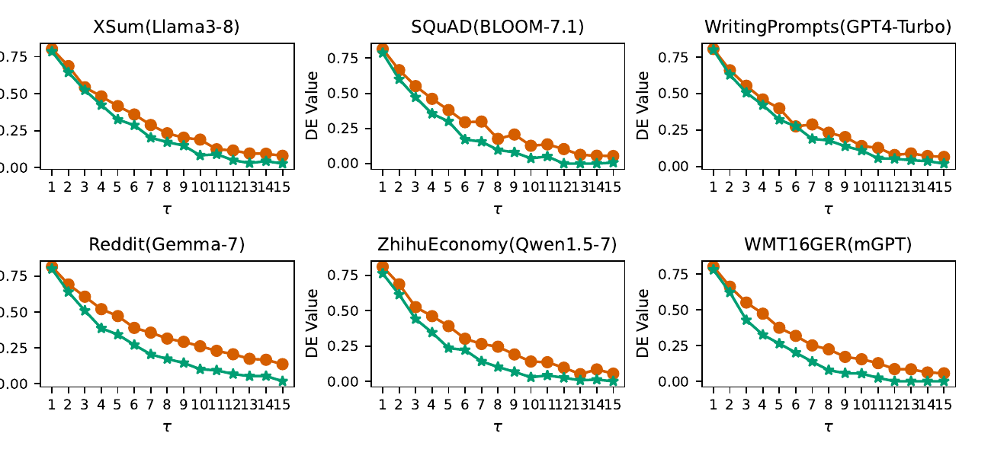
MDE patterns in human and LLM text
08
Human
Richer transitions
across scales
LLM
More concentrated
local patterns
Human DE curves are consistently higher in these six examples.
Notes:
Suggested timing: 1:00
Read the figure qualitatively. Across the six dataset and model pairs, human text has higher diversity entropy at most scales. This supports the claim that human probability dynamics are more varied, while LLM text produces more concentrated patterns.

Slide 9
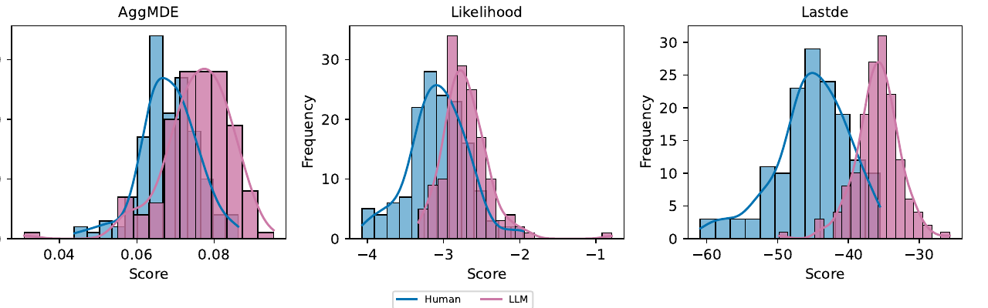
Lastde score
09
Global signal
Average log likelihood measures how predictable the complete text is.
Local signal
The standard deviation of MDE summarizes dynamics across scales.
The combined score separates the distributions more clearly.
Notes:
Suggested timing: 1:15
The numerator captures global predictability, and the denominator captures variation in local complexity across scales. The ablation distributions show more overlap when either component is used alone. Their combination gives better separation. Lastde defaults are s=3, epsilon=10n and tau-prime=5.

Slide 10
Lastde++ score normalization
10
100
10,000
default samples
Fast-DetectGPT setup
Generate conditional samples with the scoring model.
Estimate the mean and standard deviation of sample scores.
Standardize the candidate score against this reference distribution.
1/100 of the sampling budget
Defaults: s=4, ε=8n, τ′=15
Notes:
Suggested timing: 1:10
Lastde++ creates a text-specific reference distribution using conditional samples. It converts the candidate score into a standardized deviation. The default uses 100 samples, while the Fast-DetectGPT configuration discussed in the paper uses 10,000. Lastde++ defaults are s=4, epsilon=8n and tau-prime=15.

Slide 11
Experimental setup
11
6
18
8
300
2
datasets
news, QA, stories, German and Chinese
source models
open and closed
training-free
baselines
texts per dataset
150 human + 150 LLM
regimes
white box + black box
Metric
Default proxy
Main hardware
AUROC
GPT-J 6B
2 × RTX 3090
Notes:
Suggested timing: 1:00
Summarize the benchmark. The main metric is AUROC. The black-box experiments use GPT-J 6B as the default proxy. The main setup filters texts below 150 words, which limits claims about short responses.

Slide 12
Main results
12
Sample-statistic methods
Distribution-statistic methods
Black-box gains: Lastde +6.38 points, Lastde++ +5.79 points
Notes:
Suggested timing: 1:20
Compare the methods within their families. Lastde improves over DetectLRR in both settings. Lastde++ improves over Fast-DetectGPT and reaches 91.47 average AUROC in black-box detection. The black-box gains matter most because they reflect the practical proxy-model setting.

Slide 13
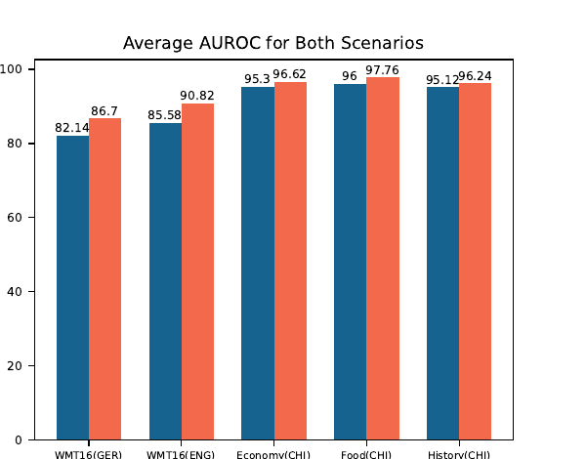
Language and paraphrase robustness
13
Setting | Fast-DetectGPT | Lastde++ | Interpretation
White box, original | 97.70 | 98.81 | High
White box, paraphrased | 92.12 | 94.70 | Both decrease
Black box, original | 83.97 | 88.86 | Lastde++ leads
Black box, paraphrased | 78.01 | 83.29 | Attack remains effective
Cross-language results remain strong. Paraphrasing still lowers AUROC.
Notes:
Suggested timing: 1:20
The cross-language experiments cover English, German and Chinese. Lastde++ remains strong across these languages. Paraphrasing reduces AUROC in both white-box and black-box settings. Lastde++ keeps a higher absolute score, but the attack remains effective.

Slide 14
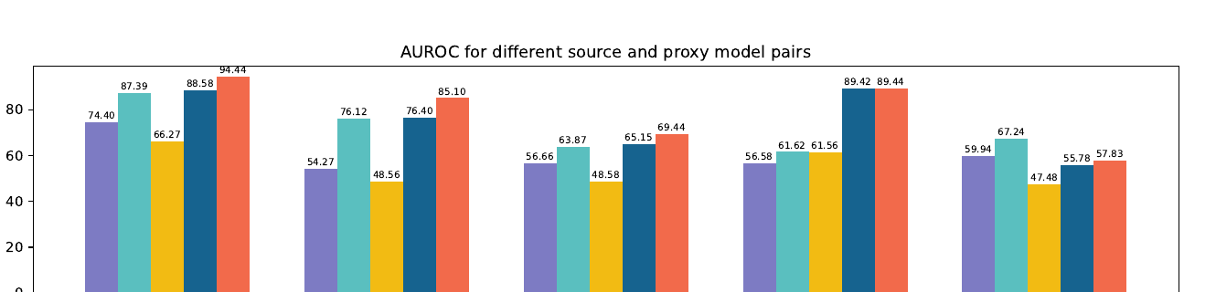
Ablation and proxy sensitivity
14
Pairs, left to right: GPT-J(Neo-2.7) | OPT-2.7(OPT-13) | Gemma-7(GPT-2) | GPT-4-Turbo(Llama-13) | GPT-4-Turbo(Llama3-8)
Bars, left to right: Likelihood | Lastde | DNA-GPT | Fast-DetectGPT | Lastde++
Complementary components
Proxy sensitivity
Interpretation
Table 11 and Figure 10 show that likelihood and Agg-MDE work better together than either component alone.
Figure 8 shows large AUROC differences across source and proxy model pairs.
Tokenizer choice, model coverage and probability geometry can shift TPS statistics.
Notes:
Suggested timing: 1:15
The ablation supports the combination of global likelihood and local MDE. Figure 8 adds an important caveat: black-box performance changes substantially with the proxy model. A method can perform well with one proxy and much worse with another.

Slide 15
Limitations and responsible use
15
01
Short text
The main benchmark filters texts below 150 words.
02
Adaptive attacks
Paraphrasing and style imitation reduce performance.
03
Proxy dependence
Black-box results vary across proxy models.
04
Threshold transfer
High AUROC does not supply a universal operating threshold.
05
High-impact decisions
The ethics statement recommends supplementary use and human judgment.
Notes:
Suggested timing: 1:15
Summarize the limits that affect interpretation. The benchmark provides limited evidence for short text. Paraphrasing reduces performance, proxy choice matters, and AUROC does not determine a universal threshold. The paper's ethics statement says the detector should provide supplementary evidence and support human judgment in critical decisions.

Slide 16
Conclusions
16
1
Signal
Human and LLM text produce different local TPS dynamics
2
Method
Lastde combines multiscale entropy with average likelihood
3
Extension
Lastde++ normalizes scores with 100 conditional samples
4
Evidence
Reported gains are strongest in the black-box averages
5
Boundary
Length, proxy choice and paraphrasing still affect reliability
Notes:
Suggested timing: 0:50
Conclude with the central chain of evidence. Local token-probability dynamics differ between human and LLM text. Lastde combines this local signal with global likelihood. Lastde++ adds efficient normalization. The reported results are strong, especially in black-box averages, but reliability still depends on text length, proxy choice and resistance to rewriting.
Sources:
- Xu et al., ICLR 2025.

