Slide 1
Housekeeping
Lab 1:
I’ll grade it later this week.
One typo on the example, I’ll adjust some marks to compensate.
Today:
Other data structures.
Recursion.
Some exercises on creating classes using the above.
Tangential concepts – compilation/interpretation, call stack, mutability.

Slide 2
Data Structures

Slide 3
Data Structures in Python
All data structures do, more-or-less, the same thing – hold some data in a “package”.
It’s far easier to handle a list of products as a unit, rather than 37 billion individual items.
Most scenarios are well suited to familiar data structures:
Lists – many items, totally flexible, find items by index.
Dataframes – using tabular data, as we commonly do in data science.
Arrays – roughly a ”fixed” list, used a lot for machine learning. (Hopefully you’ll touch these in stats soon-ish).
Other times we may want or need a data structure with different functionality.

Slide 4
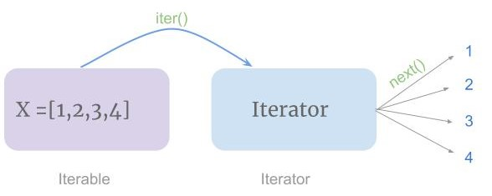
Iterability
Later in machine learning, we have some methods that can accept an array, list, or dataframe without any adaptation on our end because of this interoperability.
These data structures can be iterated through.
Can use a for loop just as we would with a list.
Each data structure provides it’s own “next” (internally, we don’t need to worry about it now), so anything asking for the “next item”, like a loop, will work.

Slide 5
Mutability
Another concept that is important in data structures is mutability, or the ability to be changed.
Different data structures have different rules on if their items are mutable.
Tuples are immutable – the items in a tuple can’t be changed.
Sets are immutable – we can add/remove, but not change the items.
I.e. the set’s contents can change, but the items in it are fixed.
Lists and Dictionaries are mutable – we can change anything we want.

Slide 6
Mutability Reasons
Why would anyone want an unchanging variable?
Immutable objects can allow for:
Provability – if we need to mathematically prove a program works (e.g. mission-critical).
Thread safe – programs that are multithreaded are easier with immutable variables.
Efficiency - since immutable things don’t change, compilers* can allocate exact memory.
This stuff can matter a lot when doing lower-level coding.
Can “fix” objects that we know will not need to change.
Compilers can rely on this non-changing rule, and optimize around it.
These concerns are not super relevant to us using Python for data science.

Slide 7
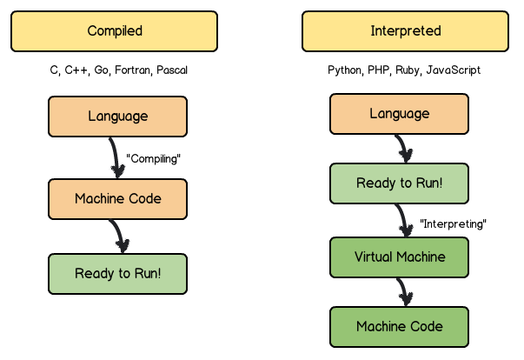
Computer Science Detour – Compliers and interpreters
Python is an interpreted language – we run code and get results.
Also JavaScript, Ruby, PHP. Sometimes called scripting languages.
Other languages are compiled – we compile our code into machine code then run that.
E.g. C/C++, Java, C#, most things that you install and run.
The compiler creates the code that the computer uses.
The compiler is very smart – it makes our code better.
It will try to optimize for efficiency, memory use, and errors.
Interpreted is easier to write, read, use, and revise.
Compiled is faster, more efficient, and better for “large” progs.

Slide 8
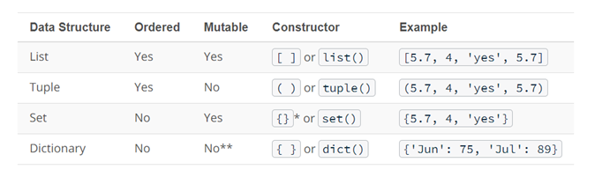
Unordered Data Structures
Some data structures hold data without maintaining indices or positions for objects.
Interactions with unordered structures is different:
Interactions with ordered data structures are oriented around the index.
Interactions with unordered data structures are oriented around the item.

Slide 9
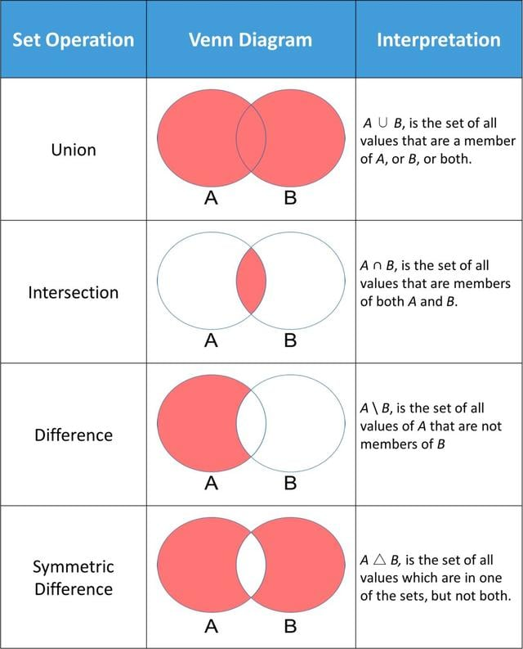
Sets
Sets are a basic unordered data structure.
Sets are largely an implementation of a math set.
Set operations allow us a one-step way to do some useful calculations on data.
This is also an example of operator overloading – sets redefine operators like “-” to do something specific for them.

Slide 10
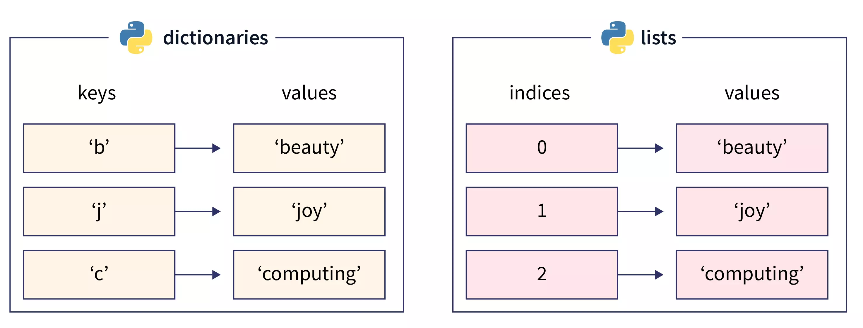
Dictionaries
Dictionaries are an unordered data structure that stores Key - Value pairs.
Dictionaries are generally used where:
We know what we are looking for – Key.
We want to know the value of it – Value.

Slide 11
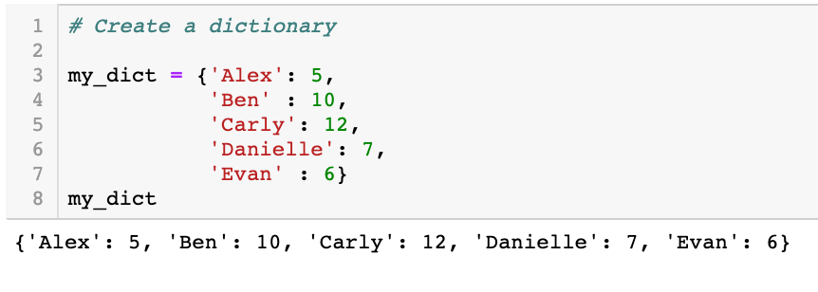
Dictionaries
Dictionaries can be made with curly braces or from another data structure.
Dictionaries have:
Items() – the key/value pairs.
Keys() – the keys.
Values() – the values.
We refer to items by key:
My_dict[“Alex”]

Slide 12
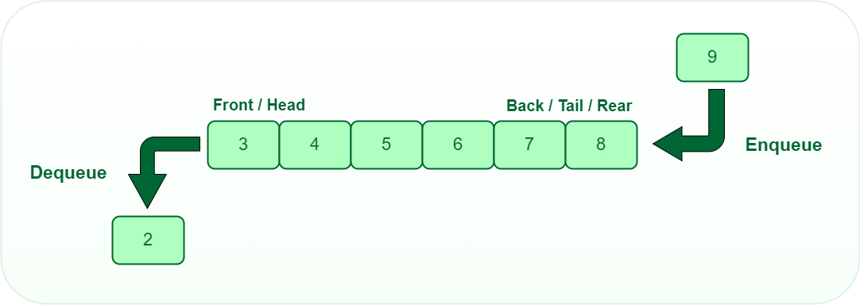
Queues
Queues are data structures that are, well… queues.
Queues are First In Last Out:
We can only add items to the back.
We can only remove items from the front.
We can import a queue module.

Slide 13
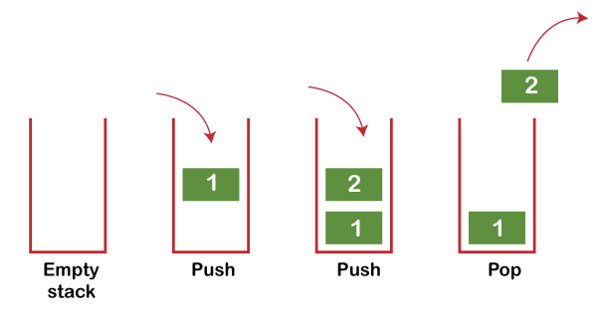
Stacks
Stacks are the opposite of a queue.
Stacks are Last In First Out.
Both stacks and queues are commonly used in processing “stuff”.
In recursion we’ll look at the Call Stack – the stuff the program is about to execute.

Slide 14
Leveraging Data Structure Properties
We can largely use any data structure to serve any purpose.
We might need to do a lot of work to make that work.
Choosing the correct data structure can sometimes make our lives much easier.
If we can’t allow duplicates, using something like a set may make sense.
If we need to track order, a dictionary is less useful than a list.
We can normally create one data structure from another easily.
E.g. we can write a “to_list()” or “to_dict()” function if needed.

Slide 15
Data Structure Life
In data science, we will mainly use dataframes, lists, arrays, and some dictionaries.
Considering the need for the data can dictate which container to use and save us time and effort.
We might write a loop for figure out which items or in two lists, or we could make them sets and it’ll do it for us with an intersection command.
If we need to process thing in some order while adding and removing, a stack or queue might be useful.

