Slide 1
FIELD SESSION WRAP-UP
Field Session 2012

Slide 2
FINAL ACTIVITIES
Discuss Software Engineering: the big picture
  Why projects fail
  Best practices
Final report requirements
  Report due by 5 pm on Tuesday 6/19
  Submit .doc or .pdf on BB, will be posted online
  Check with clients to determine if any issues with posting
  Submit hard copy for grading (arrange with advisor)
Individual reflections paper (lessons learned)
  Submit hardcopy report by 5 pm on Tuesday 6/19

Slide 3
FINAL ACTIVITIES
Final presentation requirements
  Ask clients what dates/times work
  Let me know by Wednesday (6/13) if possible
  I will post final schedule by Thursday/Friday
  Practice talks on Tuesday/Wednesday
Team member evaluations
  Done during first presentation day (6/19)
Client evaluations
  I will email survey forms to clients
  Need responses by Friday 6/22 at latest
  Be sure you have installed software, delivered documentation by Tuesday 6/18

Slide 4
FINAL ACTIVITIES
CD
  Submit a CD containing your work on Thursday 6/21
  CD is used primarily as a backup
  You don’t need to reproduce the working environment

Slide 5
SOFTWARE ENGINEERING
A retrospective

Slide 6

WHY DO PROJECTS FAIL?
Steve McConnell's doghouse analogy describes how small projects aren't necessarily representative of the problems you'll encounter on larger projects:
  People who have written a few small programs in college sometimes think that writing large, professional programs is the same kind of work -- only on a larger scale. It is not the same kind of work. I can build a beautiful doghouse in my backyard in a few hours. It might even take first prize at the county fair's doghouse competition. But that does not imply that I have the expertise to build a skyscraper. The skyscraper project requires an entirely more sophisticated kind of expertise.
http://www.codinghorror.com/blog/2007/09/steve-mcconnell-in-the-doghouse.html

Slide 7
WHAT DOESN’T WORK…
Projects are frequently built using a strategy that almost guarantees failure. Software engineering is a kind of engineering. Building a large information system is like constructing a 20-story office building. If a bunch of electricians, plumbers, carpenters and contractors meet in a field, talk for a few hours and then start building, the building will be unstable if it even gets built at all. At one of my presentations, an audience member shared the quip that “If building engineers built buildings with the same care as software engineers build systems, the first woodpecker to come along would be the end of civilization as we know it.”
http://www.hks.harvard.edu/m-rcbg/ethiopia/Publications
/Top%2010%20Reasons%20Why%20Systems%20Projects%20Fail.pdf

Slide 8
WE NEED A PLAN!
If we would keep in mind that building software is just like building an office building, then most of our problems would go away. Before building an office building, an architect draws up detailed plans, builds models, and makes blueprints. At each stage, the plans are carefully and repeatedly reviewed. During construction, each step is tested and inspected. In software projects, if we haven’t started writing code in three months, we mistakenly think that something must be wrong. Can’t we see the senselessness of plunging ahead without a careful plan? As an example, on one project I was involved with, the project manager brought in the tech writing team to start writing the training manuals before the user interface was even stable. This is about as smart as bringing in the painters before the walls have been built.

Slide 9
SOFTWARE ENGINEERING FAILURES
Interviews with 600 people closely involved in software development projects finds that even at the start of a project many people expect their projects to fail!
  “Fuzzy business objectives, out-of-sync stakeholders, and excessive rework” mean that 75% of project participants lack confidence that their projects will succeed.
  A truly stunning 78% of respondents reported that the “Business is usually or always out of sync with project requirements”.
http://calleam.com/WTPF/?page_id=1445

Slide 10
SOFTWARE ENGINEERING FAILURES
IBM survey in the success / failure rates of “change” projects finds;
  Only 40% of projects met schedule, budget and quality goals
  Best organizations are 10 times more successful than worst organizations
  Biggest barriers to success listed as people factors: Changing mindsets and attitudes - 58%. Corporate culture - 49%. Lack of senior management support - 32%.
  Underestimation of complexity listed as a factor in 35% of projects
http://calleam.com/WTPF/?page_id=1445

Slide 11
BEST PRACTICES
Development process. Make this a conscious choice. Consider size and scope of project. Agile does not mean no planning! (or no documentation)
Requirements. Are you creating what the customer wants? Are there non-functional requirements? (efficiency etc.)
Architecture. How do the pieces fit together?
Design. Guiding principles: keep it simple, information hiding. How much design before coding? Agile: just enough…
http://www.ibm.com/developerworks/websphere/library/techarticles/0306_perks/perks2.html

Slide 12
BEST PRACTICES (CONTINUED)
Construction. Daily build and smoke test. Continuous or frequent integration.
Peer reviews of code.
Testing.
Other steps listed in web article, not covered here.

Slide 13
FIELD SESSION
Final Report requirements

Slide 14
WHAT ARE WE DOING FOR FIELD SESSION?
Design is hard – difficult to do first when you’re new to the process
Rather than write design documents first, we are writing them at the end
  Field session projects are small, so extremely formal design process not needed
  Use field session projects to think about/practice skills needed for larger projects
These projects will be turned over to clients – many will need some documentation

Slide 15
OUR REPORT SECTIONS
Section | Approximate # of pages
Cover page | 1
I. Introduction (includes client description & project vision) | ½ to ¾
II. Requirements (functional & non-functional) | 1
III. System Architecture | 2
IV. Technical Design | 2-3
V. Design & Implementation Decisions | 1
VI. Results | 1/2
Appendices | Project specific
The # of pages are estimates, the advisor and/or client may request more detail.

Slide 16


COVER PAGE
Client name
Team members’ names
Date
Logo could be a nice touch (not required, but take a look at ModsDesigns, CSM3 or CSM2 from Summer 2011)

Slide 17
INTRODUCTION

Slide 18
I. INTRODUCTION
Who/What/Why
Client description (who): show that you have a good understanding of who your client is. Should be brief.
Product vision (What and Why): What are you building? How will this benefit the client?

Slide 19
PRODUCT VISION
Why are you making this product?
http://www.scrumalliance.org/articles/115-the-product-vision
“Often Scrum’s emphasis on ‘getting work done’ is misunderstood as a rush to develop with not enough thought to where the project should be going. Don’t make that mistake. Every Scrum project needs a product vision that acts as the project’s true north, sets the direction and guides the Scrum team.”

Slide 20
INTRODUCTION – EXAMPLE 1
Silicon Mountain Technologies (SMT) is an e‐Business Partner that provides a variety of web services including a product called Web Crescendo (WC). WC is a web management platform that enables the layman to quickly build and modify very robust and complex websites.
WC previously did not support the uploading and displaying of videos on these websites short of manual implementation, defeating the purpose of an "approachable by anyone" model with powerful results. This also means that WC had no way of securing videos (i.e., allowing only certain users to access certain videos).
In light of the growing demand for video services, SMT has asked our team to develop a system for incorporating videos into the current WC system as well as create a service to authenticate users when they attempt to view such videos. The system we developed allows clients to include videos in their websites using WC and provide security with which clients can specify who can and cannot view those videos.

Slide 21
INTRODUCTION – EXAMPLE 2
Agilent Technologies, Inc. produces radio frequency (RF) and microwave network analyzers, as well as various other types of measurement equipment. This equipment ranges from the small scale to devices that can cost upwards of $100,000. Over the years, Agilent has produced a large collection of sample measurement automation programs and program snippets, stored on a Microsoft Share Drive, that are used to control the equipment that their company manufactures. The problem is that these shared drives have little to no logical file structure and it is very difficult to find necessary programs. Often only a few people are relied on to find the necessary programs and in the worst case the program cannot be found and is rewritten, assuming that it already existed. This creates inefficiency in the company and possible loss in business due to frustrated costumers.
The client’s first and primary requirement was a system that allowed for fast, easy, logical searches of the data stored in their Microsoft Share Drives. The implementation chosen consists of a Spider program, written in Ruby, to parse the data on the drives, and a web front-end, written in Ruby on Rails, to display and allow for searches of the information.

Slide 22
REQUIREMENTS

Slide 23
II. REQUIREMENTS
We captured requirements in our product backlog, but it’s also common to create a list of requirements to share with the customer.
Two kinds of requirements to consider:
Functional
Non-functional

Slide 24
FUNCTIONAL REQUIREMENTS
Functional requirements specify the functionality that must be included in your system. They should:
state what needs to be included (but not how it will be implemented)
be testable (e.g., include a login page)
avoid subjective requirements (e.g., easy to use)
http://eaitken1.hubpages.com/hub/How-to-write-functional-requirements

Slide 25
NON-FUNCTIONAL REQUIREMENTS
Functional requirements are supported by non-functional requirements (also known as quality requirements), which impose constraints on the design or implementation (such as performance requirements, cost constraints, security, or reliability).
wikipedia

Slide 26
WHY BOTHER?
…failing to write a spec is the single biggest unnecessary risk you take in a software project. It's as stupid as setting off to cross the Mojave desert with just the clothes on your back, hoping to "wing it."
The most important function of a spec is to design the program.
http://www.joelonsoftware.com/articles/fog0000000036.html

Slide 27
EXAMPLE FROM JOEL
Original spec:
When opening a file created with an older version of the product, the file is converted to the new format
Customer sees spec, says "wait a minute! We don't want to switch everyone at once!"

Slide 28
EXAMPLE CONTINUED
Revised spec:
When opening a file created with an older version of the product, the file is converted to the new format in memory. When saving this file, the user is given the option to convert it back.
Spec is reviewed by the boss, an object nut. He suggests the following design:
The code will be factored to use two interfaces: V1 and V2. V1 contains all the version one features, and V2, which inherits from V1, adds all the new features. Now V1::Save can handle the backwards compatibility while V2::Save can be used to save all the new stuff. If you've opened a V1 file and try to use V2 functionality, the program can warn you right away, and you will have to either convert the file or give up the new functionality.

Slide 29
FINAL THOUGHTS FROM JOEL
A giant reason to write specs is to save time communicating.
Everybody on team reads spec before doing detailed design
QA reads spec so they know how to test
Marketing uses spec to write sales fluff
Customers use spec to ensure team is building the product they want
Tech writers read it to write documentation
Another giant reason: without a good spec, it’s impossible to estimate & schedule.

Slide 30
REQUIREMENTS – EXAMPLE 1
A. Functional Requirements
1. The program must display a list of drill intercepts as they arrive.
2. The program must show real-time stock quotes from companies publishing the intercepts.
3. The program should have a map feature for easy geographic intercept referencing.
4. The program should have a search function to narrow down results that are displayed.
5. The program must have a convenient user interface that allows users to easily access needed information. Data can be presented in a basic format, and then an option should be available to retrieve detailed information (e.g. map, additional intercept information, or stock charts).

Slide 31
REQUIREMENTS – EXAMPLE 1 CONTINUED
B. Non-Functional Requirements
1. The program must use the Eclipse development environment.
2. The program must be written in the Java programming language.
3. The program must be an Android mobile application.
4. The program must utilize Newmont’s Hot Drillholes database and the Intercepts Web Service.
5. The program must be uploaded to a Subversion repository on Newmont’s servers.*
* remember we talked about Definition of Done?

Slide 32
REQUIREMENTS – EXAMPLE 2
Functional Requirements
SimpleIWA must process user identity from IWA and create a SAML assertion that will be sent to an Identity Router. In addition SimpleIWA must be packaged allowing it to be easily distributed. Specific requirements include:
  ○ Maintain the current system’s SSO functionality
  ○ Accept user browser requests
  ○ Identify Active Directory users with IWA
  ○ Require the user to log into Active Directory if the user identity cannot be provided by IWA
  ○ Create a SAML assertion that verifies the user and provides other, to be determined attributes of that user

Slide 33
REQUIREMENTS – EXAMPLE 2 CONTINUED
○ Send the SAML assertion to the IdR over HTTP Post
○ Create an installer to install the product on different servers
○ Allow the application to be configured in the installer
Non-Functional Requirements
○ Allow SimpleIWA to be deployed on any domain within the network
○ Write SimpleIWA in C# with ASP.Net
○ SimpleIWA must install and run on a Windows Server running IIS

Slide 34
ARCHITECTURE

Slide 35
III. SOFTWARE ARCHITECTURE
The software architecture of a system is the set of structures needed to reason about the system, which comprise software elements, relations among them, and properties of both. The term also refers to documentation of a system's "software architecture." Documenting software architecture:
facilitates communication between stakeholders,
documents early decisions about high-level design, and
allows reuse of design components and patterns between projects.
from Wikipedia

Slide 36
SOFTWARE ARCHITECTURE – WHY?
The software architecture discipline is centered on the idea of reducing complexity through abstraction and separation of concerns.
The software architecture of a program or computing system is a depiction of the system that aids in the understanding of how the system will behave.
Software architecture serves as the blueprint for both the system and the project developing it, defining the work assignments that must be carried out by design and implementation teams. The architecture is the primary carrier of system qualities such as performance, modifiability, and security, none of which can be achieved without a unifying architectural vision.
http://www.sei.cmu.edu/architecture/

Slide 37
ARCHITECTURE DIAGRAM IN OUR REPORT
The architecture section of your report should:
Include a graphical representation of the system.
Include a brief description of each component.
Focus on the interface between the components (one of the most error-prone aspects of system design)
All images in your document should have a figure number and be referenced within the text.

Slide 38
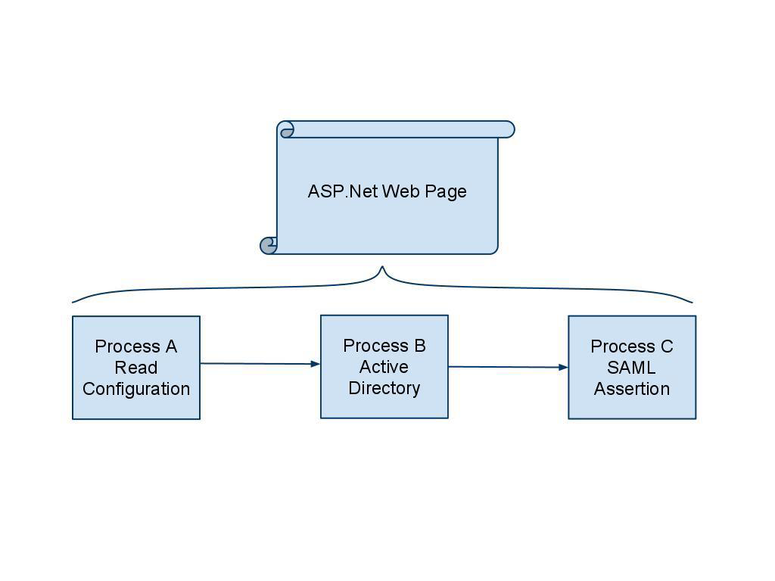
ARCHITECTURE – EXAMPLE 1
See Symplified final report for explanation

Slide 39
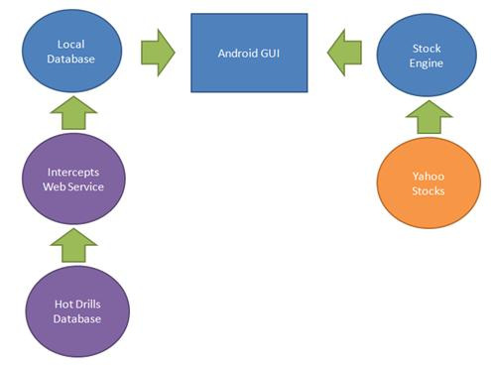
ARCHITECTURE – EXAMPLE 2
See Newmont 1 final report.

Slide 40
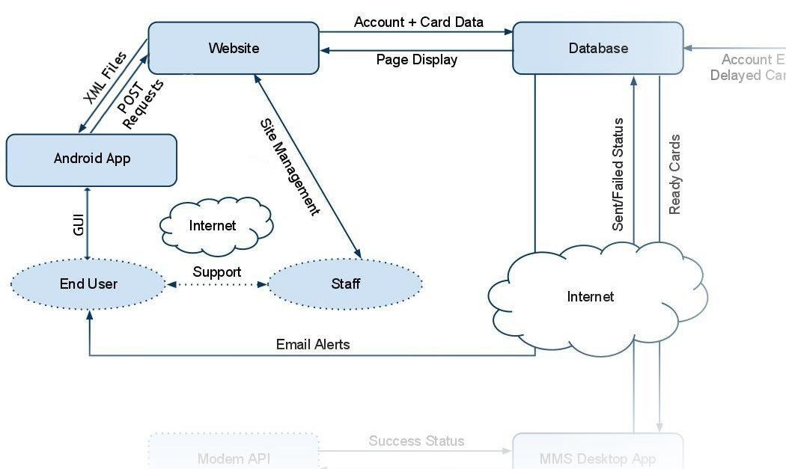
ARCHITECTURE – EXAMPLE 3
See ModsDesigns final report

Slide 41
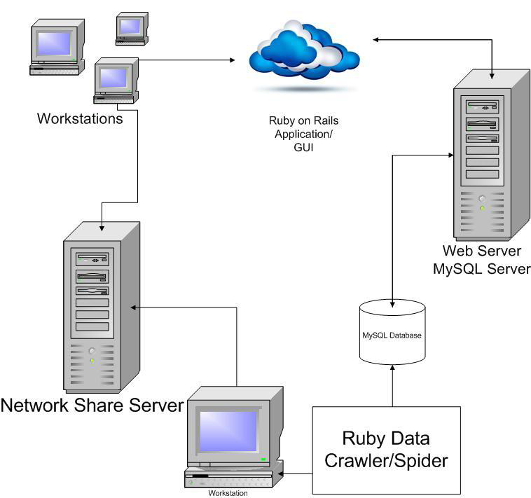
ARCHITECTURE – EXAMPLE 4
See Agilent final report.

Slide 42
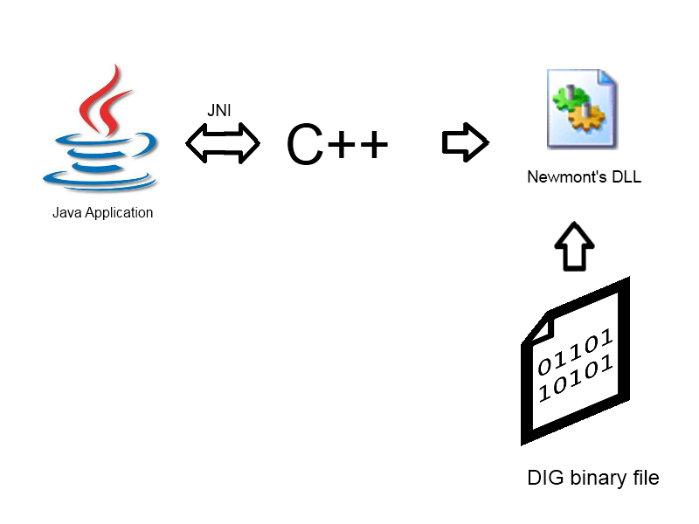
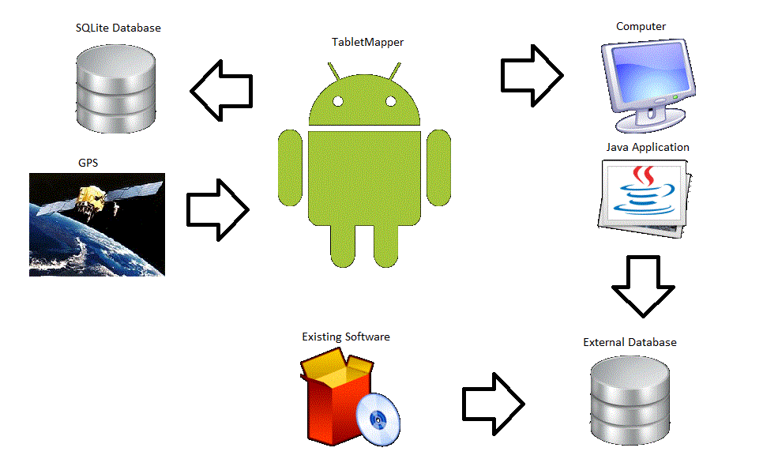
ARCHITECTURE – EXAMPLE 5
Two examples from Newmont 2 Final report

Slide 43
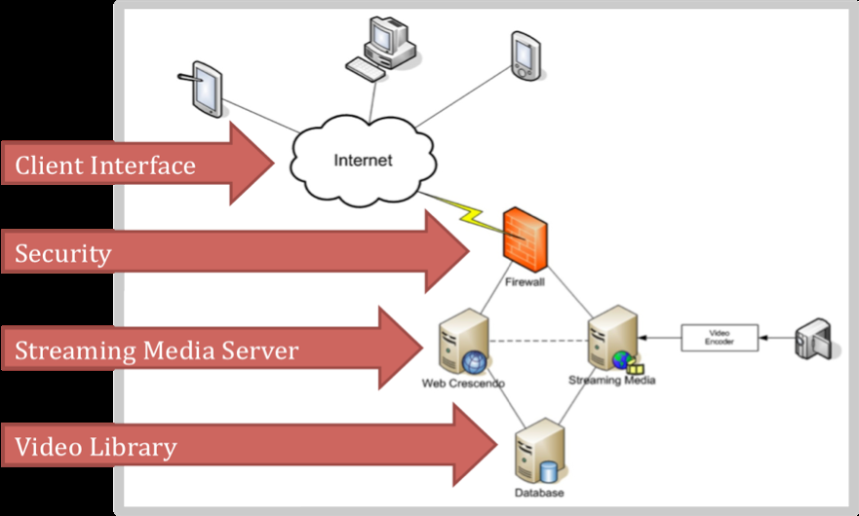
ARCHITECTURE – EXAMPLE 6
See SMT final report

Slide 44
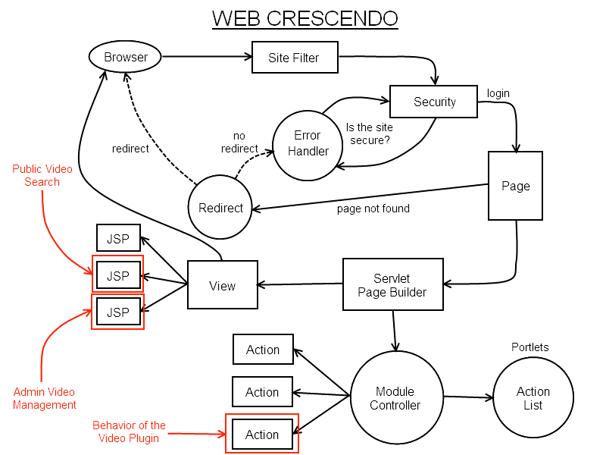
ARCHITECTURE – EXAMPLE 7
From SMT

Slide 45
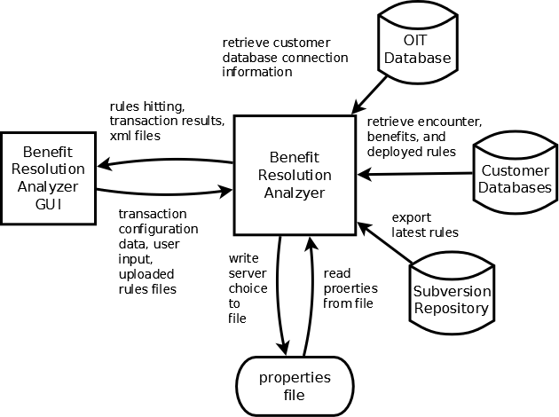
ARCHITECTURE – EXAMPLE 8
From Recondo 2

Slide 46
MORE EXAMPLES
Diagrams plus explanations are available within the CSCI370 website final report description

Slide 47
TECHNICAL DESIGN

Slide 48
IV. TECHNICAL DESIGN
This section of the document will describe the most important aspects of your design, including appropriate figure(s) with supporting descriptions. Typical figures in this section will include UML diagrams, database schema, activity diagrams, finite state diagrams, etc. Examples follow (some are fuzzy due to cut-and-paste from pdf – your figures should be readable)
NOTE: past sessions documented their entire system – we are requiring only the primary components of your design to be described in detail. You should confirm with your advisor what aspects you will include in this section.

Slide 49
TECHNICAL DESIGN
State diagrams and flowcharts

Slide 50
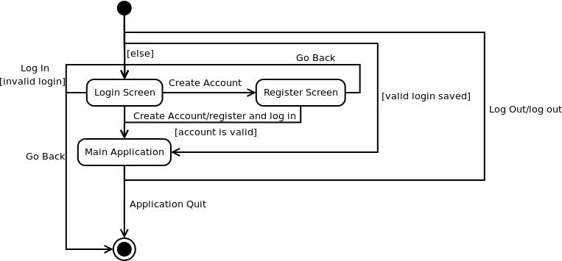
STATE DIAGRAM
See ModsDesigns

Slide 51
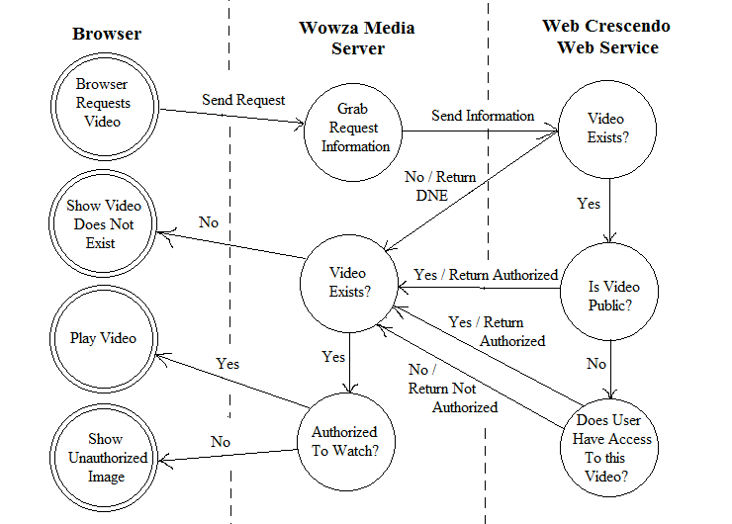
FINITE AUTOMATA
From SMT

Slide 52
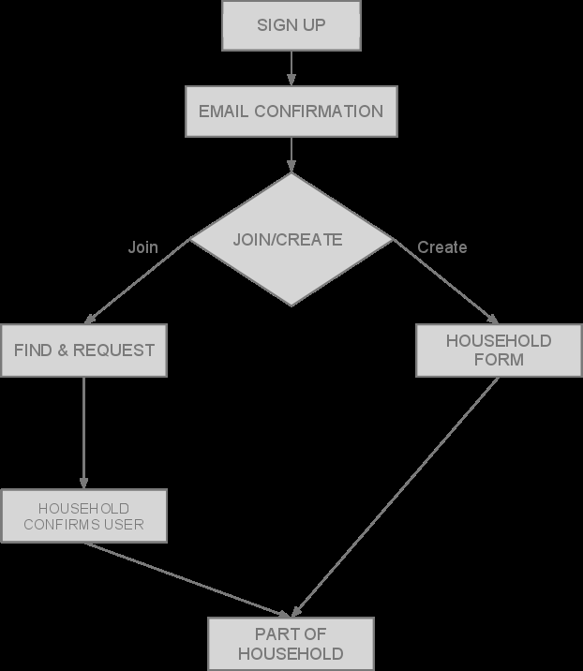
FLOWCHART
From Circle 77 (illustrates security process)

Slide 53
TECHNICAL DESIGN
Database design examples

Slide 54
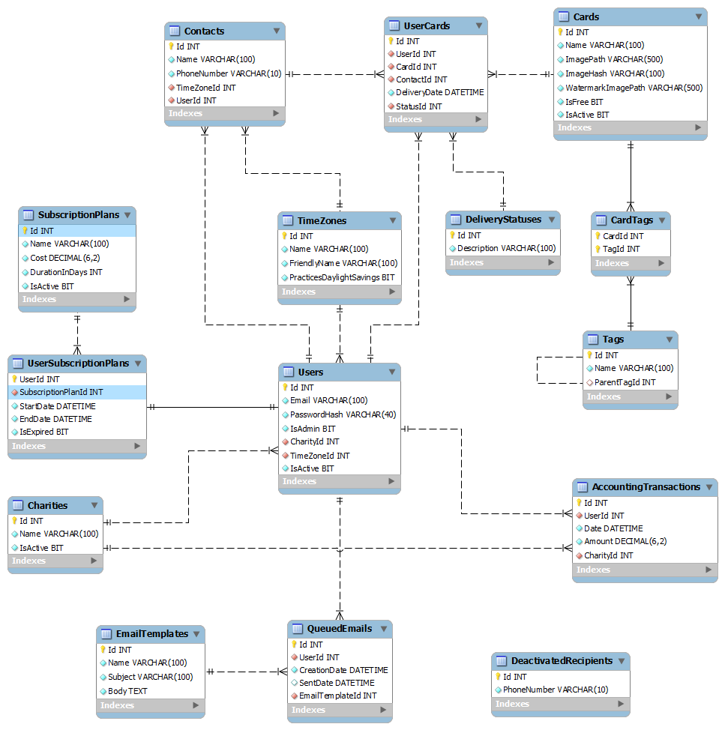
DATABASE SCHEMA
Database schema from ModsDesigns

Slide 55
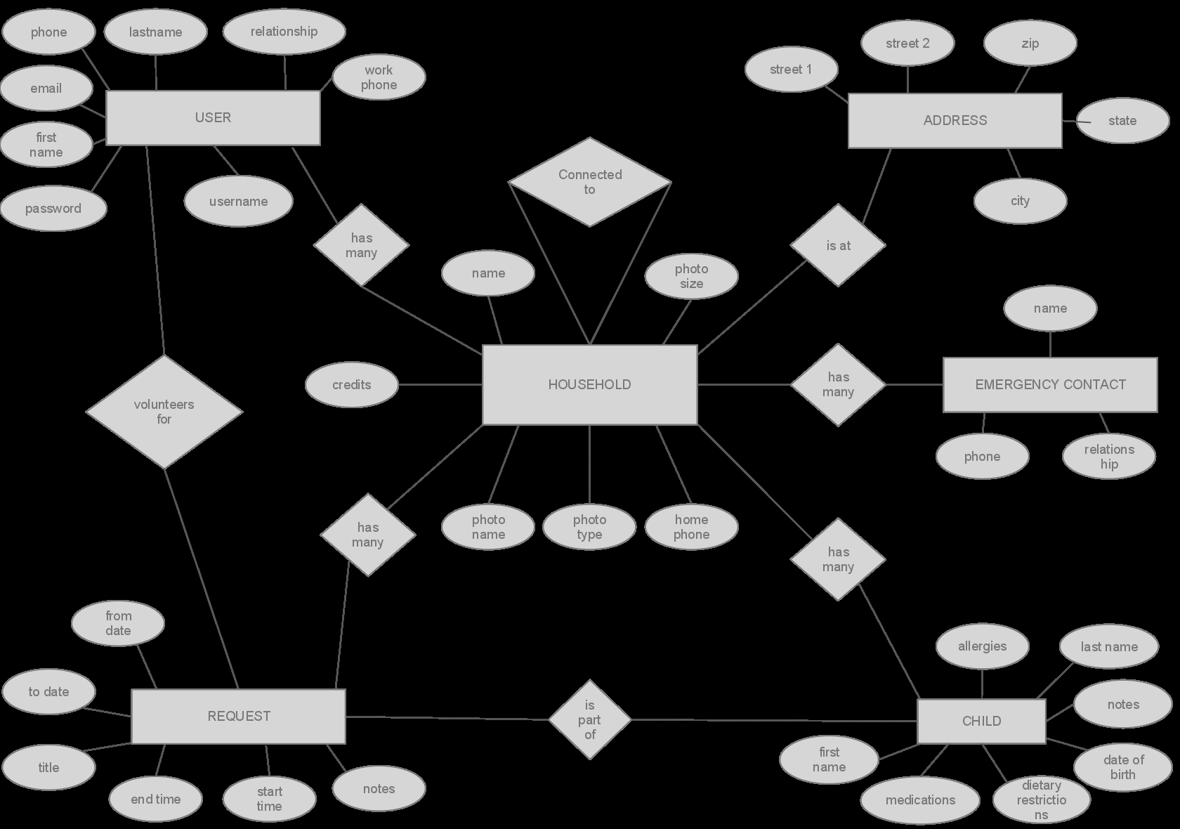
ENTITY-RELATIONSHIP DIAGRAM
ER diagram – Circle 77

Slide 56
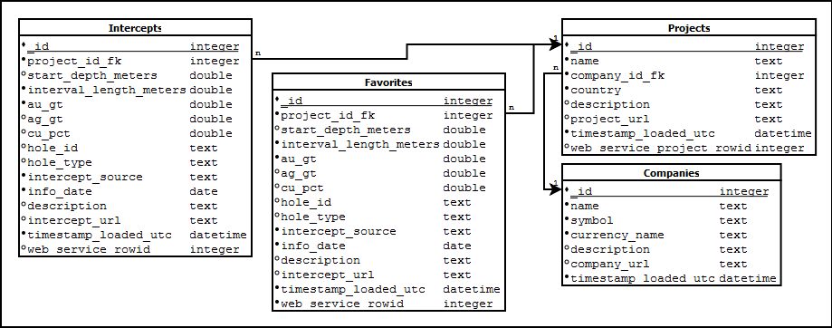
SCHEMA
DB schema: Newmont
For database tables you create, include supporting text that describes the various fields and relationships. That level of detail not needed for tables in an existing customer system.

Slide 57
TECHNICAL DESIGN
UML examples

Slide 58
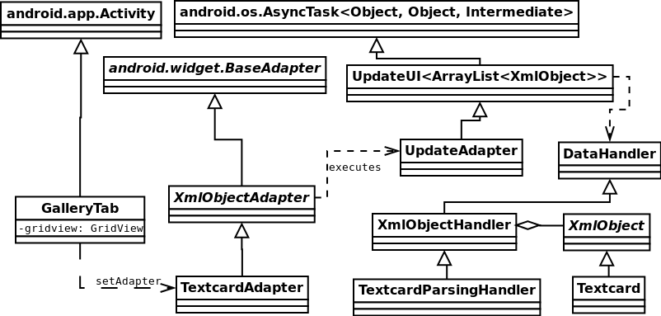
UML
Also from ModsDesigns
Remember that DIA has an option to not show attributes/methods.

Slide 59
DESIGN & IMPLEMENTATION DECISIONS

Slide 60
V. DESIGN & IMPLEMENTATION DECISIONS
It is common to consider various alternatives as part of the design process. In this section you will document those decisions. Which decisions? Imagine someone from the client is going to update your code. Try to think of all the places where that person might say “I wonder why they did it that way?” (used that library, chose that language, created those classes/tables, etc).
This section should also contain a description of any issues you encountered during implementation (and how you resolved them).

Slide 61
DESIGN DECISIONS – EXAMPLE 1
SimpleIWA was written in Visual Studio 2010 using C# and ASP.Net. Windows IIS uses virtual directories that run ASP.Net web pages and there was quite a lot of functionality for SimpleIWA’s requirements already existing in Visual Studio C#.
The configuration file follows an XML schema. This was a natural choice for the configuration file because it follows the pattern of other IIS and ASP.NET configuration files. In addition, SimpleIWA is required to produce a SAML Assertion, a protocol that is based on XML.
SimpleIWA utilizes a modified SAML Library written in C# and provided by The Code Project Open License. A library was used to generate SAML to avoid rewriting publicly available code. This library was chosen because it was well documented. In addition, the simplicity of the library allowed it to be modified and integrated into SimpleIWA.
The private key file chooser dialog in the configuration utility runs on a separate thread from the installer thread. This is because the Windows OpenFileDialog class is required to run on a thread with a single threaded apartment state. The installer thread does not satisfy this requirement. A separate thread is created to use the Windows class and provide familiar functionality to the user.
Windows Installer XML (WIX) was considered as the basis for SimpleIWA’s installer, but after research, it was determined that the learning curve for WIX would be too steep. Ultimately, A Visual Studio Installer fit the scope of the project. A Visual Studio Installer is not as powerful as using a WIX installer. However, it offers a complete ASP.NET installer that can be configured with Custom Actions to add additional functionality. This additional functionality was essential to allow SimpleIWA to be configured in the install process.
Language choice
Data design
Reuse/library choice
Implementation decision (threads)
Discuss alternatives

Slide 62

DESIGN DECISIONS – EXAMPLE 2
Two potential integrations were considered for the actual integration of the video conversion process. One converts on the fly through a Java interaction and the other converts through a schedule using the command line.
Workflow A
Figure 11 shows the first approach. A client uploads a video that eventually gets sent to the Jave interface. Jave does some quick analysis on the video and runs an FFmpeg script on it. The FFmpeg script and Jave continue to communicate, providing the client with feedback on the conversion process. Once completed, the
video is either rejected (with errors) or approved and saved to the final location.
Figure 11 Encoding

Slide 63
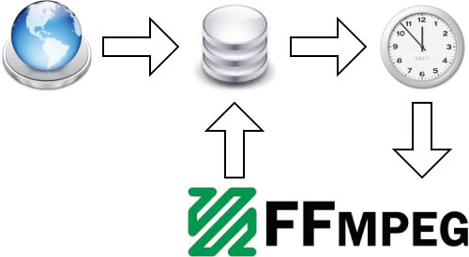
EXAMPLE 2 (CONTINUED)
Video conversion is a very expensive process, even when simply muxing. Due to this fact and that of FFmpeg's location ON the media server itself, it is unwise to have both streaming and converting occurring simultaneously.
Figure 12 illustrates one option (also the chosen method) to address this concern. By running FFmpeg as a scheduled process, the taxing conversion process could be performed in the late hours of the night while little to no video is being served. A client would upload a file into a designated "pending" folder and await conversion. Upon the appointed time, FFmpeg will fire up and automatically convert all videos in this pending state.

Slide 64
DESIGN DECISIONS – EXAMPLE 3
There are two widely used XML parsers used in Java - Simple API for XML (SAX) and Document Object Model (DOM). Although it required more coding, we implemented the SAX parser because it uses less memory and runs faster.
Our client preferred that we utilize the Yahoo Finance API to retrieve the stock information and chart displayed on the company screen. We initially retrieved the chart from the Yahoo Finance API, but overlaying intercepts on this chart was difficult and error-prone. Our client decided to develop another web service that uses a graphics development tool called R to generate the stock charts. These charts are more atheistically pleasing and allowed for overlaying intercepts easily. We ended up using this web service to retrieve the stock charts.

Slide 65
RESULTS

Slide 66
VI. RESULTS
This section will vary based on the project, but may include:
future work
performance testing results
results of usability tests (e.g., testing educational software with real students)

Slide 67
RESULTS – EXAMPLE 1
SimpleIWA was tested with six different Active Directory servers. The servers were running on different versions of Windows and had different releases of IIS. In addition SimpleIWA was tested with Symplified’s Single Point Studio Software. SimpleIWA works smoothly in all the different testing environments. Many of the different testing environments have different dependencies. The SimpleIWA installer identifies when these dependencies are missing and provides instructions to install them.

Slide 68
RESULTS – EXAMPLE 2
In this project, we were successful in meeting all of the functional and non-functional requirements that our client gave to us. However, we were not able to meet any of the stretch goals for the project, which are now included in future work for this project.

Slide 69
RESULTS – EXAMPLE 3
After the bulk of our coding was done, we were able to test our game with students. One student said, “I like that [the game] is realistic with changing weather.” Every student that tested it tried to use renewable energy in some way. There were confusing points in the game for most of the students, and many times they were not able to connect power and or buildings appropriately, as the power lines and roads were hidden behind the buildings in some cases.

Slide 70
RESULTS – DON’T DO THIS
We really learned a lot and were able to create a great product that will be really helpful to our client.

Slide 71
APPENDICES

Slide 72
APPENDIX A-?
Use the appendices to include any other information that your client may need to take full advantage of your product. Possibilities include:
Product installation instructions
Development environment description
Calculation details
Explanation of modeling technique
Coding conventions
Acceptance tests
etc.

Slide 73
ACCEPTANCE TESTS - EXAMPLE
Security
▪ Can anyone view public videos?
Public videos are viewable by anyone, regardless of a JSESSIONID existing or
not.
▪ Can permitted users (and only permitted users) view secured videos?
If a user requests a video but does not have permission to view it, the request
is rejected. Likewise, if a video is requested anonymously (i.e. a user is not
logged in) and is not public, the request is rejected.
▪ Will a change in user roles correctly block a previously viewable video?
To test this requirement, a user with sufficient privileges opened a page with
an embedded video. While viewing the video, the roles of the user were
changed to remove permissions. Upon refreshing the page, the user could no
longer receive the video. Likewise, changing the video role from public to
private also denied further video requests.

Slide 74
REPORT EVALUATION

Slide 75
GRADING RUBRIC
Your document will be graded based on the following rubric.
Item | Points
Document contains all the required sections. | 5
Document has adequate detail | 5
Document is formatted correctly, including figures with labels (referenced in text) | 3
Document complies with style and grammar guidelines, no spelling errors | 2
Total | 15

Slide 76
FINAL PRESENTATIONS

Slide 77
PRESENTATIONS - OVERVIEW
Presentations will be on Thursday June 21 and Friday June 22, schedule online.
Clients are invited (not required to attend).
Attendance is required for students. Student teams will be evaluating all presentations, along with the advisors. Evaluation criteria are available online (hard copy forms will be supplied).
Dress is business casual – for both days

Slide 78
PRESENTATION -DETAILS
Each presentation should be 20 minutes in length, with an additional 2 minutes for Q&A
There will be 3 minutes between talks to switch from one team to the next (be ready!)
Overall, your talk should be about 1/3 problem statement (possibly a bit less), 1/3 problem design and implementation, 1/3 demonstration and results. Multimedia presentations can be useful, particularly in the problem statement and/or demonstration sections. BUT, do not substitute style for content. We want to be INFORMED, not just entertained.

Slide 79
PRESENTATION – MORE DETAILS
Awards will be given for the team with the most engaging talk and the team with the best technical detail.
We will all view all 14 presentations. DO NOT just do bullets. Include diagrams, pictures, etc. Speak up, show enthusiasm!
Click the Presentation Guidelines link on the field session website for more details.

Slide 80
PRACTICE TALKS
Practice talks will be scheduled for Tuesday and Wednesday (June 19 and June 20).
We will have four groups of 3 teams and one group of 2 teams.
Teams will critique each others presentations, using the evaluation criteria
One of the advisors will be present at the start of each session to ensure everyone knows what is expected.

Slide 81
PRACTICE TALK SCHEDULE (TENTATIVE)
Tuesday 9-11 AM | AG Wassenaar | Card Gnome | CSM3
Tuesday 1-3 PM | CSM2 | Bump-O-Meter | Symplified
Wednesday 9-11AM | SpinFusion | Ubermind | OCR
Wednesday 11:30-1:30PM | NLP | Oracle | Aug Reality
Wednesday 2-4PM | Newmont Tracker | Disney Online

Slide 82
INDIVIDUAL REFLECTION PAPERS
Lessons Learned

Slide 83
V. LESSONS LEARNED
The purpose is to reflect on the overall process – what did you learn (could be technical and/or process-oriented)? what worked well? what do you want to avoid in the future?

Slide 84
LESSONS LEARNED – EXAMPLE 1
Despite initial impressions, "open source" does not translate to "viable commercial solution". In a business environment where software stability and support is crucial, the conglomerate of code representing most open source applications created more problems than it solved. In the case of FFmpeg, building a version that included the H264 support required an involved process of tracking down libraries and troubleshooting builds, relying on information posted in various forums dating as old as five to ten years. In the event encoding needs changed, a new build must be made with new libraries and generally required much more technical expertise than should be needed for such a simple implementation. For these reasons we recommend using a live, updating commercial application that is backed by customer support... you really do get what you pay for!

Slide 85
LESSONS LEARNED – EXAMPLE 2
… We also learned that heavily coupled classes can be unpredictable. In some cases, it prevents J-Unit tests from being able to function properly, and if there is an error it can make tracking down exactly what the issue is extremely difficult. Along with coupled classes, program functionality should never be coupled with a GUI. It makes testing program functionality nearly impossible without creating an instance of the GUI, which should not be necessary.

Slide 86
LESSONS LEARNED – EXAMPLE 3
This project has been a great learning experience for what the industry will mostly be like in the future. We learned that doing backups and using versioning is extremely important, so it is possible to regress. Making poorly documented changes can make it extremely difficult to get back to where you were. If you've made several changes in a system, and didn't document their previous state or back it up, tracking down which change made the code stop working can be extremely difficult. Using a repository, such as Subversion or Mercurial, to store lifetime changes to the code would ultimately save time and energy when dealing with a faulty build.
We also learned being flexible is extremely important. Making a wrong decision can put you in a difficult situation, but clinging to that decision can make the situation even worse. We had initially decided to add the network bootable function to the python scripts of the text installer; however, we quickly realized the amount of work involved with adding network functionality in python was beyond our current abilities. While we could have pursued this option further, we decided that modifying the Automated Installer would be more within our abilities and time constraints.

Slide 87
OTHER EVALUATIONS

Slide 88
TEAM MEMBERS
Each person will rate the performance of his/her team members.
Forms will be distributed during the first day of field session.
If there are any team member issues, let your advisor know NOW!
Team evaluation is 10% of your grade

Slide 89
CLIENT FEEDBACK
Forms will be/have been sent to clients
Provide feedback on communication, product quality, etc.
Client feedback is 40% of your grade

Slide 90
WANT MORE?

Slide 91
CSCI 598: READINGS IN SOFTWARE ENGINEERING
A course you might want to consider if:
You love to code
You enjoy reflecting on what makes code really good (or really bad…)
You have pretty good coding skills, but want to improve them
You work well in open-ended, team-based environments.

