Slide 1
Internet Protocol Addressing
SI-E Workshop
AfNOG 2013 - Zambia

Slide 2
Purpose of an IP address
Unique Identification of:
  Source
    How would the recipient know where the message came from?
    How would you know who hacked into your network (network/data security)
  Destination
    How would you send data to other network
Network Independent Format
  IP over anything

Slide 3
Purpose of an IP Address
Identifies a machine’s connection to a network
Uniquely assigned in a hierarchical format
  IANA (Internet Assigned Number Authority)
  IANA to RIRs (AfriNIC, ARIN, RIPE, APNIC, LACNIC)‏
  RIR to ISPs and large organisations
  ISP or company IT department to end users
IPv4 uses unique 32-bit addresses
IPv6 uses unique 128-bit addresses

Slide 4
Basic Structure of an IPv4 Address
32 bit number (4 octet number):
(e.g. 133.27.162.125)‏
Decimal Representation:
Binary Representation:
Hexadecimal Representation:
133
27
162
125
10000101
00011011
10100010
01111101
85
1B
A2
7D

Slide 5
Address Exercise
SWITCH
A
N
PC
Router
Router
PC
B
M
PC
Router
Router
PC
C
L
PC
Router
Router
PC
D
K
PC
Router
Router
PC
E
J
PC
Router
Router
PC
F
I
PC
Router
Router
PC
G
H
PC
Router
Router
PC

Slide 6
Address Exercise
Construct an IP address for your router’s connection to the backbone network.
196.200.220.x
x = 1 for row A, 2 for row B, etc.
Write it in decimal form as well as binary form.

Slide 7
Addressing in Internetworks
The problem we have
  More than one physical network
  Different Locations
  Larger number of hosts/computer systems
  Need a way of numbering them all
We use a structured numbering system
  Hosts that are connected to the same physical network may have “similar” IP addresses

Slide 8
Network part and Host part
Remember IPv4 address is 32 bits
Divide it into a “network part” and “host part”
  “network part” of the address identifies which network in the internetwork (e.g. the Internet)‏
  “host part” identifies host on that network
  Hosts or routers connected to the same link-layer network will have IP addresses with the same network part, but different host part.
  Host part contains enough bits to address all hosts on that subnet; e.g. 8 bits allows 256 addresses

Slide 9
Dividing an address
Hierarchical Division in IP Address:
  Network Part (or Prefix) – high order bits (left)‏
    describes which physical network
  Host Part – low order bits (right)‏
    describes which host on that network
  Boundary can be anywhere
    Boundaries are chosen according to number of hosts required
Network Part
Host Part

Slide 10
Network Masks
“Network Masks” help define which bits describe the Network Part and which for the Host Part
Different Representations:
  decimal dot notation: 255.255.224.0
  binary: 11111111 11111111 11100000 00000000
  hexadecimal: 0xFFFFE000
  number of network bits: /19
    count the 1's in the binary representation
Above examples all mean the same: 19 bits for the Network Part and 13 bits for the Host Part

Slide 11
Example Prefixes
137.158.128.0/17 (netmask 255.255.128.0)
198.134.0.0/16 (netmask 255.255.0.0)
205.37.193.128/26 (netmask 255.255.255.192)
1111 1111
1111 1111
1 000 0000
0000 0000
1000 1001
1001 1110
1 000 0000
0000 0000
1111 1111
1111 1111
0000 0000
0000 0000
1100 0110
1000 0110
0000 0000
0000 0000
1111 1111
1111 1111
1111 1111
11 00 0000
1100 1101
0010 0101
1100 0001
10 00 0000

Slide 12
Special Addresses
All 0’s in host part: Represents Network
  e.g. 193.0.0.0/24
  e.g. 138.37.64.0/18
All 1’s in host part: Broadcast
  e.g. 193.0.0.255 (prefix 193.0.0.0/24)‏
  e.g. 138.37.127.255 (prefix 138.37.64.0/18)‏
127.0.0.0/8: Loopback address (127.0.0.1)‏
0.0.0.0: For various special purposes

Slide 13
Ancient History:
A classful network naturally “implied” a prefix-length or netmask:
  Class A: prefix length /8 (netmask 255.0.0.0)
  Class B: prefix length /16 (netmask 255.255.0.0)
  Class C: prefix length /24 (netmask 255.255.255.0)
Modern (classless) routed networks rather have explicit prefix-lengths or netmasks.
  So ideally you can't just look at an IP address and tell what its prefix-length or netmask should be.
  Protocol configurations in this case also need explicit netmask or prefix length.

Slide 14
Post-1994 era of classless addressing
Class A, Class B, Class C terminology and restrictions are now of historical interest only
  Obsolete since 1994
Internet routing and address management today is classless
CIDR = Classless Inter-Domain Routing
  Routing does not assume that former class A, B, C addresses imply prefix lengths of /8, /16, /24
VLSM = Variable-Length Subnet Masks
  Routing does not assume that all subnets are the same size

Slide 15
Classless addressing example
An ISP gets a large block of addresses
  e.g., a /16 prefix, or 65536 separate addresses
Assign smaller blocks to customers
  e.g., a /24 prefix (256 addresses) to one customer, and a /28 prefix (16 addresses) to another customer (and some space left over for other customers)
An organisation that gets a /24 prefix from their ISP divides it into smaller blocks
  e.g. a /27 prefix (32 addresses) for one department, and a /28 prefix (16 addresses) for another department (and some space left over for other internal networks)

Slide 16
Classless addressing exercise
Consider the address block 133.27.162.0/24
Allocate 5 separate /28 blocks, one /27 block, and one /30 block
What are the IP addresses of each block allocated above?
  In prefix length notation
  Netmasks in decimal
  IP address ranges
What blocks are still available (not yet allocated)?
How big is the largest available block?

Slide 17
Configuring interfaces – ifconfig
ifconfig interface [address_family] address [params]
  interface: network interface, e.g., eth0 or bge0
  options: up, down, netmask mask
  address: IP address
Examples:
  ifconfig bge0 inet 192.168.2.2; ifconfig bge1 192.168.3.1
  ifconfig eth0 inet 172.16.1.1/24
  ifconfig bge0 192.168.2.2 netmask 255.255.255.0
  ifconfig bge0 inet6 2001:db8:bdbd::123 prefixlen 48 alias

Slide 18
IPv6 Addressing
IP Addresses Continues

Slide 19
IP version 6
IPv6 designed as successor to IPv4
  Expanded address space
    Address length quadrupled to 16 bytes (128 bits)‏
  Header Format Simplification
    Fixed length, optional headers are daisy-chained
  No checksum at the IP network layer
  No hop-by-hop fragmentation
    Path MTU discovery
  64 bits aligned fields in the header
  Authentication and Privacy Capabilities
    IPsec is mandated
  No more broadcast

Slide 20
IPv4 and IPv6 Header Comparison
IPv4 Header
IPv6 Header
Version
IHL
Type of Service
Total Length
Version
Traffic Class
Flow Label
Identification
Flags
Fragment Offset
Payload Length
Next Header
Hop Limit
Time to Live
Protocol
Header Checksum
Source Address
Source Address
Destination Address
Options
Padding
Legend
Destination Address
Field’s name kept from IPv4 to IPv6
Fields not kept in IPv6
Name and position changed in IPv6
New field in IPv6

Slide 21
Larger Address Space
IPv4 = 32 bits
IPv6 = 128 bits
  IPv4
    32 bits
    = 4,294,967,296 possible addressable devices
  IPv6
    128 bits: 4 times the size in bits
    = 3.4 x 10³⁸ possible addressable devices
    = 340,282,366,920,938,463,463,374,607,431,768,211,456
    ∼ 5 x 10²⁸ addresses per person on the planet

Slide 22
IPv6 Address Representation
16 bit fields in case insensitive colon hexadecimal representation
  2031:0000:130F:0000:0000:09C0:876A:130B
Leading zeros in a field are optional:
  2031:0:130F:0:0:9C0:876A:130B
Successive fields of 0 represented as ::, but only once in an address:
  2031:0:130F::9C0:876A:130B is ok
  2031::130F::9C0:876A:130B is NOT ok (two “::”)
  0:0:0:0:0:0:0:1 → ::1 (loopback address)
  0:0:0:0:0:0:0:0 → :: (unspecified address)

Slide 23
IPv6 Address Representation
In a URL, it is enclosed in brackets (RFC3986)‏
  http://[2001:db8:4f3a::206:ae14]:8080/index.html
  Complicated for typical users
  This is done mostly for diagnostic purposes
  Use fully qualified domain names (FQDN)‏ instead of this
Prefix Representation
  Representation of prefix is same as for IPv4 CIDR
    Address and then prefix length, with slash separator
  IPv4 address:
    198.10.0.0/16
  IPv6 address:
    2001:db8:1200::/40

Slide 24
IPv6 Addressing
Type
Binary
Hex
Unspecified
0000…0000
::/128
Loopback
0000…0001
::1/128
Global Unicast Address
0010 ...
2000::/3
Link Local Unicast Address
1111 1110 10...
FE80::/10
Unique Local Unicast Address
1111 1100 ...
1111 1101 ...
FC00::/7
Multicast Address
1111 1111 ...
FF00::/8
Notes:
The actual addressing scheme of IPv6

Slide 25
IPv6 Global Unicast Addresses
Provider
Site
Host
48 bits
16 bits
64 bits
Global Routing Prefix
Subnet-id
Interface ID
001
IPv6 Global Unicast addresses are:
  Addresses for generic use of IPv6
  Hierarchical structure intended to simplify aggregation

Slide 26
IPv6 Address Allocation
/12
/32
/48
/64
2000
0db8
Interface ID
Registry
ISP prefix
Site prefix
LAN prefix
The allocation process is:
  The IANA is allocating out of 2000::/3 for initial IPv6 unicast use
  Each registry gets a /12 prefix from the IANA
  Registry allocates a /32 prefix (or larger) to an IPv6 ISP
  ISPs usually allocate a /48 prefix to each end customer

Slide 27
IPv6 Addressing Scope
64 bits used for the interface ID
  Possibility of 2⁶⁴ hosts on one network LAN
  Arrangement to accommodate MAC addresses within the IPv6 address
16 bits used for the end site
  Possibility of 2¹⁶ networks at each end-site
  65536 subnets

Slide 28
IPV6 Subnetting
2001:0db8:0000:0000:0000:0000:0000:0000
64 bits interface ID
/64
/60=16 /64
/56=256 /64
/52=4096 /64
/48=65536 /64
/32=65536 /48

Slide 29
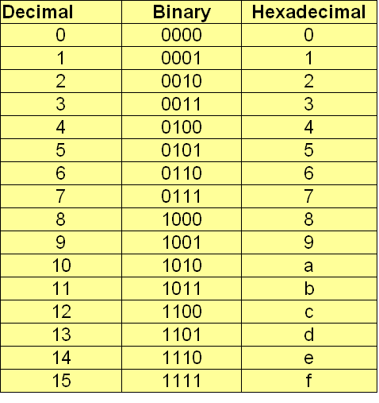
Nibble (4 bits) Concept

Slide 30
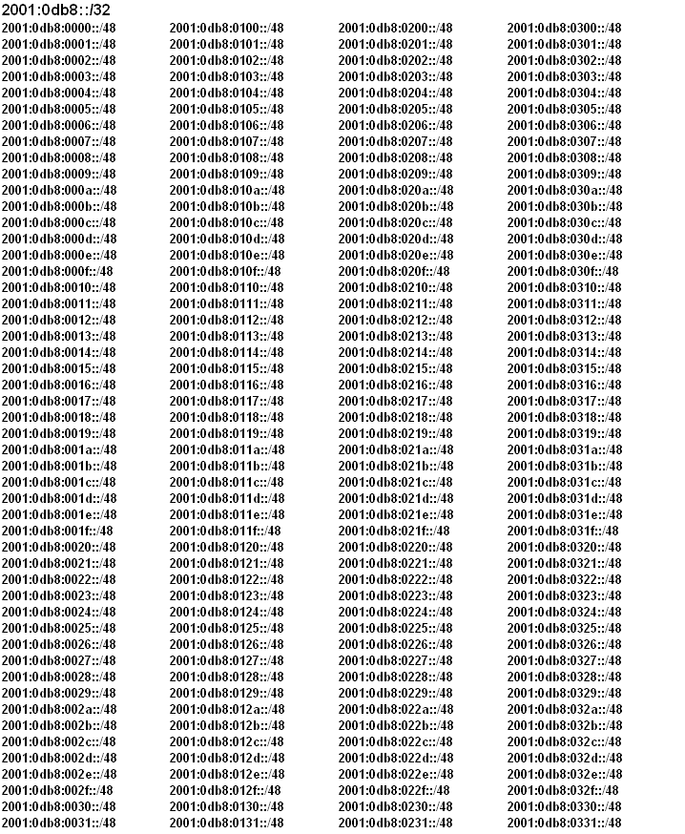

Slide 31
Summary
Vast address space
Hexadecimal addressing
Distinct addressing hierarchy between ISPs, end-sites, and LANs
  ISPs are typically allocated /32s or bigger
  End customers are typically assigned /48s
  LANs have /64s
Other IPv6 features discussed later

Slide 33
The need for Packet Forwarding
Many small networks can be interconnected to make a larger internetwork
A device on one network cannot send a packet directly to a device on another network
The packet has to be forwarded from one network to another, through intermediate nodes, until it reaches its destination
The intermediate nodes are called “routers”

Slide 34
An IP Router
A device with more than one link-layer interface (breaks broadcast domains)
Different IP addresses (from different subnets) on different interfaces
Receives packets on one interface, and forwards them (usually out of another interface) to get them one hop closer to their destination
Maintains forwarding tables and routing information base

Slide 35
IP router - action for each packet
Packet is received on one interface (ingress)
Checks whether the destination address is the router itself – if so, pass it to higher TCP/IP stack layers
Decrement TTL (time to live) and discard packet if it reaches zero (0). TTL value is a single octet and maximum is 255.
Look up the destination IP address in the forwarding table.
Destination could be on a directly attached link, or through another directly connected or remote router.

Slide 36
Forwarding vs. Routing
Forwarding: moving packets between ingress and egress interfaces
  Depends on the forwarding table
  Information is in the packet
Routing: process of building routing maps and giving directions
  One or more routing protocols
  Procedures (algorithms) to convert routing info to forwarding table.
(Much more later …)

Slide 37
Forwarding is hop by hop
Each router makes an independent decision, based on its own forwarding table
Different routers have different forwarding tables and make different decisions
Routers talk routing protocols to each other, to help update routing information and forwarding tables

Slide 38
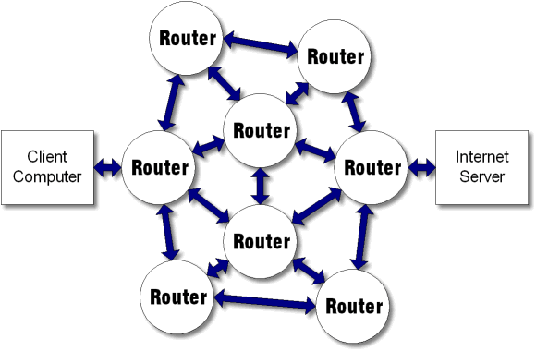
Hop by Hop Forwarding

Slide 39
Router Functions
Determine optimum routing paths through a network
  Lowest delay means shortest path
  Highest reliability
Move packets through the network
  Determine and extermine destination address in packet
  Makes a decision on which port to forward the packet through
  Decision is based on the Routing Table
Interconnected Routers exchange routing tables in order to maintain a clear picture/map of the network
In a large network, the routing table updates can consume a lot of resource (cpu, memory, bandwidth)
  a protocol for route updates is required

Slide 40
Forwarding table structure
Not every IP address on the Internet is listed otherwise the routing/forwarding table would be huge.
Instead, the forwarding table contains ip prefixes (networks or subnetwork)
  "If the first /n bits in the routing table matches this entry, send the datagram that way"
  If more than one prefix matches, the longest prefix wins (more specific routes)
0.0.0.0/0 is "default route" - matches anything, but only if no other prefix matches.

Slide 41
ARP
Continuation

Slide 42
Encapsulation Reminder
Lower layers add headers (and sometimes trailers) to data from higher layers
Application
Data
Transport
Header
Transport Layer Data
Network
Header
Network Layer Data
Network
Header
Header
Data
Data Link
Header
Link Layer Data
Trailer
Data Link
Header
Header
Header
Data
Trailer

Slide 43
Ethernet Essentials
Ethernet is a broadcast medium
Structure of Ethernet frame:
Entire IP packet makes data part of Ethernet frame
Delivery mechanism (CSMA/CD)‏
  back off and try again when collision is detected
Preamble
Dest
Source
Length
Type
Data
CRC

Slide 44
Ethernet/IP Address Resolution
Internet Address
  Unique worldwide (excepting private nets)‏
  Independent of Physical Network technology
Ethernet Address
  Unique worldwide (excepting errors)‏
  Ethernet Only
Need to map from higher layer to lower
(i.e. IP to Ethernet, using ARP)‏

Slide 45
Address Resolution Protocol
ARP is only used in IPv4
  ND (Neighbor Discovery) replaces ARP in IPv6
Check ARP cache for matching IP address
If not found, broadcast packet with IP address to every host on Ethernet
“Owner” of the IP address responds
Response cached in ARP table for future use
Old cache entries removed by timeout

Slide 46
ARP Procedure
1. ARP Cache is checked
5. ARP Entry is added
2. ARP Request is Sent using broadcast
4. ARP Reply is sent unicast
3. ARP Entry is added

Slide 47
ARP Table
IP Address
Hardware Address
Age (Sec)
192.168.0.2
08-00-20-08-70-54
3
192.168.0.65
05-02-20-08-88-33
120
192.168.0.34
07-01-20-08-73-22
43

Slide 48
Types of ARP Messages
ARP request
  Who is IP addr X.X.X.X tell IP addr Y.Y.Y.Y
ARP reply
  IP addr X.X.X.X is Ethernet Address hh:hh:hh:hh:hh:hh
  An ARP announcement is not intended to solicit a reply; instead it updates any cached entries in the ARP tables of other hosts that receive the packet.

Slide 49
Asante Sana
Any ????

