Slide 1
Hypertext Transfer Protocol
Dr. Ian Kropp

Slide 2
Topics for these upcoming lessons
Client/Server Architecture
Request-Response Model
Methods
URI (Uniform Resource Identifier)
Status Codes
Headers
Cookies
Caching
Security

Slide 3
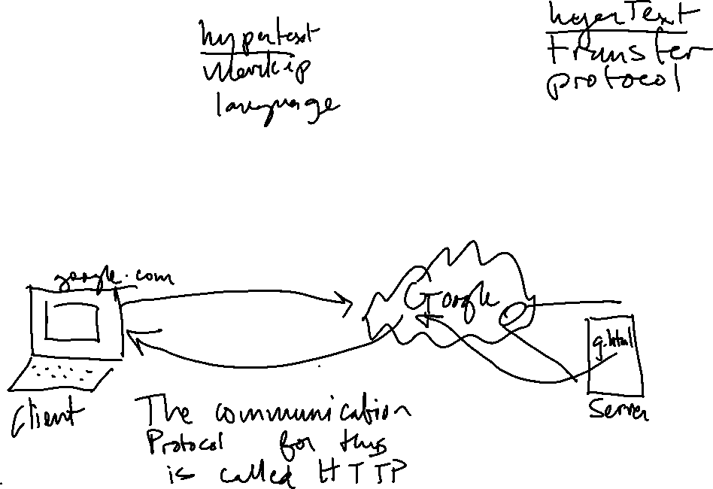
Context
So far, we’ve been clicking on somefile.html
But when we go to www.google.com, or www.mozilla.org, how do we get the html file?
Client/server architecture:

Slide 4
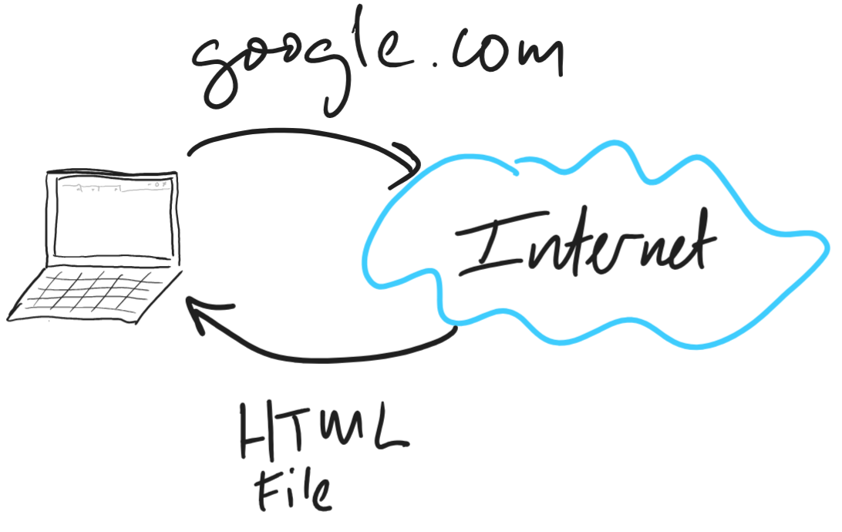
Context
So far, we’ve been clicking on somefile.html
But when we go to www.google.com, or www.mozilla.org, how do we get the html file?

Slide 5
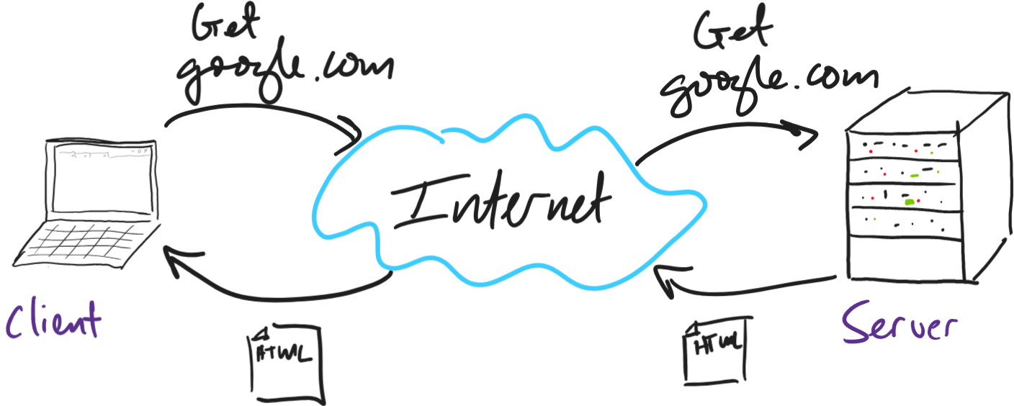

HTTP
The file comes from another computer!
Client/server architecture
The client and server use a protocol to talk
The protocol is the HyperText Transfer Protocol (HTTP)

Slide 6
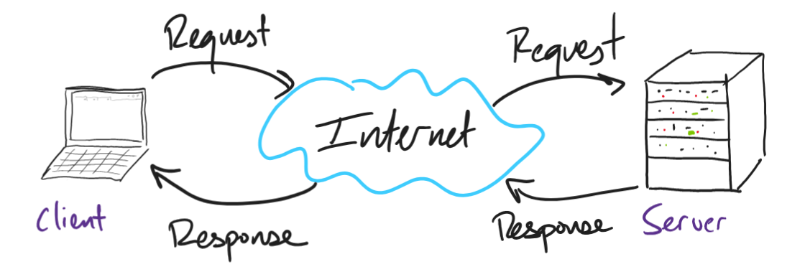
HTTP
The file comes from another computer!
Client/server architecture
The client and server use a protocol to talk
The protocol is the HyperText Transfer Protocol (HTTP)

Slide 7
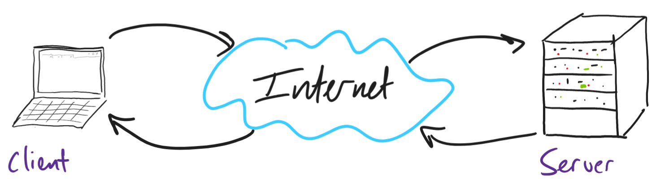
Request/response model concepts
Method
Uniform Resource Identifier
Headers
Body

Slide 8
HTTP methods
Method | Description
GET | Request a resource from the server
POST | Update resource on the server
PUT | Idempotent update resource on the server
DELETE | Delete resource
PATCH | Partially modify a resource
OPTIONS | Describe communication options for resources
CONNECT | Creates a tunnel with a requested resource
TRACE | Tests the path for the target resources

Slide 9
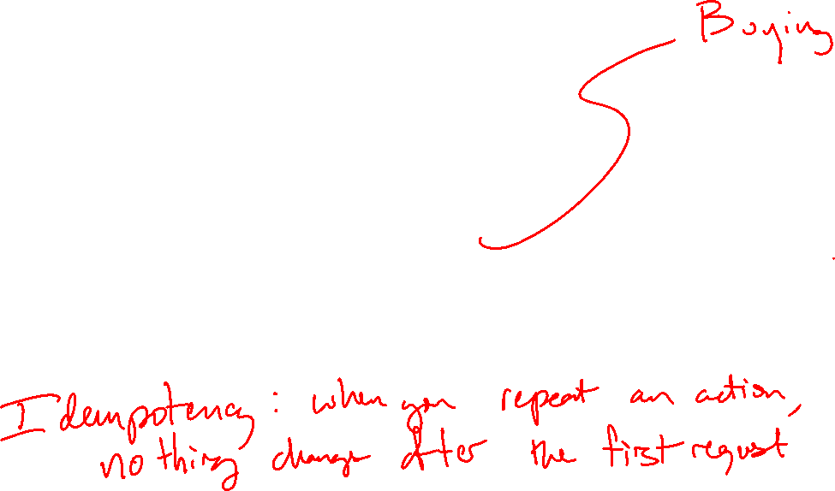
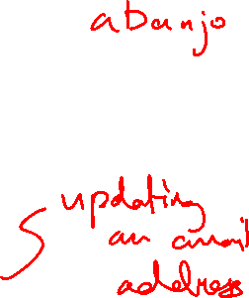
HTTP methods
Method | Description
GET | Request a resource from the server
POST | Update resource on the server
PUT | Idempotent update resource on the server
DELETE | Delete resource

Slide 10
Uniform Resource Identifier
When you type in a URI in to the browser, you’re giving the server a lot of information
https://www.amazon.com/How-Write-One-Song-Loving/dp/0593183525?ref=sr_1_1&keywords=jeff+tweedy+how+to+write+one+song&qid=1678270768&sprefix=jeff+tweedy+%2Caps%2C105&sr=8-1

Slide 11
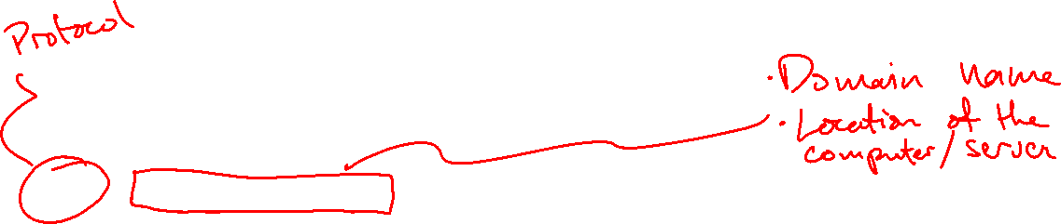
Uniform Resource Identifier
https://www.amazon.com/How-Write-One-Song-Loving/dp/0593183525?ref=sr_1_1&keywords=jeff+tweedy+how+to+write+one+song&qid=1678270768&sprefix=jeff+tweedy+%2Caps%2C105&sr=8-1

Slide 12

Uniform Resource Identifier
https://www.amazon.com
/How-Write-One-Song-Loving/dp/0593183525?ref=sr_1_1&keywords=jeff+tweedy+how+to+write+one+song&qid=1678270768&sprefix=jeff+tweedy+%2Caps%2C105&sr=8-1

Slide 13
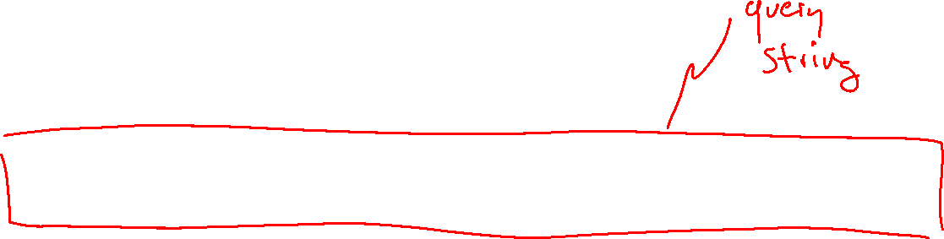
Uniform Resource Identifier
https://www.amazon.com
/How-Write-One-Song-Loving/dp/0593183525
?
ref=sr_1_1&keywords=jeff+tweedy+how+to+write+one+song&qid=1678270768&sprefix=jeff+tweedy+%2Caps%2C105&sr=8-1

Slide 14
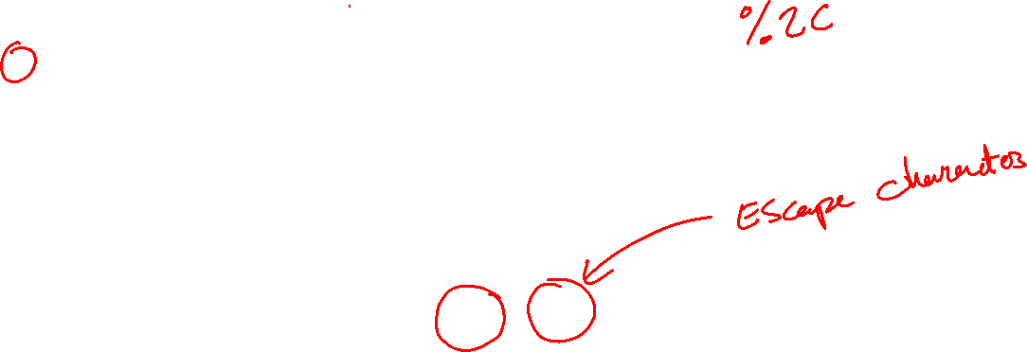

Uniform Resource Identifier
https://www.amazon.com
/How-Write-One-Song-Loving/dp/0593183525
?
ref = sr_1_1
&
keywords = jeff+tweedy+how+to+write+one+song
&
qid = 1678270768
&
sprefix = jeff+tweedy+%2Caps%2C105
&
sr = 8-1

Slide 15
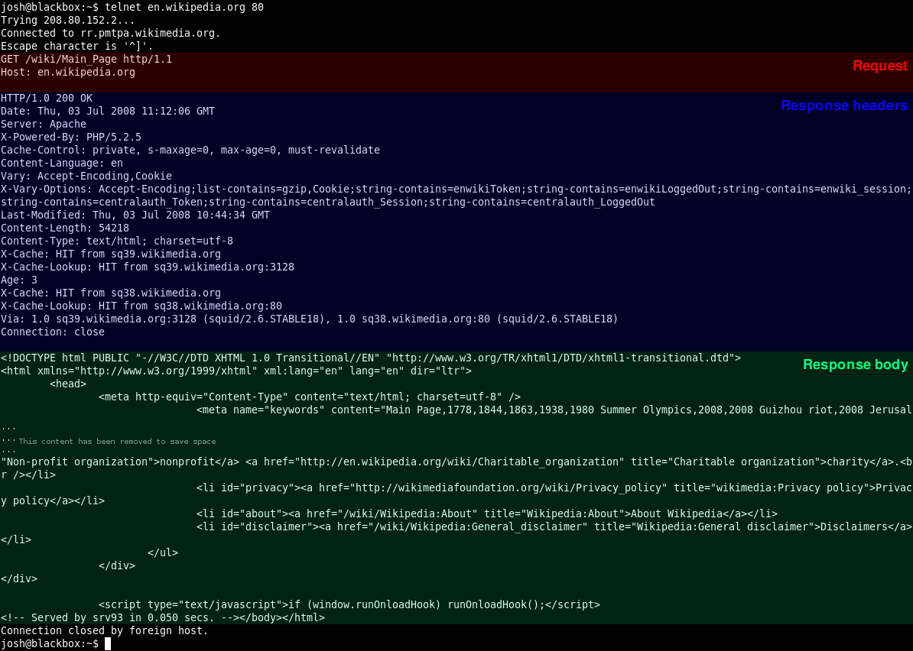
Response headers and body

Slide 16
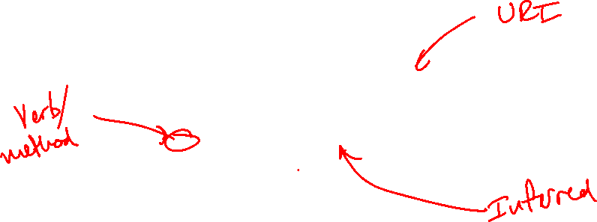
Response headers and body
The browser (or telnet in this example) translates your URI to a formal HTTP request
How will the server respond?

Slide 17
Response headers and body

Slide 18
Response headers and body

Slide 19
HTTP Status Codes
The HTTP status code tells the client whether the request was successful or not.
Common examples:
200: OK
301: Permanent redirect
404: Not found
500: Internal server error

Slide 20
Demo

Slide 21
Cookies
Why cookies?
The request/response cycle by default is stateless
In other words, without cookies, we could not:
Stay logged in to websites
Keep personalization on websites
Track user activies on the web

Slide 22
Cookies
What is a cookie?
Typically, a state information that a server gives a browser
The browser can use this information to:
Determine if a given browser is logged in or not
Personalize the website for the user
Track individuals on the website

Slide 23
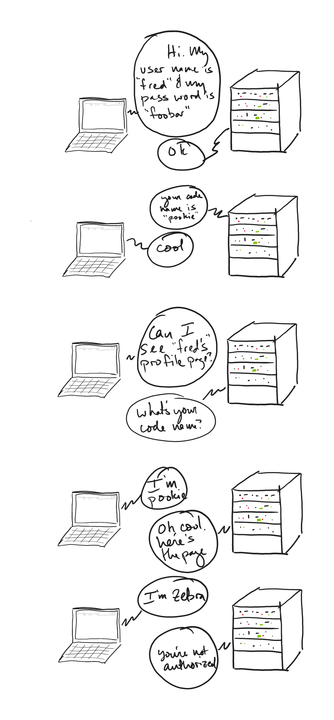
Simplified cookie example 1: Authorized session
Step 1: Client logs in

Slide 24
Simplified cookie example 1: Authorized session
Step 2: Server issues a session cookie with the value of “pookie”

Slide 25

Simplified cookie example 1: Authorized session
Step 3: Client requests a private web page for its current log-in session

Slide 26
Simplified cookie example 1: Authorized session
Step 4: The server receives the session cookie, which is “pookie,” and provides the website.

Slide 27

Simplified cookie example 2: Unauthorized session
Step 1: A client tries to access “fred’s” private admin page

Slide 28
Simplified cookie example 2: Unauthorized session
Step 2: Access is denied because the malicious client doesn’t know the session cookie

Slide 29
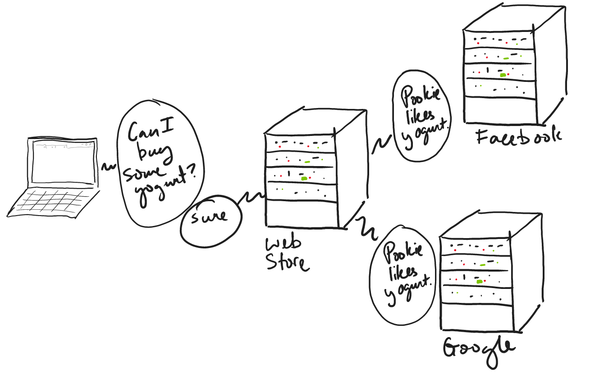
Simplified cookie example 3: User tracking
Step 1: Client performs some action online

Slide 30
Simplified cookie example 3: User tracking
Step 2: Server uses the cookie session information to share this action with third parties

Slide 31
Cookie Demo

Slide 32
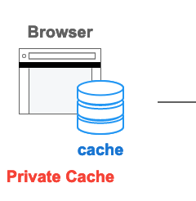

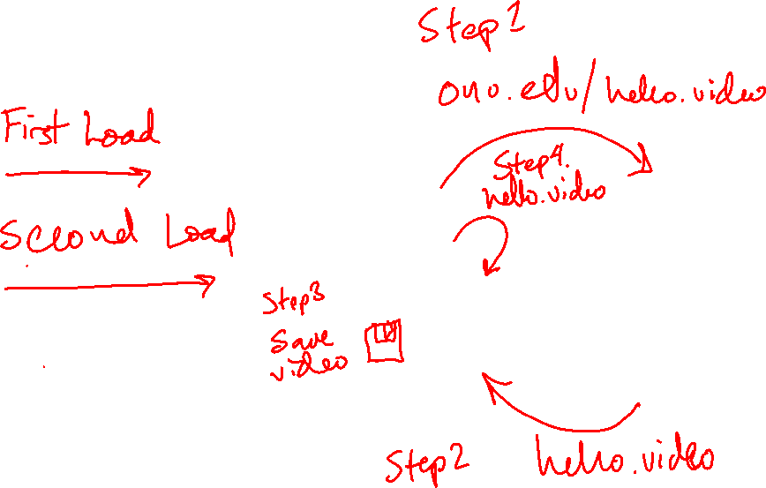

Caching
Image credit https://developer.mozilla.org/en-US/docs/Web/HTTP/Caching

Slide 33
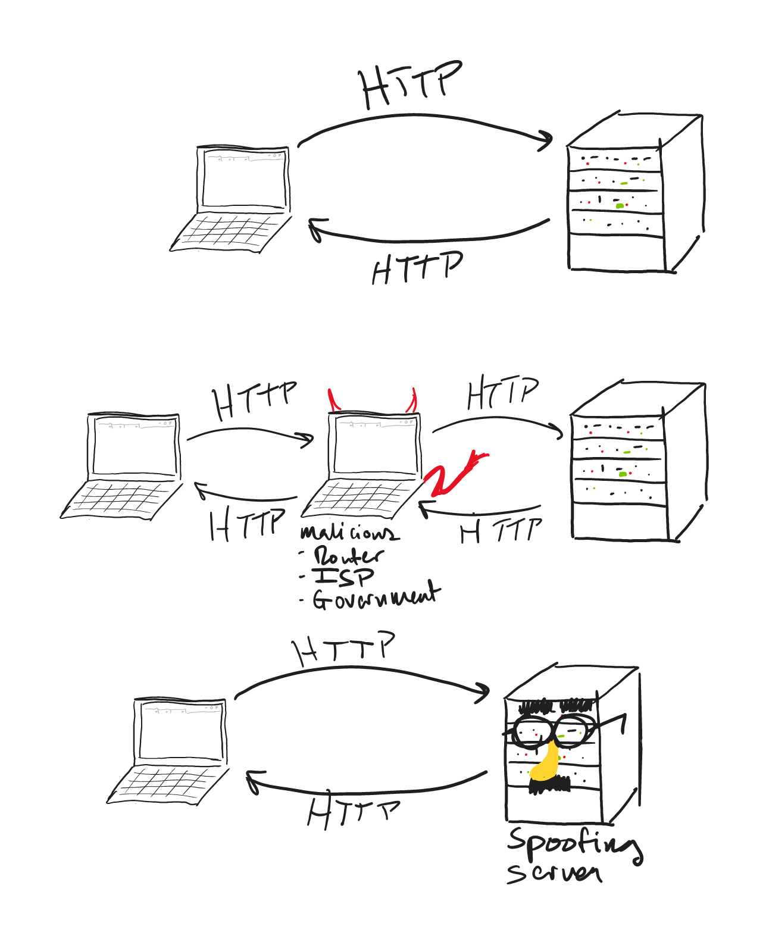
Security issues with HTTP
HTTP is sent through plain text files

Slide 34
Security issues with HTTP
Issue 1: malicious actors could tap into the network to eavesdrop
This can compromise:
Personal information
Password
Credit cards

Slide 35
Security issues with HTTP
Issue 2: A webserver could impersonate the website you’re trying to access

Slide 36



HTTPS
A secure (i.e., encrypted) connection is made between the client and the server
A secure connection is only made if the server is verified

Slide 37


HTTPS: Benefits
1. Eavesdroppers cannot understand the encrypted connection between the client and server
???

Slide 38


HTTPS: Benefits
2. If a server is trying to impersonate another server, it will be flagged

