Slide 1



Bigtable vs. PNUTS
Battle of the databases
By: Orkun Krand

Slide 2
Lingo
Row range = Tablet
Chubby: Distributed Lock Service
SSTable: File format used to store Bigtable data
GFS: Google File System
MapReduce: Parallel computation framework

Slide 3

Bigtable: A Distributed Storage System for Structured Data
Row
Up to 64KB in size, usually 10-100 bytes
Lexicographic order by row
Column
Column keys → Column families → Locality Group
Data in column families are the same type
3D Indexing!

Slide 4
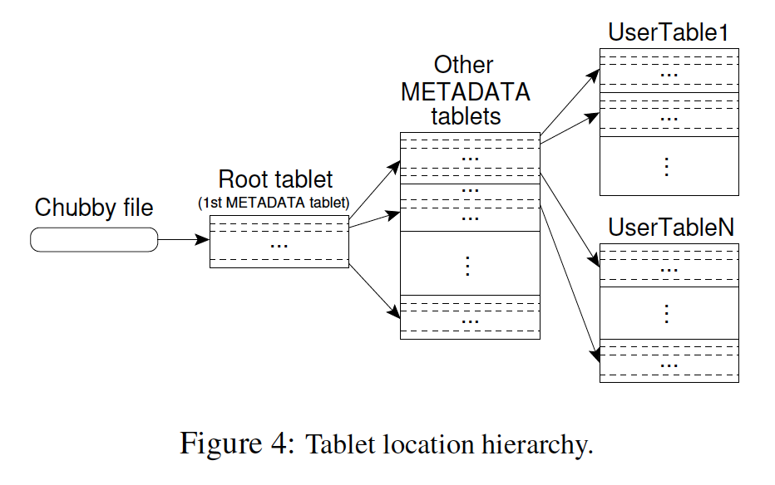
Chubby
Keeps track of tablets
Master: Assigns tablets to tablet servers
Tablet server: Manages tablets (10-1000)
Tablet servers can communicate with clients, skipping master
Figure 4: Chang (2006)
Notes:
The first level is a file stored in Chubby that contains
the location of the root tablet . The root tablet contains
the location of all tablets in a special METADATA table.
Each METADATA tablet contains the location of a set of
user tablets. The root tablet is just the first tablet in the
METADATA table, but is treated specially. it is never
split to ensure that the tablet location hierarchy has no
more than three levels.

Slide 5
Compaction
Memtable: Contains recently committed updates
Kept in memory
Minor compaction
Replacing memtable to limit memory usage
Write old memtable to GFS(SSTable)
Major Compaction
Merge SSTables into one

Slide 6
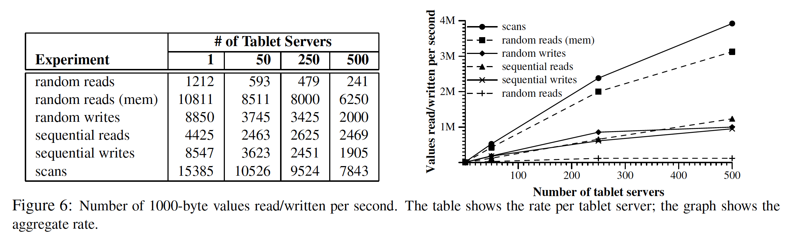
Performance
Bottleneck: Individual tablet server CPU
Load isn’t perfectly balanced (not linear increase)
Figure 6: Chang (2006)

Slide 7
Lessons
Different types of failures
Don’t add features until you know how it will be utilized
Not every idea is a good idea
Monitoring is key
Chubby knows everything
Helps see improvement opportunities
Simple designs!!

Slide 8
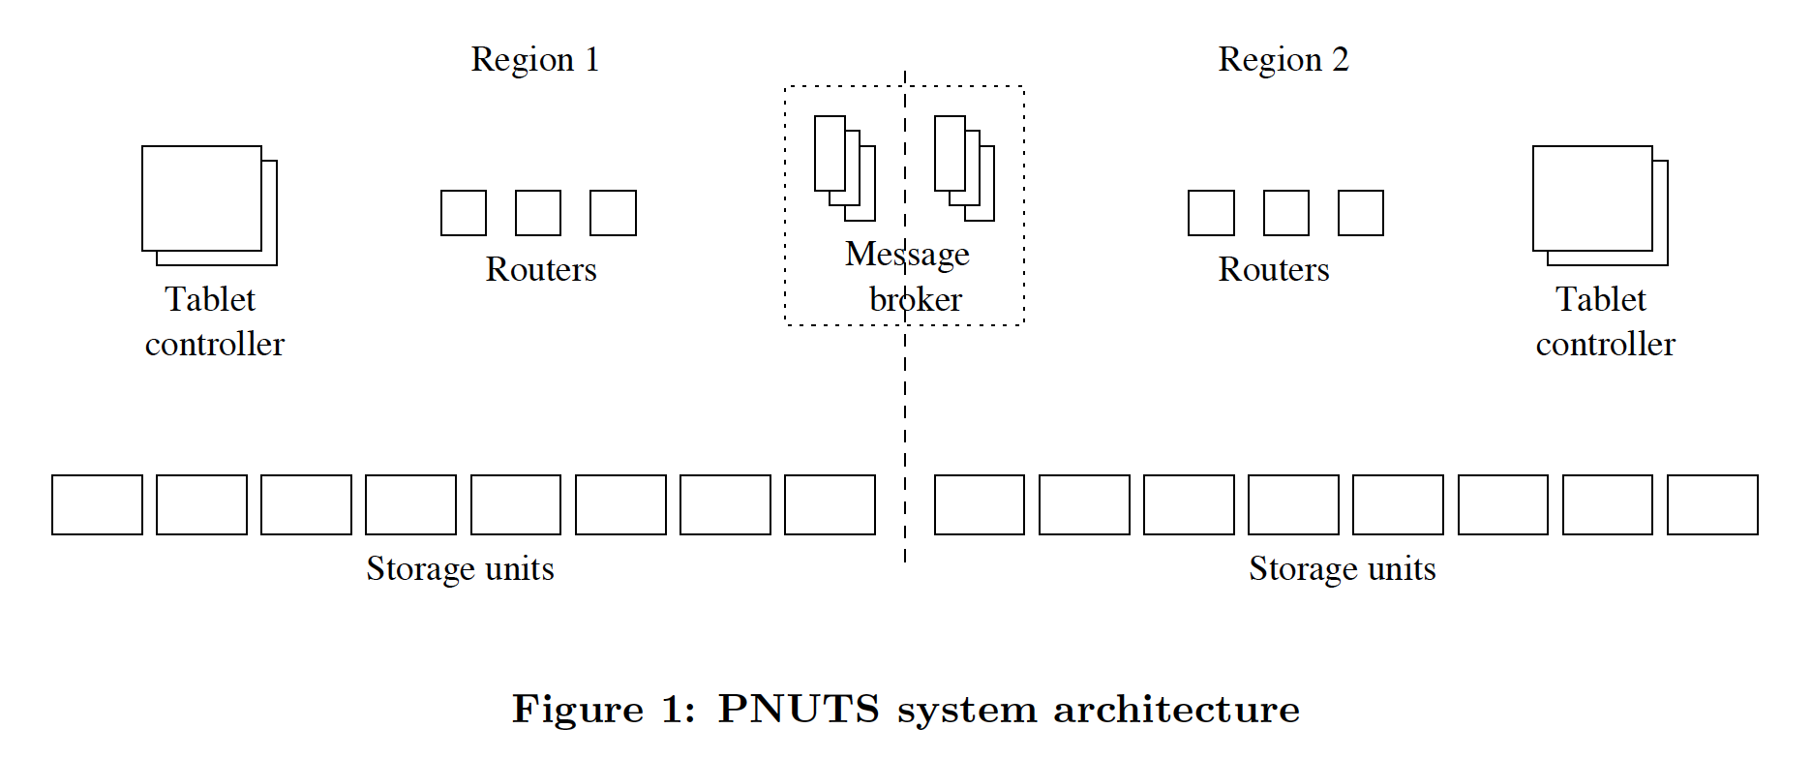
PNUTS
Massive-scale, hosted database system to support Yahoo!’s web applications
Relational model ☹
Pub/sub ☺
Future work includes implementing Hadoop, similar to MapReduce used by BigTable
Figure 1: Cooper (2008)

Slide 9
Asynchronous Replication
Yahoo! Message Broker
Pub/sub
Commited when received
Stays in YMB until all replicas receive update
No single master

Slide 10
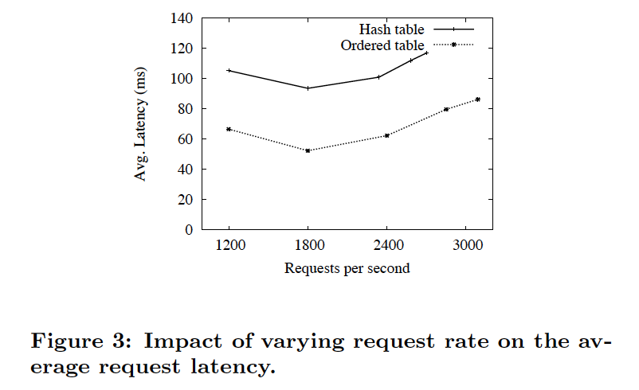
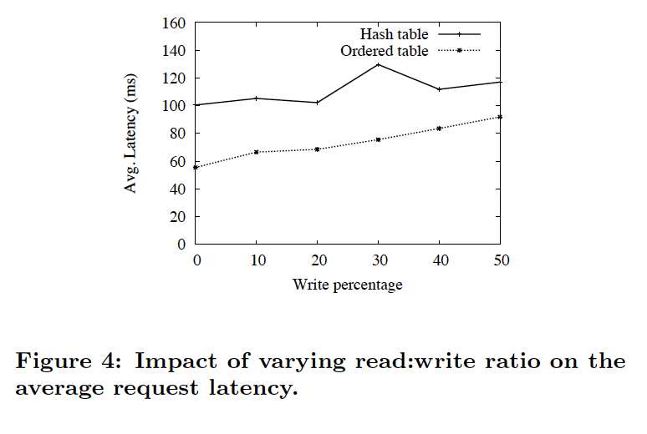
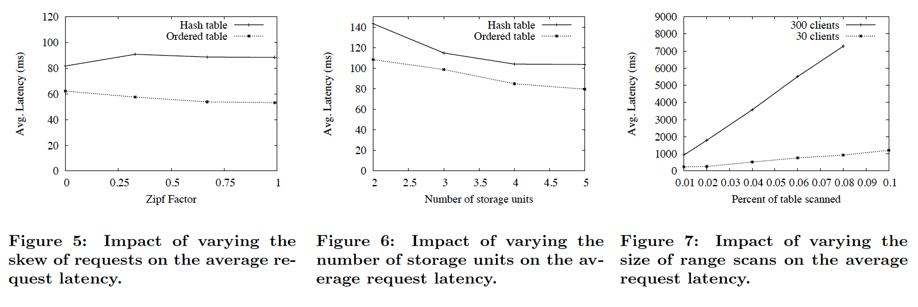
Performance
3 regions
1 in east U.S., 2 in west
Testing avg. latency

Slide 11
Applications
Google Analytics
Google Earth
Personalized Search
Orkut
User Database
Yahoo! Users
Social applications
Content Meta-Data
Listings Management
Session Data

Slide 12
Overall
Chubby
Not relational
Compaction
Compression
Caching
Bloom filters
Asynchronous replication
Geographic replication
Secondary indexes
Materialized views
Creating multiple tables
Hash-organized tables

