Slide 1
Leuski, Anton, and Victor Lavrenko. "Tracking dragon-hunters with language models." Proceedings of the 15th ACM international conference on Information and knowledge management. ACM, 2006.
Li, Wen, et al. "The where in the tweet." Proceedings of the 20th ACM international conference on Information and knowledge management. ACM, 2011.
Orkun Krand
CS734 – Introduction to Information Retrieval

Slide 2
Tracking dragon hunters with language models
Leuski, Anton, and Victor Lavrenko. "Tracking dragon-hunters with language models." Proceedings of the 15th ACM international conference on Information and knowledge management. ACM, 2006.
MMORPG: Massively Multiplayer Online Role-Playing Game
Language modeling: Machine learning with text
What can we learn from in-game chats?
Given a press release, can we detect a change in the stock prices?

Slide 3
Contributions
Analyze and model the relationship between a stream of activities and text generated in regard to those activities using statistics
Using MMORPG as a test bed since all the data is recorded
Using language modeling to discover various information about this new domain

Slide 4
Why MMORPG?
Massive user base (35-40 million people)
Not one-on-one
Large and collaborative environment
Well developed economy rules
People (players) need to organize and perform actions together
Variety of interactions with other players
Chat (friends, guild members, teaming up)
Player actions: gestures, trading goods, giving orders
Good model of social processes in real world
Notes:
Goods and accounts can be sold on ebay
Good model of social processes in real world

Slide 5
Research Goals
Activity detection: Predict activity (time, place, type) given messages
Player forensics: Predict participants given time, and messages
Investigative search: Find relevant messages given activity (Left for future work)
World mapping: Given all messages from all players, locate players

Slide 6
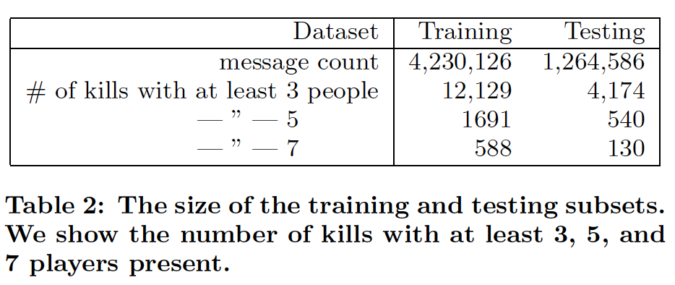
Experimental Data
5.5M messages
284.7K unique terms
19,144 unique login names
Table 2 (Leuski)

Slide 7
Activity Detection
Given messages, guess the time and locations of all activities of type A
Activity specific language models (training)
Clustering messages indexed by time and location
Label clusters with activities happened in that time and location
Detection (testing)
Cluster messages
Using the language models to determine activity metadata

Slide 8
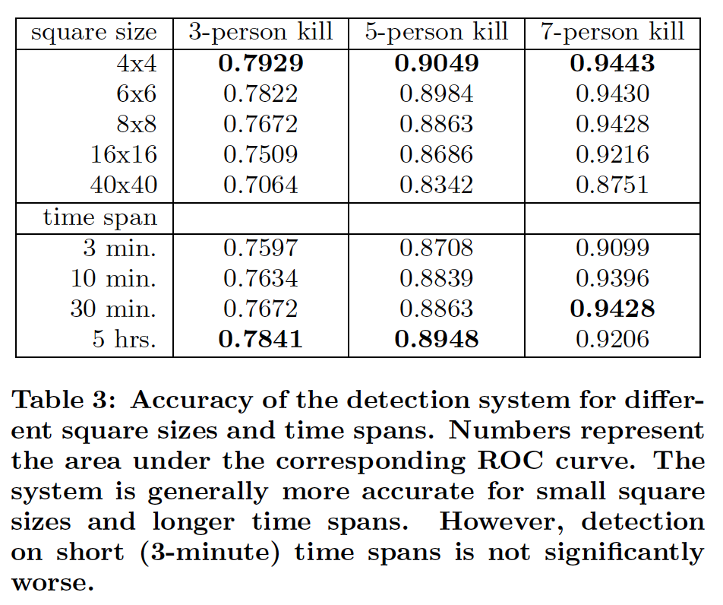
Activity Detection Evaluation
Table 3 (Leuski)
Notes:
Detecting the time and location of event accuracy in percentage. Probability that it will happen in the next 5 hours is very high (obviously). ROC = Receiver Operating Characteristic

Slide 9
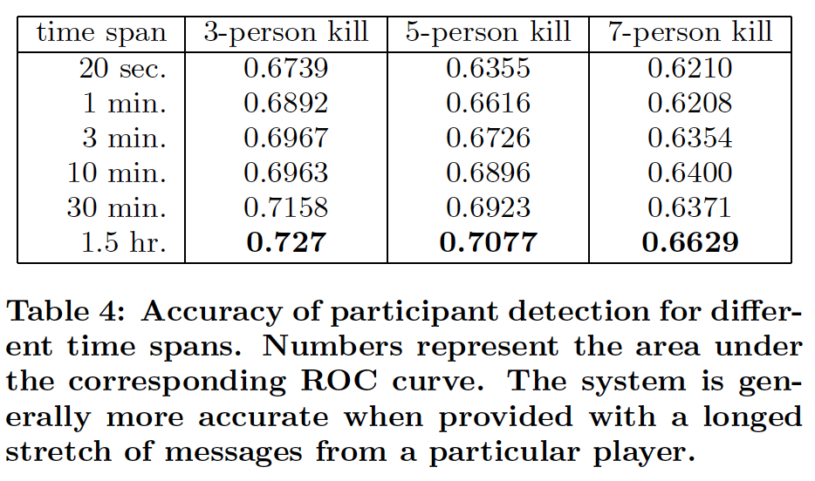
Player Forensics
Find players involved in an activity given time and messages (no location)
Table 4 (Leuski)

Slide 10
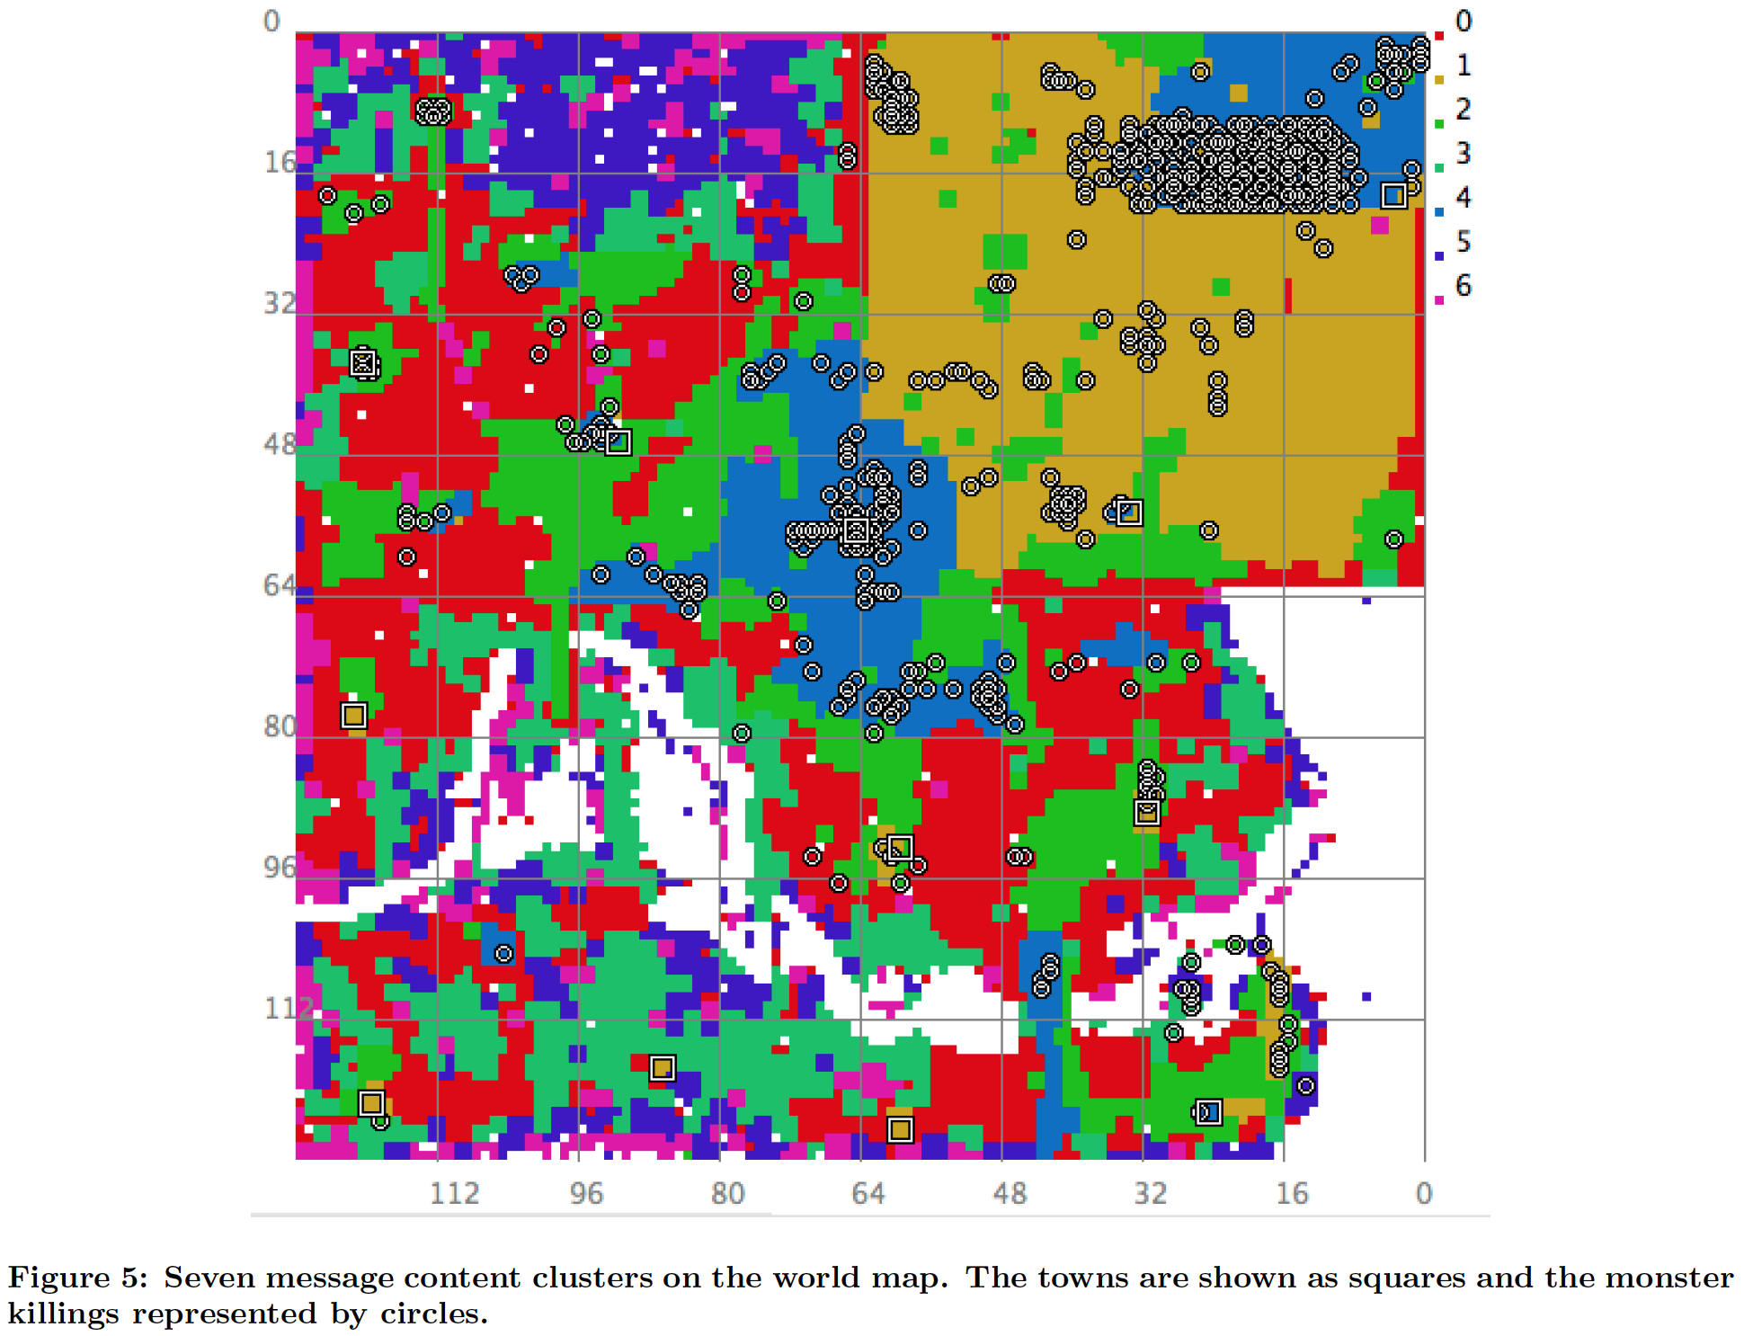
World Mapping
Figure 5 (Leuski)
Notes:
100 clusters total. Cluster world into regions by messages. Show 6 largest and the rest is the 7th. White has no messages. Circles correlate with light blue (killings) squares are towns

Slide 11
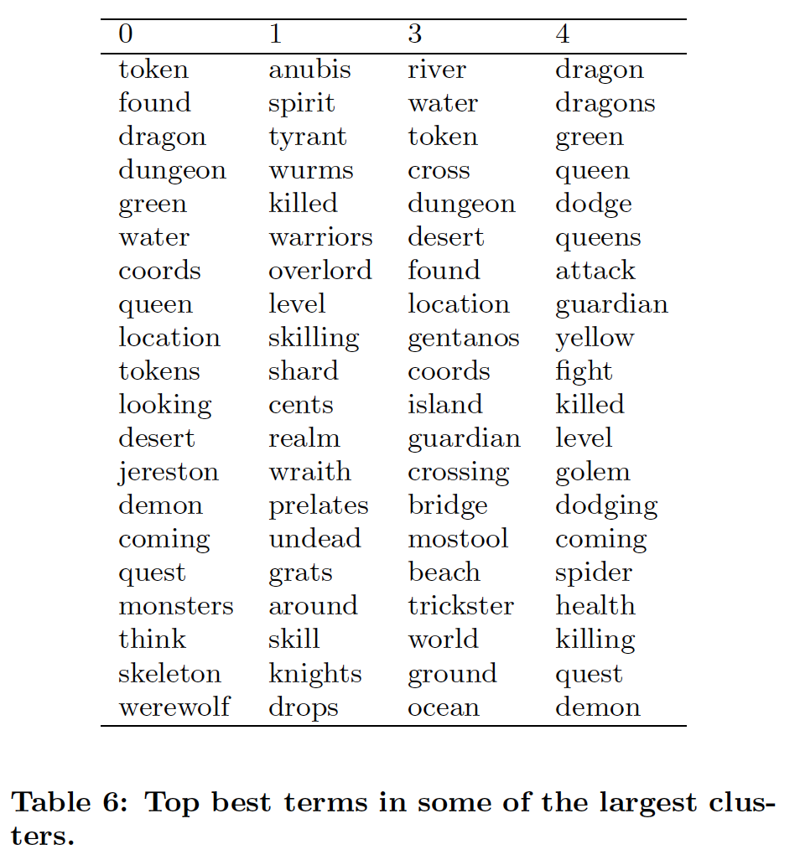
World Map Clusters
Cluster 0: Exploratory game activities
Cluster 1: Spirit Realm and monsters that inhabit it
Cluster 3: River and oceanside
Cluster 4: Fighting and monster kills
Table 6 (Leuski)

Slide 12
Conclusions
Can detect the location and time of an activity that involves a large number of people solely from analyzing chat
Can detect some players in an activity by analyzing chat
Can cluster spatial layout by analyzing chat
Statistical language modeling in a new domain

Slide 13
The Where in the Tweet
Li, Wen, et al. "The where in the tweet." Proceedings of the 20th ACM international conference on Information and knowledge management. ACM, 2011.
Locate users from tweets (text and time)
Predict POI tags (Point of Interest)
Use search engines to improve predictions
Social function of a place can be represented via language models
Rank POIs according to the tweet

Slide 14
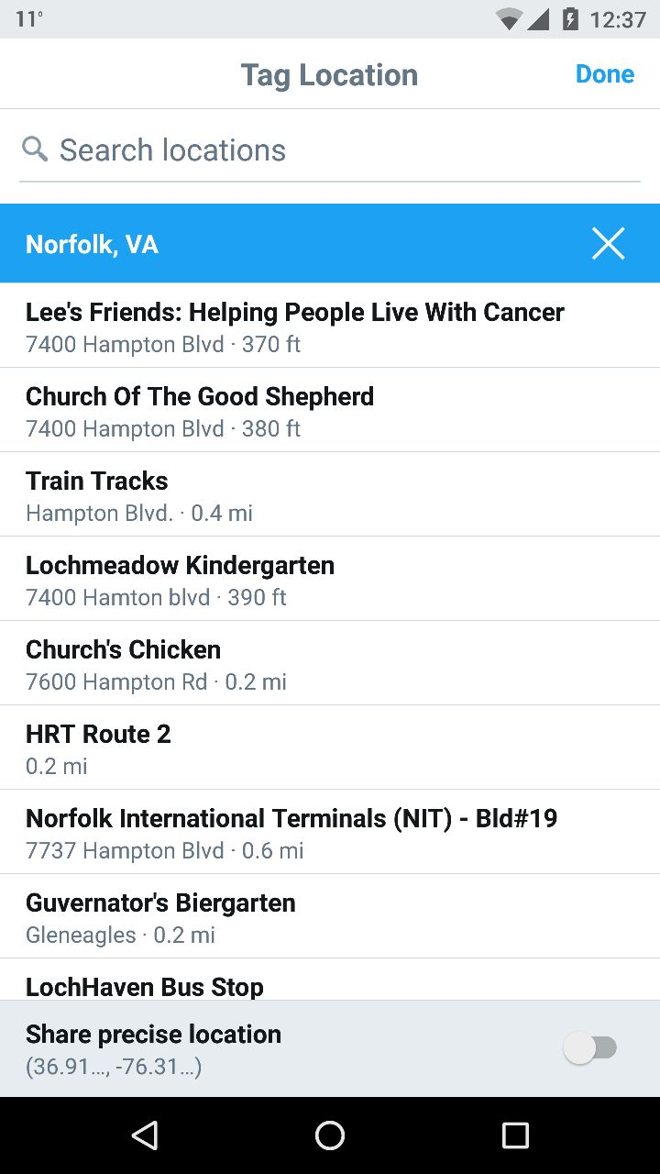
Experiment
700K tweets
177.8K POIs
52,488 users
4 big cities in the USA (Chicago, Los Angeles, New York, and San Francisco)
10 most popular POIs from each city with 100 - 400 tweets each
Query the POI names against Microsoft Bing and collect the textual information of the top 30 results
Language model built from tweets

Slide 15
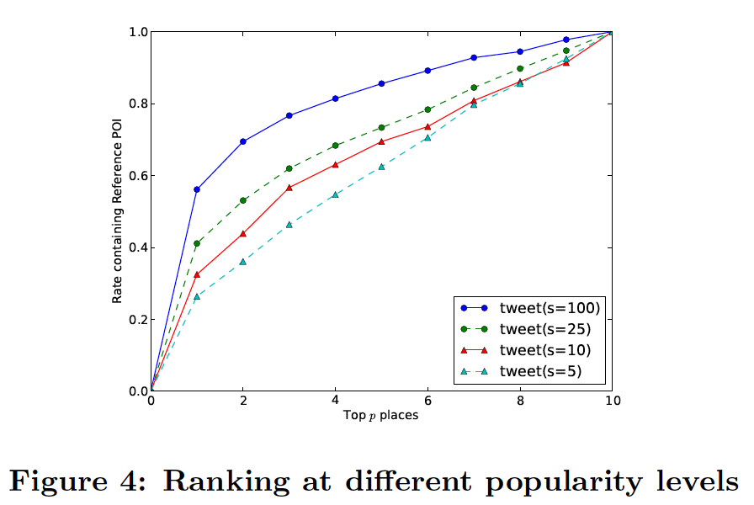
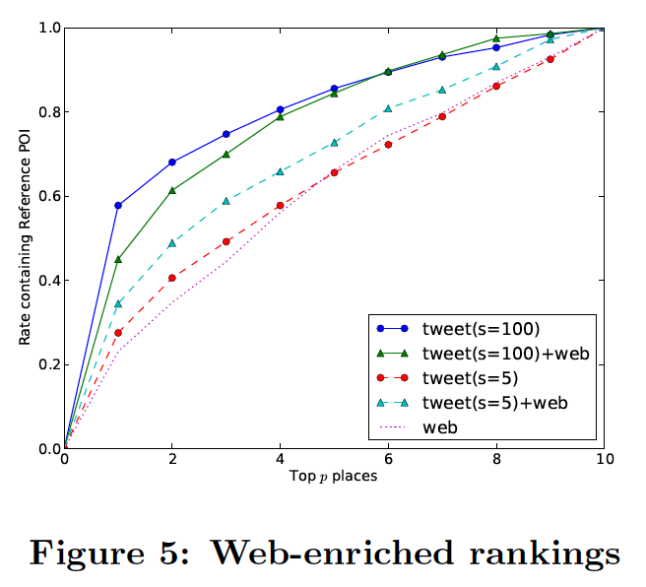
Experiment Results
Figures 4 & 5 (Li)

Slide 16
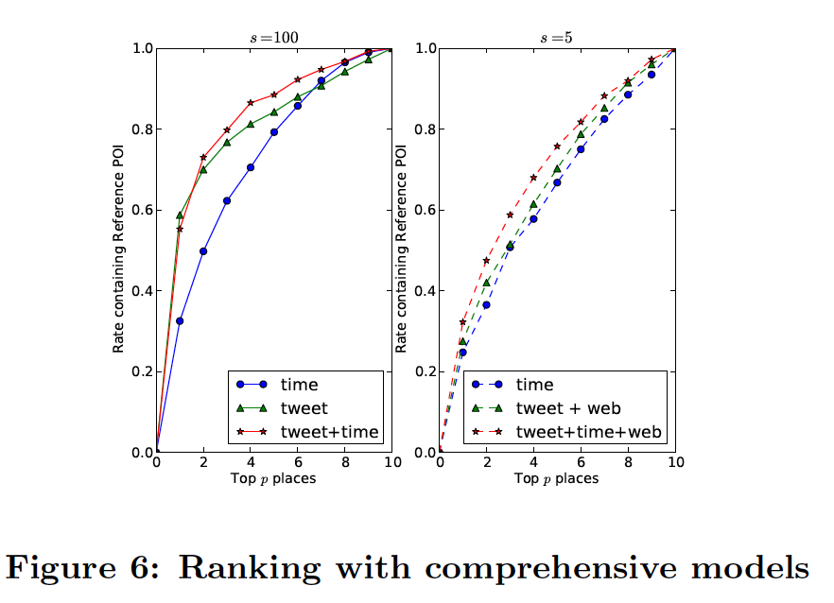
Experiment Results
Figure 6 (Li)

Slide 17
Conclusion
Using a ranking approach and language models allows the prediction of POIs based on tweets
For POIs that don’t have enough tweets (s=5), web-enriched models boost ranking performance but hurts it when there are enough tweets (s=100)
Time information boost ranking performance

Slide 18
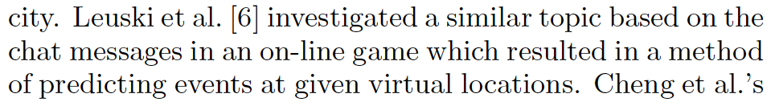
Why Cite The First Paper?
Background and Related Work (Li)
Similar topic
Learning metadata from textual and temporal data

