Slide 1
Doug Beeferman and Adam Berger. 2000. Agglomerative clustering of a search engine query log. In Proceedings of the sixth ACM SIGKDD international conference on Knowledge discovery and data mining (KDD '00). ACM, New York, NY, USA, 407-416.
Thorsten Joachims. 2002. Optimizing search engines using clickthrough data. In Proceedings of the eighth ACM SIGKDD international conference on Knowledge discovery and data mining (KDD '02). ACM, New York, NY, USA, 133-142.
Orkun Krand
CS734 – Introduction to Information Retrieval

Slide 2
Agglomerative clustering of a search engine query log
Doug Beeferman and Adam Berger. 2000. Agglomerative clustering of a search engine query log. In Proceedings of the sixth ACM SIGKDD international conference on Knowledge discovery and data mining (KDD '00). ACM, New York, NY, USA, 407-416.
Record: Query + URL
Crowdsource URL similarity
Content is irrelevant

Slide 3
Content-Ignorance
Advantages:
Faster: Requires smaller database
Text-free pages (YouTube)
Pages with restricted-access (LeoOnline)
Pages with dynamic content (News websites)
Efficient: Simple algorithm

Slide 4
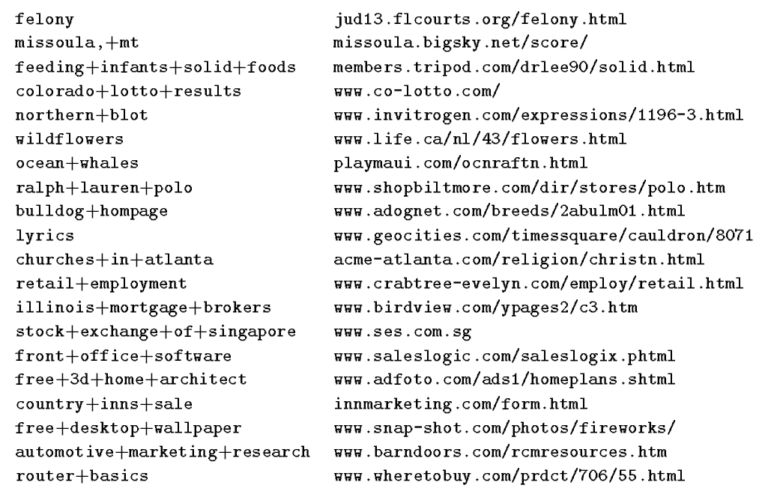
Clickthrough Data
Search engines can collect information about the user (name, IP, browser, resolution, location)
No preprocessing
Table 1 (Beeferman)

Slide 5
Clustering URLs
Grouping related URLs
Creating a user specific profile of interesting pages
Performed by humans
Hierarchical Agglomerative Clustering (HAC)
Find the closest two documents and merge them
Difference from HAC: Content-ignorant

Slide 6
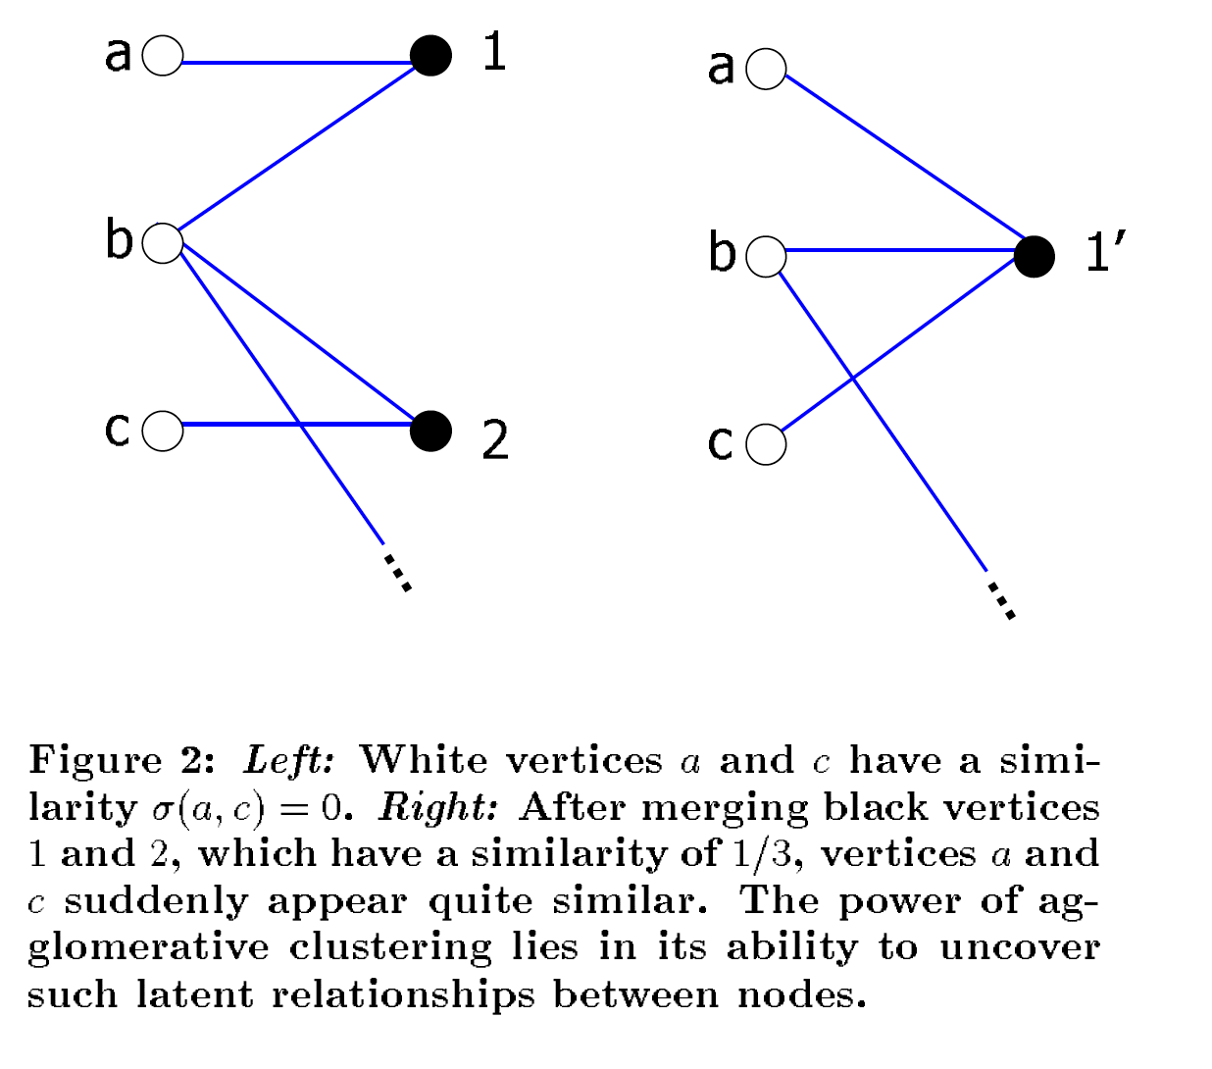
Agglomerative Clustering
Figure 2 (Beeferman)

Slide 7

Clustering Queries
Figure 1 (Beeferman)

Slide 8
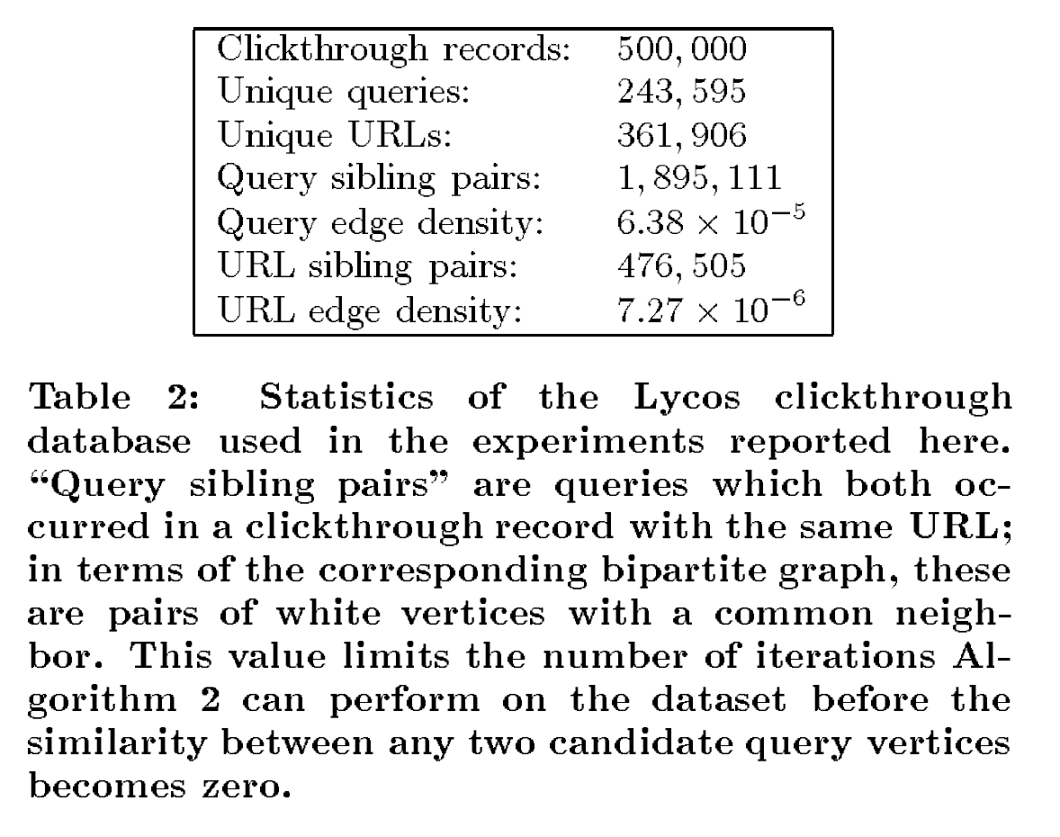
Experiment Database
Table 2 (Beeferman)

Slide 9
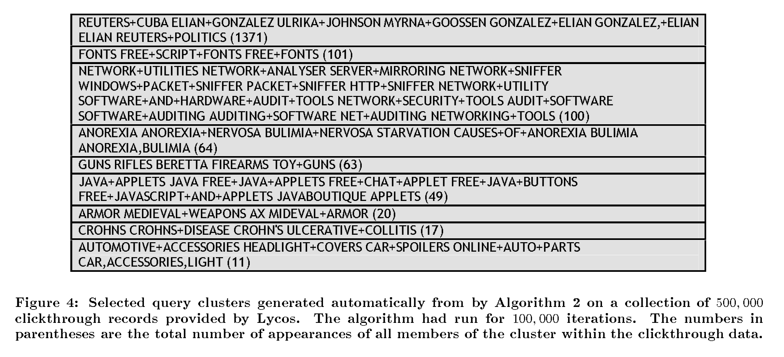
Query Clusters
Figure 4 (Beeferman)

Slide 10
Methods to Build Suggestion Lists
Baseline: standard Lycos algorithm
Data intensive
Can’t track new topics of interest (EFI <-> Motorcycles)
Full replacement
Only applies to queries whose words are in one cluster
Hybrid
Replace the lowest ranked baseline algo suggestions with best clustering based suggestions

Slide 11
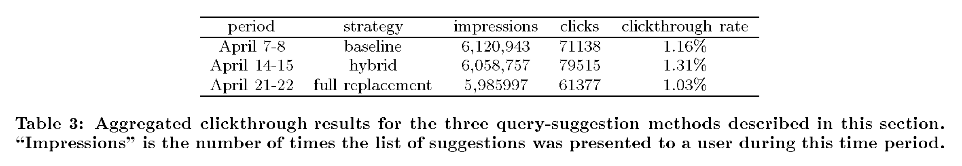
Results
Table 3 (Beeferman)
Hybrid is best? Depends on the query
Baseline better when searching known, high-traffic queries (airlines)
Clustering better when trying to search a new term (tropical fish)

Slide 12
Optimizing search engines using clickthrough data
Thorsten Joachims. 2002. Optimizing search engines using clickthrough data. In Proceedings of the eighth ACM SIGKDD international conference on Knowledge discovery and data mining (KDD '02). ACM, New York, NY, USA, 133-142.
Learn from user clickthrough data (q, r, c) to improve retrieval functions
Ranking SVM changes the ranking function
Notes:
Query, Ranking presented to the User, The links the user clicked on

Slide 13
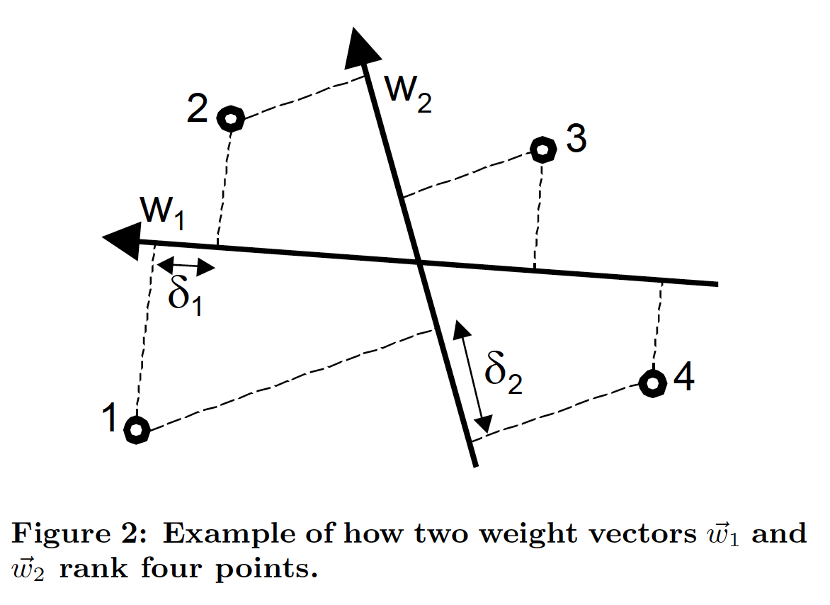
Ranking SVM
Figure 2 (Joachims)

Slide 14
Experiment
Striver: Meta-search engine that gets results from Google, MSNSearch, Excite, Altavista, and Hotbot
Top 50 links are presented to the user post processing
User clicks are collected using a proxy system

Slide 15
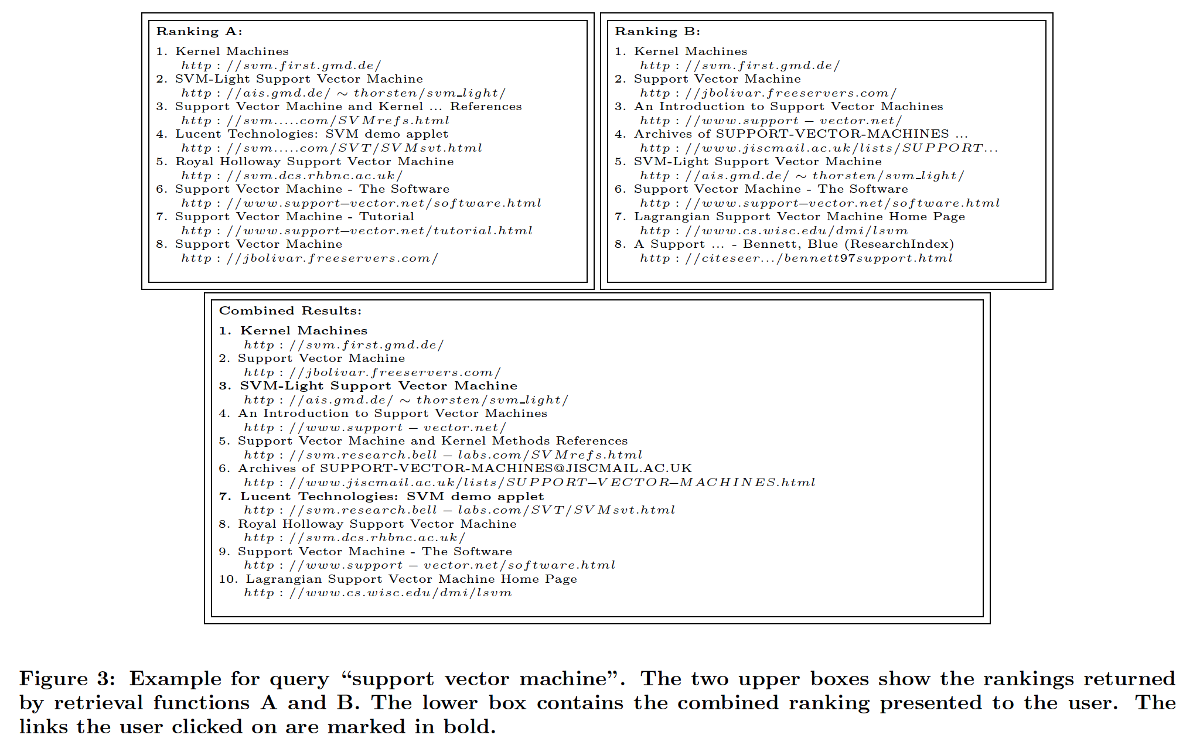
Ranking SVM
Figure 3 (Joachims)

Slide 16
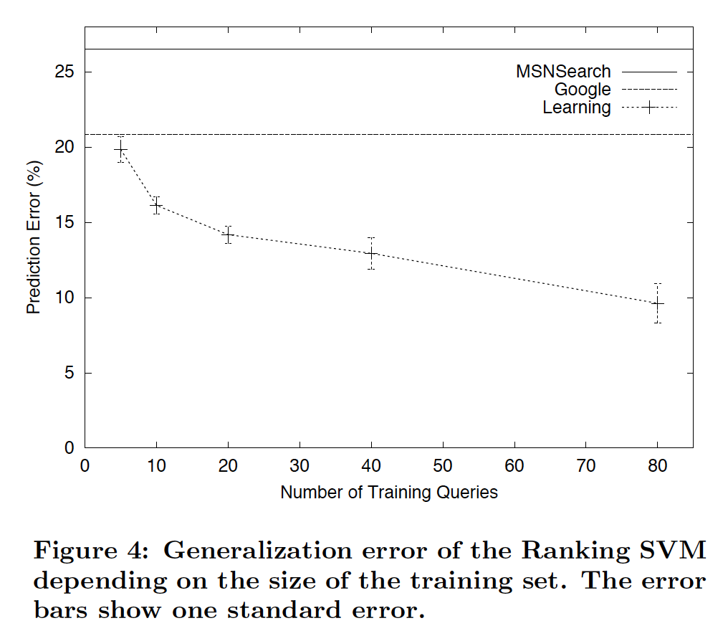
Predictive Performance of SVM
Figure 4 (Joachims)

Slide 17
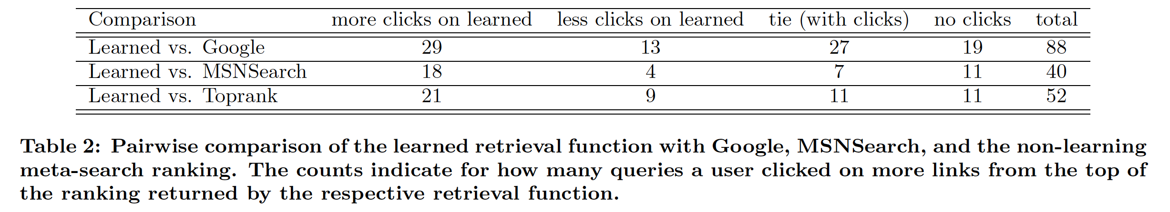
Online Experiment
Training data: 20 users, 260 queries in 20 days
Evaluation: Comparing against Google, MSNSearch, and Toprank (meta-search engine)
Table 2 (Joachims)
Notes:
Toprank ranks things based on their rankings in the search engines. First the rank 1s from each search engine, than rank 2s and so on

Slide 18
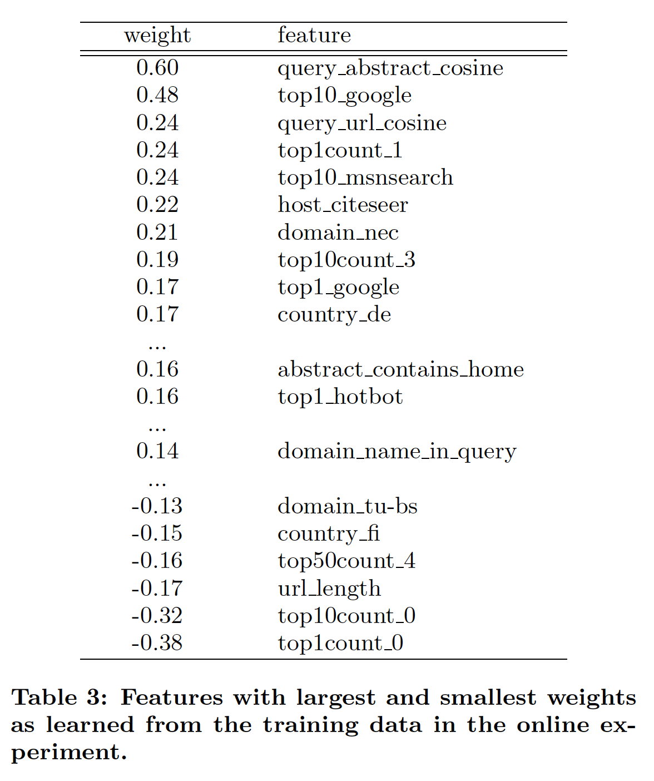
Feature Weights
Table 3 (Joachims)

Slide 19
Why Cite The First Paper?
Build support for their reasoning for using clickthrough data
Show that clickthrough data has more than one application and is proven to be useful to improve search engines
End goal is to improve search engines

