Slide 1
Ben Carterette, James Allan, and Ramesh Sitaraman. 2006. Minimal test collections for retrieval evaluation. In Proceedings of the 29th annual international ACM SIGIR conference on Research and development in information retrieval (SIGIR '06). ACM, New York, NY, USA, 268-275. DOI=http://dx.doi.org/10.1145/1148170.1148219
Filip Radlinski, Madhu Kurup, and Thorsten Joachims. 2008. How does clickthrough data reflect retrieval quality?. In Proceedings of the 17th ACM conference on Information and knowledge management (CIKM '08). ACM, New York, NY, USA, 43-52. DOI=http://dx.doi.org/10.1145/1458082.1458092
Orkun Krand
CS734 – Introduction to Information Retrieval

Slide 2
Minimal test collections for retrieval evaluation
Ben Carterette, James Allan, and Ramesh Sitaraman. 2006. Minimal test collections for retrieval evaluation. In Proceedings of the 29th annual international ACM SIGIR conference on Research and development in information retrieval (SIGIR '06). ACM, New York, NY, USA, 268-275.
How good is your retrieval function?
Large collection for evaluation
Is there a way to maximize efficiency?
Precision & Recall

Slide 3
MAP
MAP: Mean Average Precision
Proven to be able to identify a difference between two systems
𝜀MAP: Expected value of MAP
Directly comparable to MAP
Normally distributed
𝜀MAP takes advantage of non-relevance unlike MAP
Notes:
Precision: relevant docs vs. all docs.
AP proven to be able to identify differences between two systems
AP normally distributed

Slide 4
Experiment Setup
8 retrieval systems
8 retrieval runs
200 baseline topics
Different retrieval models, stemmers, and stop lists
Baseline topics:
Robust track topics (50)
Ad hoc topics (301-450)
Corpora: Aquaint corpus (1M) and TREC (500K)
Aquaint -> Robust
TREC -> Ad hoc
6 annotators -> 60 topics -> judge results from systems
Notes:
Annotators came up with 60 new topics

Slide 5
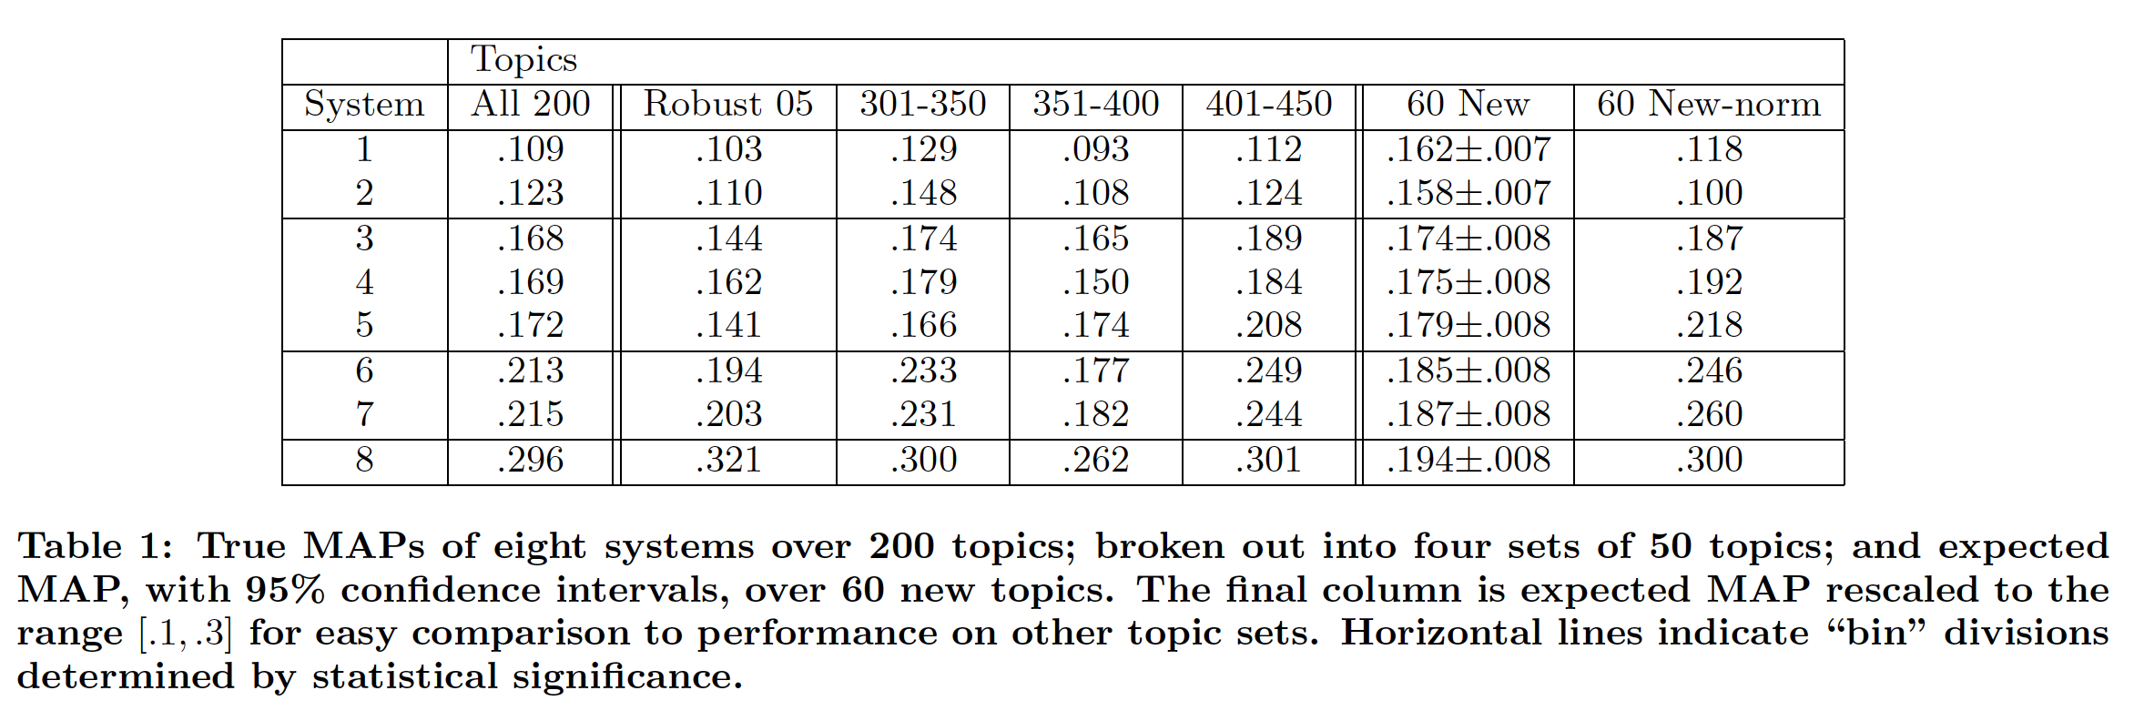
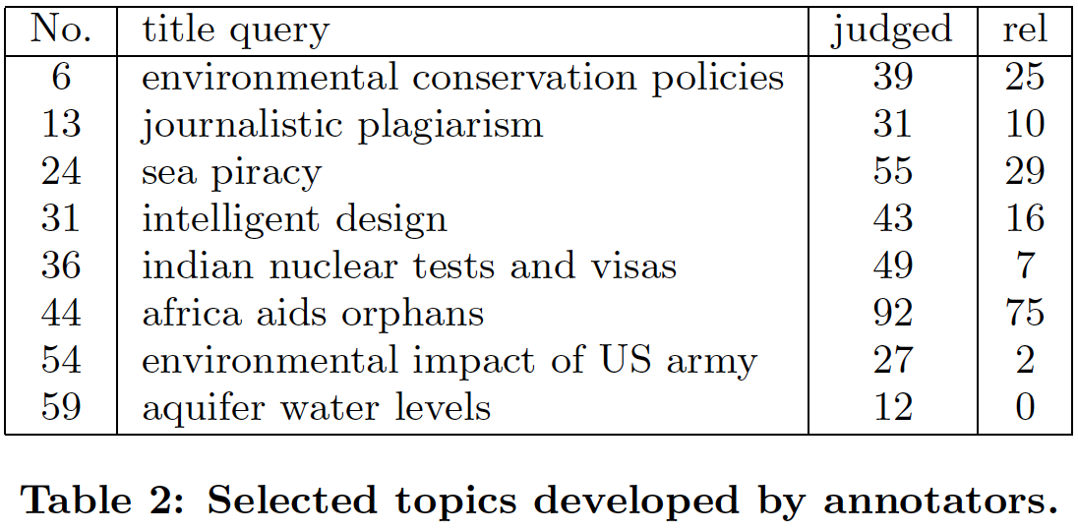
Experiment Results
Table 1 & 2 (Carterette)
Notes:
Relevant documents out of the judged ones

Slide 6
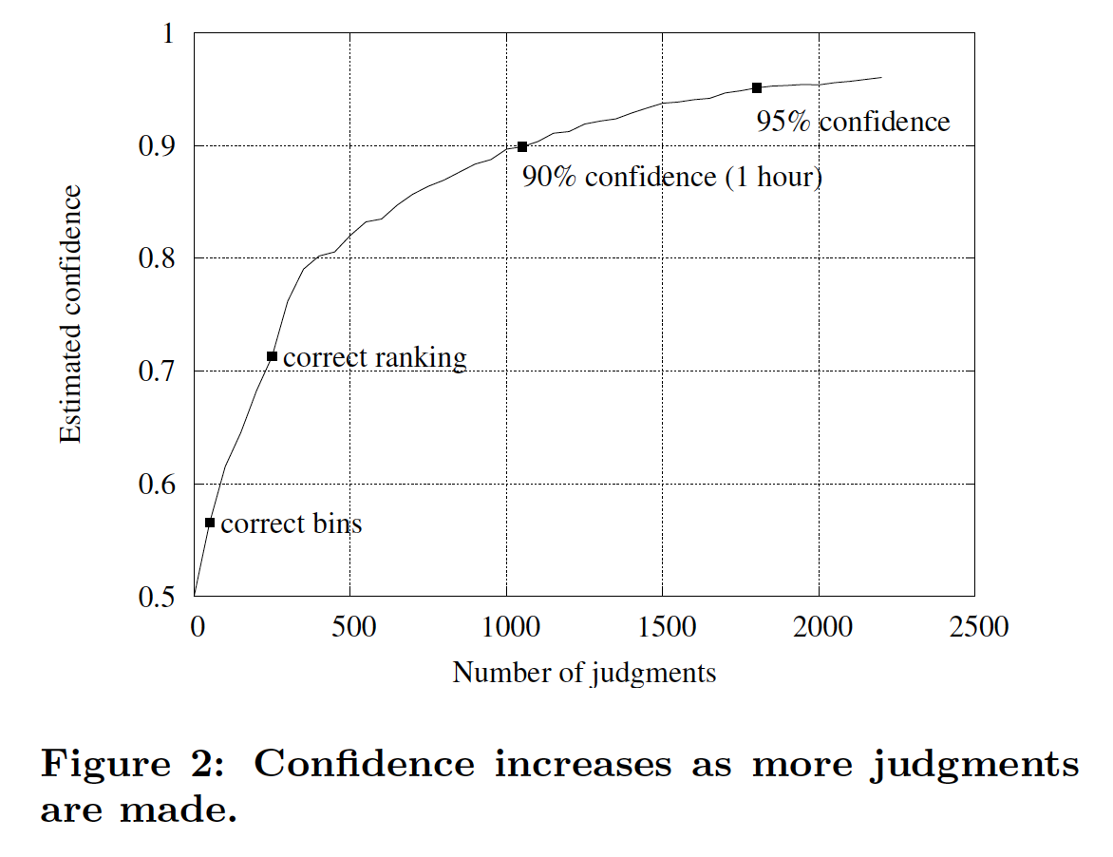
How many judgments?
Figure 2 (Carterette)
Notes:
Mean Average Precision (MAP) is the average of Aps computed for a set of topics
Confidence in ΔMAP > 0 if any two systems are selected at random`

Slide 7
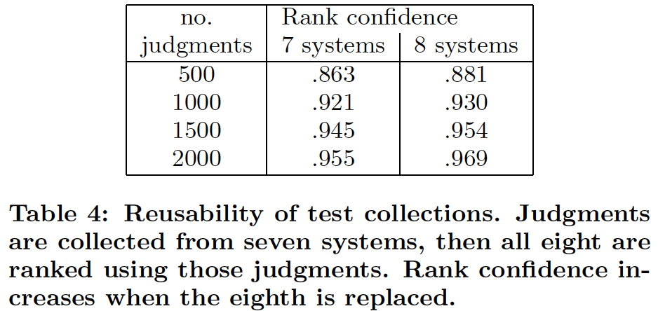
Overall
New algorithm for selecting documents to be judged to evaluate retrieval system
Only 6 hours of annotator judging time to get 90% confidence, comparing 8 systems
Table 4 (Carterette)

Slide 8
How does clickthrough data reflect retrieval quality?
Filip Radlinski, Madhu Kurup, and Thorsten Joachims. 2008. How does clickthrough data reflect retrieval quality?. In Proceedings of the 17th ACM conference on Information and knowledge management (CIKM '08). ACM, New York, NY, USA, 43-52.
Judge retrieval function quality based on user clickthrough data
Works best for comparing two functions
Absolute metrics vs. Interleaving

Slide 9
Experiment Setup
Implemented academic article search engine
arXiv.org e-print archive
700 queries per day from 300 distinct IP addresses, registers 600 clicks
Degrade a hand-tuned ranking function (ORIG) to derive more functions
Expose search engine users to different ranking function results, record clicks
Does observable user behavior reflect the differences in the functions?

Slide 10
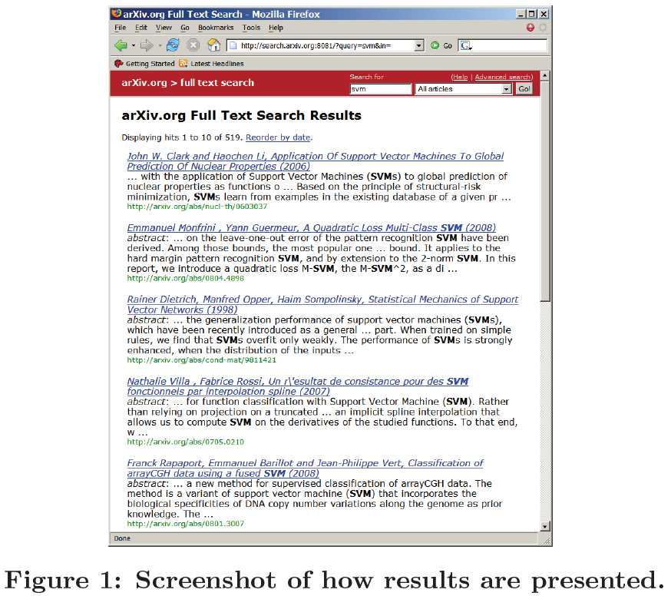
Search Engine
Figure 1 (Radlinski)
Notes:
You can see the fields: authors, title, year, snippet, arXiv ID
On average, receives 700 queries per day from 300 distinct IP addresses, registers 600 clicks

Slide 11
Ranking Functions
ORIG: authors, title, abstract, full text, category, area, submitter, journal, identifier
FLAT: full text, author list, identifier
RAND: Randomize first 11 results of FLAT
SWAP2: Randomly swap 2 results in first 5 of ORIG with 2 results between 7-11
SWAP4: Same as SWAP2 but with 4 results
ORIG > FLAT > RAND and ORIG > SWAP2 > SWAP4
Notes:
Orig looks at the fields but weighs them according to importance

Slide 12
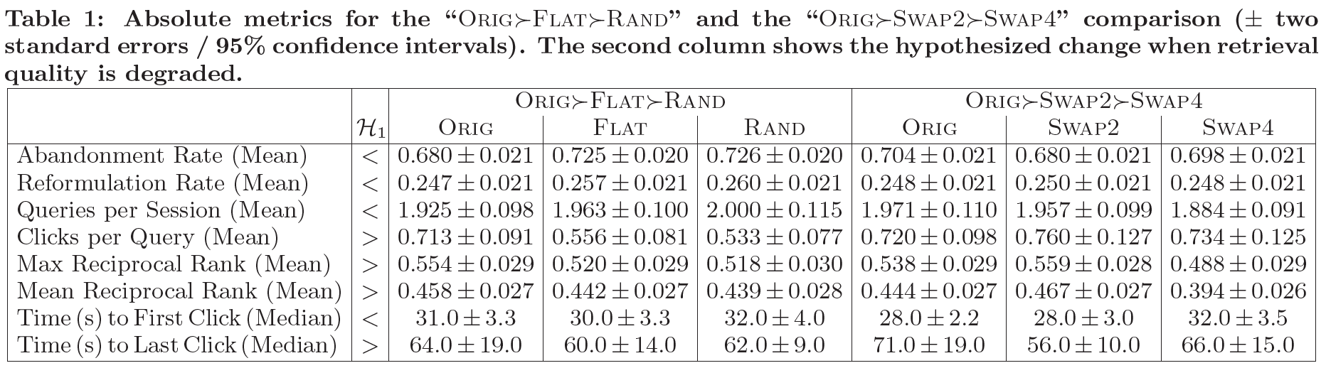
Experiment 1: Absolute Metrics
Table 1 (Radlinski)
Inconclusive results
Could be improved with more data

Slide 13
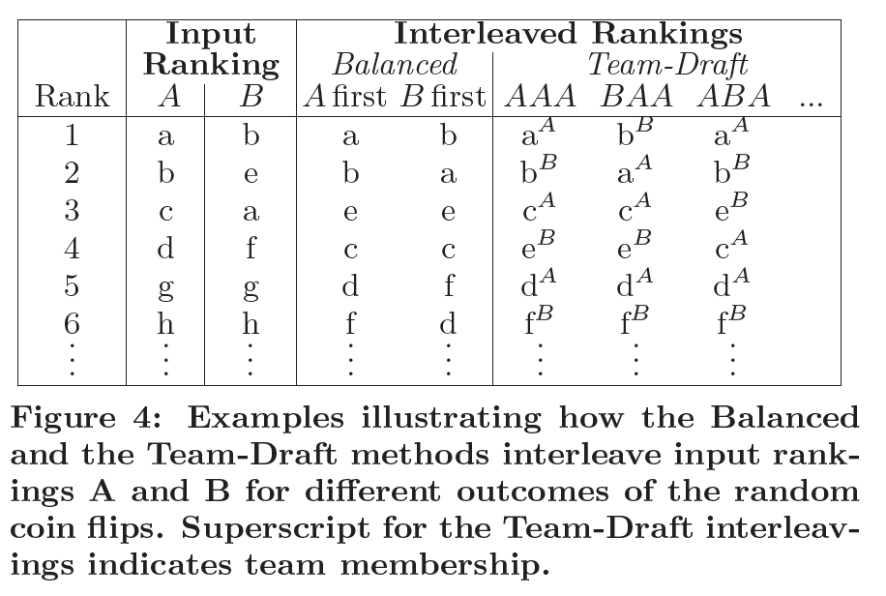
Experiment 2: Paired Comparison
Figure 4 (Radlinski)
Interleaving: Merging the results of two functions into one results list
Team-Draft: Pick who goes first each round

Slide 14
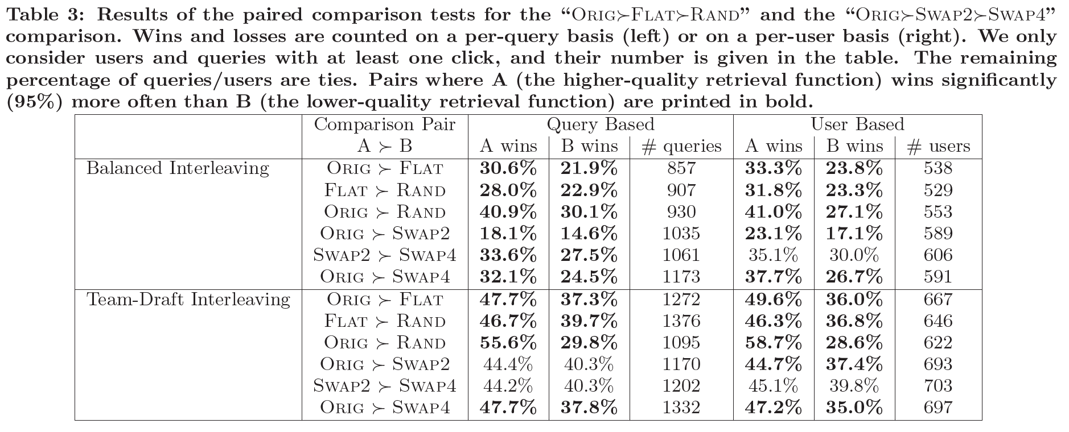
Experiment 2 Results
Table 3 (Radlinski)
Consistent unlike absolute metrics

Slide 15
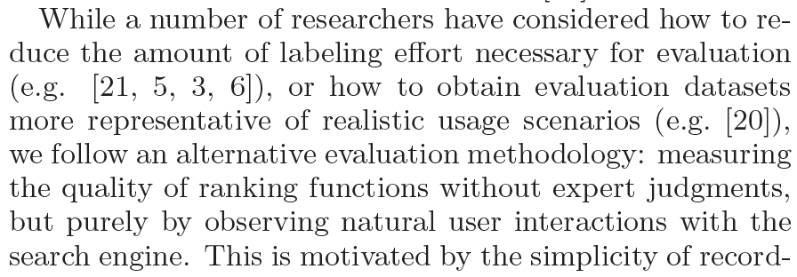
Why Cite The First Paper?
Related Work (Radlinski)
Labeling a corpus to determine retrieval function quality has been done
Let’s try something different

