Slide 1
MapReduce and Genome Analysis Toolkit
Orkun Krand
CS734 – Introduction to Information Retrieval

Slide 2
MapReduce = Map + Reduce
Dean J, Ghemawat S. 2008. MapReduce: Simplified data processing on large clusters. Commun ACM 51: 107–113.
Easy to write distributed programs
Map: Creates intermediate key/value pairs
Reduce: Reduce maps to a single value for each key

Slide 3
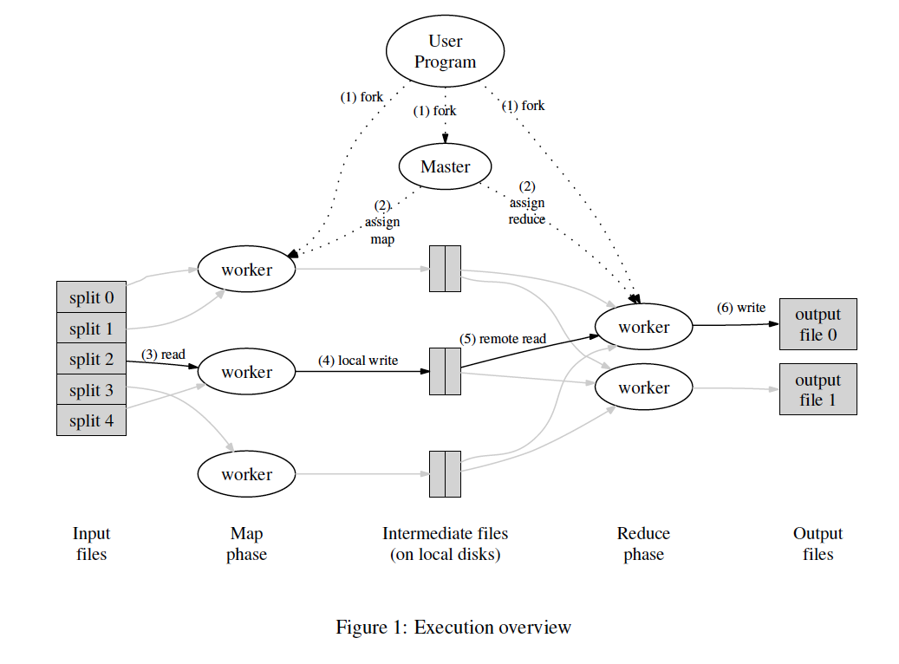
How MapReduce Works

Slide 4
Implementation Details
MapReduce master tries to schedule map tasks on machines that contain the files (Less need for network)
Stragglers: A machine slowing down for various reasons
Backup executions of last few tasks.
Rough numbers:
M = 200,000 (16-64 MB each)
R = 5,000
# of workers = 2,000

Slide 5
Handling Failures
Worker Failure
Master pings periodically
Completed map tasks are re-executed
Completed reduce tasks are safe
Master Failure (unlikely)
Client needs to manually restart MapReduce
High number of workers assure minimum effect by failures

Slide 6
Refinements
Partitioning functions: Specifying output
Processed in increasing key order (guaranteed)
Combiner Function
Mini Reduce at Map <the, 1>
Users can define input/output formats
Auxiliary files on user demand
Skip bad records
Debugging version with sequential execution
Counting occurrences – Live status info

Slide 7
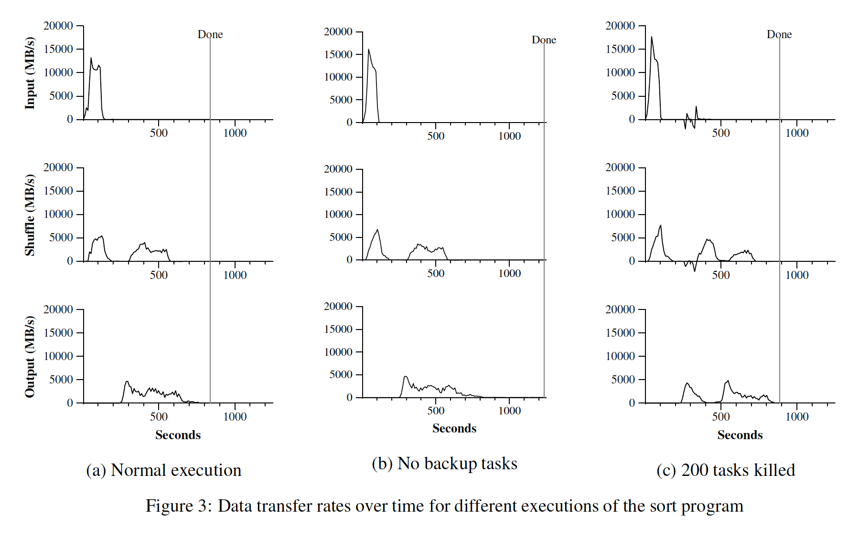
MapReduce Performance (Sort 1TB)

Slide 8
Uses Within Google
Large-scale machine learning problems
Clustering problems for the Google News and Froogle products
Extraction of data used to produce reports of popular queries (e.g. Google Zeitgeist)
Extraction of properties of web pages for new experiments and products
Large-scale graph computations
Complete rewrite of the production indexing system

Slide 9
Genome Analysis Toolkit (GATK)
McKenna A, Hanna M, Banks E, Sivachenko A, Cibulskis K, Kernytsky A, et al. The Genome Analysis Toolkit: a MapReduce framework for analyzing next-generation DNA sequencing data. Genome Res 2010; 20:1297 - 303; http://dx.doi.org/10.1101/gr.107524.110
A structured programming framework designed to ease the development of efficient and robust analysis tools for next-generation DNA sequencers using the functional programming philosophy of MapReduce (McKenna, Henna et. Al 2010)

Slide 10
GATK Architecture
Converts to BAM (Binary Alignment Map) and sorts for performance
Contract with the developer
Tools can easily parallelize and distribute processing
Two structures:
Traversals: division and prep of data
Walkers: Map and reduce methods
Sharding: Dividing data into big chunks (shards) before sending to traversal engines

Slide 11
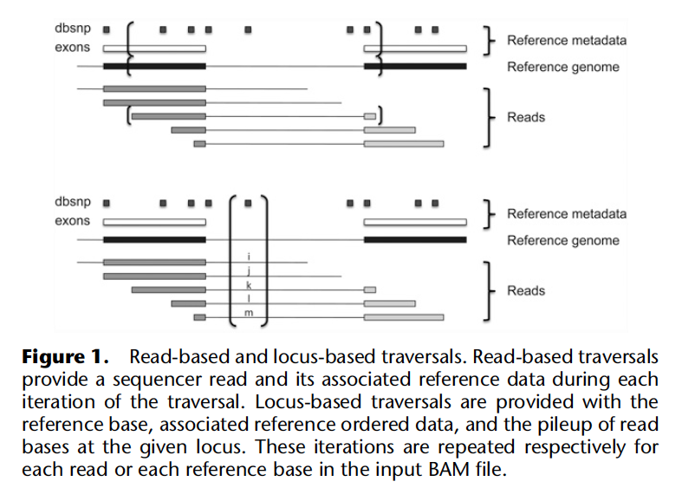
Traversal types

Slide 12
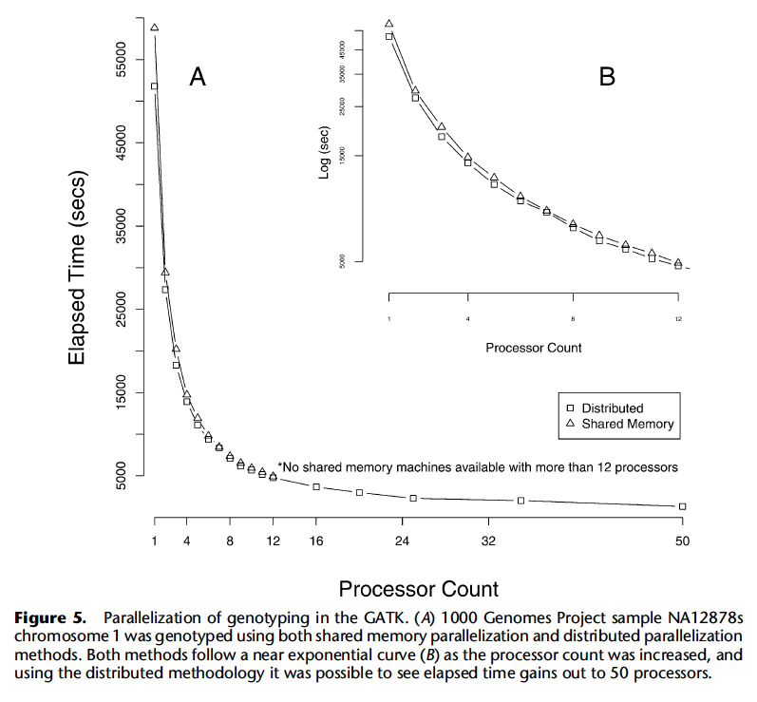
Parallelization

Slide 13
GATK
Allows easy implementation of next-generation DNA sequencing tools
Used in 1000 Genomes Project and The Cancer Genome Atlas
MapReduce → Separates the infrastructure needed from the logic for each analysis tool

