Slide 1
Effect of RADAR azimuthal rotation speed on Doppler velocity and direction estimation
Tworit Kumar Dash
Promoter (TU Delft): Prof. Dr. Alexander Yarovoy (Chairman, Ms3)
Supervisor (TU Delft): Dr. Oleg Krasnov

Slide 2
Challenge
When the radar beam on azimuth rotates very fast, the time on target at one direction in space is too low.
The faster the radar rotates, the smaller are the time samples at one direction of space.
$$T_{d}=\frac{BW[rad]}{Ω[rad.s^{-1}]}$$
Beamwidth
Rotation speed in radian/second
Time spent in one single Beamwidth in space

Slide 3
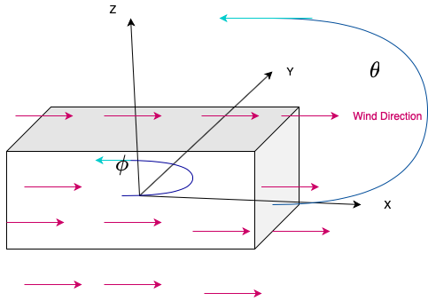
Model of Homogeneous wind
Wind is considered homogeneous
The elevation of the radar beam is fixed
The wind velocity spectrum for ground truth is considered as a Gaussian shaped spectrum.
$$S(v)=\frac{1}{\sqrt{2πσ_{v}^{2}}}e^{\frac{-(v-μ_{v})^{2}}{2v_{σ_{v}}^{2}}}$$
Radar forward model
The time domain signal is sampled based on the time on target direction.
The phase is modified based on the observation direction
$$s_{Ω}(t)=A(t)e^{jΨ(t)cos(ϕ_{wind}-ϕ(t))}$$
$$ϕ(t)=ϕ_{0}+Ωt$$

Slide 4
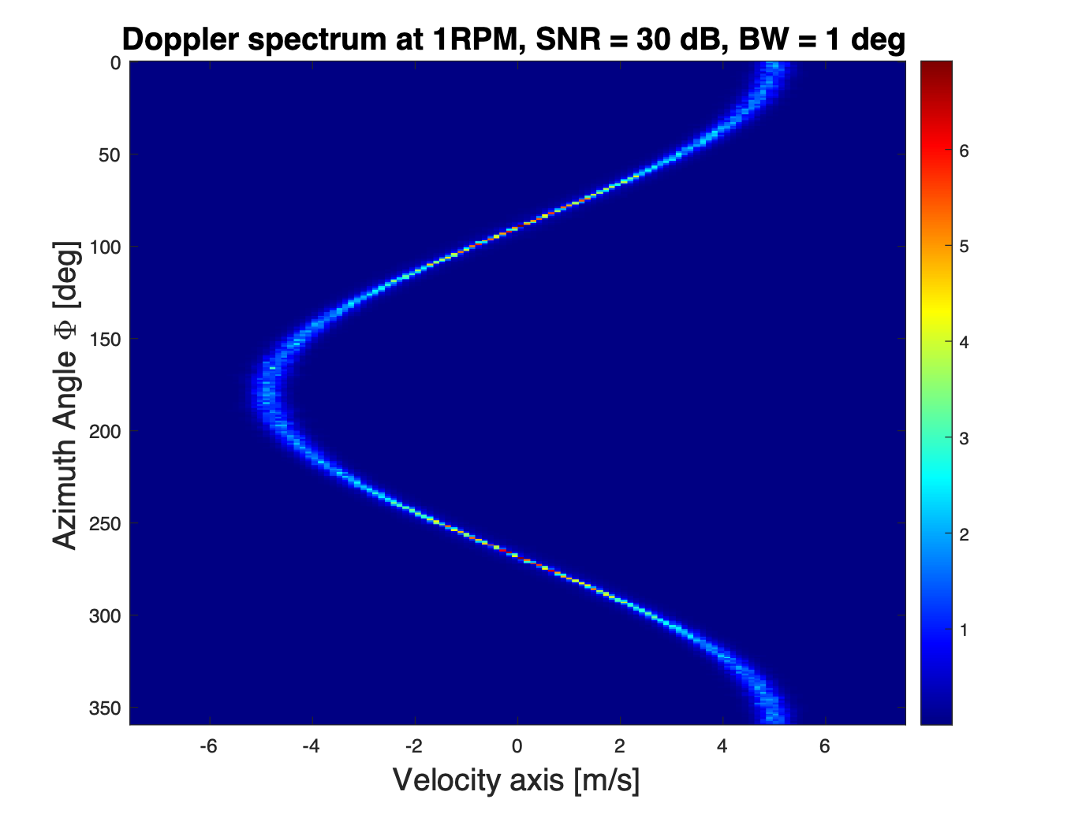
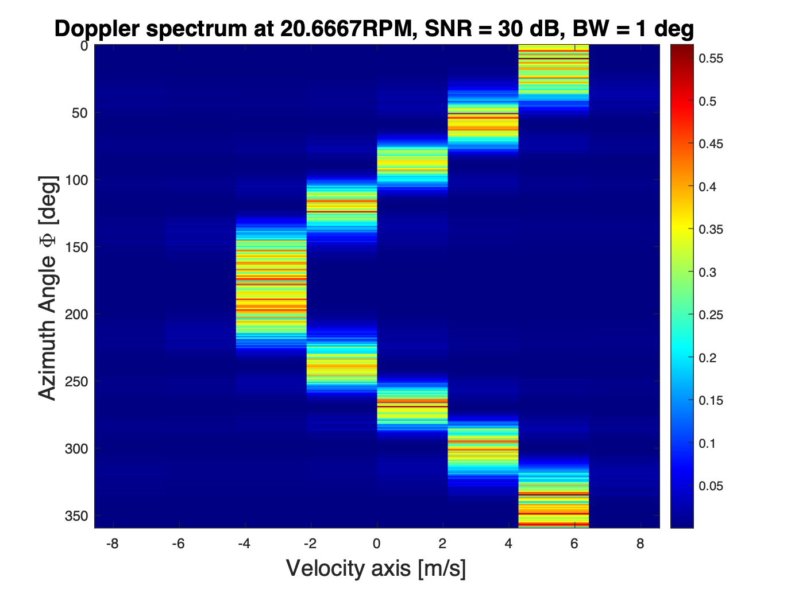
Preliminary Results
Ground Truth:
$$μ=5[m/s]σ=0.2[m/s]ϕ_{wind}=0$$
 |  | Samples for FFT processing
1 | 167 | 128
20 | 9 | 8
40 | 5 | 4
60 | 3 | 2
$$Ω[RPM]$$
$$N_{bursts}$$

Slide 5
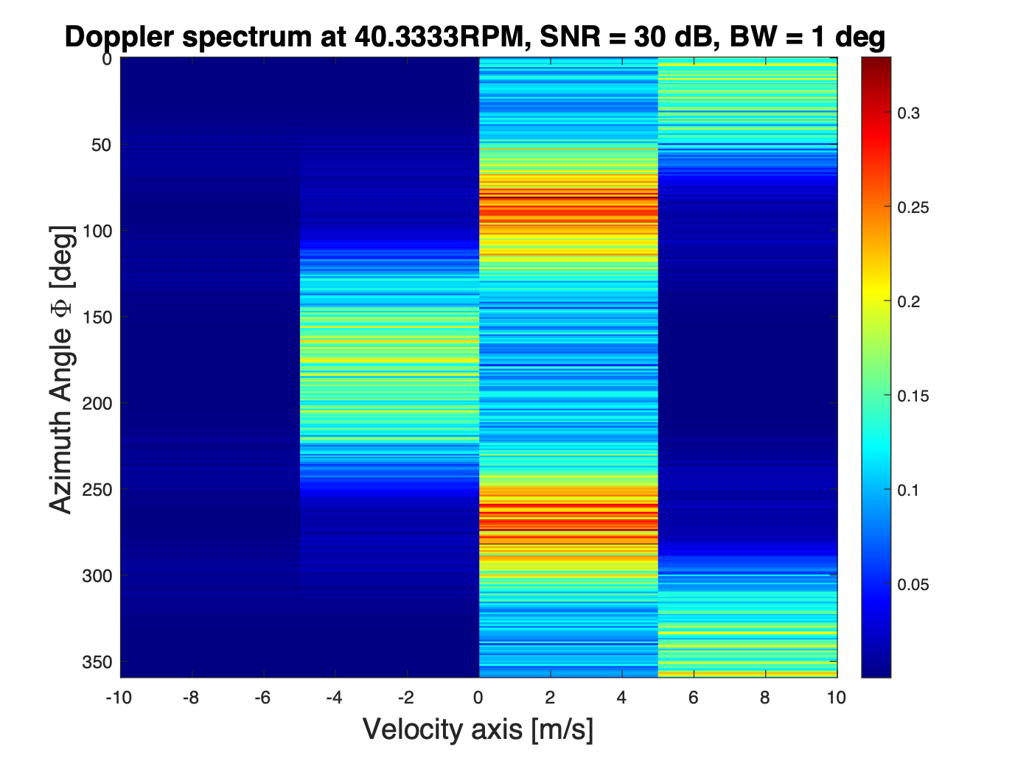
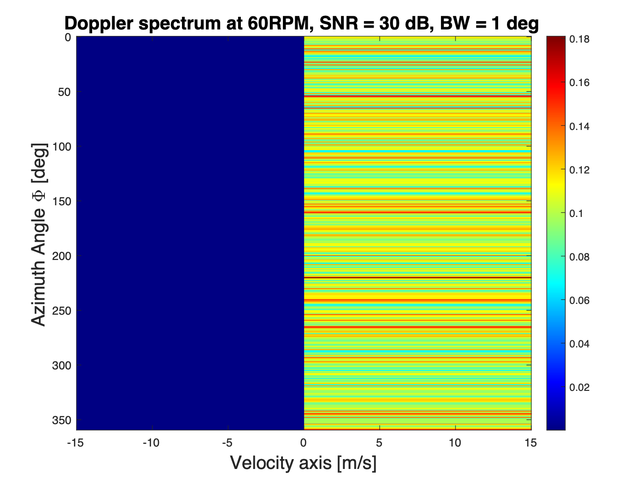
Preliminary Results
Ground Truth:
$$μ=5[m/s]σ=0.2[m/s]ϕ_{wind}=0$$
 |  | Samples for FFT processing
1 | 167 | 128
20 | 9 | 8
40 | 5 | 4
60 | 3 | 2
$$Ω[RPM]$$
$$N_{bursts}$$

Slide 6
Short-term Goal of this model
Find mean Doppler velocity and Doppler spectrum width as a function of :
$$V_{mean}=g(SNR,BW,Ω)$$
$$σ_{width}=f(SNR,BW,Ω)$$
Error analysis of mean Doppler velocity and Doppler spectrum width as a function of the above mentioned quantities
To develop an algorithm which estimates the direction of wind flow.

