Slide 1
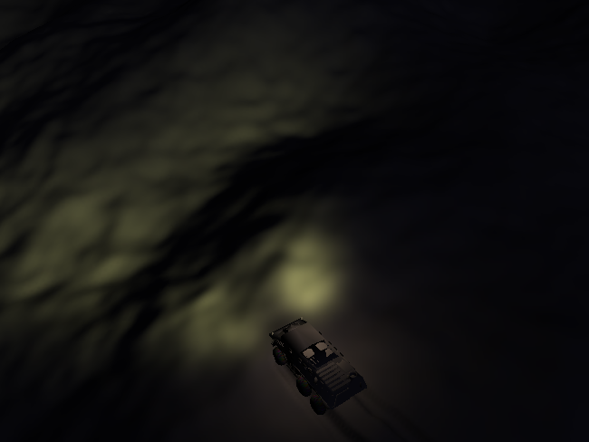
Offroad driving game
Soft ground
Car mounted lights
”Large” terrain

Slide 2
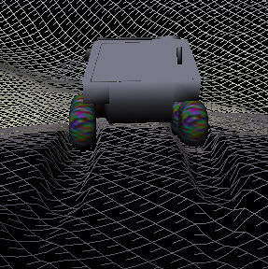
Soft ground requirements
Very dense terrain mesh
4096 x 4096 squares
33 million triangles
Geo mip mapping
Invisible surface culling

Slide 3
Terrain representation
Generate terrain: …, add noise, LP-filter, upsample, …
Scale pyramid: …, LP-filter, downsample, vertices, normals, …

Slide 4
Drawing and culling
Decision point
(already decided)

Slide 5
Drawing and culling
Decision point
(already decided)

Slide 6
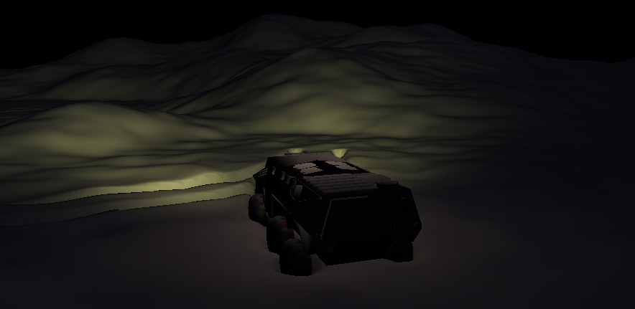
Let there be headlights
Two spotlight light sources following car
Phong shading (not used in screenshot)

Slide 7
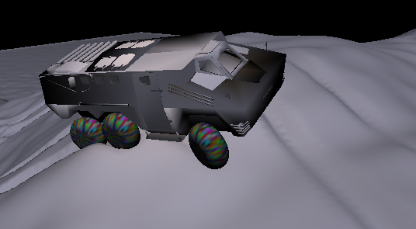
Physics simulation
Rigid body chassis (mass, moment of inertia)
Suspension (spring, damper, linear motion)
Tyres have no mass
Euler integration (good enough result)

Slide 8
Physics simulation, friction force
See whiteboard…

Slide 9
Physics simulation, friction force
sin(phi)^2*cos(th)^2*pdotx+(cos(phi)*sin(th)^2*cos(v)^2*sin(phi)*dt/m+cos(phi)*cos(th)^2*dt/Ith*ry^2*sin(phi)+sin(phi)^2*sin(v)*dt/Iv*rx^2*sin(th)*cos(v)+cos(phi)^2*cos(th)*ry*dt/Ith*rz*sin(v)+sin(phi)^2*sin(v)*dt/Ith*rz^2*sin(th)*cos(v)+cos(phi)^2*sin(th)*sin(v)*dt/Iv*ry^2*cos(v)+cos(phi)*sin(th)^2*sin(v)^2*dt/Iv*ry^2*sin(phi)+cos(phi)*sin(th)^2*sin(v)^2*dt/Iphi*rz^2*sin(phi)+sin(phi)^2*cos(v)^2*ry*dt/Iv*rx*sin(th)+cos(phi)*cos(th)^2*sin(phi)*dt/m-2*cos(phi)*sin(th)*sin(v)*rz*dt/Iphi*rx*sin(phi)*cos(th)-2*cos(phi)*sin(th)^2*sin(v)*ry*dt/Iv*rx*sin(phi)*cos(v)-sin(phi)*cos(v)^2*cos(phi)*dt/m-sin(phi)*cos(v)^2*dt/Iphi*rz^2*cos(phi)-cos(phi)^2*sin(th)*cos(v)*dt/Iv*rx^2*sin(v)-sin(phi)^2*sin(v)*rz*dt/Ith*ry*cos(th)-sin(phi)*sin(v)^2*dt/Iv*rx^2*cos(phi)-sin(phi)*cos(v)^2*dt/Iv*ry^2*cos(phi)-sin(phi)^2*cos(v)*dt/Iv*ry^2*sin(th)*sin(v)-sin(phi)^2*sin(v)^2*rx*dt/Iv*ry*sin(th)-sin(phi)^2*cos(v)*dt/Iphi*rz^2*sin(th)*sin(v)-cos(phi)^2*sin(th)*cos(v)^2*rx*dt/Iv*ry-cos(phi)^2*sin(th)*cos(v)*dt/Ith*rz^2*sin(v)-sin(phi)*sin(v)^2*dt/Ith*rz^2*cos(phi)-2*cos(phi)*sin(th)*cos(v)*rz*dt/Ith*ry*sin(phi)*cos(th)-cos(phi)^2*cos(th)*rx*dt/Iphi*rz*cos(v)-sin(phi)*sin(v)^2*cos(phi)*dt/m+cos(phi)*sin(th)^2*cos(v)^2*dt/Ith*rz^2*sin(phi)+cos(phi)*sin(th)^2*sin(v)^2*sin(phi)*dt/m+cos(phi)*cos(th)^2*dt/Iphi*rx^2*sin(phi)+cos(phi)*sin(th)^2*cos(v)^2*dt/Iv*rx^2*sin(phi)+cos(phi)^2*sin(th)*sin(v)^2*ry*dt/Iv*rx+sin(phi)^2*cos(v)*rz*dt/Iphi*rx*cos(th)-2*sin(phi)*cos(v)*ry*dt/Iv*rx*cos(phi)*sin(v)+cos(phi)^2*sin(th)*sin(v)*dt/Iphi*rz^2*cos(v))*Fz+sin(phi)*sin(th)*cos(v)*rx*vdot-sin(phi)*sin(th)*cos(v)*rz*thdot+sin(phi)*sin(th)^2*cos(v)^2*cos(phi)*pdotz+sin(phi)*sin(th)*cos(v)^2*cos(th)*pdoty+cos(phi)^2*cos(v)^2*pdotx+(2*cos(phi)*cos(v)*dt/Iv*ry^2*sin(phi)*sin(th)*sin(v)+2*cos(phi)^2*cos(v)*ry*dt/Iv*rx*sin(v)+sin(phi)^2*sin(th)^2*sin(v)^2*dt/m+sin(phi)^2*sin(th)^2*sin(v)^2*dt/Iv*ry^2+2*sin(phi)*sin(th)*sin(v)^2*ry*dt/Iv*rx*cos(phi)-2*sin(phi)^2*sin(th)^2*sin(v)*ry*dt/Iv*rx*cos(v)-2*cos(phi)*sin(v)*dt/Iv*rx^2*sin(phi)*sin(th)*cos(v)-2*cos(phi)*sin(v)*dt/Ith*rz^2*sin(phi)*sin(th)*cos(v)+cos(phi)^2*sin(v)^2*dt/Iv*rx^2+sin(phi)^2*sin(th)^2*cos(v)^2*dt/Iv*rx^2+cos(phi)^2*cos(v)^2*dt/m+sin(phi)^2*cos(th)^2*dt/m+cos(phi)^2*sin(v)^2*dt/m+2*cos(phi)*sin(v)*rz*dt/Ith*ry*sin(phi)*cos(th)-2*sin(phi)^2*sin(th)*cos(v)*rz*dt/Ith*ry*cos(th)+sin(phi)^2*sin(th)^2*sin(v)^2*dt/Iphi*rz^2+sin(phi)^2*cos(th)^2*dt/Ith*ry^2+sin(phi)^2*cos(th)^2*dt/Iphi*rx^2+sin(phi)^2*sin(th)^2*cos(v)^2*dt/Ith*rz^2+sin(phi)^2*sin(th)^2*cos(v)^2*dt/m+cos(phi)^2*cos(v)^2*dt/Iphi*rz^2+cos(phi)^2*sin(v)^2*dt/Ith*rz^2-2*sin(phi)^2*sin(th)*sin(v)*rz*dt/Iphi*rx*cos(th)+cos(phi)^2*cos(v)^2*dt/Iv*ry^2+2*cos(phi)*cos(v)*dt/Iphi*rz^2*sin(phi)*sin(th)*sin(v)-2*cos(phi)*cos(v)*rz*dt/Iphi*rx*sin(phi)*cos(th)-2*cos(phi)*cos(v)^2*ry*dt/Iv*rx*sin(phi)*sin(th))*Fx+(rx*dt/Iphi*rz*sin(phi)*sin(th)^2*sin(v)-sin(th)*sin(phi)*cos(th)*dt/m-cos(th)^2*sin(v)*rz*dt/Iphi*rx*sin(phi)+cos(th)*sin(v)^2*ry*dt/Iv*rx*cos(phi)+cos(th)*sin(v)^2*dt/Iphi*rz^2*sin(phi)*sin(th)+cos(th)*cos(v)^2*sin(phi)*sin(th)*dt/m-2*cos(th)*sin(v)*ry*dt/Iv*rx*sin(phi)*sin(th)*cos(v)+sin(th)*rx*dt/Iphi*rz*cos(phi)*cos(v)-cos(th)*cos(v)*dt/Ith*rz^2*cos(phi)*sin(v)-cos(th)^2*cos(v)*rz*dt/Ith*ry*sin(phi)-cos(th)*cos(v)^2*rx*dt/Iv*ry*cos(phi)+cos(th)*cos(v)^2*dt/Ith*rz^2*sin(phi)*sin(th)+cos(th)*cos(v)^2*dt/Iv*rx^2*sin(phi)*sin(th)+cos(th)*sin(v)*dt/Iphi*rz^2*cos(phi)*cos(v)+cos(th)*sin(v)*dt/Iv*ry^2*cos(phi)*cos(v)+cos(th)*sin(v)^2*dt/Iv*ry^2*sin(phi)*sin(th)-cos(th)*cos(v)*dt/Iv*rx^2*cos(phi)*sin(v)-sin(th)*dt/Ith*ry^2*sin(phi)*cos(th)-sin(th)*ry*dt/Ith*rz*cos(phi)*sin(v)+ry*dt/Ith*rz*sin(phi)*sin(th)^2*cos(v)-sin(th)*dt/Iphi*rx^2*sin(phi)*cos(th)+cos(th)*sin(v)^2*sin(phi)*sin(th)*dt/m)*Fy-cos(phi)*cos(v)^2*sin(phi)*pdotz+cos(phi)*cos(v)*rz*phidot-cos(phi)*cos(v)*ry*vdot+sin(phi)^2*sin(th)^2*sin(v)^2*pdotx-cos(phi)*sin(v)^2*sin(phi)*pdotz-cos(phi)*sin(v)*rx*vdot+cos(phi)*sin(v)*rz*thdot+sin(phi)^2*sin(th)^2*cos(v)^2*pdotx+sin(phi)*sin(th)*sin(v)^2*cos(th)*pdoty+sin(phi)*sin(th)^2*sin(v)^2*cos(phi)*pdotz+cos(phi)^2*sin(v)^2*pdotx+sin(phi)*sin(th)*sin(v)*rz*phidot-sin(phi)*sin(th)*sin(v)*ry*vdot+sin(phi)*cos(th)*ry*thdot+sin(phi)*cos(th)^2*cos(phi)*pdotz-sin(phi)*cos(th)*rx*phidot-sin(phi)*cos(th)*sin(th)*pdoty = 0
One of three equations, solve Fx, Fy, Fz
Linear?!

Slide 10
”Byt bas och se bättre”
(phidot+dt/Iphi*(rz*Fx*cos(phi)*cos(v)+rz*Fx*sin(phi)*sin(th)*sin(v)+rz*cos(th)*sin(v)*Fy-rz*Fz*sin(phi)*cos(v)+rz*Fz*cos(phi)*sin(th)*sin(v)-rx*sin(phi)*cos(th)*Fx+rx*sin(th)*Fy-rx*cos(phi)*cos(th)*Fz))*rz-(vdot+dt/Iv*(-rx*Fx*cos(phi)*sin(v)+rx*Fx*sin(phi)*sin(th)*cos(v)+rx*cos(th)*cos(v)*Fy+rx*Fz*sin(phi)*sin(v)+rx*Fz*cos(phi)*sin(th)*cos(v)-ry*Fx*cos(phi)*cos(v)-ry*Fx*sin(phi)*sin(th)*sin(v)-ry*cos(th)*sin(v)*Fy+ry*Fz*sin(phi)*cos(v)-ry*Fz*cos(phi)*sin(th)*sin(v)))*ry+(cos(phi)*cos(v)+sin(phi)*sin(th)*sin(v))*(pdotx+dt*Fx/m)+cos(th)*sin(v)*(pdoty+dt*Fy/m)+(-sin(phi)*cos(v)+cos(phi)*sin(th)*sin(v))*(pdotz+dt*Fz/m) = 0
(vdot+dt/Iv*(-rx*Fx*cos(phi)*sin(v)+rx*Fx*sin(phi)*sin(th)*cos(v)+rx*cos(th)*cos(v)*Fy+rx*Fz*sin(phi)*sin(v)+rx*Fz*cos(phi)*sin(th)*cos(v)-ry*Fx*cos(phi)*cos(v)-ry*Fx*sin(phi)*sin(th)*sin(v)-ry*cos(th)*sin(v)*Fy+ry*Fz*sin(phi)*cos(v)-ry*Fz*cos(phi)*sin(th)*sin(v)))*rx-(thdot+dt/Ith*(ry*sin(phi)*cos(th)*Fx-ry*sin(th)*Fy+ry*cos(phi)*cos(th)*Fz+rz*Fx*cos(phi)*sin(v)-rz*Fx*sin(phi)*sin(th)*cos(v)-rz*cos(th)*cos(v)*Fy-rz*Fz*sin(phi)*sin(v)-rz*Fz*cos(phi)*sin(th)*cos(v)))*rz+(-cos(phi)*sin(v)+sin(phi)*sin(th)*cos(v))*(pdotx+dt*Fx/m)+cos(th)*cos(v)*(pdoty+dt*Fy/m)+(sin(phi)*sin(v)+cos(phi)*sin(th)*cos(v))*(pdotz+dt*Fz/m) = 0
(thdot+dt/Ith*(ry*sin(phi)*cos(th)*Fx-ry*sin(th)*Fy+ry*cos(phi)*cos(th)*Fz+rz*Fx*cos(phi)*sin(v)-rz*Fx*sin(phi)*sin(th)*cos(v)-rz*cos(th)*cos(v)*Fy-rz*Fz*sin(phi)*sin(v)-rz*Fz*cos(phi)*sin(th)*cos(v)))*ry-(phidot+dt/Iphi*(rz*Fx*cos(phi)*cos(v)+rz*Fx*sin(phi)*sin(th)*sin(v)+rz*cos(th)*sin(v)*Fy-rz*Fz*sin(phi)*cos(v)+rz*Fz*cos(phi)*sin(th)*sin(v)-rx*sin(phi)*cos(th)*Fx+rx*sin(th)*Fy-rx*cos(phi)*cos(th)*Fz))*rx+sin(phi)*cos(th)*(pdotx+dt*Fx/m)-sin(th)*(pdoty+dt*Fy/m)+cos(phi)*cos(th)*(pdotz+dt*Fz/m) = 0
Linear in Fx, Fy, Fz!

Slide 11
The memory is the limit
Highest resolution 4097 x 4097 points
Total of 4097x4097 + 2049x2049 + … + 3x3 =
22 386 012 points,
each with height, vertex coordinates, normal
(1+3+3)*sizeof(float) = 28 byte
Total: 626 808 336 byte…
(8193x8193) 2 506 315 308
(16385x16385) 10 023 425 608

Slide 12
Could be done
Game part of ”offroad driving game”
Not keeping all terrain in main memory
Anti roll bar in car model
New terrain generation on the fly

