Slide 1

ENPM – 667 CONTROL OF ROBOTIC SYSTEMS PROJECT – 1 PRESENTATION ON LONGITUDINAL CONTROL OF AUTOMATED CHVs WITH SIGNIFICANT ACTUATOR DELAYS
Kumara Ritvik Oruganti Venkata Sai Ram Polina
(117368963) (118436579)
Date: 11/25/2021

Slide 2
ABSTRACT
This presentation on “Longitudinal Control of Automated CHVs With Significant Actuator Delays” discusses about the problem of longitudinal control in Commercial heavy vehicles (CHVs) where the presence of significant delays in the fuel and brake actuators leads to degraded performance. The main objective of this report is to discuss about three main autonomous controller schemes namely adaptive PIQ scheme with variable time headway and variable gain, backstepping-based nonlinear scheme with elaboration on Lyapunov function and prediction using MPC control block and PID-based nonlinear scheme with variable time headway and variable gain with and without actuator delays.

Slide 3
INTRODUCTION
Firstly, we discuss the PIQ controller which is modified to adaptive PIQ, which is further enhanced by modelling the headway and separation gain as a function of relative velocity.
Next controller is designed using backstepping procedure, where a new control law is proposed which demonstrates significantly improved performance in the presence of large actuator delays.
We discuss the Lyapunov function and choice of making unknown input to make the derivative negative semi-definite.
The simulations for backstepping are not provided. For the predictive approach, we have used the model predictive control (MPC) block in Simulink, which does not give an expected performance.
The complex design of the controllers and manufacturing cost led to the development of a significantly simpler PID-like controller whose performance is better than the backstepping controller without the prediction according to the simulated results.
This controller is not an actual PID controller, but uses the concept of PID control, because it uses the nonlinear spacing terms of initially designed PIQ controller and has thus the same nonlinear complexity.

Slide 4
NOTE
We are using a single vehicle as a follower for all the simulations and results.
The parameters were not mentioned in the research paper and hence, we have assumed the parameters for simulations and simulated the same using Matlab.
The backstepping controller was discussed in detail in the report attached to this presentation. Simulations were not presented for backstepping. We just go through the concepts on the top level here.
The parameters for prediction were not mentioned in the original paper, hence we have used the Model Predictive Control to prove that the prediction doesn't improve the performance.
We also assumed that there are no external disturbances while simulating the model.
We have taken the follower vehicle velocity higher than the leading velocity to prove that the vehicle doesn’t collide with the vehicle in front.

Slide 5
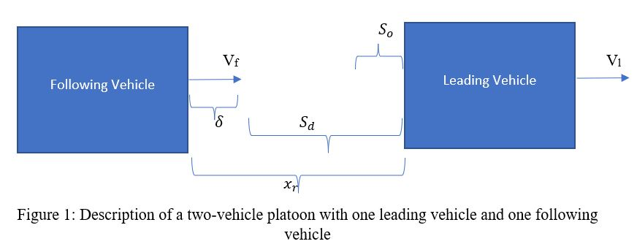
PIQ CONTROLLER
PIQ scheme was introduced to overcome the cons of PID controller. The primary disadvantage of PID controller is the requirement of knowledge on the derivative of the error term.
In speed tracking, overshoot is much more undesirable than undershoot because of passenger comfort considerations. It is even more undesirable in a vehicle-following scenario, since it may lead to collisions.
Therefore, a signed quadratic (Q) term is added to the PI controller. This nonlinear term allows fast compensation of large tracking errors without the need for high gains. As a result, PIQ controller significantly reduces the overshoot associated with high-gain control.

Slide 6
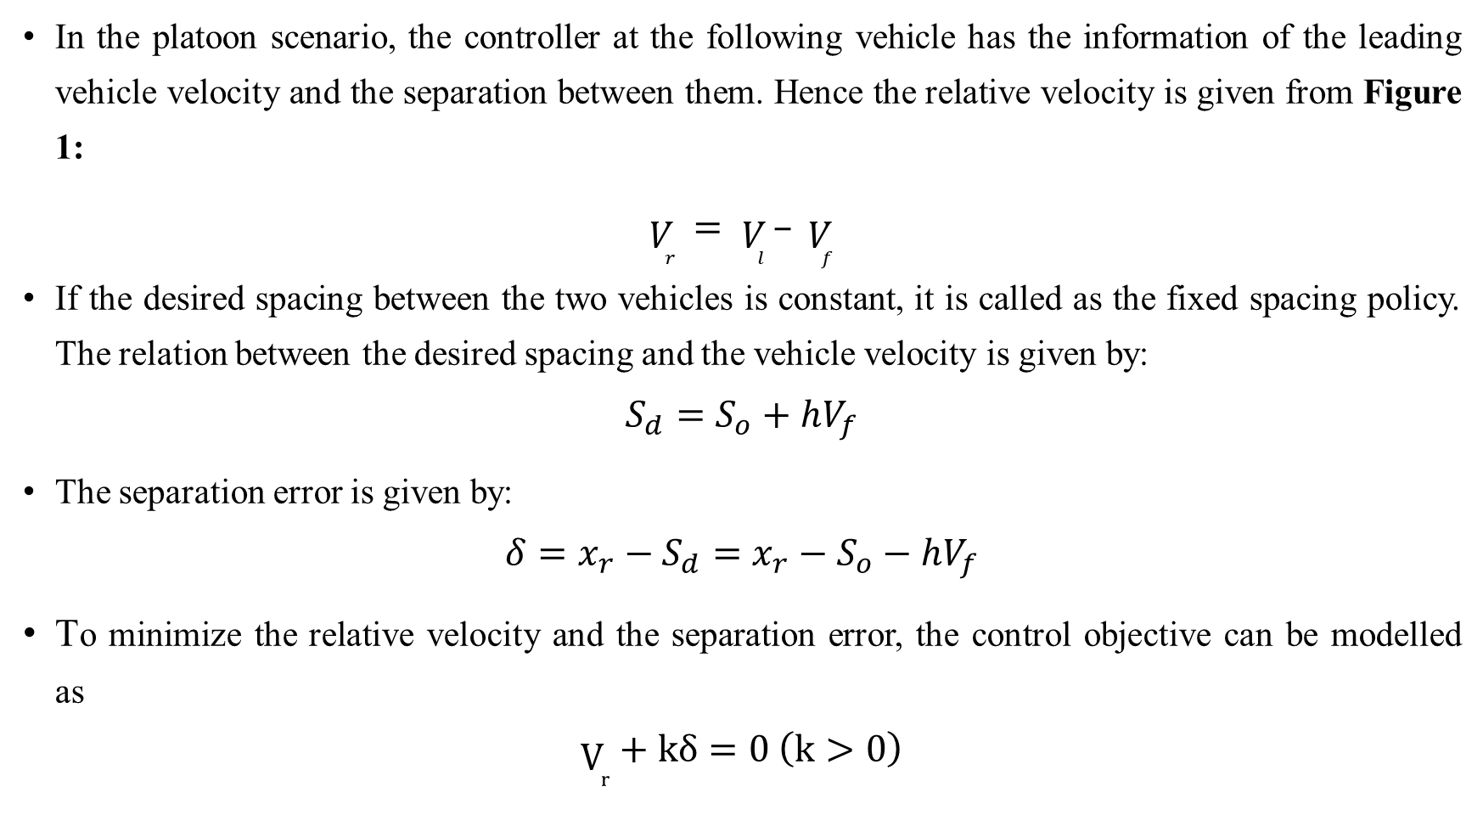
In the platoon scenario, the controller at the following vehicle has the information of the leading vehicle velocity and the separation between them. Hence the relative velocity is given from Figure 1:
$\begin{aligned}V_{r} = V_{l} – V_{f}\#\end{aligned}$
If the desired spacing between the two vehicles is constant, it is called as the fixed spacing policy. The relation between the desired spacing and the vehicle velocity is given by:
$$S_{d}=S_{o}+hV_{f}$$
The separation error is given by:
$$δ=x_{r}−S_{d}=x_{r}−S_{o}−hV_{f}$$
To minimize the relative velocity and the separation error, the control objective can be modelled as
$$V_{r}+kδ=0 \left(k>0\right)$$

Slide 7
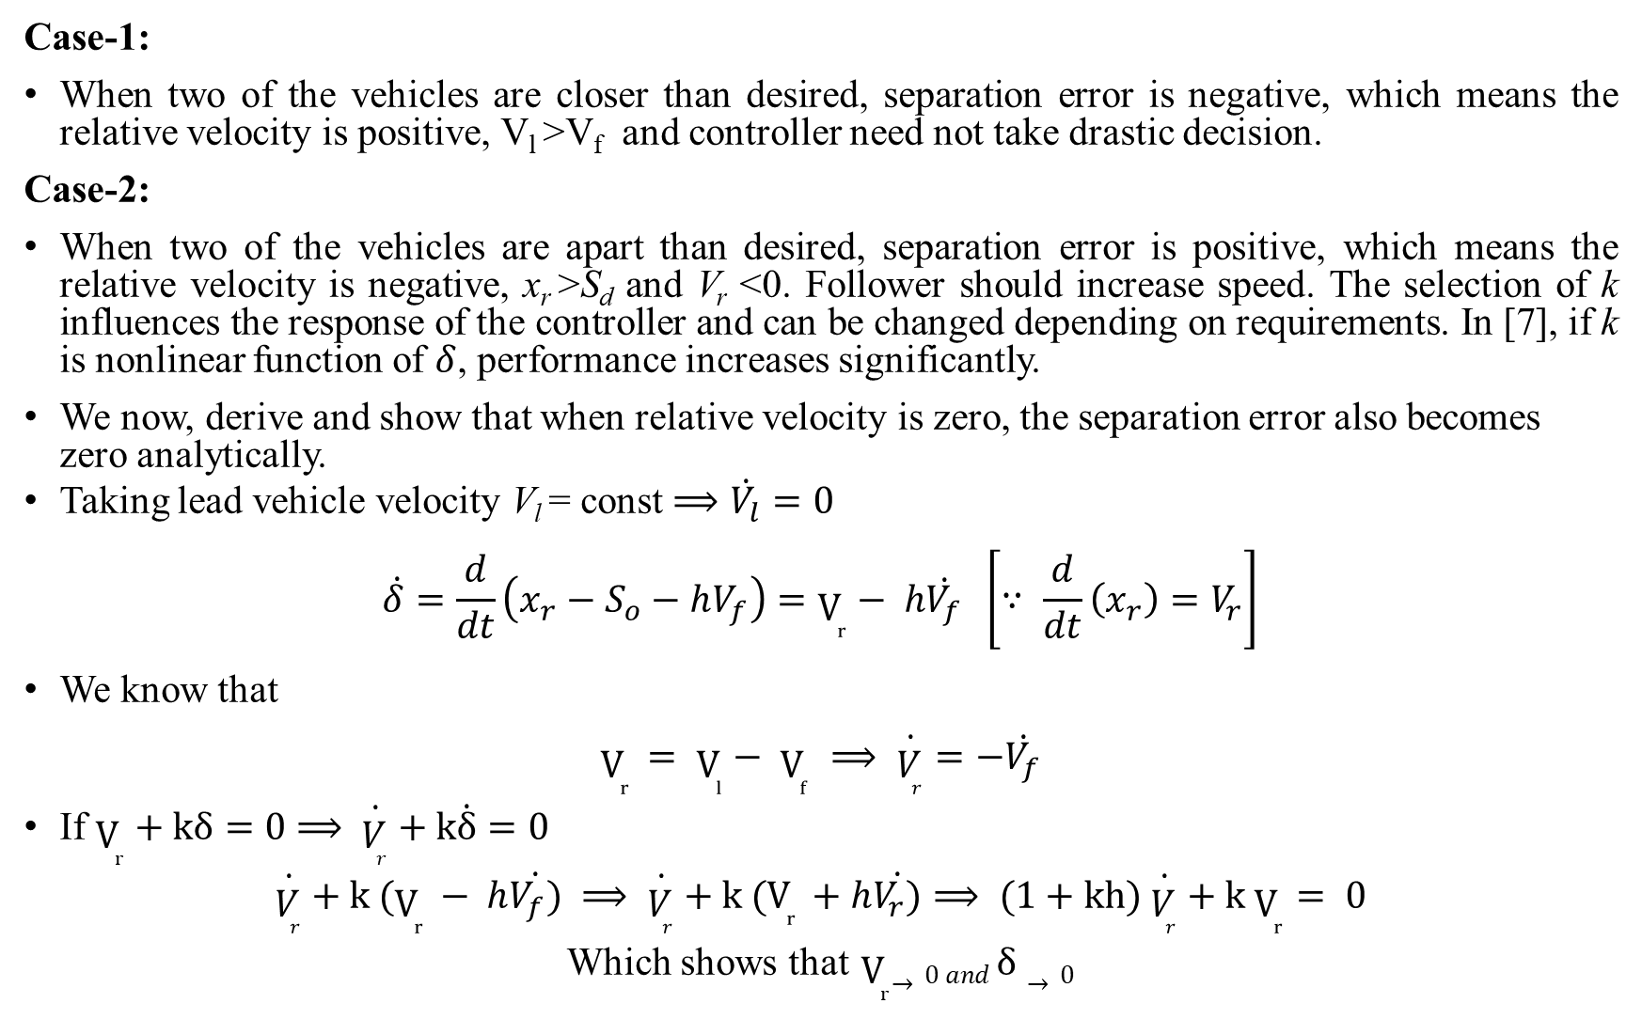
Case-1:
When two of the vehicles are closer than desired, separation error is negative, which means the relative velocity is positive, V_{l} >V_{f} and controller need not take drastic decision.
Case-2:
When two of the vehicles are apart than desired, separation error is positive, which means the relative velocity is negative, x_{r} >S_{d} and V_{r} <0. Follower should increase speed. The selection of k influences the response of the controller and can be changed depending on requirements. In [7], if k is nonlinear function of $δ$, performance increases significantly.
We now, derive and show that when relative velocity is zero, the separation error also becomes zero analytically.
Taking lead vehicle velocity V_{l} = const $⟹\dot{V_{l}}=0$
$$\begin{aligned}\dot{δ}=\frac{d}{dt}\left(x_{r}−S_{o}−hV_{f}\right)=V_{r}− h\dot{V_{f}} \left[∵ \frac{d}{dt}\left(x_{r}\right)=V_{r}\right]\#\end{aligned}$$
We know that
$$\begin{aligned}V_{r} = V_{l}− V_{f} ⟹ \dot{V_{r}}=−\dot{V_{f}}\#\end{aligned}$$
If $V_{r}+kδ=0$ $⟹$ $\dot{V_{r}}+k\dot{δ}=0$
$$\dot{V_{r}}+k (V_{r} − h\dot{V_{f})} ⟹ \dot{V_{r}}+k (V_{r} +h\dot{V_{r})}⟹ (1+kh) \dot{V_{r}}+k V_{r}= 0$$
Which shows that${ V}_{r}→0 and δ→0$

Slide 8
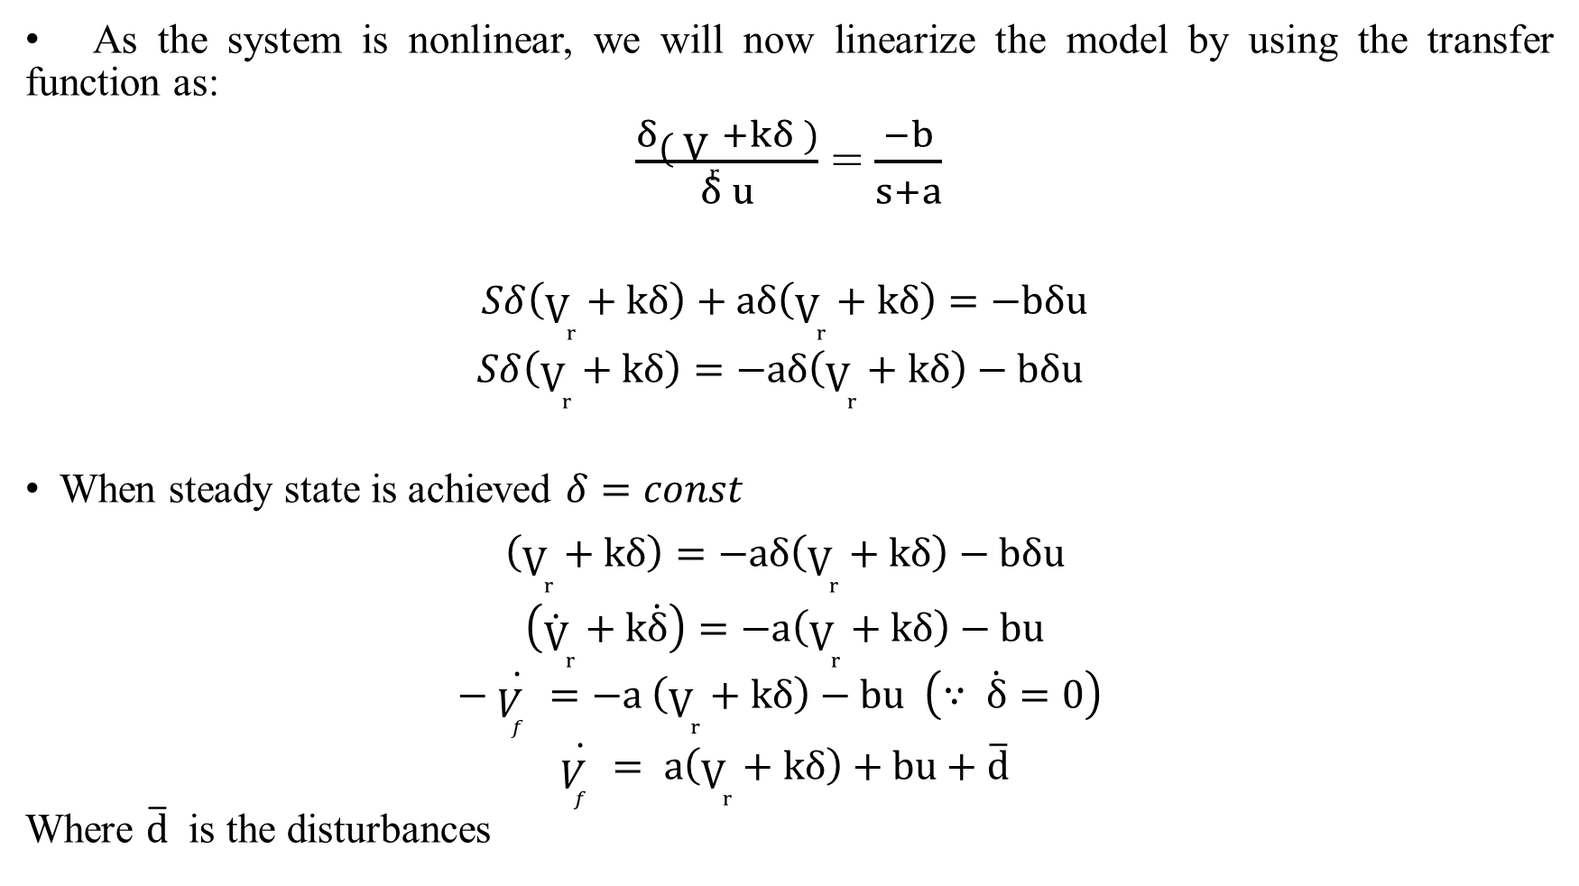
Linearizing the control objective
As the system is nonlinear, we will now linearize the model by using the transfer function as:
$\frac{δ{( V}_{r}+kδ )}{δ u}$ = $\frac{−b}{s+a}$
$$\begin{aligned}Sδ\left(V_{r}+kδ\right)+aδ\left(V_{r}+kδ\right)=−bδu \#\end{aligned}$$
$$\begin{aligned}Sδ\left(V_{r}+kδ\right)=−aδ\left(V_{r}+kδ\right)−bδu \#\end{aligned}$$
When steady state is achieved $δ=const$
$$\begin{aligned}\left(V_{r}+kδ\right)=−aδ\left(V_{r}+kδ\right)−bδu \#\end{aligned}$$
$$\begin{aligned}\left({\dot{V}}_{r}+k\dot{δ}\right)=−a\left(V_{r}+kδ\right)−bu \#\end{aligned}$$
$\begin{aligned}− \dot{V_{f} }=−a \left(V_{r}+kδ\right)−bu \left(∵ \dot{δ}=0\right) \#\end{aligned}$
$$\begin{aligned}\dot{V_{f} }= a\left(V_{r}+kδ\right)+bu+\overline{d} \#\end{aligned}$$
Where $\overline{d}$ is the disturbances

Slide 9
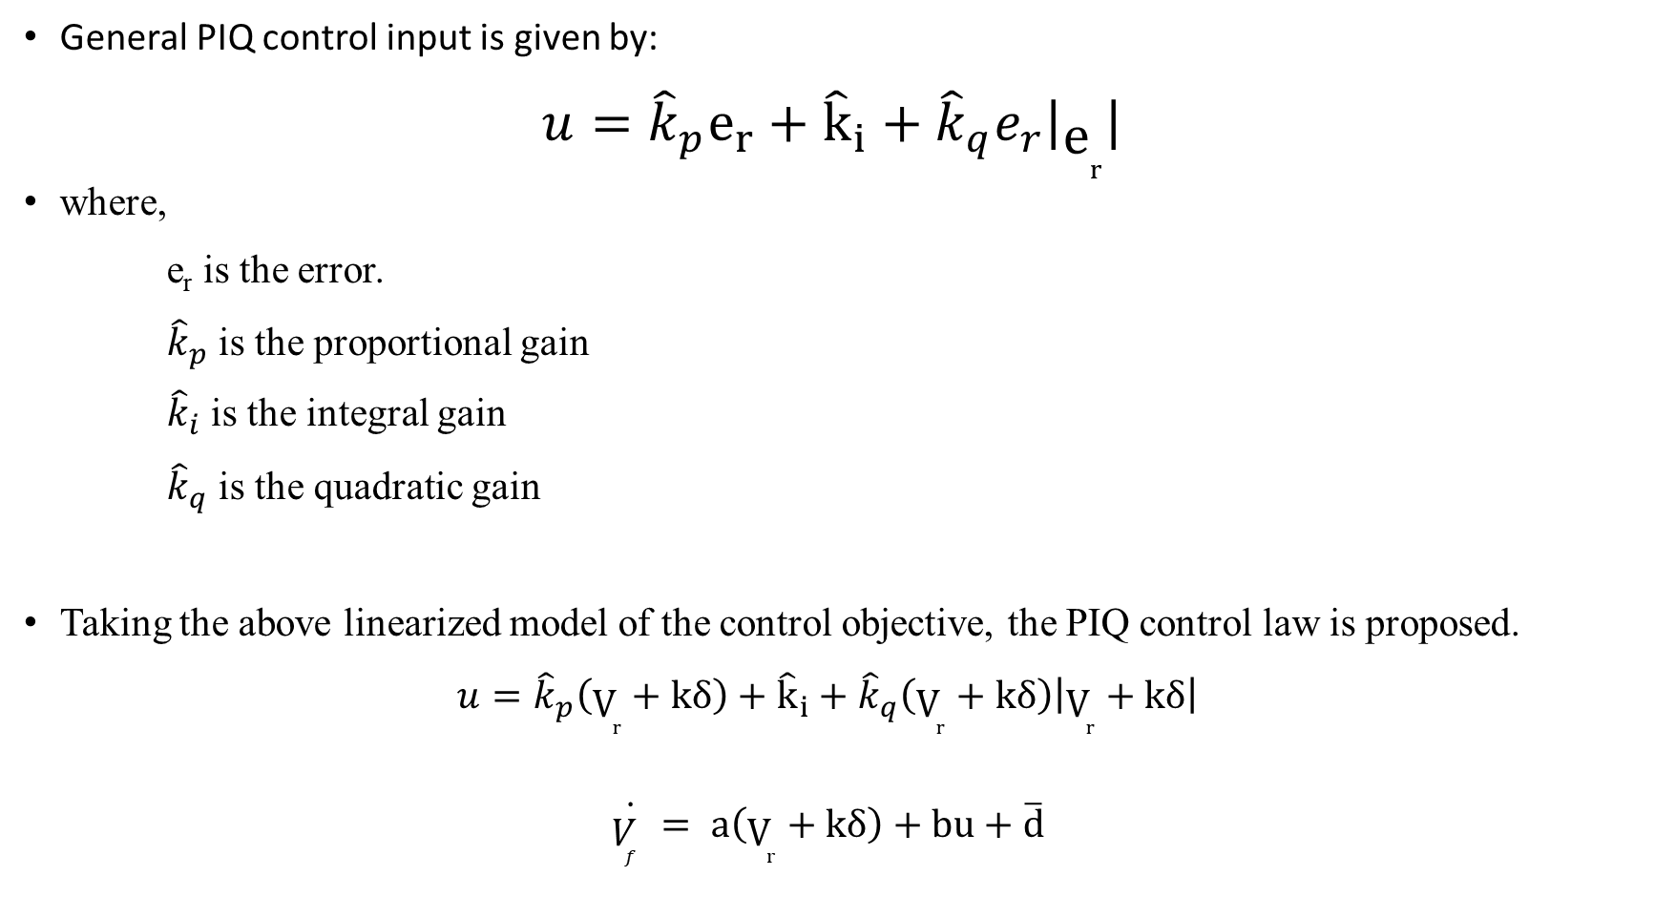
Adaptive PIQ Controller design
General PIQ control input is given by:
$${u=\hat{k}}_{p}e_{r}+{\hat{k}}_{i}+{\hat{k}}_{q}e_{r}\left|e_{r}\right|$$
where,
e_{r} is the error.
${\hat{k}}_{p}$ is the proportional gain
${\hat{k}}_{i}$ is the integral gain
${\hat{k}}_{q}$ is the quadratic gain
Taking the above linearized model of the control objective, the PIQ control law is proposed.
$$\begin{aligned}u={\hat{k}}_{p}\left(V_{r}+kδ\right)+{\hat{k}}_{i}+{\hat{k}}_{q}\left(V_{r}+kδ\right)\left|V_{r}+kδ\right| \#\end{aligned}$$
$$\begin{aligned}\dot{V_{f} }= a\left(V_{r}+kδ\right)+bu+\overline{d} \#\end{aligned}$$

Slide 10
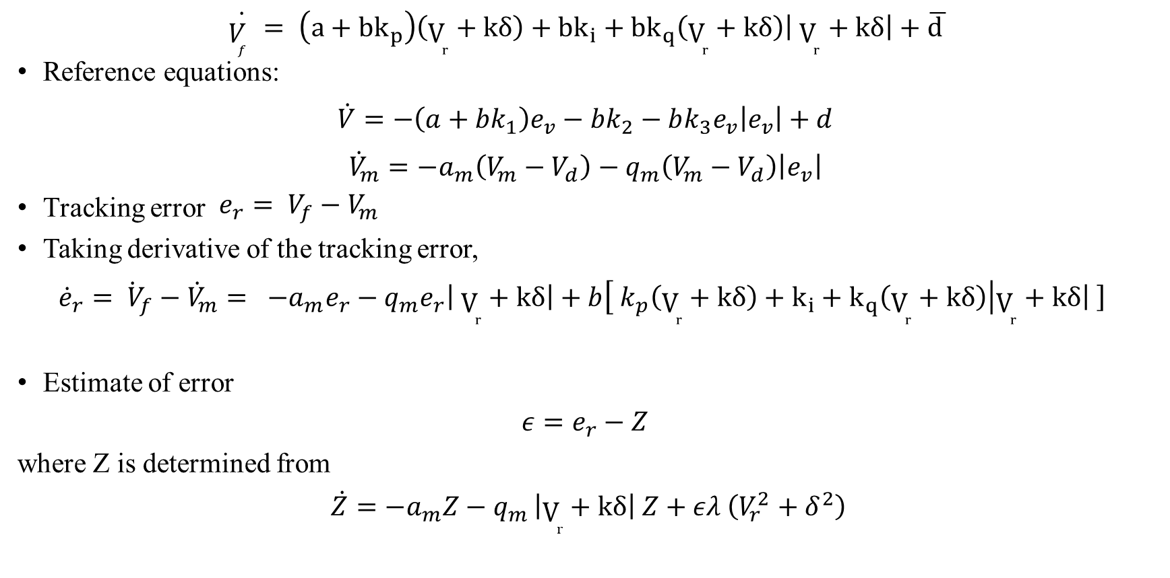
Adaptive PIQ Controller design
$$\begin{aligned}\dot{V_{f} }= \left(a+{bk}_{p}\right)\left(V_{r}+kδ\right)+{bk}_{i}+{bk}_{q}\left(V_{r}+kδ\right)\left| V_{r}+kδ\right|+\overline{d }\#\end{aligned}$$
Reference equations:
$$\begin{aligned}\dot{V}=−\left(a+bk_{1}\right)e_{v}−bk_{2}−bk_{3}e_{v}\left|e_{v}\right|+d \#\end{aligned}$$
$$\begin{aligned}{\dot{V}}_{m}=−a_{m}\left(V_{m}−V_{d}\right)−q_{m}\left(V_{m}−V_{d}\right)\left|e_{v}\right| \#\end{aligned}$$
Tracking error $\begin{aligned}{e_{r}= V}_{f}−V_{m} \#\end{aligned}$
Taking derivative of the tracking error,
$$\begin{aligned}{\dot{e}}_{r}={\dot{ V}}_{f}−{\dot{V}}_{m}= −a_{m}e_{r}−q_{m}e_{r}\left| V_{r}+kδ\right|+b\left[{ k}_{p}\left(V_{r}+kδ\right)+k_{i}+k_{q}\left(V_{r}+kδ\right)\right|V_{r}+kδ\left| \right] \#\end{aligned}$$
Estimate of error
$\begin{aligned}ε=e_{r}−Z \#\end{aligned}$
where Z is determined from
$$\begin{aligned}\dot{Z}=−a_{m}Z−q_{m }\left|V_{r}+kδ\right| Z+ελ \left(V_{r}^{2}+δ^{2}\right)\#\end{aligned}$$

Slide 11
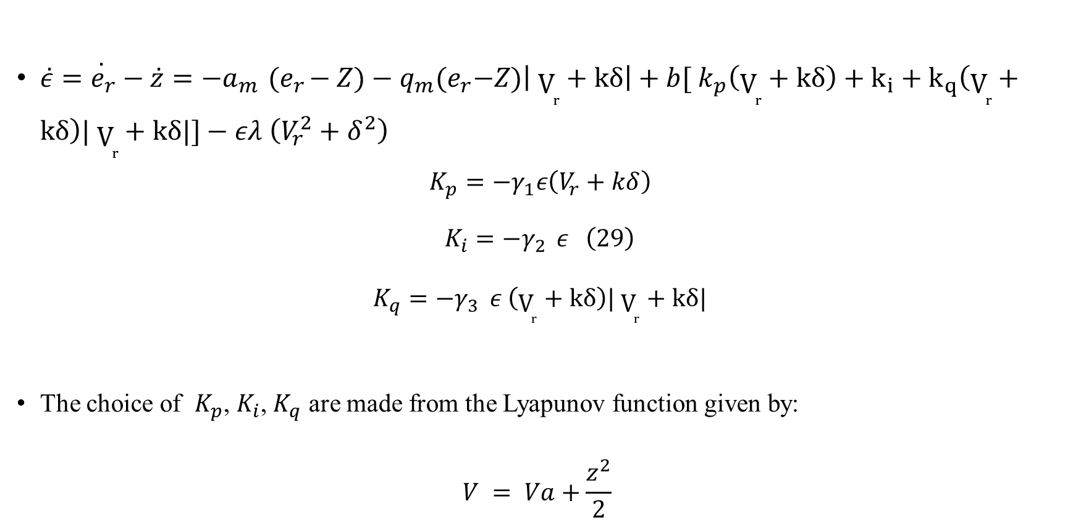
Adaptive PIQ Controller design
$\dot{\dot{ε}=e_{r}−\dot{z}}=−a_{m}{ (e}_{r}−Z)−q_{m}{(e}_{r}−Z)\left| V_{r}+kδ\right|+b[{ k}_{p}\left(V_{r}+kδ\right)+k_{i}+k_{q}\left(V_{r}+kδ\right)| V_{r}+kδ|]−ελ \left(V_{r}^{2}+δ^{2}\right)$
$$K_{p}=−γ_{1}ε\left(V_{r}+kδ\right)$$
$$\begin{aligned}K_{i}=−γ_{2 } ε \#\left(29\right)\end{aligned}$$
$$K_{q}=−γ_{3 } ε \left(V_{r}+kδ\right)| V_{r}+kδ|$$
The choice of $K_{p}$, $K_{i}$, $K_{q}$ are made from the Lyapunov function given by:
$$\begin{aligned}V = Va+\frac{z^{2}}{2} \#\end{aligned}$$

Slide 12
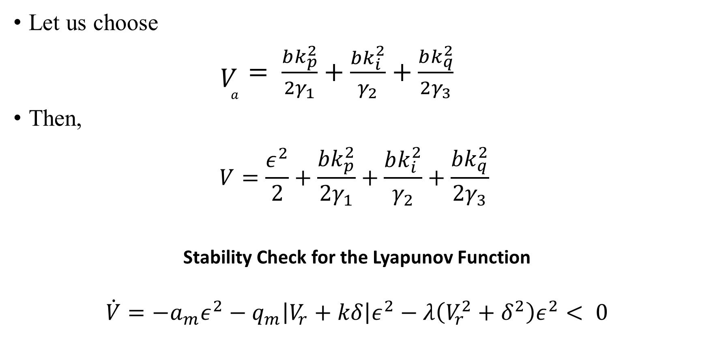
Adaptive PIQ Controller design
Let us choose
$\begin{aligned}V_{a}= \frac{bk_{p}^{2}}{2γ_{1}}+\frac{bk_{i}^{2}}{γ_{2}}+\frac{bk_{q}^{2}}{2γ_{3}} \#\end{aligned}$
Then,
$$\begin{aligned}V=\frac{ε^{2}}{2}+\frac{bk_{p}^{2}}{2γ_{1}}+\frac{bk_{i}^{2}}{γ_{2}}+\frac{bk_{q}^{2}}{2γ_{3}} \#\end{aligned}$$
Stability Check for the Lyapunov Function
$$\dot{V}=−a_{m}ε^{2}−q_{m}\left|V_{r}+kδ\right|ε^{2}−λ\left(V_{r}^{2}+δ^{2}\right)ε^{2}< 0$$

Slide 13

Adaptive PIQ Controller design
State Space Form
$$\left[\begin{matrix}{\dot{V}}_{f} \\ \dot{ε}\end{matrix}\right]=\left[\begin{matrix}a+bk_{p}\left|V_{r}+kδ\right| & 0 \\ bk_{p}\left|V_{r}+kδ\right| & −a_{m}−q_{m}\left|V_{r}+kδ\right|+λ \left(V_{r}^{2}+δ^{2}\right)\end{matrix}\right]\left[\begin{matrix}V_{r}+kδ \\ ε\end{matrix}\right]+ \left[\begin{matrix}1 & 1 \\ 0 & 1\end{matrix}\right]\left[\begin{matrix}b k_{i} \\ d\end{matrix}\right]$$
Where
$A=\left[\begin{matrix}a+bk_{p}|V_{r}+kδ| & 0 \\ bk_{p}|V_{r}+kδ| & −a_{m}−q_{m}\left|V_{r}+kδ\right|+λ \left(V_{r}^{2}+δ^{2}\right)\end{matrix}\right]$ $X= \left[\begin{matrix}V_{r}+kδ \\ ε\end{matrix}\right]$
$\dot{X}= \left[\begin{matrix}{\dot{V}}_{r}+k\dot{δ} \\ \dot{ε}\end{matrix}\right]$ $BU=\left[\begin{matrix}bk_{i} & d \\ bk_{i} & o\end{matrix}\right]\left[\begin{matrix}1 \\ 1\end{matrix}\right]$

Slide 14
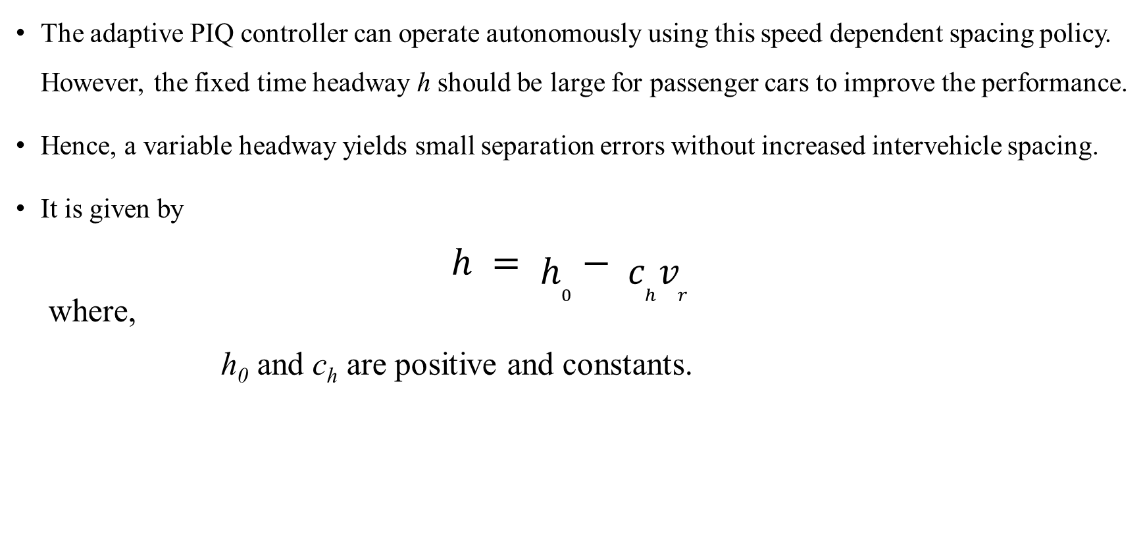
Variable Time Headway – Nonlinear Spacing
The adaptive PIQ controller can operate autonomously using this speed dependent spacing policy. However, the fixed time headway h should be large for passenger cars to improve the performance.
Hence, a variable headway yields small separation errors without increased intervehicle spacing.
It is given by
$$\begin{aligned}h = h_{0}− c_{h}v_{r} \#\end{aligned}$$
where,
h₀ and c_{h} are positive and constants.

Slide 15
Variable Separation Gain
Another modification that can be done is to introduce variable separation gain k given by
k = c_{k} + (k₀ – c_{k} ) e^{(-δ^2) *σ}
Where
0<c_{k}<k₀ and σ≥0.
This design modification is to reduce the undesirable aggressive reaction of the controller for large separation with high acceleration. The gain also gets reduced even when the separation error is negative

Slide 16
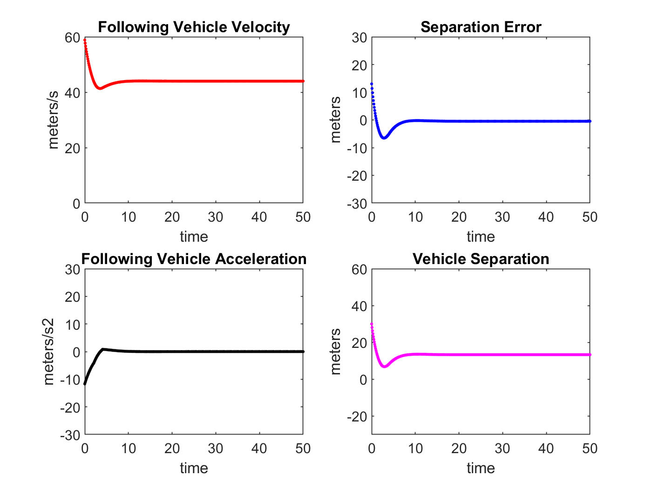
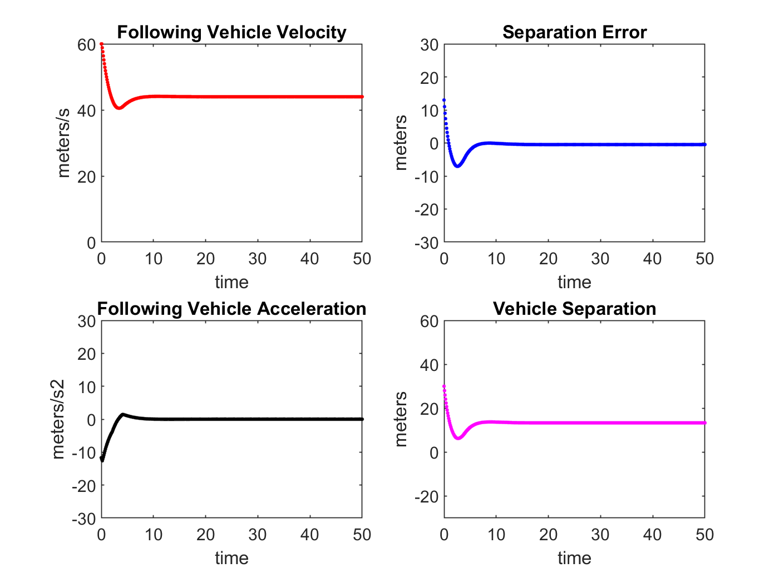
Simulations of Adaptive PIQ Controller Fixed spacing policy
Figure: No actuator delay
Figure: With actuator delay of 0.2s

Slide 17
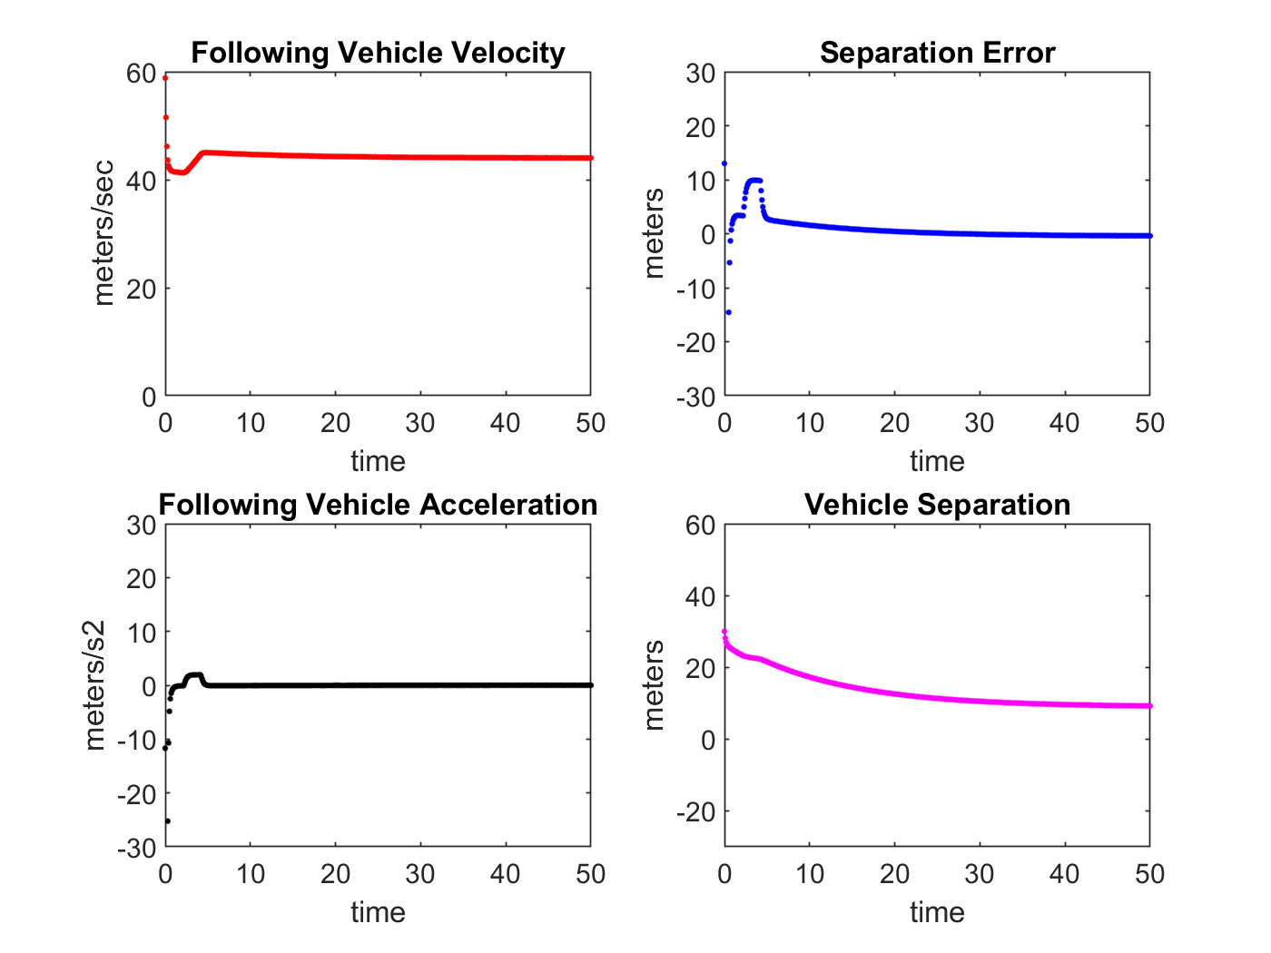
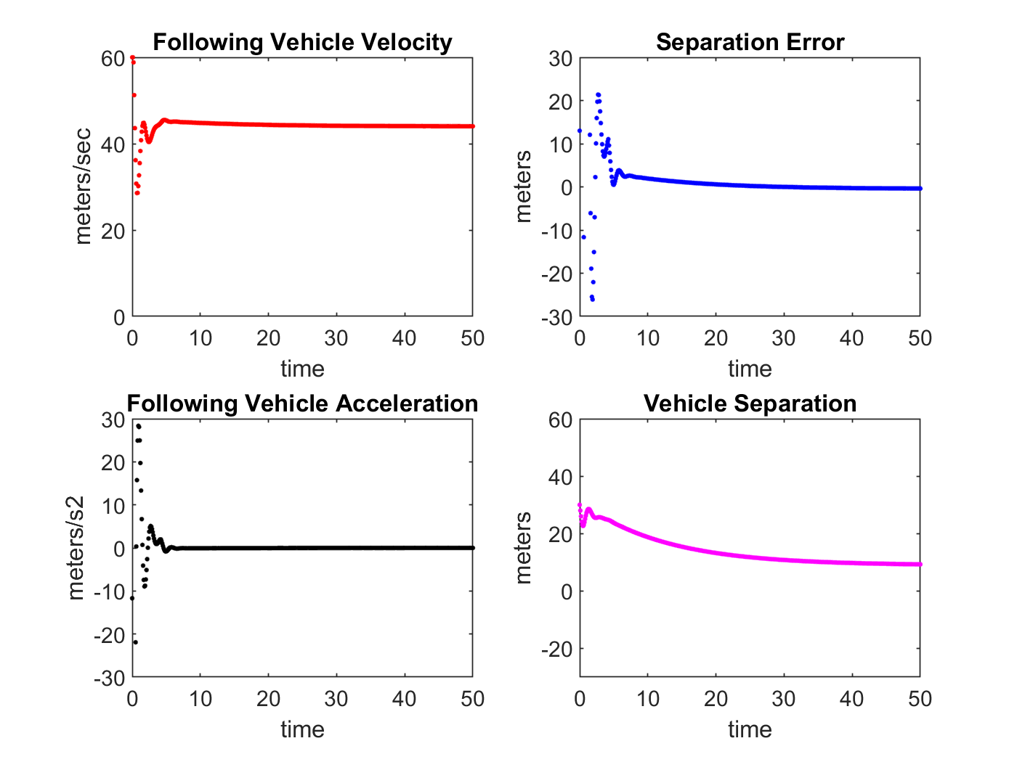
Simulations of Adaptive PIQ Controller with Variable Time Headway
Figure: No actuator delay
Figure: With actuator delay

Slide 18
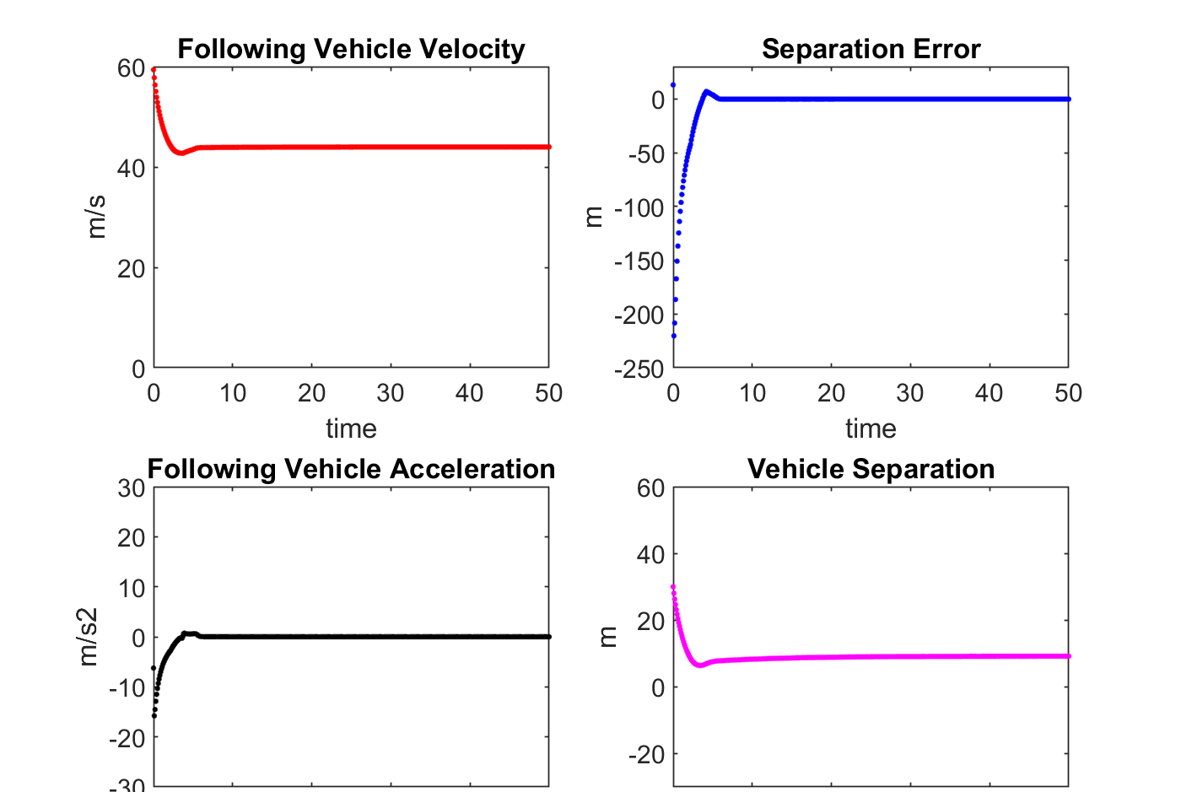

Simulations of Adaptive PIQ Controller with Variable Time Headway and Variable Separation Gain
Figure: No actuator delay
Figure: With actuator delay

Slide 19
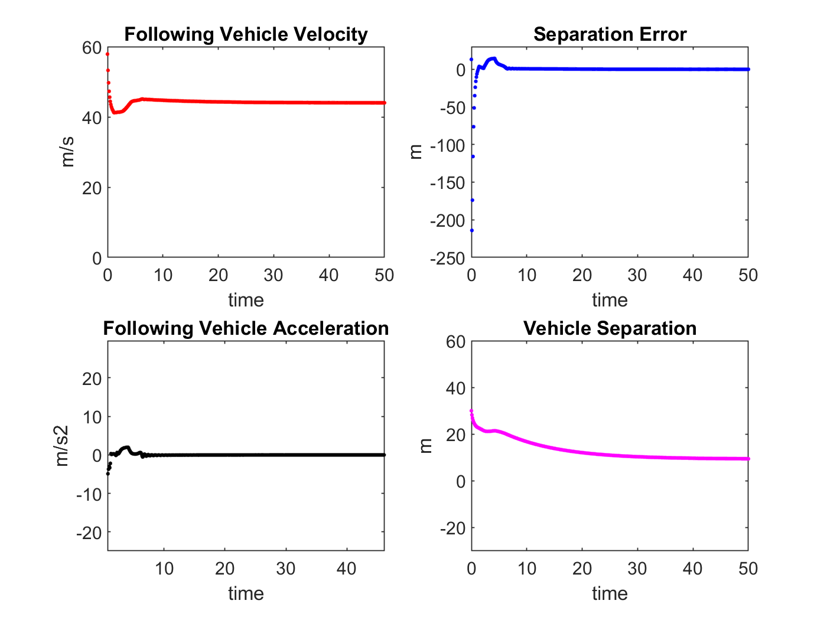
Simulations of Adaptive PIQ Controller with Variable Time Headway and Variable Separation Gain
Figure: With actuator delay and high PIQ Gain

Slide 20
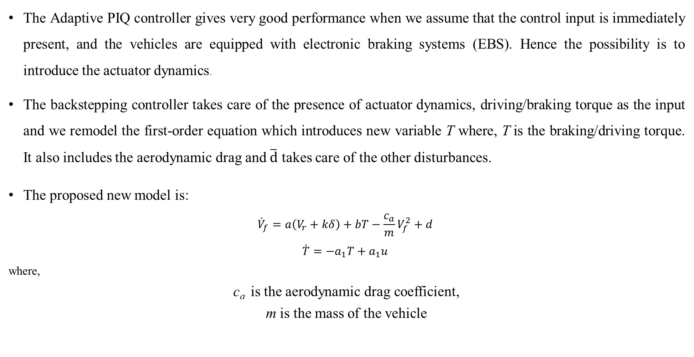
Backstepping Controller
The Adaptive PIQ controller gives very good performance when we assume that the control input is immediately present, and the vehicles are equipped with electronic braking systems (EBS). Hence the possibility is to introduce the actuator dynamics.
The backstepping controller takes care of the presence of actuator dynamics, driving/braking torque as the input and we remodel the first-order equation which introduces new variable T where, T is the braking/driving torque. It also includes the aerodynamic drag and $\overline{d}$ takes care of the other disturbances.
The proposed new model is:
$$\begin{aligned}{\dot{V}}_{f}=a\left(V_{r}+kδ\right)+bT−\frac{c_{a}}{m}V_{f}^{2}+d \#\end{aligned}$$
$$\begin{aligned}\dot{T}=−a_{1}T+a_{1}u \#\end{aligned}$$
where,
c_{a} is the aerodynamic drag coefficient,
m is the mass of the vehicle

Slide 21
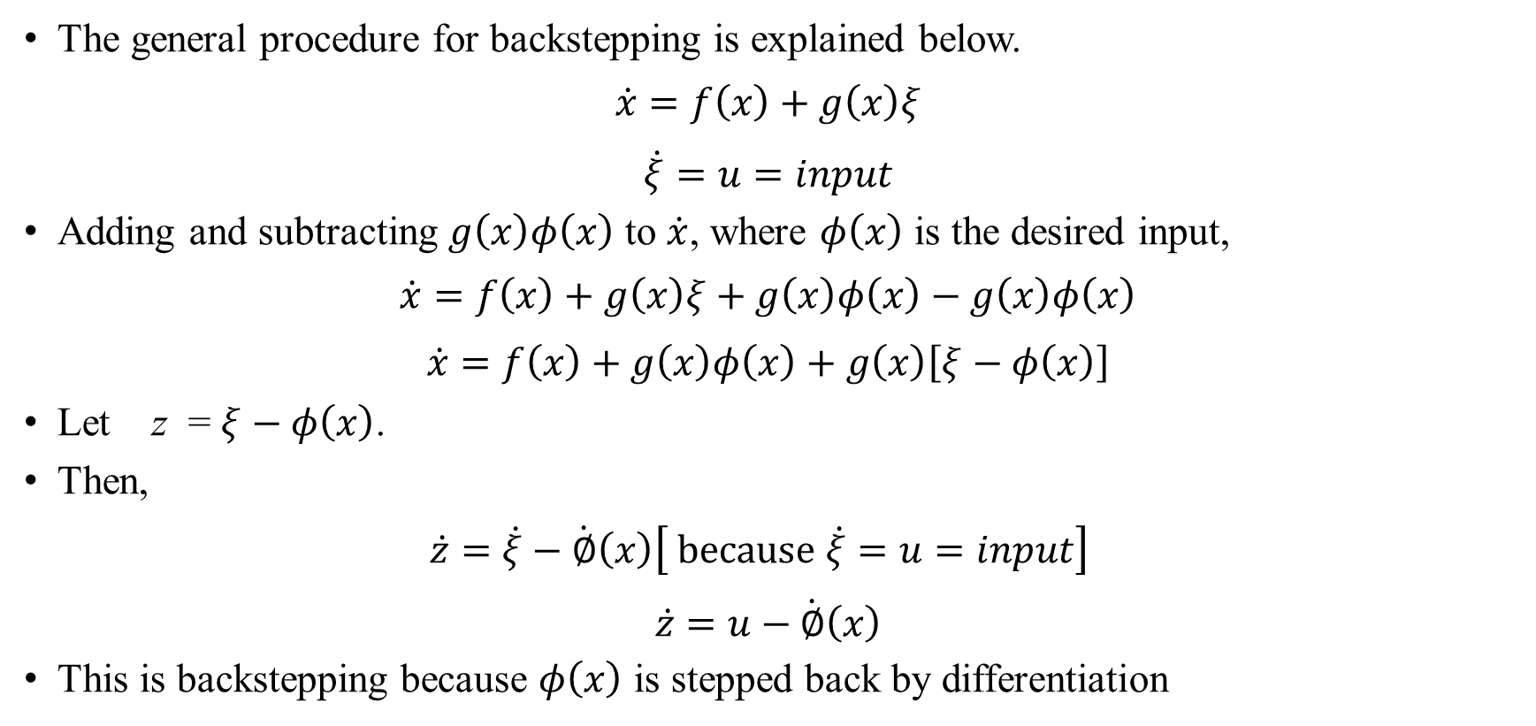
Generalized form for Backstepping Controller
The general procedure for backstepping is explained below.
$$\begin{aligned}\dot{x}=f\left(x\right)+g\left(x\right)ξ \end{aligned}$$
$$\begin{aligned}\dot{ξ}=u=input \end{aligned}$$
Adding and subtracting $g\left(x\right)φ\left(x\right)$ to $\dot{x}$, where $φ\left(x\right)$ is the desired input,
$$\begin{aligned}\dot{x}=f\left(x\right)+g\left(x\right)ξ+g\left(x\right)φ\left(x\right)−g\left(x\right)φ\left(x\right) \#\end{aligned}$$
$$\begin{aligned}\dot{x}=f\left(x\right)+g\left(x\right)φ\left(x\right)+g\left(x\right)\left[ξ−φ\left(x\right)\right] \#\end{aligned}$$
Let z = $ξ−φ\left(x\right)$.
Then,
$$\begin{aligned}\dot{z}=\dot{ξ}−\dot{∅}\left(x\right)\left[ because \dot{ξ}=u=input\right] \end{aligned}$$
$$\begin{aligned}\dot{z}=u−\dot{∅}\left(x\right) \#\end{aligned}$$
This is backstepping because $φ\left(x\right)$ is stepped back by differentiation

Slide 22
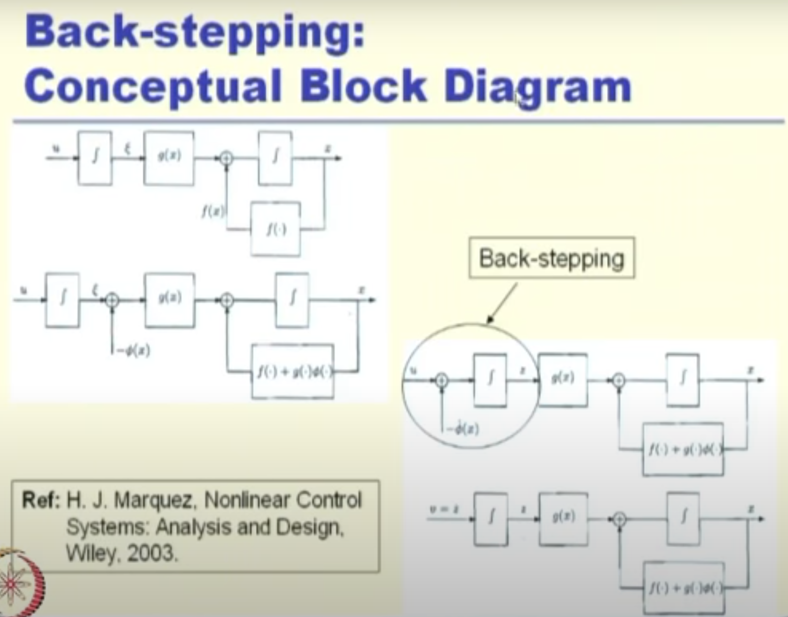
Generalized form for Backstepping Controller

Slide 23
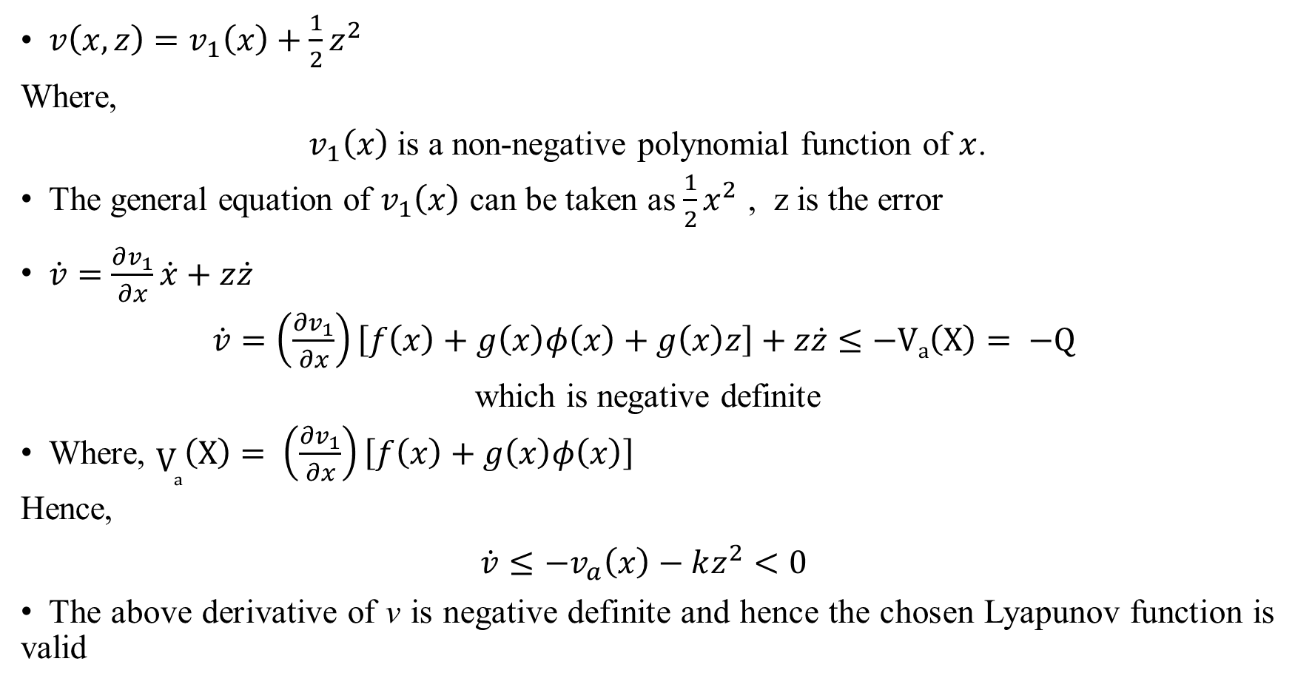
Choice of Lyapunov Function
$\begin{aligned}v\left(x,z\right)=v_{1}\left(x\right)+\frac{1}{2}z^{2} \#\end{aligned}$
Where,
$v_{1}\left(x\right)$ is a non-negative polynomial function of $x$.
The general equation of $v_{1}\left(x\right)$ can be taken as $\frac{1}{2}x^{2}$ , z is the error
$\begin{aligned}\dot{v}=\frac{∂v_{1}}{∂x}\dot{x}+z\dot{z} \#\end{aligned}$
$\begin{aligned}\dot{v}=\left(\frac{∂v_{1}}{∂x}\right)\left[f\left(x\right)+g\left(x\right)φ\left(x\right)+g\left(x\right)z\right]+z\dot{z}≤−Va\left(X\right)= −Q \#\end{aligned}$
which is negative definite
Where, $\begin{aligned}V_{a}\left(X\right)= \left(\frac{∂v_{1}}{∂x}\right)\left[f\left(x\right)+g\left(x\right)φ\left(x\right)\right]\#\end{aligned}$
Hence,
$$\begin{aligned}\dot{v}≤−v_{a}\left(x\right)−kz^{2}<0 \#\end{aligned}$$
The above derivative of v is negative definite and hence the chosen Lyapunov function is valid

Slide 24
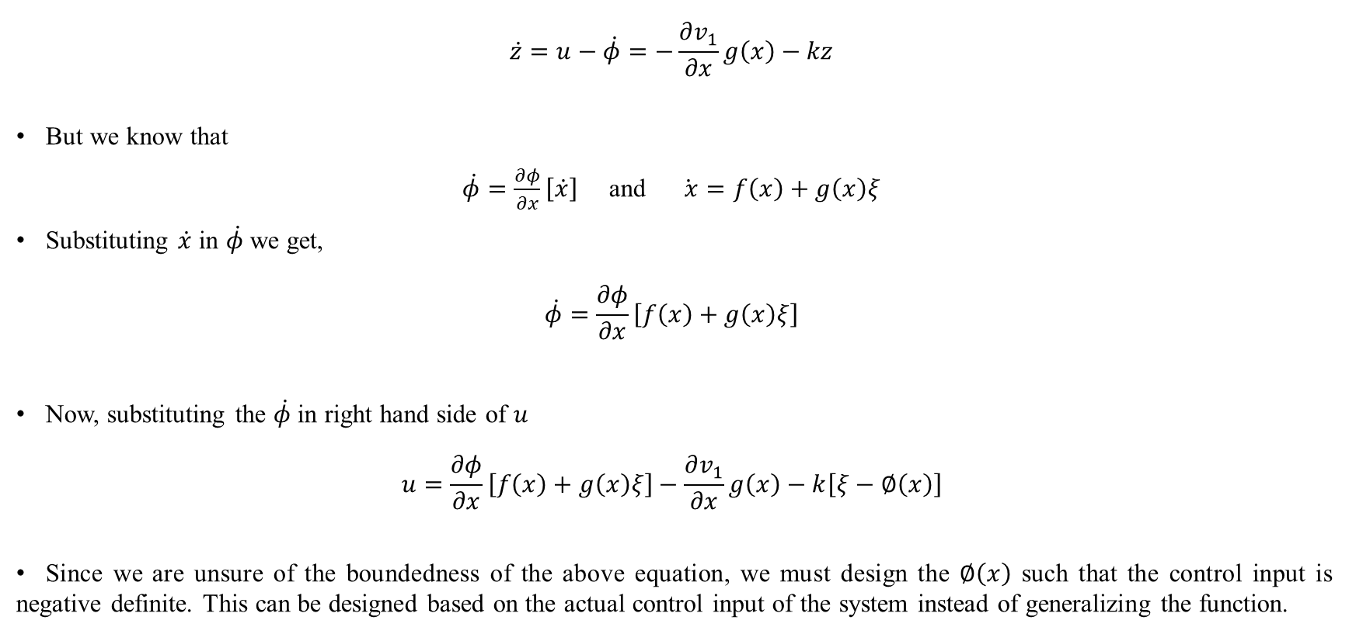
Designing the Control Input
$$\begin{aligned}\dot{z}=u−\dot{φ}=−\frac{∂v_{1}}{∂x}g\left(x\right)−kz \#\end{aligned}$$
But we know that
$\dot{φ}=\frac{∂φ}{∂x}\left[\dot{x}\right]$ and $\dot{ x}=f\left(x\right)+g\left(x\right)ξ$
Substituting $\dot{x}$ in $\dot{φ}$ we get,
$$\begin{aligned}\dot{φ}=\frac{∂φ}{∂x}\left[f\left(x\right)+g\left(x\right)ξ\right] \#\end{aligned}$$
Now, substituting the $\dot{φ}$ in right hand side of $u$
$$u=\frac{∂φ}{∂x}\left[f\left(x\right)+g\left(x\right)ξ\right]−\frac{∂v_{1}}{∂x}g\left(x\right)−k\left[ξ−∅\left(x\right)\right]$$
Since we are unsure of the boundedness of the above equation, we must design the $∅\left(x\right)$ such that the control input is negative definite. This can be designed based on the actual control input of the system instead of generalizing the function.

Slide 25
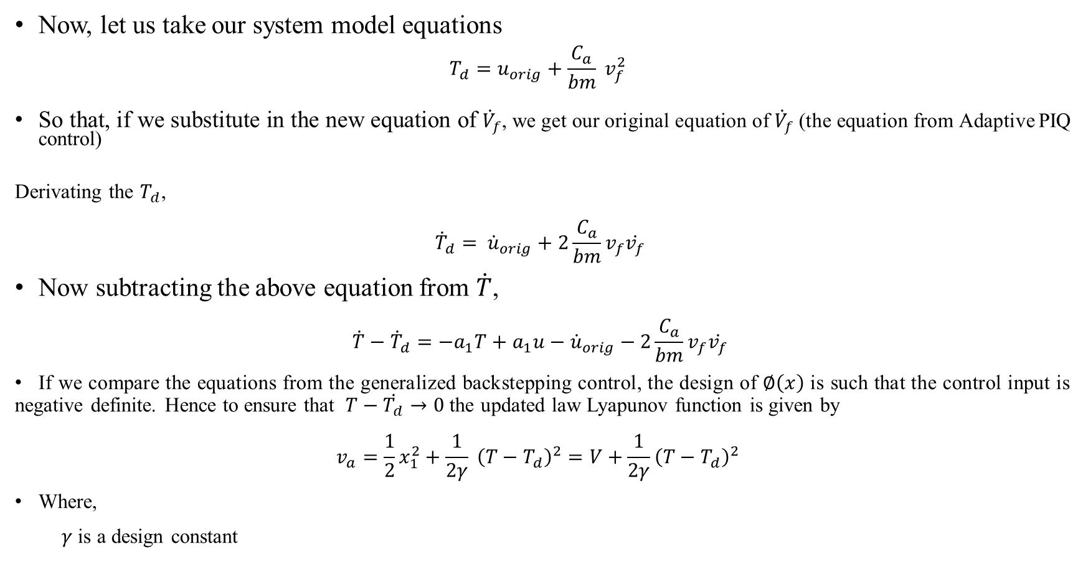
Design of Control Input for the System Model
Now, let us take our system model equations
$$\begin{aligned}T_{d}=u_{orig}+\frac{C_{a}}{bm} v_{f}^{2} \#\end{aligned}$$
So that, if we substitute in the new equation of ${\dot{V}}_{f}$, we get our original equation of ${\dot{V}}_{f}$ (the equation from Adaptive PIQ control)
Derivating the $T_{d}$,
$$\begin{aligned}{\dot{T}}_{d}= {\dot{u}}_{orig}+2\frac{C_{a}}{bm}v_{f}\dot{v_{f}} \#\end{aligned}$$
Now subtracting the above equation from $\dot{T}$,
$$\begin{aligned}\dot{T}−{\dot{T}}_{d}=−a_{1}T+a_{1}u−{\dot{u}}_{orig}−2\frac{C_{a}}{bm}v_{f}\dot{v_{f}} \#\end{aligned}$$
If we compare the equations from the generalized backstepping control, the design of $∅\left(x\right)$ is such that the control input is negative definite. Hence to ensure that $T−\dot{T_{d}}→0$ the updated law Lyapunov function is given by
$$\begin{aligned}v_{a}=\frac{1}{2}x_{1}^{2}+\frac{1}{2γ} {\left(T−T_{d}\right)}^{2}=V+\frac{1}{2γ}{\left(T−T_{d}\right)}^{2} \#\end{aligned}$$
Where,
$γ$ is a design constant

Slide 26
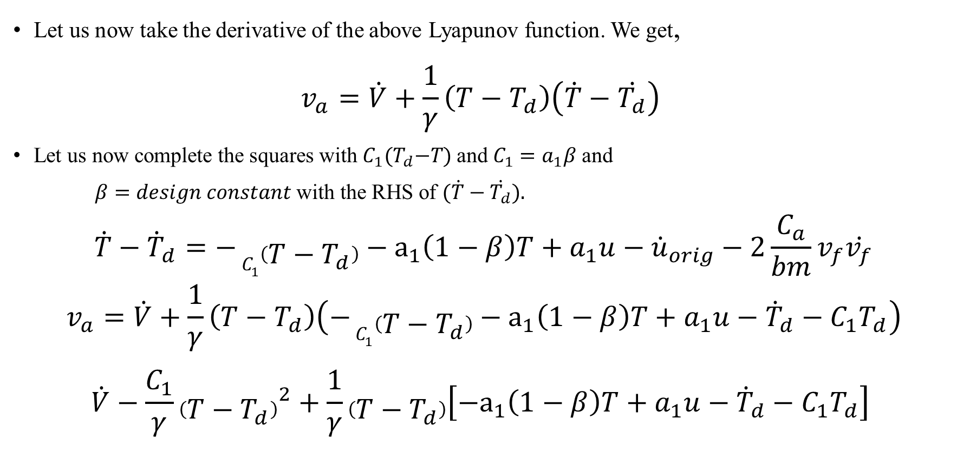
Design of Control Input for the System Model
Let us now take the derivative of the above Lyapunov function. We get,
$$\begin{aligned}v_{a}=\dot{V}+\frac{1}{γ}\left(T−T_{d}\right)\left(\dot{T}−\dot{T_{d}}\right) \#\end{aligned}$$
Let us now complete the squares with${ C}_{1}{(T}_{d}−T$) and $C_{1}=a_{1}β$ and
$β=design constant$ with the RHS of $(\dot{T}−\dot{T_{d}})$.
$$\dot{T}−{\dot{T}}_{d}=− C_{1}\left(T−T_{d}\right)−a_{1}\left(1−β\right)T+a_{1}u−{\dot{u}}_{orig}−2\frac{C_{a}}{bm}v_{f}\dot{v_{f}}$$
$$\begin{aligned}v_{a}=\dot{V}+\frac{1}{γ}\left(T−T_{d}\right)\left(− C_{1}\left(T−T_{d}\right)−a_{1}\left(1−β\right)T+a_{1}u−{\dot{T}}_{d}−C_{1}T_{d}\right)\#\end{aligned}$$
$$\begin{aligned}\dot{V}−\frac{C_{1}}{γ}{\left(T−T_{d}\right)}^{2}+\frac{1}{γ}\left(T−T_{d}\right)\left[−a_{1}\left(1−β\right)T+a_{1}u−{\dot{T}}_{d}−C_{1}T_{d}\right] \#\end{aligned}$$

Slide 27
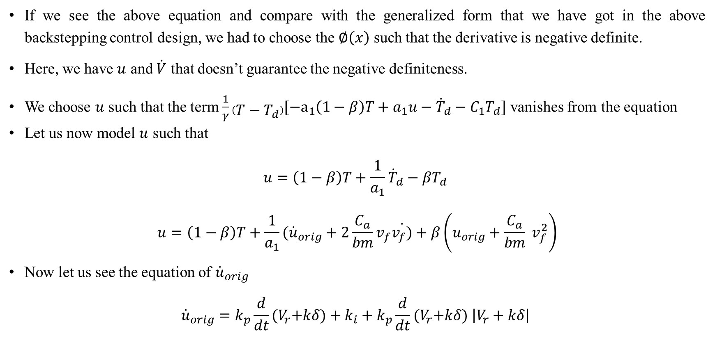
Design of Control Input for the System Model
If we see the above equation and compare with the generalized form that we have got in the above backstepping control design, we had to choose the $∅\left(x\right)$ such that the derivative is negative definite.
Here, we have $u$ and $\dot{V}$ that doesn’t guarantee the negative definiteness.
We choose $u$ such that the term $\frac{1}{γ}\left(T−T_{d}\right)[−a_{1}\left(1−β\right)T+a_{1}u−{\dot{T}}_{d}−C_{1}T_{d}]$ vanishes from the equation
Let us now model $u$ such that
$$\begin{aligned}u=\left(1−β\right)T+\frac{1}{a_{1}}{\dot{T}}_{d}−βT_{d} \#\end{aligned}$$
$$u=\left(1−β\right)T+\frac{1}{a_{1}}({\dot{u}}_{orig}+2\frac{C_{a}}{bm}v_{f}\dot{v_{f})}+β\left(u_{orig}+\frac{C_{a}}{bm} v_{f}^{2}\right)$$
Now let us see the equation of ${\dot{u}}_{orig}$
$${\dot{u}}_{orig}=k_{p}\frac{d}{dt}{(V}_{r}+kδ)+k_{i}+k_{p}\frac{d}{dt}{(V}_{r}+kδ) \left|V_{r}+kδ\right|$$

Slide 28
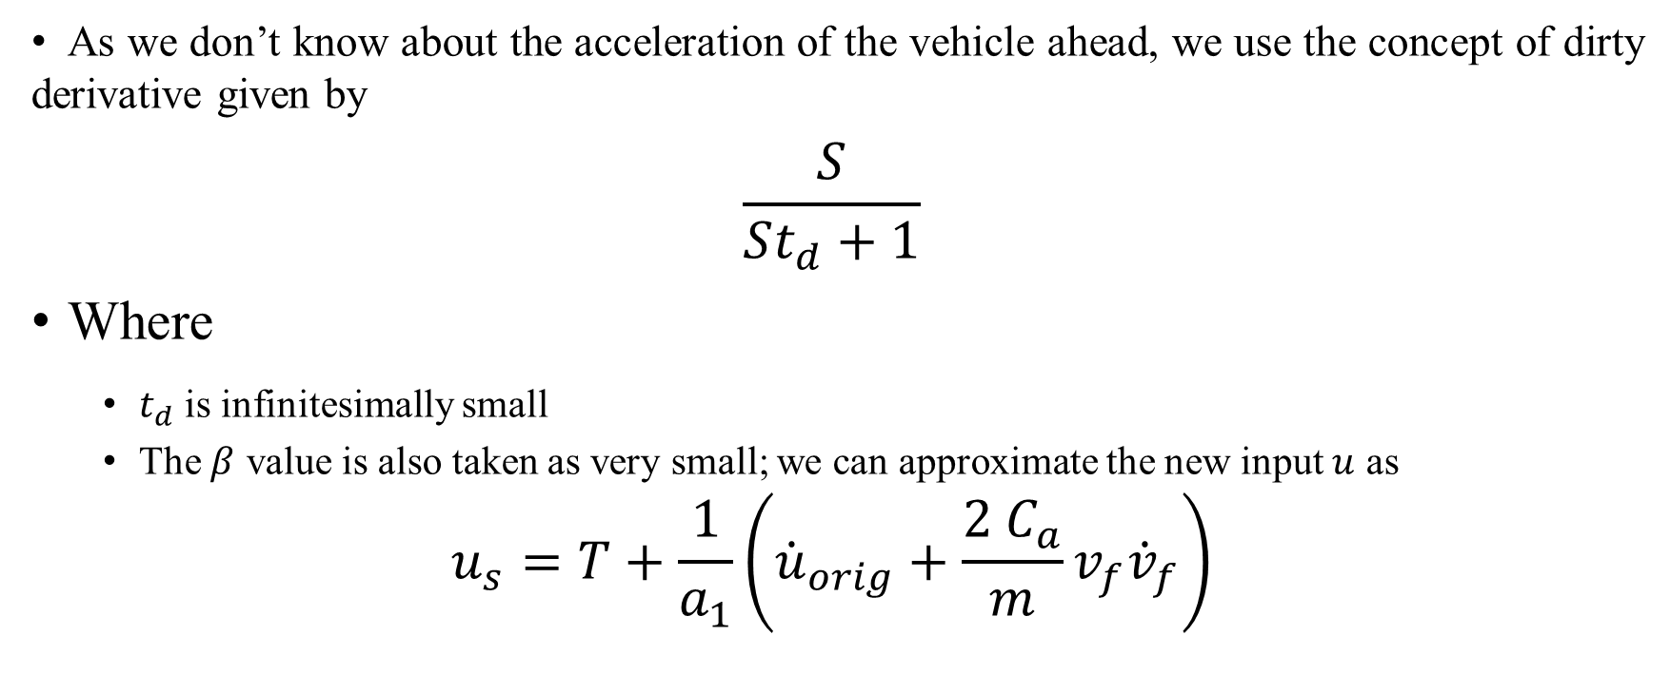
Design of Control Input for the System Model
As we don’t know about the acceleration of the vehicle ahead, we use the concept of dirty derivative given by
$$\begin{aligned}\frac{S}{St_{d}+1} \#\end{aligned}$$
Where
$t_{d}$ is infinitesimally small
The $β$ value is also taken as very small; we can approximate the new input $u$ as
$$\begin{aligned}u_{s}=T+\frac{1}{a_{1}}\left({\dot{u}}_{orig}+\frac{2 C_{a}}{m}v_{f}{\dot{v}}_{f}\right) \#\end{aligned}$$

Slide 29
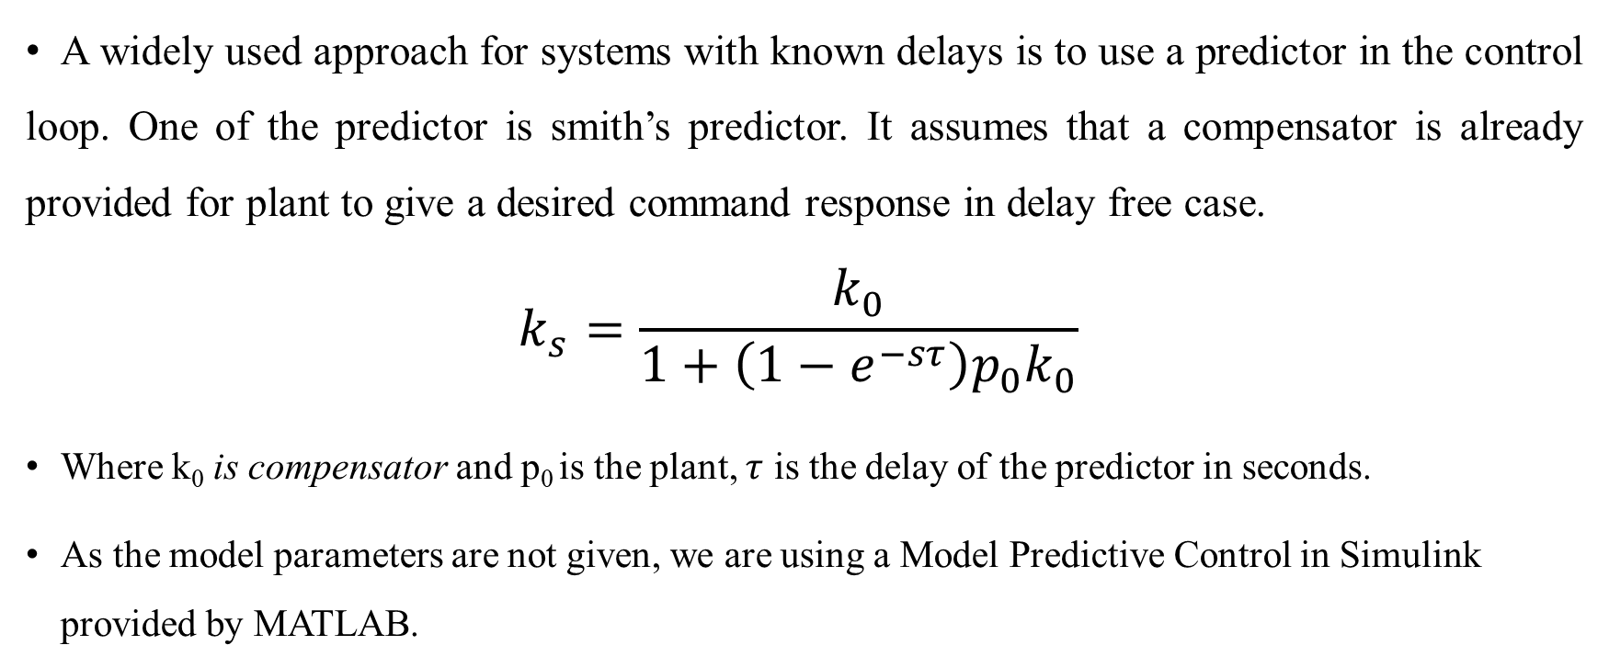
Predictive Design
A widely used approach for systems with known delays is to use a predictor in the control loop. One of the predictor is smith’s predictor. It assumes that a compensator is already provided for plant to give a desired command response in delay free case.
$$\begin{aligned}k_{s}=\frac{k_{0}}{1+\left(1−ⅇ^{−sτ}\right)p_{0}k_{0}} \#\end{aligned}$$
Where k₀ is compensator and p₀ is the plant, $τ$ is the delay of the predictor in seconds.
As the model parameters are not given, we are using a Model Predictive Control in Simulink provided by MATLAB.

Slide 30
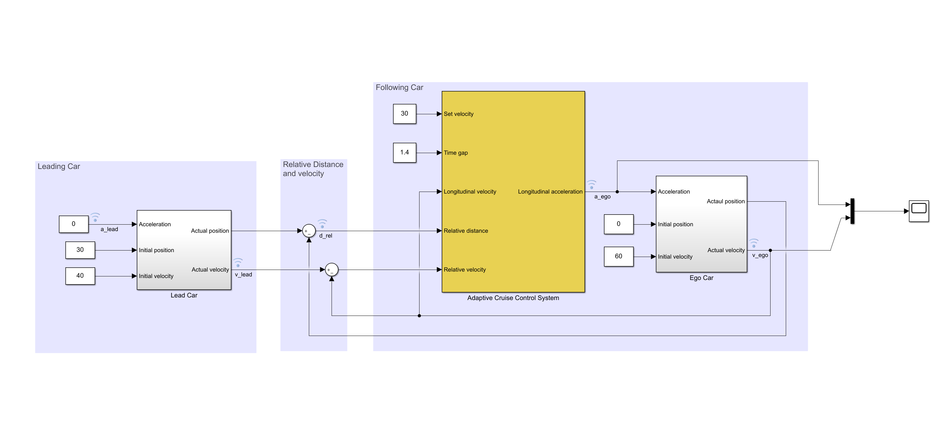
Model Predictive Control
Figure: Model Predictive Cruise Control using Simulink

Slide 31
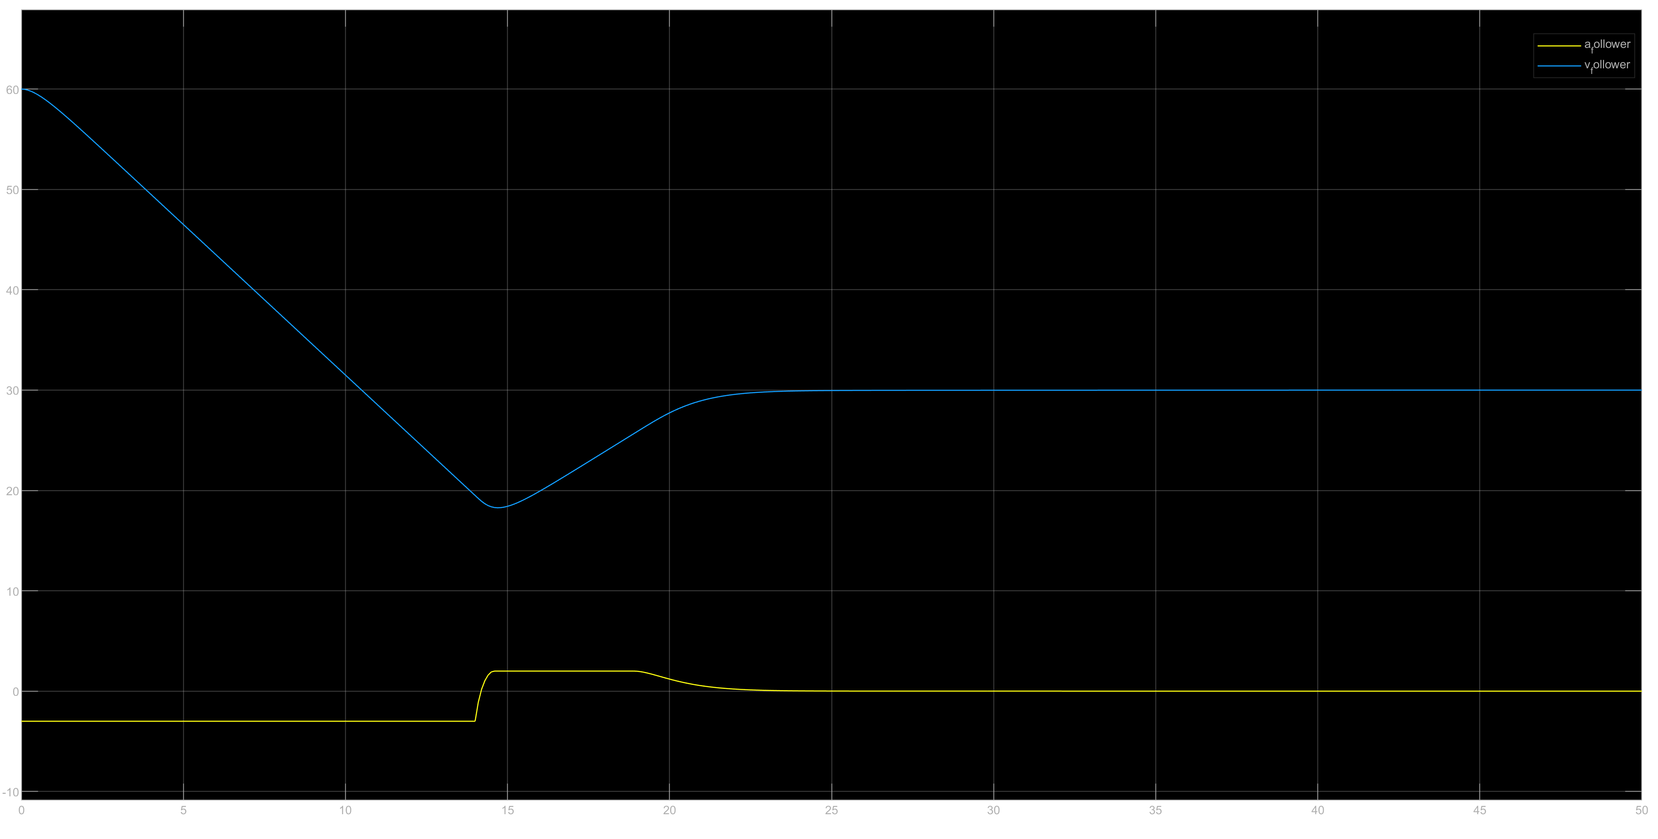
MP Cruise Control Simulation Fixed Spacing
Figure: Model Predictive Control with time gap of 1.4s

Slide 32
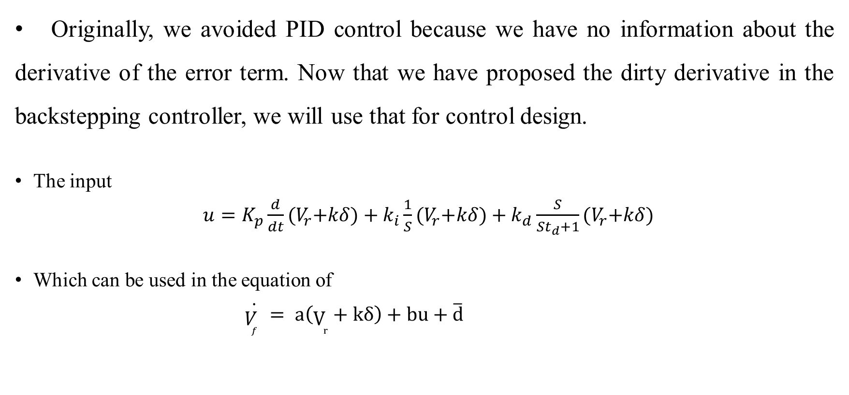
PID Controller
Originally, we avoided PID control because we have no information about the derivative of the error term. Now that we have proposed the dirty derivative in the backstepping controller, we will use that for control design.
The input
$u=K_{p}\frac{d}{dt}{(V}_{r}+kδ)+k_{i}\frac{1}{S}{(V}_{r}+kδ)+k_{d}\frac{S}{St_{d}+1}{(V}_{r}+kδ)$
Which can be used in the equation of
$$\begin{aligned} \dot{V_{f} }= a\left(V_{r}+kδ\right)+bu+\overline{d} \end{aligned}$$

Slide 33


PID Controller Simulations with Variable Time Headway and Variable Separation Gain
Figure: No actuator delay
Figure: With actuator delay

Slide 34
Conclusions
In the Adaptive PIQ controller with variable time headway and variable separation gain, we can see that we had to reduce the PIQ gains so that the error is reduced, and the cruise is smooth. This is because of the separation gain and the headway are function of the relative velocity.
If we compare the nonlinear PID controller with the Adaptive PIQ controller, the simulations are nearly close and hence we can assume that the complexity can be reduced in the form of converting the PIQ to PID, thus reducing the manufacturing cost and hardware complexity.
The variable time headway and variable separation gain has made the relative distance between the follower and leader smoother for changes in the acceleration of leader. The changes were encountered in the separation error.
The controller with Model Predictive Control did not give better performance than the ones without Model Predictive Control. For some velocities, the vehicles collided with each other.

Slide 35
Future Scope
This work can be extended for simulating the model with multiple followers and intervehicle communication.
The backstepping controller, backstepping with prediction were not simulated in this report due to insufficient parameters but can be designed with proper information.
This design of controllers can be extended for other systems where there is no information about the system parameters except the control objective.

Slide 36
GitHub link for Simulations
Link:
https://github.com/okritvik/ENPM-667_Project-1
Questions can be emailed to:
okritvik@umd.edu
sairamp@umd.edu

Slide 37
THANK YOU

