Slide 1
GDB ( GNU Debugger)
Tutorial 1
呂宗穎

Slide 2
GDB? What is that?
GDB is a free debugger that runs on many Unix-like systems
Easy to print the value
Don’t need to edit your code than you can dynamic change the value
Print some special value
ex: stack, pc…

Slide 3
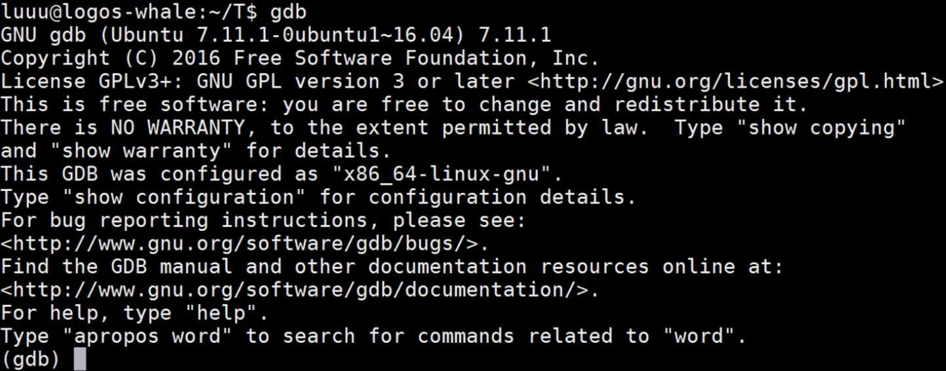
How to start GDB?
Add -g into the command-line
Input GDB to enter the GDB interface
Notes:
在compile程式

Slide 4

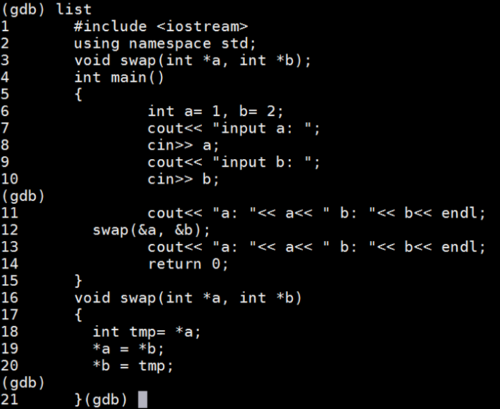
Load instruction
file exec. （load file ）
list （show your code）

Slide 5
Breakpoint instruction
break n （set the breakpoint in line n）
clear n （clear the line n breakpoint）
break func（set the breakpoint in func）

Slide 6
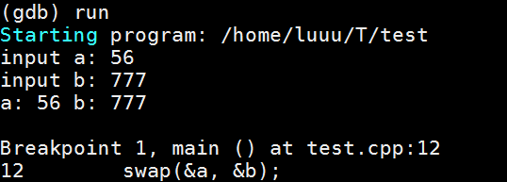

Runtime instruction
run （It will stop at the breakpoint）
continue

Slide 7

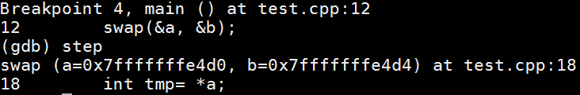
Runtime instruction
next （execute the function directly）
step （execute the function step by step）

Slide 8
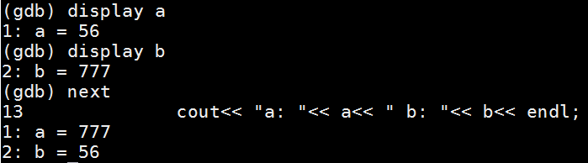
Runtime instruction
display var（show var every time when you execute next/step）

Slide 9
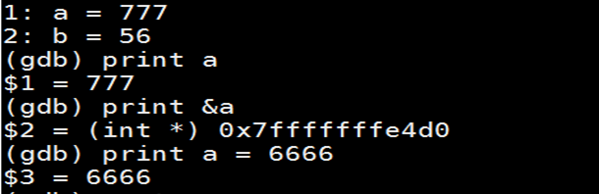
Runtime instruction
print var （show the var once time）
print &var （show the var’s address once time）
print var = value （set the var’s value）

Slide 10
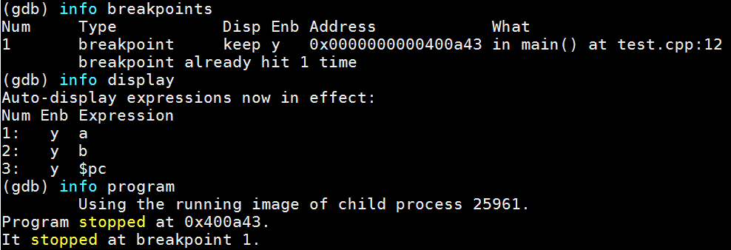
Info instruction
Show the program’s information
Notes:
disable display 1

Slide 11
Other instruction
help
q （exit gdb）
delete break # （delete the # breakpoint）
delete display # （delete the ＃ display）

Slide 12
More learn !
Debugging with GDB http://www.study-area.org/goldencat/debug.htm
Basis gdb http://www.study-area.org/cyril/opentools/opentools/x1253.html
GNU GDB online document https://sourceware.org/gdb/onlinedocs/gdb/

