Slide 1

Logos Lab
Kung Chen Chin

Slide 2
Outline
Concept
Basic
Remote Repository Collaboration
How to Use Git in Project?

Slide 3
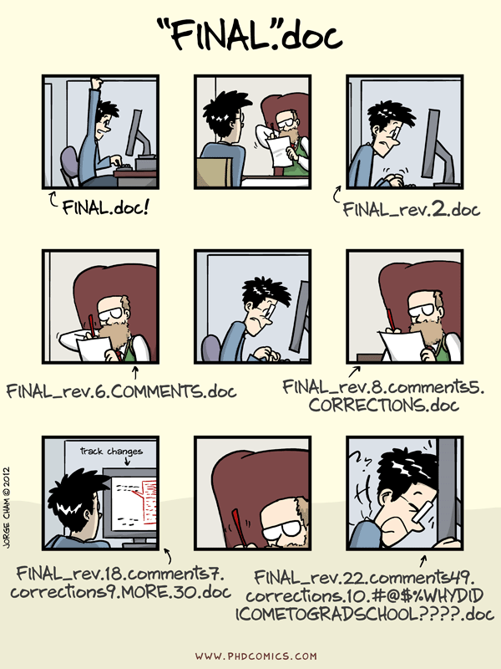
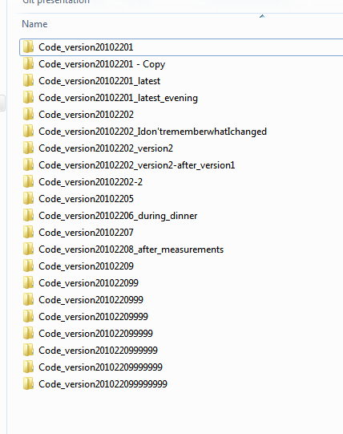
Story Before Version Control
Identify version by long file name
No history record
Tons of files in different version and name
Hard to manage
How to collaborate with team?
Modify same file simultaneously
Notes:
調查同學是否有 過了很久回去看 文件or Code，不記得修改的地方？(one person version control:history)
是否和同學co-working，產生大量版本，不知道誰改哪個版本？(collaborative document editing)

Slide 4
How git help you?
Make your life easier
Get rid of tons of files of different versions
Record the snapshot of file and store to history
Know who, when, what modification on the code
Monitor the changes of file
Notes:
Git是紀錄每次修改的差異，保有所有的修改紀錄

Slide 5
Git Setup
Download git for OSX
Download git for Windows
Download git for Linux

Slide 6
Get Started!
git init
Creates a new Git repository
git config
Configure your Git installation (or an individual repository)
--global user.name <name>
--global user.email <email>
git clone
Copies an existing Git repository
Notes:
Init行為

Slide 7
State in Git
(index)
(working tree)
Working
Directory
Staging
Area
.git
Repository
track
commit
Changes in Files
Create file
Snapshot
Cached Area
for next commit
Store the changes
to history with msg.

Slide 8

Add New File
Working
Directory
Staging
Area
.git
Repository
Add New
File
add
Notes:
解釋清楚

Slide 9
git add
git add <file>
Add changes in the working directory to the staging area
Add more then one file for commit
Grouping changes to a complete function
#Changes are not actually recorded until you run git commit

Slide 10
Add New File / Modify File
Working
Directory
Staging
Area
.git
Repository
Add New
File
Modify some
Existed file…
Notes:
解釋清楚

Slide 11
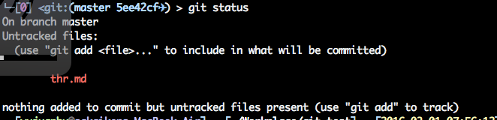
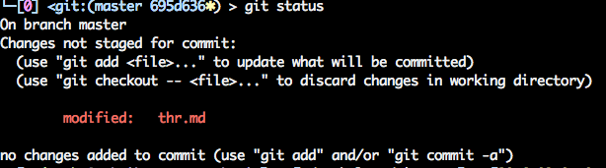
git status
Create new file thr.md
Modified file thr.md

Slide 12
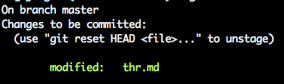
Commit File
Working
Directory
Staging
Area
.git
Repository
commit
Notes:
解釋清楚

Slide 13
git commit
git commit –m “msg”
Commit the staged snapshot to the project history
Canonical msg. format:
a sentence commenting the changes (less than 50 word)
Content of Commit
Identifying hash
When
Who
Commit msg.
Changes … etc

Slide 14
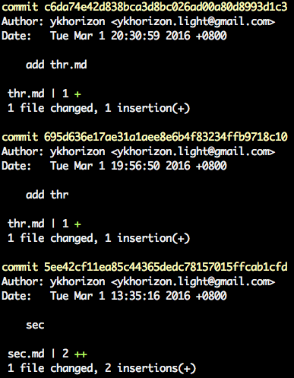
git log
Show all the history
of commits
git log --stat
Notes:
每次提交(commit)，都會有唯一的序號，確保不會衝突。

Slide 15
.gitignore
Specifies intentionally untracked files to be ignored
Add .gitignore in your directory
EX: *.o, executable …etc
Github C++ .gitignore
If files have been committed
(both the repository and staging areas will be deleted)
git rm –cached <file>

Slide 16
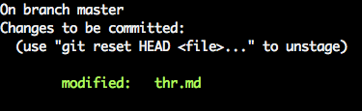
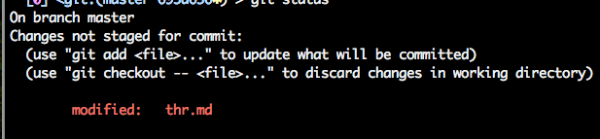
Unstage Modified File from Staging Area
When you add wrong file to staging area
Working
Directory
Staging
Area
Repository
(.git)
But the code in
Working Directory
is not changed
git reset [--mixed] HEAD
Notes:
git rm --cached <file>

Slide 17
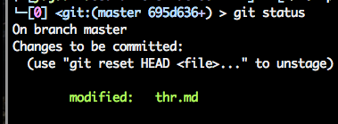
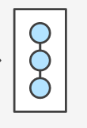
Back Last Commit
When you write wrong commit msg. or forget to add some file.
Working
Directory
Staging
Area
Repository
(.git)
The change from Last Commit is back
You can re-write msg.
Add more file
git reset --soft HEAD^
Notes:
git rm --cached <file>

Slide 18

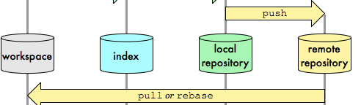
Remote Repository Collaboration
Local
git remote -v
Show remote info.
git push
Upload the local commits to remote
git clone
Copy repository
git pull
Download the remote commits to local & merge
Notes:
加上 github

Slide 19

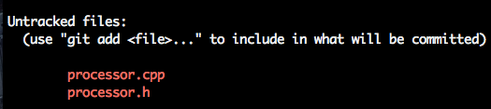
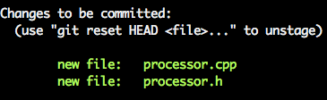
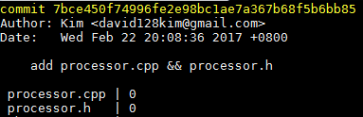

How to Use Git in Project?(1/2)
Git clone
https://github.com/logoslab/Archi2017_Project1
Initial commit, create files in /”project name”/simulator
git status
git add processor.cpp
git add processor.h
git status
git commit –m “add
processor.cpp & processor.h”
git log -stat
Notes:
實際範例

Slide 20
How to Use Git in Project?(2/2)
When you finish a feature in project(which may relate to several files)
Test the functionality is correct
git status
git add processor.cpp
git add processor.h
git status
git commit –m “done jtype decoding”
git log --stat
TA will check you git log during 1-to-1 demo
Notes:
實際範例

Slide 21
Reference
More : git diff, git merge …etc
*Super Easy Git
Git official document
https://www.atlassian.com/git/tutorials/saving-changes/git-add
GitHub Help

