Slide 1
Computer Architecture Tutorial 2
LOGOS LAB
2017/03/28

Slide 2
Outline
Project 1 – Issues
Submission issue
Demo day
Project 2 – Pipeline
Concept
Input & Output
Submission

Slide 3
Project 1 – Issues

Slide 4
Submission issue
Fairness
Your simulator should “make” on our server.
Your output should be same as golden simulator output.
We don’t accept more command options.

Slide 5
NOP instruction
Specify “sll $0, $0, 0” to “NOP”.
0x00000000 is an example.
In “sll”, $rs is don’t care number.

Slide 6


Demo day
Date: 4/07(Fri.)
Time: 15 mins/person
Place: General Building II(綜二) 737、738
Content: makefile, git, gdb, Q&A

Slide 7
Project 2 - Pipeline

Slide 8
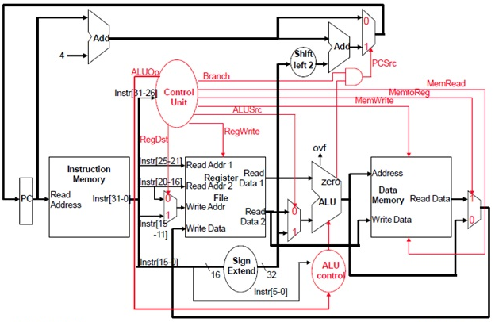
Single Cycle Data Path
Low design complexity
Poor throughput

Slide 9
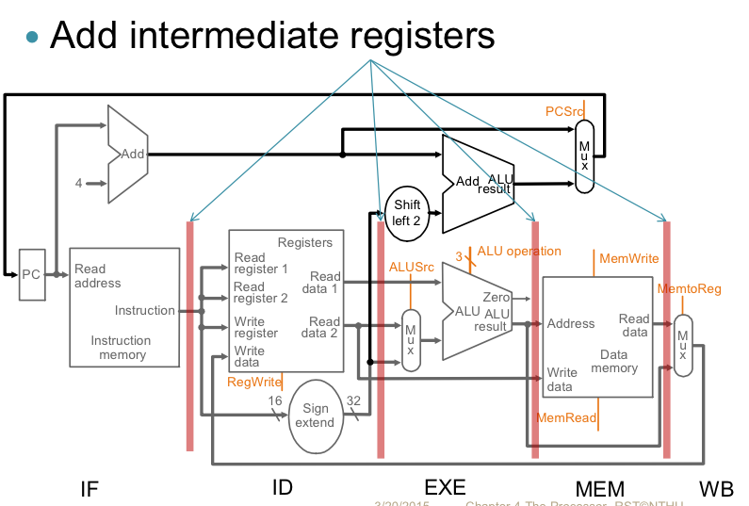
Pipeline
IF/ID
ID/EX
EX/DM
DM/WB
More complex design
High throughput

Slide 10
5 Pipeline Stages
Independent of instruction type
Dependent of instruction type
IF
instruction fetch
PC+4
ID
Read Register File
Sign extension
Control unit decode
Hazard detect, Branch/Jump detect, Branch
EX
ALU
DM
Access data memory
WB
Write value to Register File

Slide 11

Resolving Pipeline Hazards
Data hazard
Stall
Forwarding ( appendix C-2 )
EX/DM to ID
EX/DM to EX
DM/WB to EX
Control hazard
Flush

Slide 12
Forwarding Paths
EX/DM to ID
EX/DM to EX
DM/WB to EX
IF/ID
ID/EX
EX/DM
DM/WB

Slide 13
Input & Output
Input: same as project 1
Output:
snapshot.rpt
Contents of registers
whether an instruction is completely executed
Status of the instruction executing in a pipeline stage
whether to be stalled in next cycle
whether to forward in this cycle
error_dump.rpt
Different listing order

Slide 14
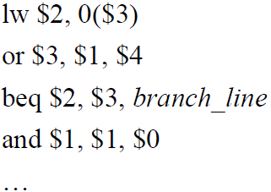

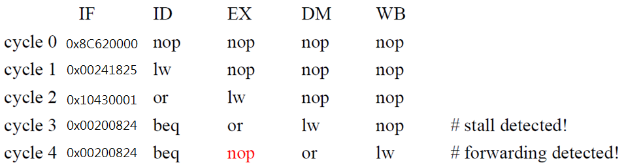
Snapshot: Stall
Data hazard

Slide 15

Snapshot: Forwarding
Data hazard
EX/DM

Slide 16
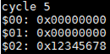
Snapshot: Register contents
…

Slide 17

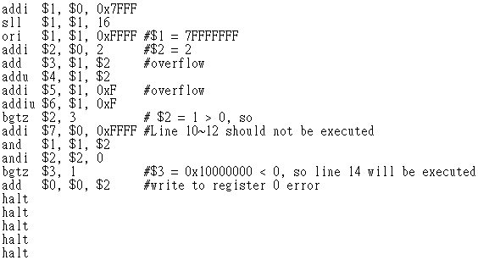

Snapshot: Flush
error_3

Slide 18
Test Case Design
Your test case should cover at least one hazard handling.
The number of NOPs and forwarding paths is not limited.
< 500,000 cycles

Slide 19
Implementation
Initialization: The pipeline is initialized with NOPs in all stages
Termination: after five “halt”s; otherwise invalid

Slide 20
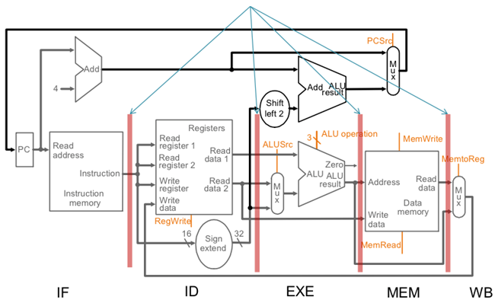
Implementation
Simulation Order (highly recommended)
WB ➔ DM ➔ EX ➔ ID ➔ IF
IF/ID
ID/EX
EX/DM
DM/WB
add $3, $1, $4
lw $1, 0($2)
Notes:
Function角度解釋

Slide 21
Modules
C files
Header files
main.c
simulate.c
instruction.c
regfile.c
memory.c
pipereg.c
piperpt.c
hazard.c
arithmetic.h
simulate.h
instruction.h
regfile.h
memory.h
pipereg.h
piperpt.h
hazard.h

Slide 22
Submission
Same grading policy as that of project 1
1st Submission: 2017/ 4/ 29
2nd Submission: 2017/ 5/ 06

Slide 23
Q&A

