Slide 1
Project 3 Tutorial
CMP (Cache_Memory_Pagetable)
Notes:
今天由我講解implement memory hierarchy

Slide 2
Translation with a TLB
CPU
Cache
Main Memory
Cache
Hit
Cache
Miss
VA
TLB
PA
Disk
TLB Miss
PT Hit
Swap in
PTE
PT Miss
Page Fault
Notes:
Virtual Memory 的機制

Slide 3
Virtual Memory in Modern System
Core
D-TLB
I-TLB
D-Cache
I-Cache
Memory
Disk
Page Table
Notes:
Virtual Memory 在我們現在系統上的架構

Slide 4
CMP Architecture (1/2)
hit
load/store
Instruction
hit
CPU
VA(PC)
d-cache
hit
d-tlb
i-tlb
hit
i-cache
miss
hit
miss
hit
miss
hit
miss
hit
d-page
table
i-page
table
d-mem
i-mem
(miss)
swap
(miss)
swap
miss
miss
d-disk
(dimage.bin)
i-disk
(iimage.bin)
Notes:
CMP指令跟資料hit/miss的流程圖, 幫助同學在實作的時候更了解tlb cache pt之間的關係

Slide 5
CMP Architecture (2/2)
TLB | Page table | Cache | Solution
Hit | Hit | Hit
Hit | Hit | Miss | Search memory ➔ update cache
Miss | Hit | Hit | Update TLB
Miss | Hit | Miss | Update TLB search memory ➔ update cache
Miss | Miss | Miss | Swap ➔ update PageTable ➔ update TLB ➔ update cache
TLB & Memory adopt LRU replacement policy
Cache adopt bits-pseudo LRU replacement policy

Slide 6

LRU
Several Implementations
Use variable to record time (cycle)
Cache Miss =>Replace least recently used block
variable
35
33
8
11
5
15
8
Only in simulation, it is infeasible for real hardware
How is an LRU cache implemented in a CPU?
Notes:
最近最少被使用

Slide 7

Bits-pseudo LRU (1/2)
MRU, to record the usage status of each cache block
Cache Miss =>Replace the lowest indexed block of MRU=0
Cache Miss
Notes:
MRU 記錄每一個block的使用狀況
從最小block的MRU開始找等於0的做替換

Slide 8



Bits-pseudo LRU (2/2)
there is one last block with MRU=0
Cache Miss
Reset others, except the one just replaced
Notes:
除了將index 4 的MRU改為1 而且reset其他的MRU為0

Slide 9
Same & Difference
Same single cycle execution as Project 1.
No more error handler. (no error_dump.rpt)
Error | behavior | handle
Write reg. 0 | $0 still maintain 0 | Not print
Overwrite HI-LO registers | Store wrong result | Not print
Num. Overflow | Store wrong result | Not print
Mem. misalignment | Invalid design test case (program will crash then stop)
Mem. Overflow

Slide 10
Input
Same input file format
iimage.bin
diimage.bin
Invalid testcase
i-memory & d-memory address overflow
i-memory & d-memory misaligned
Simulation cycles over 500,000

Slide 11
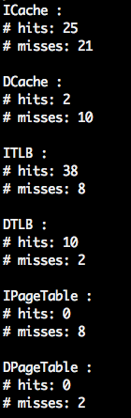
Output
snapshot.rpt
register file content at each cycle
report.rpt
total number of TLB/ PageTable/ Cache hits/misses

Slide 12
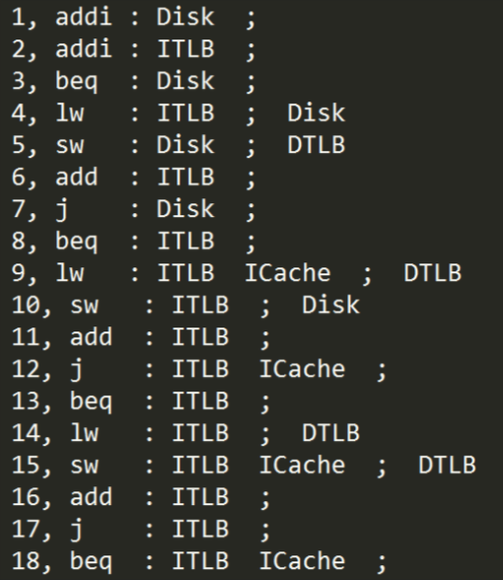
Trace.rpt
Format:
Cycle, Instruction :Instruction hit location ;Data hit location
It is not to be graded , just help you to know what happens in each cycle

Slide 13
Execution Parameter
Executable is configurable
All size are in number of bytes.
All size related parameters should be of 2^{n}, n > 1.
When just execute the program (“./CMP”):
The program should be default configuration:
(P1, P2, …, P10) = (64, 32, 8, 16, 16, 4, 4, 16, 4, 1)
memory
page
cache
Intr.
Data
Intr.
Data
Intr.
Data
Notes:
可配置
設定mem page cache size跟associativity

Slide 14
Execution Parameter Detail
./CMP [P1] [P2] [P3] [P4] [P5] [P6] [P7] [P8] [P9] [P10]
[P1]: The I-memory size
[P2]: The D-memory size
[P3]: The page size of I-memory
[P4]: The page size of D-memory
[P5]: The total size of I-cache
[P6]: The block size of I-cache
[P7]: The set associativity of I-cache
[P8]: The total size of D-cache
[P9]: The block size of D-cache
[P10]: The set associativity of D-cache

Slide 15
Submission
（capital )
Tar on this folder
CMP
testcase
iimage.bin
dimage.bin
simulator
CMP
makefile
XXX.c …etc
1st Submission: 2017/06/03
2nd Submission: 2017/06/10
(capital )

Slide 16
Evaluation
For open, hidden, and student test case, TA will use 3 config. to evaluate.
default configuration
two other configurations
Grading:
10% discount if you fail one of them（九折）
19% discount if you fail both of them（九折*九折）
0 point if you fail all of them

Slide 17
Bonus
If you hand in your homework before 5/20 (two weeks before 1st submission), you can get additional 14% bonus.
The bonus point will deduct 1% everyday.
5/20 | 5/21 | 5/22 | 5/23 | 5/24 | 5/25 | 5/26
14% | 13% | 12% | 11% | 10% | 9% | 8%
5/27 | 5/28 | 5/29 | 5/30 | 5/31 | 6/1 | 6/2
7% | 6% | 5% | 4% | 3% | 2% | 1%

Slide 18
Modularization
CMP
main
mem
processor
reg
Notes:
模組化的格式 同學可以參考一下

Slide 19
Project 2 Demo time
5/12 fill in the demo time (18:00)
5/14 mother’s day
5/19 project 2 demo

Slide 20


