Slide 1
Quantum System Simulation
Final report
Michelle Chalupnik, Oksana Makarova,
Shelley Cheng, Gregory Cunningham
CS 205 Group 9

Slide 2
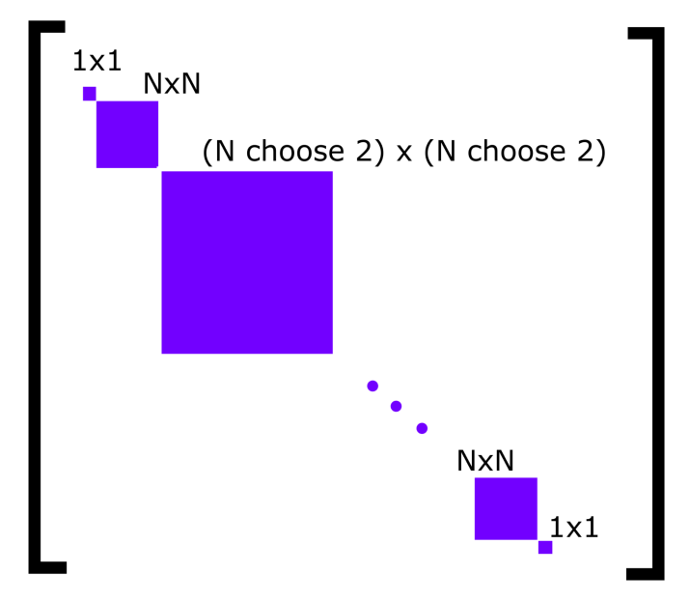
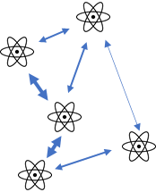

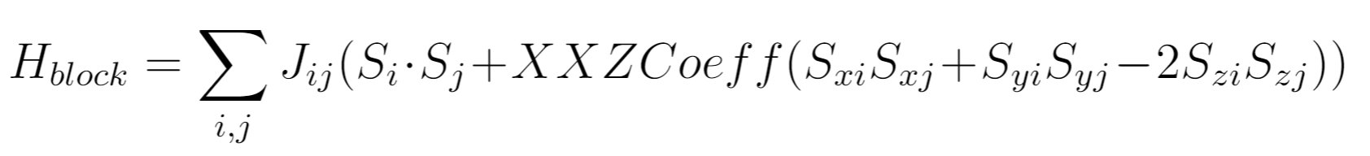
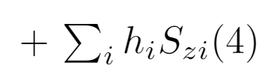



Quantum simulations (Overview)
x N
N particles
(State Preparation)
Let ‘em interact
(Time Evolution)
Final state
post-processing
Notes:
We’re planning to simulate quantum systems using classical computers. The main problem with quantum simulations is that adding one extra particle (spin), doubles the problem size, so it’s hard to simulate more than 20 spins at a time. We want to simulate larger systems and average them over different initial conditions. It’ll involve acceleration of matrix diagonalization, multiplication, Kronecker product and parallelize it across different nodes to perform a sweep over possible initial conditions.

Slide 3
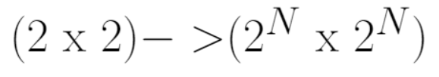
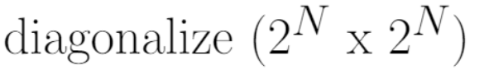
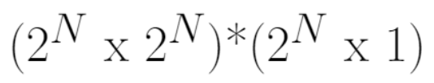
Necessary computations for N particles
Prepare initial state
Make a large system of spins and its H (Hamiltonian)
Kronecker product
Time evolution
Find H in a new basis
Solve eigensystem
average over different locations of spins
Get final state
Apply new H to the spins
Matrix multiplication

Slide 4
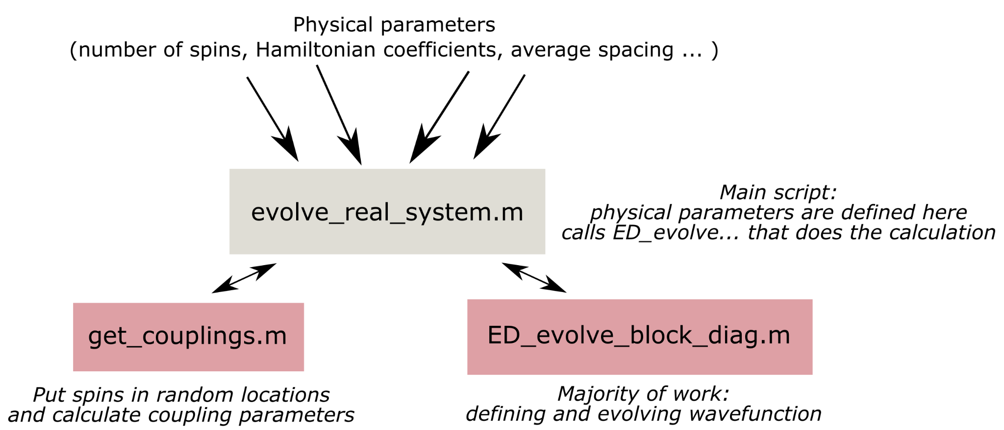
Base code structure

Slide 5
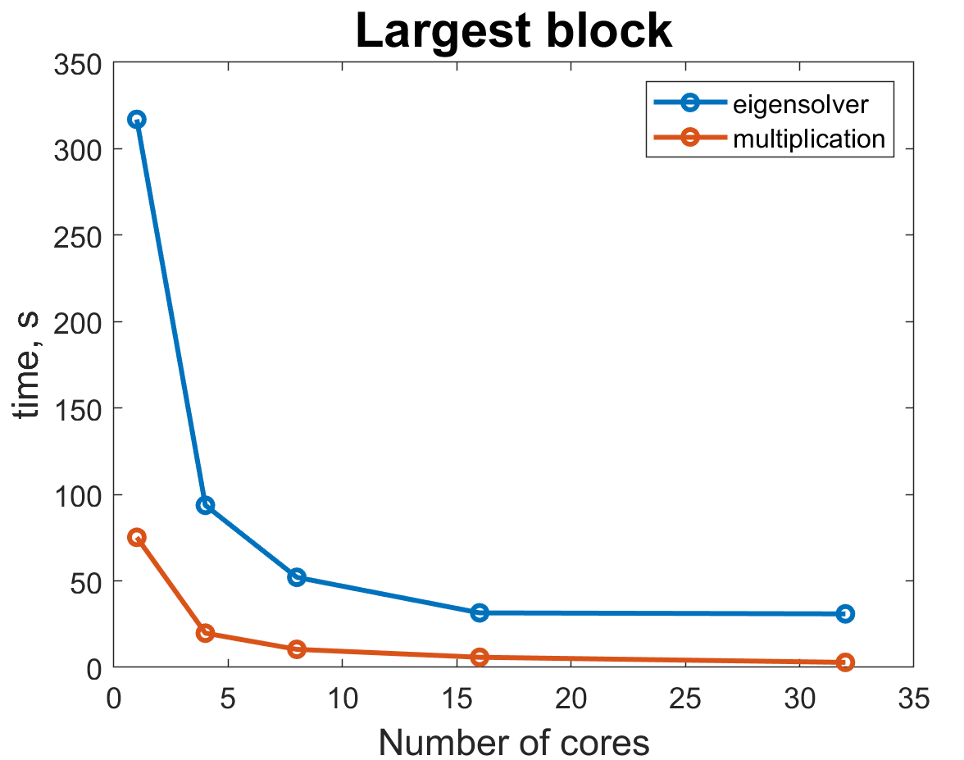
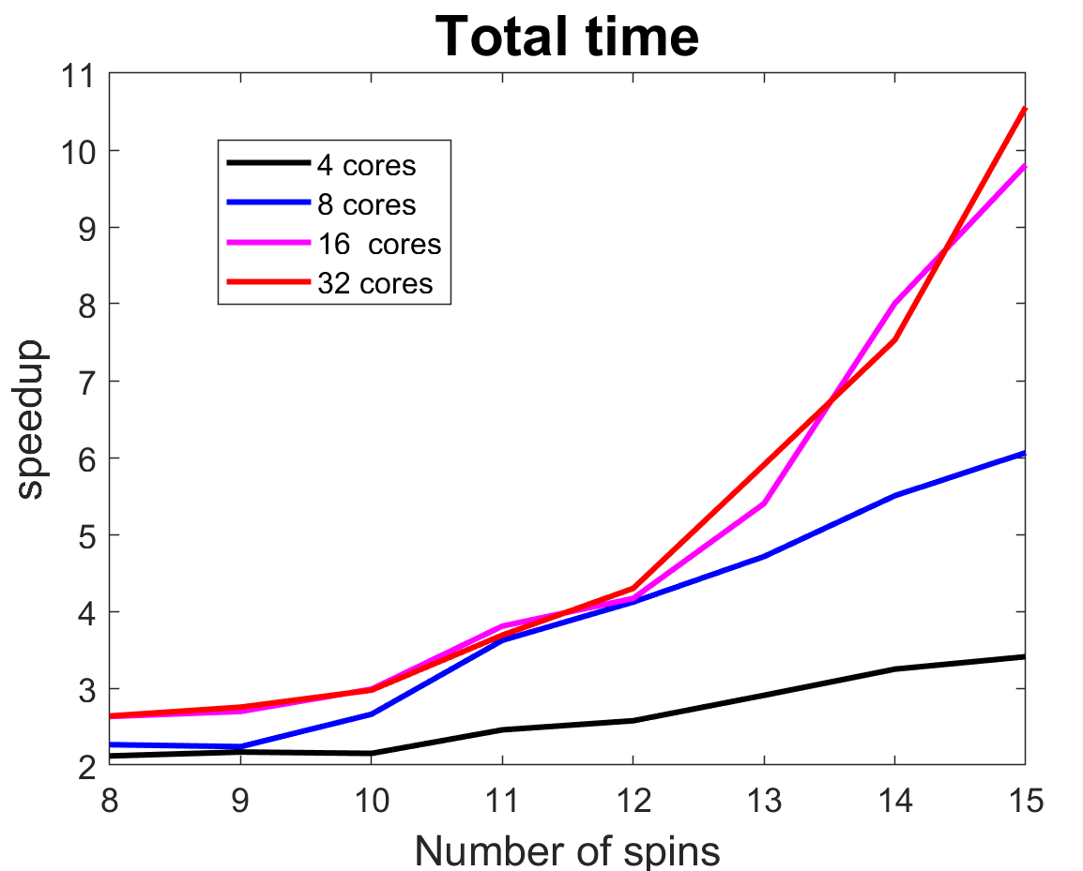
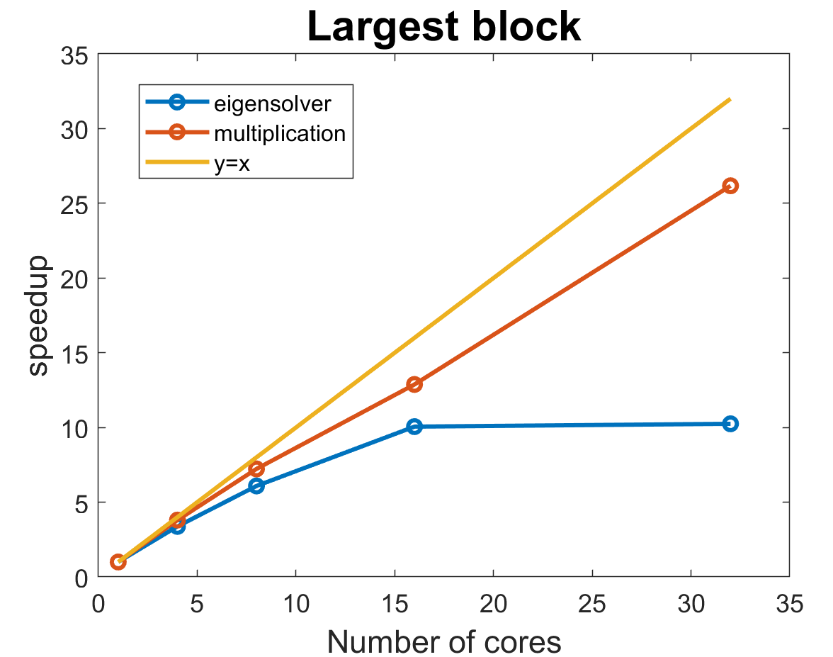
Benchmarking “serial” code
T_serial_total = 1300 s for 15 spins
MATLAB built-in functions and operations are multithreaded by default and can run on multiple cores-> even the base serial code version can run on multiple cores

Slide 6
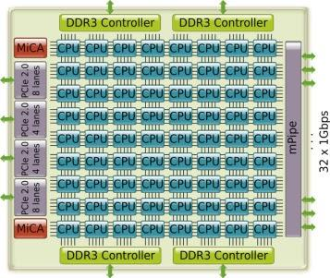

Software design
Big Compute and Big Data
GPU
Many-core, and multi-node
SPMD
Levels of parallelism:
Task level
Multi-node for postprocessing
PySpark
Loop level
Many-core for matrix ops
GPU
Notes:
As a reminder, we designed our quantum simulator to fall under big compute and big data. The application is a GPU-type application that produces many 2^N (where is is number of qubits) by M (where M is number of timesteps) polarization values from quantum states which we sort by polarization, then average using PySpark on AWS. The types of parallelism we use are both many-core and multi-node, since we use GPU acceleration as well as a PySpark cluster. Our parallel execution model is single program multiple data, with a single program running on multiple nodes and multiple cores. We use task-level parallelism, where interrelated tasks within the application run in parallel, in order to run many simulations simultaneously, and then postprocess. We also use loop level parallelism, which parallelizes iterations within a loop, in order to speed up solving for eigenvalues as well as the matrix multiplication.
We use the MATLAB programming language, the academic cluster (with slurm job manager), and AWS.

Slide 7
GPU-accelerated diagonalization: load balancing
Blocking: separate block-diagonal matrix into the diagonal blocks
Creates a parallel pool of workers across available GPUs
Runs blocks on GPUs iteratively
Automatically: assigns 1 block to each GPU
Manual load balancing: combine smaller blocks into bigger blocks, reducing communication time
Automatic
Manual
Notes:
Since diagonalization is a very time-consuming step for large spin numbers, we implemented GPU-accelerated and load-balancing. To improve the speed further, we take advantage of the block-diagonal form of the Hamiltonian matrix.
First, we implement blocking and split up the block diagonal matrix into the individual blocks. This already reduces the matrix size significantly since we are discarding many of the off-diagonal elements.
Next, we create a parallel pool in MATLAB, with a worker assigned to each available gpu. For ease of testing, we have carried out tests using 3 Tesla K80 gpus on the academic cluster. All the blocks are then run on the gpu parallel pool. Without any intervention, MATLAB assigns one block to a GPU, and waits for the computation on that block to complete before assigning a different block to that GPU. In the graphic on the right, each grey box represents a gpu worker, and each blue box represents a block of the matrix. MATLAB automatically assigns a single block to each gpu worker. If blocks are small, this involves a lot of data transfer between the CPU and GPU memory and a large communication overhead.
Therefore, we implemented manual load-balancing. This involves creating blocks of similar size to the largest size using all other smaller blocks. In the graphic here, we see that smaller blocks have been combined and run on a single gpu worker. This reduces the number of times data transfer occurs between the cpu and gpu and thus reduces the communication overhead.

Slide 8
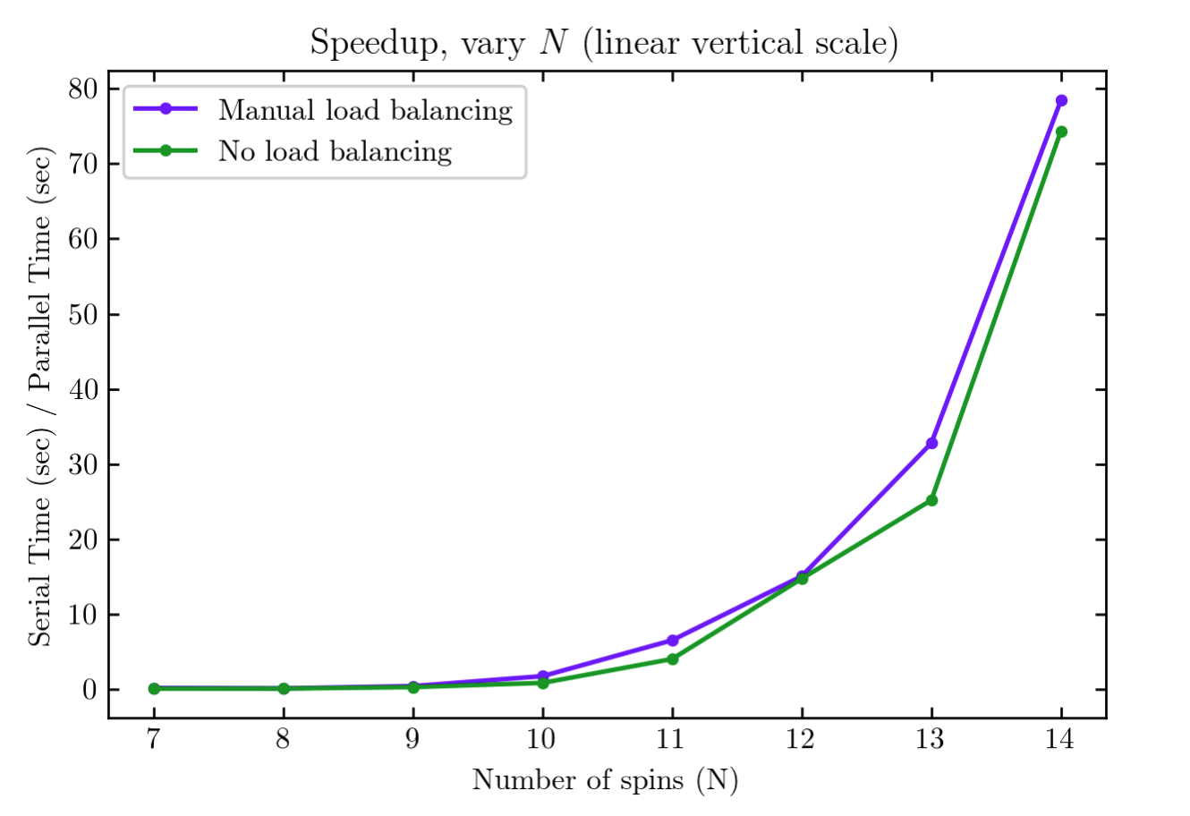
GPU-accelerated diagonalization: performance
For larger problem sizes, GPU-accelerated diagonalization always faster
Without load-balancing: speedup > 1 for N > 10
With load-balancing: speedup > 1 for N > 9
Starting from N = 10, manual load balancing is faster than no load-balancing
Notes:
To quantify the performance of our GPU-accelerated diagonalization, we ran serial versions of the matrix diagonalization which diagonalizes the full Hamiltonian matrix without any blocking or gpu acceleration.
From the speedup plot here, we can clearly see that the parallel code outperforms the serial version for larger problem sizes. Specifically, without load-balancing, speedup becomes greater than 1 for N > 10. The version with manual load-balancing improves this by having speedup greater than 1 for N > 9. For smaller N, the serial version is actually faster, since data transfer between the CPU and GPU memory dominates for small problem sizes.
For large problem sizes (10 spins or more), manual load balancing leads to better speed up. This is indicative of the importance of load balancing, which was mentioned in class but not heavily discussed.

Slide 9
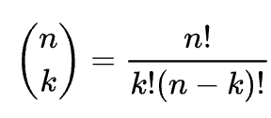
GPU-accelerated diagonalization: challenges
GPU memory
Limits number to spin to a maximum of N=14
Limits size of recombined blocks in load-balancing
Number of GPUs
Restriction on academic cluster
Blocking
Mathematically complex: factorials and combinatorics
Load-balancing leads to a change of basis
Notes:
In this evaluation, we were limited by 2 factors: GPU memory, and number of GPUs. Specifically, the code fails to run for more than 14 spins since the easily accessible GPUs on the cluster don’t have enough memory to hold the largest block of a 15-spin block-diagonal Hamiltonian. Also, this same memory limitation applies to load-balancing - there is an upper limit of the size of reconstructed combined blocks.
Also, since requesting large numbers of GPUs is quite slow on the academic cluster, we could only effectively test our code with 3 GPUs.
The blocking used in our problem is very specific to the underlying physics and mathematics of the problem, and finding a systematic way to load-balance was quite difficult mathematically since the block sizes involved factorials and combinatorics. There may be other ways to load-balance more effectively using mathematical tricks or other change-of-basis operations.
Finally, another challenge is that load-balancing alters the basis of the matrix blocks. This becomes relevant for subsequent steps, where altered basis requires different calculation steps that may reduce speed.

Slide 10
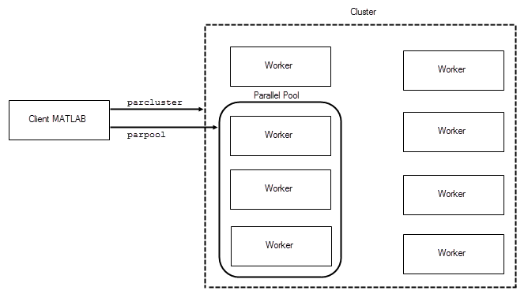
Parallelization of Matrix Ops: MATLAB’s Toolbox
The parallel pool
Workers → CPUs or GPUs
1 thread per worker
Methods: “parfeval”, distributed arrays
Metrics
Granularity
Synchronization
Matrix Block Sizing
MATLAB documentation, digital image, accessed 9 May 2021, <https://www.mathworks.com/help/parallel-computing/run-code-on-parallel-pools.html>

Slide 11
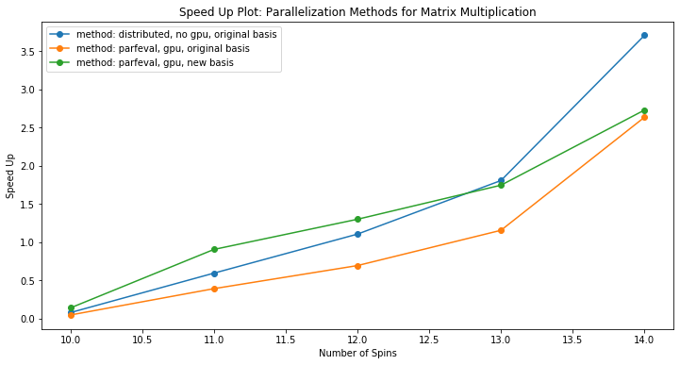
Matrix Multiplication: To GPU or not to GPU
Serial
1 core, no GPUs
Distributed arrays (blue)
4 cores, no GPUs
Data split unevenly amongst workers
Parfeval (orange, green)
4 cores, 4 GPUs
Each worker uses a GPU

Slide 12
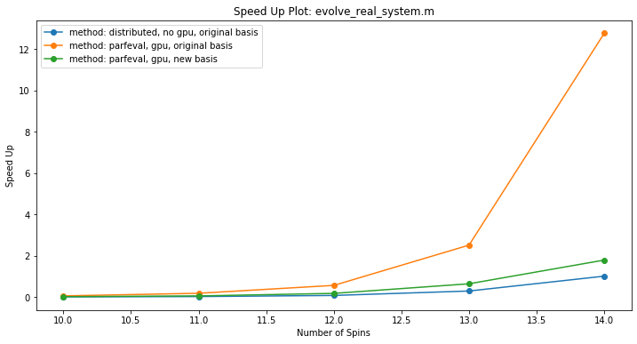
Speed Up: Overall Code
Method approaches MATLAB’s black box optimization for CPUs
Load-balanced optimization method hindered by change of basis postprocessing
Setting up workers requires distributed memory processing, so it might be slower than default version
Notes:
Setting up workers requires distributed memory processing → automatically increases the timing

Slide 13
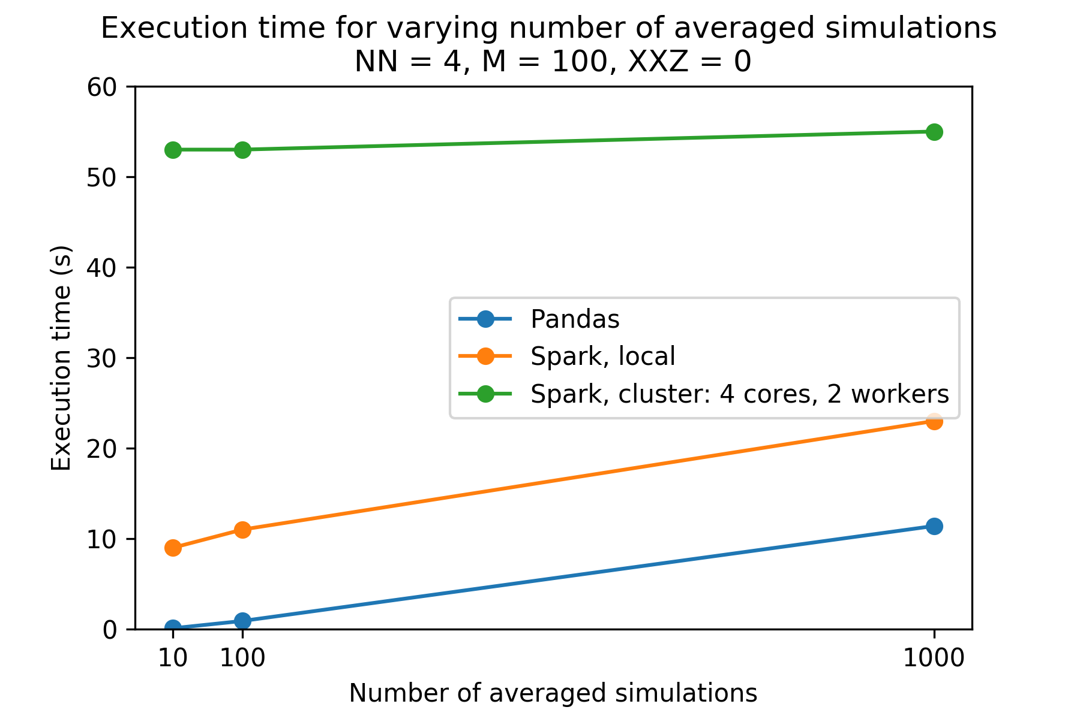
PySpark and Big Data
Matlab code outputs CSVs
[timesteps] + 3 rows
[# of sims] * 4 columns
CSVs processed by sorting and averaging polarizations Large slowdown when using Spark
We are not quite in the regime of big data!
Notes:
To improve accuracy, these simulations require running many times starting with different initial conditions. Important physical results such as polarization along the X, Y, or Z access are then calculated and saved to a csv for each time step. Specifically, this csv contains M + 3 columns, where M is the number of time steps, and three columns, one which specifies simulation type, one which specifies simulation number, and one which gives the simulation time; as well as simnum * 4 rows, where simnum is the number of simulations run, with one row for each polarization axis, plus a row for the time steps. For many simulation runs involving many random initial conditions, one might imagine this process would produce large amounts of data requiring sorting by X, Y, and Z, and then averaging, to produce three final averaged polarizations at each timestep.
Unfortunately, spark turned out to be less well-suited to this task than a serial python library called pandas. We can see based on this plot that the execution time for pandas was much less than local spark, which, in turn, was much less than the spark cluster. When submitting only 10 or 100 csv files to be averaged on the AWS machine (plot above), it took about 10 seconds using pyspark in local mode but only 0.9 seconds using the serial pandas version polz_avg_test_nospark.py. And even worse, it took 53 seconds on the spark cluster with 4 cores and 2 workers. There are several potential reasons for this.
First, it is worth noting that the overhead for starting up spark is quite great.
It’s also important to note that spark is not well-suited for tasks involving a large number of columns. Spark will even crash when the number of columns is too large. For instance, when I tried running with 10,000 columns (from 10,000 time steps) I ran into an error that stated the constant pool had grown past JVM limit of 0xFFFF. It makes sense that the number of columns would be limited, though, since Spark is more suited for datasets with many rows rather than many columns.
Overall Spark seems to be a bad tool for collating and averaging across the three polarization measurements when the number of time divisions is large (100 to 1000) and when the number of simulations run is relatively small (1000 or so). If we increased the number of simulations to average across, spark might become a better tool. However, because of the poor performance, we left the spark portion as a standalone and did not integrate with the rest of the code.

Slide 14
Conclusion
Even default MATLAB code is very good at Big Compute
GPU acceleration leads to significant speed improvements in matrix diagonalization and multiplication
Load balancing contributes a small speed increase for diagonalization, but ultimately slows down overall performance due to postprocessing
PySpark is not well-suited for data analysis for this particular problem

Slide 15
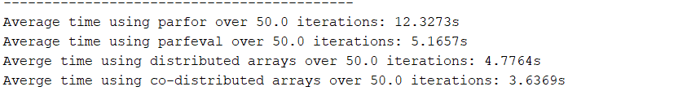
Matrix Multiplication: To GPU or not to GPU
Strategy: time each method when used for random matrix multiplication (2^N x 2^N, N=12)
Challenge: GPU acceleration not supported with some toolbox methods
Outcome: matrix multiplication is bottlenecked by communication over computation

