Slide 1
Rule-Based NER + Chatbot
Or
The Power of Heuristics

Slide 2
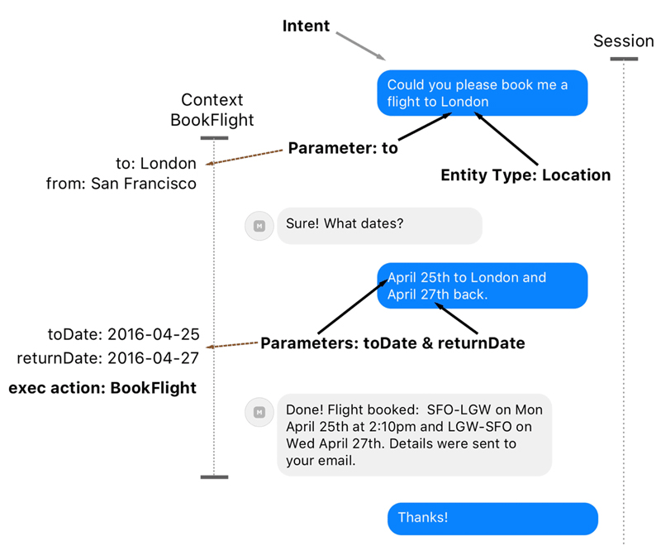
1
Extract reference data.
Preprocess raw text data.
Recognize the date.
Find the location.
Find reference: from or to?
Create a bot.
Create a booking flight dialog.
Catch exceptions.

Slide 3
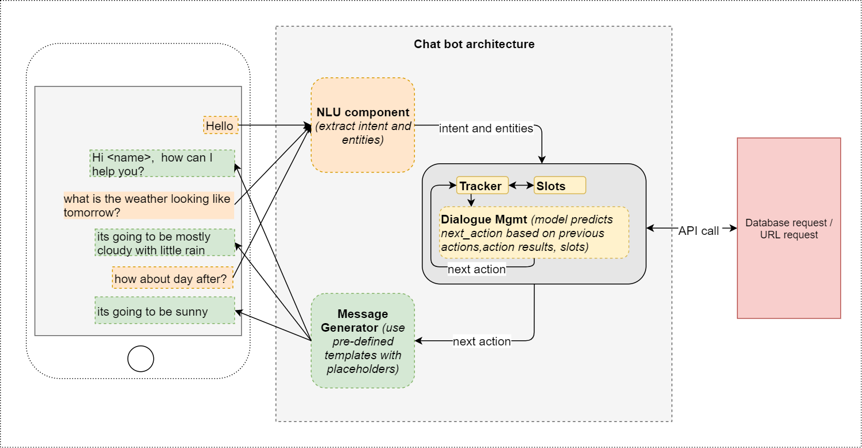
1
Natural Language Understanding as a part of chatbot structure

Slide 4
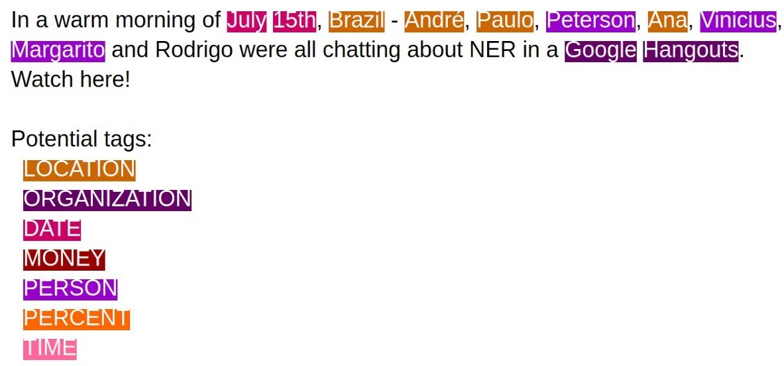
What is NER

Slide 5
Rule-Based Named Entity Recognition
Simple rule-based NER: find locations and dates.
Steps:
Extract a gazetteer from DBPedia using SparkQL.
Preprocess raw text data.
Rules for named entity recognition.
Recursion function for named entity boundary disambiguation.
Reference resolution.

Slide 6
Requests to DBPedia using SparkQL
Task!
From Python: use SPARQLWrapper
From the endpoint: use https://dbpedia.org/sparql
Extract names of countries that have a population of at least 10000.

Slide 7
Task! Preprocess raw text data
Language identification (if multiple languages)
Sentence boundary disambiguation
Tokenization
POS-tagging
Lemmatization

Slide 8
Recognize the date
Task!
Write a set of regex to recognize various date expressions, such as:
01/12/1995
August 23d, 2005
31st of May 2017
Once the date is found, parse it into the '%B %d, %Y’ format (June 5th, 2018).

Slide 9
Find the location
Task! Using heuristic knowledge, devise 3-4 rules for what constitutes a location.
Hints:
Check if it’s in the gazetteer.
Check if the POS-tag is for proper noun.
Check if there is a preposition POS-tag (‘IN’ or ‘TO’) before the candidate location.

Slide 10
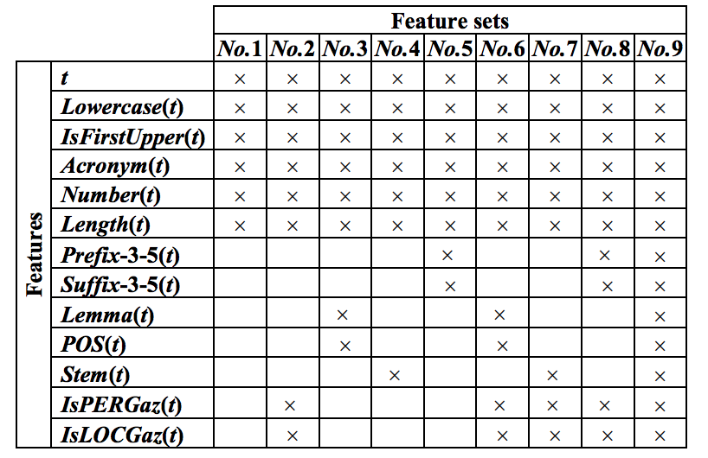
Feature engineering

Slide 11
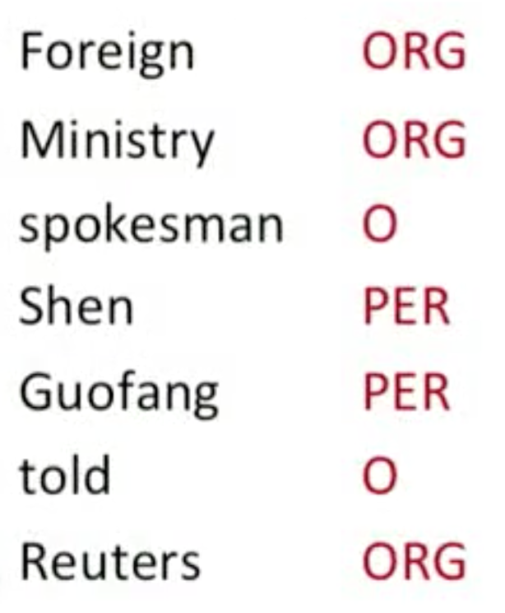
Find the location’s name boundary
A usual problem in NLP. Even though sometimes the entities will overlap, it’s faster to ignore that problem and use a simple method.
Use recursion function:
def recursion(stack, result):
if stack == []:
return result
else:
# process stack, modify result
return recursion(list, stack-1, result)

Slide 12
Connect The Locations
Ontology facts: fly_from_to(Lviv, New York)
Where are you flying from?
Where are you flying to?
Rule-based:
if the pronoun “to” is before the entity…

Slide 13
A Rule-Based Chatbot From Scratch
Initialize and exit conversation.
Match function.
Measure keywords intersection or use regex for matching.
Task! Simple greeting function.
Task! Construct a dialog: flight booking function.

