Slide 1
PRISM
MACHINE LEARNING PROJECT · PHASE 1
local
Probabilistic Retail Inventory forecasting
with State-space & Machine learning
Local Kalman filtering vs. global gradient boosting on M5
global
[Member 1] · [Member 2] · [Member 3] · [Member 4] · [Member 5] — Newton School of Technology, Rishihood University
Notes:
PRISM stands for Probabilistic Retail Inventory forecasting with State-space and Machine learning. In Phase 1 we compare a local model, a Kalman filter fitted separately to every product, with a global model, one LightGBM model fitted across all products. Every model gives full predictive distributions and is tested on the same fair rolling backtest.

Slide 2
Inventory needs a demand distribution, not a number
THE PROBLEM
63%
13.7%
7 days
Intermittent
Censored
Cold start
of days have zero sales for the median item-store series
of observed days look like stockouts: zeros that measure the shelf, not demand
of history is all a new item may have when we must forecast it
Safety stock is set from an upper quantile, so every model must produce calibrated intervals.
Notes:
Three things make retail demand hard. Most series are intermittent: the median series sells nothing on 63 percent of days. Sales are censored by stockouts: a zero can mean the shelf was empty. And new items arrive with almost no history. Inventory decisions use an upper quantile of demand, so we forecast seven quantiles for every day.

Slide 3
Learn each product alone, or all products together?
THE QUESTION
LOCAL
GLOBAL
Kalman filter per SKU
One LightGBM across all SKUs
Adapts fast to each item’s level
Exact probabilistic model
Stockouts handled as missing data
Learns every item in isolation
Shares weekly, event and price patterns
Can forecast items with little history
Direct quantile models
Needs careful, leakage-safe features
Hypothesis: the global model wins most where local data is scarce: intermittent and new items.
Notes:
A local model fits each series on its own: it adapts quickly but cannot borrow strength. A global model fits one function to all series, so it can transfer patterns to sparse and new items. Our hypothesis is that the gap is largest exactly where local data is scarce.

Slide 4
A balanced sample of M5 Walmart sales
DATA
30,490
item-store series in M5, 1,941 days each
1,500
sampled from CA_1, TX_1 and WI_1, balanced over category × demand class (pre-backtest data only)
150
established series turned into simulated new items (7–56 days of history)
Classes: Syntetos, Boylan & Croston (2005), ADI 1.32 / CV² 0.49
Notes:
M5 has 30,490 series. We use one store per state and 500 series per store. A random sample would be about 70 percent intermittent or lumpy, so we balance over category and Syntetos–Boylan class. ADI measures how irregular the timing of demand is, and CV squared how irregular the sizes are. Classes use only data before the first forecast origin.

Slide 5
What the data told us to build
EXPLORATORY ANALYSIS
Weekends +25% vs an average day
→ weekly seasonal state, day-of-week features
2/3 of series are zero on most days
→ log scale, Tweedie loss, TSB baseline
SNAP days +6–16% on FOODS
→ state-specific SNAP feature
Holidays −16%; closed at Christmas
→ event features; non-demand zeros marked
Notebook 01_eda
Notes:
The data is clean: no missing or negative values. Its problems are about meaning. Each finding turned into a modelling decision: weekly seasonality gives the seasonal state and weekday features; intermittency gives the log scale, the Tweedie loss and TSB; SNAP and events become known-ahead features; and Christmas closures are zeros that are not demand.

Slide 6
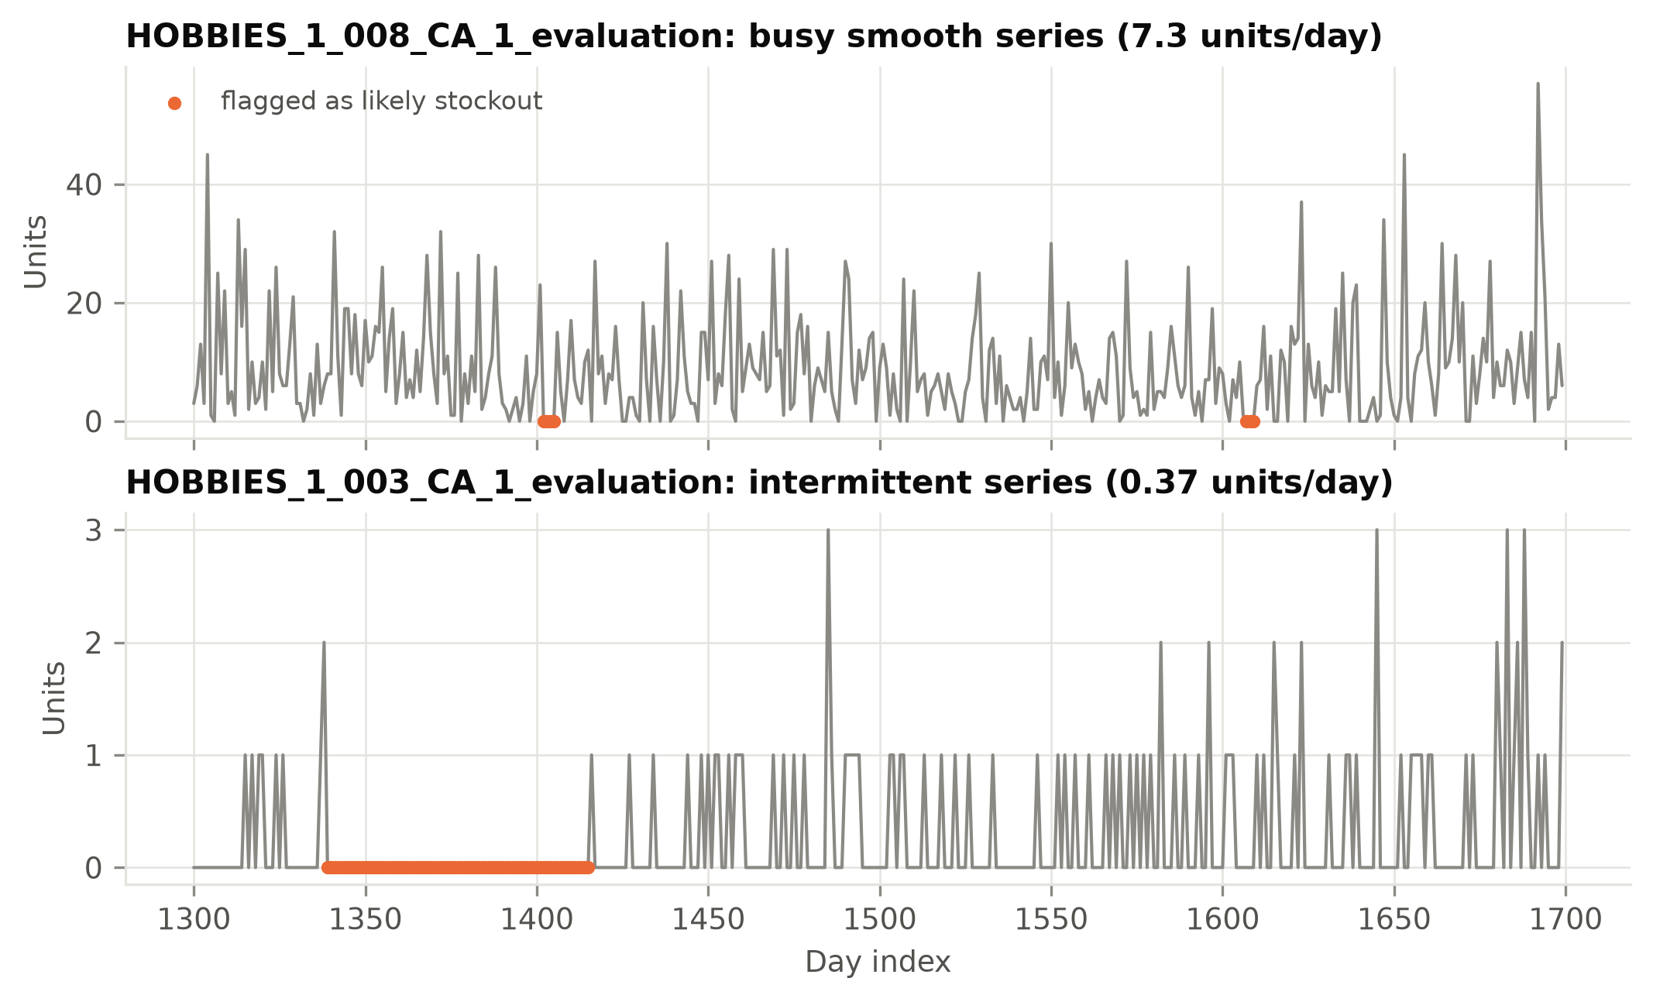
Mark suspicious zeros, never impute them
STOCKOUTS
THE RULE
Flag a run of L zeros if π̂₀ᴸ < 10⁻³
π̂₀ = the item’s zero-day rate over the previous 56 in-stock days. Backward-looking, so valid at any forecast origin.
Component | A flagged day is…
Kalman filter | missing: update step skipped (exact)
LightGBM | dropped from the training loss
Evaluation | reported raw and masked
13.7% of observed days flagged; 10–18% across p* = 10⁻⁵ … 10⁻²
Notes:
M5 has no inventory data, so stockouts must be inferred. A run of L zeros is flagged when it would be very unlikely given the item’s own recent zero rate. The threshold adapts: a busy item is flagged after 3 zeros, an item at zero 80 percent of the time only after 31. We never invent values. The Kalman filter treats a flagged day as missing, LightGBM drops the row from its loss, and every metric is reported with and without these days.

Slide 7
Five rolling origins, identical cells for every model
FAIR COMPARISON
cut d_1801
Every model is refit at each origin on a panel physically cut at that day. The last window is the official M5 test period.
209,860 scored cells per model.
MAE, WAPE on the median; RMSE, RMSSE on the mean; pinball loss and scaled pinball (SPL) on 7 quantiles; 80/90% coverage.
Diebold–Mariano and Wilcoxon significance tests.
cut d_1829
cut d_1857
cut d_1885
cut d_1913
history the model may see
28 forecast days
Tashman (2000); Gneiting (2011)
Notes:
We use five forecast origins, 28 days apart; the last one is the official M5 test window. At every origin each model is refit from scratch on a panel that physically contains no data after the cutoff, and all models are scored on exactly the same cells. Each point metric is scored on the functional it targets: absolute error on the median, squared error on the mean. Probabilistic quality is the pinball loss, a proper scoring rule.

Slide 8
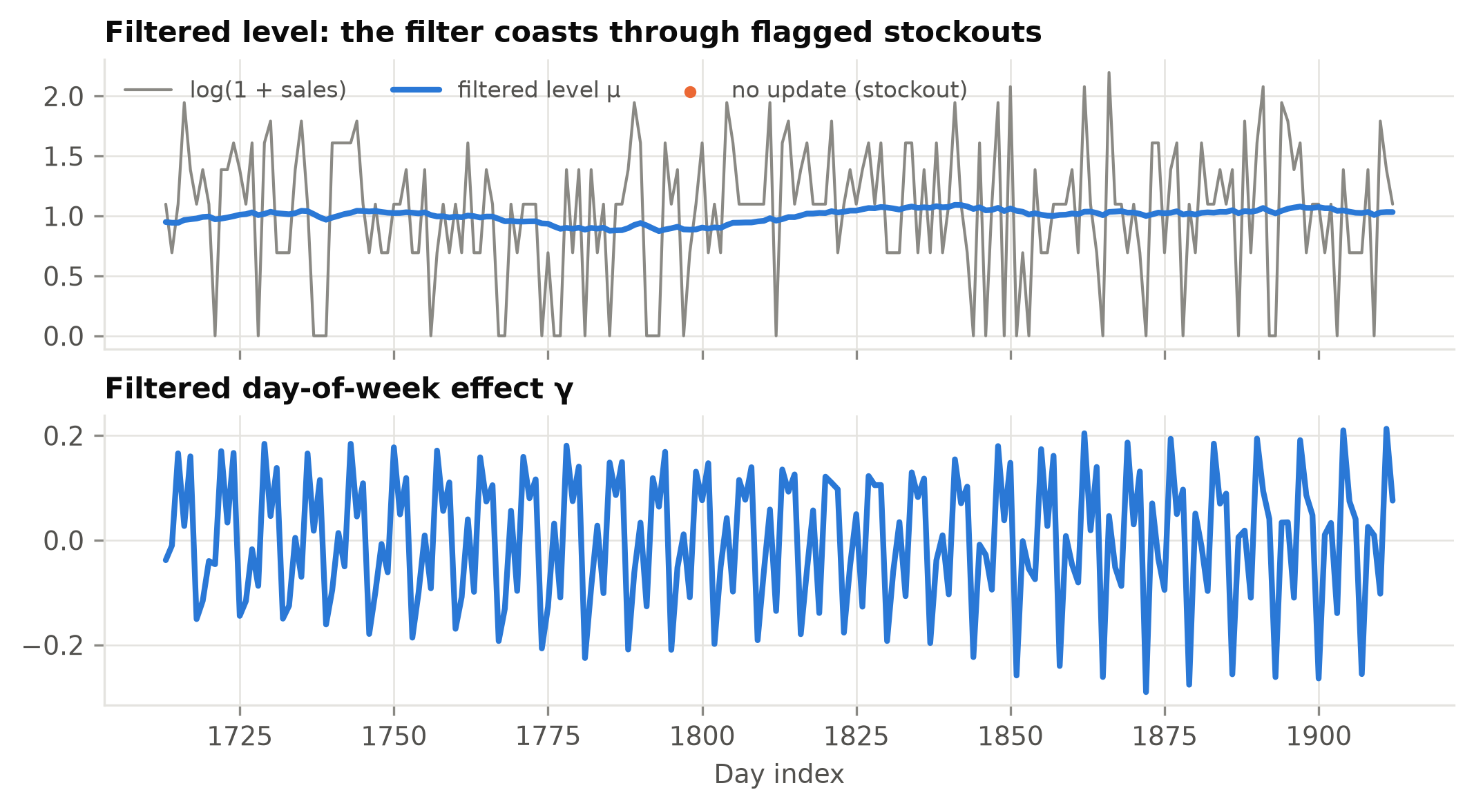
A Kalman filter per SKU, from scratch
LOCAL MODEL
Structural model on z = log(1 + y)
zₜ = μₜ + γₜ + εₜ
μₜ₊₁ = μₜ + ηₜ (level)
γₜ₊₁ = −(γₜ + … + γₜ₋₅) + ωₜ (week)
Profile-likelihood MLE per SKU
2-ratio grid, vectorised across SKUs: ~50 s for all 1,500
Exact quantiles, exact missing data
Q_y(α) = exp(Q_z(α)) − 1; stockout days skip the update
Verified against statsmodels
Log-likelihood, predictions and variances agree to 10⁻⁹
Kalman (1960); Harvey (1989); Durbin & Koopman (2012)
Notes:
The local model is Harvey’s basic structural model on the log scale: a random-walk level plus a seven-day seasonal. We wrote the Kalman recursions ourselves. Concentrating out the observation variance leaves a two-parameter profile likelihood that we search on a grid; because the filter is vectorised across products, one grid point is one pass over all 1,500 series, so the MLE takes about 50 seconds. Quantiles back-transform exactly. A stockout is a missing observation: the update is skipped. The implementation matches statsmodels to 1e-9.

Slide 9
One LightGBM for all SKUs, leakage-safe
GLOBAL MODEL
Horizon-safe direct
Lags
Rolling stats
Every sales feature for day t uses data ≤ t − L. With L ≥ h, one model covers every horizon with no recursion and no peeking.
L … L+28, and 364
mean, sd, max, zero share, zero streak
Other stores
Price
lag-7 model serves h = 1–7
same item, own sales excluded
level, relative, weekly change
lag-28 model serves h = 8–28
Tweedie mean + 7 pinball-loss quantile models; early stopping inside the training window
Calendar
Identity
weekday, events, SNAP by state
item, dept, store IDs; item age
Leakage unit test: row t is identical whether data end at t − L or t − 1
Notes:
The global model is the M5-winning recipe made leakage-safe. Each sales feature for target day t is shifted by at least L days and L is at least the horizon, so the model never sees the future and needs no recursion. A lag-7 model serves the first week, a lag-28 model the rest. The mean uses the Tweedie loss; each quantile has its own pinball-loss model. The cross-store feature subtracts the item’s own sales, so a simulated new item’s hidden history cannot leak back in.

Slide 10
LightGBM is best on every accuracy metric
RESULTS · OVERALL
Model | WAPE | RMSSE | SPL | Cov80 | Cov90
Seasonal naive | 0.757 | 0.978 | 0.358 | 0.857 | 0.924
TSB | 0.600 | 0.753 | 0.281 | 0.790 | 0.887
Kalman (local) | 0.582 | 0.744 | 0.280 | 0.818 | 0.903
LightGBM (global) | 0.569 | 0.732 | 0.264 | 0.798 | 0.915
−25%
WAPE vs seasonal naive
−5.6%
SPL vs Kalman · DM p < 10⁻²⁰ · better on 79% of series
Kalman is the best local method and the best-calibrated at 90% (0.903).
Stockout-masked, 5 origins × 28 days, 1,500 series. Bold = best (coverage: closest to nominal)
Notes:
Both learned models cut WAPE by about a quarter against seasonal naive. LightGBM is best on WAPE, RMSSE and scaled pinball loss; the difference from the Kalman filter is highly significant, with a Diebold–Mariano statistic of minus 11, and LightGBM has the lower loss on 79 percent of series. The Kalman filter is still the best local method and its 90 percent interval is almost exactly calibrated. Unmasked, the ranking is the same.

Slide 11
The ranking holds at every horizon
RESULTS · HORIZON
Saw-tooth = weekday cycle · lag-7 model helps at h ≤ 7: SPL 0.260 vs 0.264, p = 0.003
Notes:
Accuracy depends far more on the day of the week than on how far ahead we forecast: all origins start on the same weekday, so the peaks are weekends. The order of the models never changes over the 28 days. The short-lag LightGBM variant helps in the first week, and the Diebold–Mariano test says that small gain is real.

Slide 12
The gap grows as demand gets sparser
RESULTS · DEMAND CLASS
How much lower LightGBM’s SPL is than the Kalman filter’s
3%
smooth, erratic
4%
lumpy
9%
intermittent
Stockout-masked; on intermittent series even TSB beats the filter on WAPE (0.813 vs 0.836)
Notes:
This is the local-versus-global gap in one picture. On smooth and erratic series the global model is only about 3 percent better. On intermittent series the gap triples to 9 percent: a Gaussian filter on log sales describes mostly-zero counts poorly, and one series has little information to estimate its own level and season. The global model pools that structure across hundreds of similar items.

Slide 13
New items expose the local filter
RESULTS · COLD START
19%
lower SPL for LightGBM with 7–13 days of history
71% vs 90%
coverage of the 90% interval: Kalman (over-confident) vs LightGBM
~10%
gap left by 56–89 days: the filter catches up fast
150 simulated new items; own history hidden, cross-store features exclude own sales
Notes:
Cold start is where the gap is largest. With one to two weeks of history the local filter cannot estimate its own noise, so its nominal 90 percent interval covers only 71 percent of outcomes. LightGBM stays calibrated from day 7 because it borrows from the same item in other stores, the department, and price and calendar effects. As history accumulates the filter recovers quickly, which is its real strength.

Slide 14
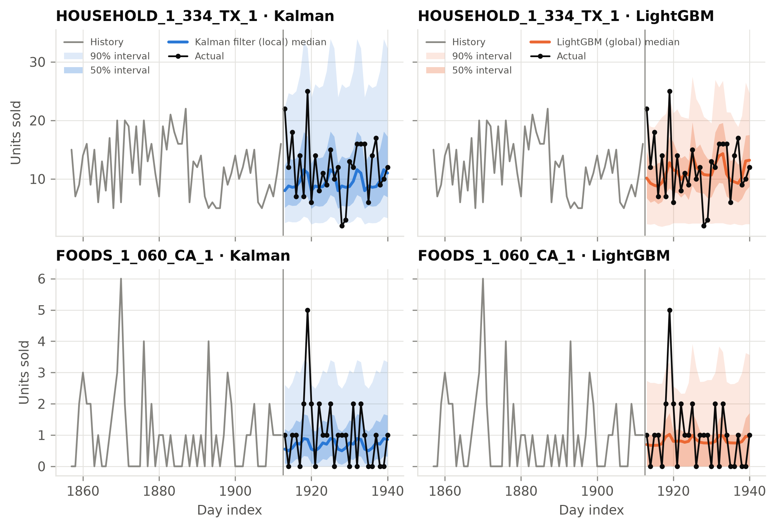
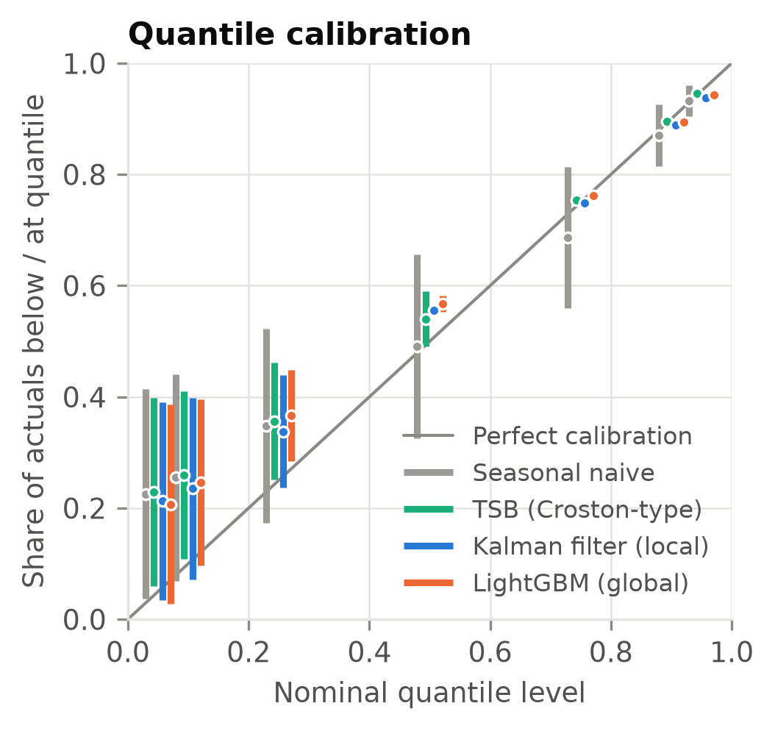
Intervals that respect the zeros
RESULTS · UNCERTAINTY
For counts, quantile α is calibrated when P(y < q) ≤ α ≤ P(y ≤ q)
Notes:
For count data a quantile is legitimately zero whenever the chance of zero sales exceeds the level, so the right check is that the level lies between the share of actuals strictly below the quantile and the share at or below it. Low quantiles are calibrated for all models; at the 0.9 level the Kalman filter and LightGBM put 0.889 and 0.895 of outcomes below, so upper tails are slightly light. On the right, LightGBM’s median for the smooth series is closer to the realised level and its upper tail is tighter; on the intermittent series its lower quartile is exactly zero.

Slide 15
Global wins, most of all where data is scarce
THE VERDICT
The local filter still adapts fastest, treats stockouts exactly and is the best-calibrated model once an item has history. The two approaches are complementary, and that is the case for a hybrid.
Notes:
The global model wins consistently and significantly, and its advantage is concentrated on intermittent and new items, exactly as hypothesised. But the margin is moderate overall, about 6 percent in scaled pinball loss, and the local filter has real strengths. That makes them complements, which motivates the hybrid in Phase 2.

Slide 16
A global deep model, then a Kalman hybrid
NEXT: PHASE 2
1
2
3
DeepAR
Hybrid
Same harness
One recurrent network for all SKUs, a negative-binomial count likelihood, item embeddings, calendar and price covariates.
Feed the Kalman filter’s level, seasonal effect and state variance to the network: local adaptation plus global sharing.
Identical origins, cells, metrics and segments; ablations with and without the Kalman features.
Success test: close the cold-start and intermittent gap while keeping the filter’s calibration.
Salinas et al. (2020), DeepAR
Notes:
Phase 2 follows from the gap we measured. First, DeepAR: a global recurrent network with a count likelihood and item embeddings. Second, the hybrid: the Kalman filter’s level, seasonal effect and state variance become covariates for the network. Both plug into the same backtest through our model interface, so the comparison stays like for like, and ablations will show whether the Kalman features add value.

Slide 17
Who built what
TEAM
Member | Module | Code & notebook
[Member 1] | Data pipeline, sampling, EDA | data.py, sampling.py · 01_eda
[Member 2] | Stockout marking, cold start | stockout.py · 02_stockouts_coldstart
[Member 3] | Kalman filter, local baselines | models/kalman.py, naive.py, croston.py · 03_kalman
[Member 4] | Features, global LightGBM | features.py, models/gbm.py · leakage test
[Member 5] | Backtest, metrics, tests, report | backtest.py, metrics.py, stats_tests.py · 04_results
Viva notes per module: docs/viva_notes.md
Notes:
Each of us owns one module end to end: the code, its notebook and its section of the report. Every member can also explain the overall pipeline and the local-versus-global story.

Slide 18
Questions?
REPRODUCIBLE END TO END
make data → make test → make backtest → make assets
18
20 min
4
1
unit tests
full backtest on a laptop
executed notebooks
IEEE report, auto-filled
Notes:
Everything in this talk is regenerated from one configuration file: download the data, run the tests, run the backtest, build the report assets and this deck. Thank you; we are happy to take questions.

