Slide 1
NEWTON SCHOOL OF TECHNOLOGY
Data Visualization & Analytics : Capstone 2
Brazilian E-Commerce Analytics
Order Fulfilment, Delivery Performance & Customer Satisfaction (2016–2018)
Sector
E-Commerce / Retail
Team
Section B • Group G-7
Faculty Mentor
Satyaki Das
Dataset
Olist Brazilian E-Commerce (Kaggle, 2016–2018)
Team Members
Saumya Kumar • Saman Iqbal Ansari • Arina Ali • Yash Kumar • Ayush Sahu • Prakhar Srivastava
GitHub: github.com/oksaumya/SectionB_G7_BrazilianE-Commerce
Tableau Public: https://public.tableau.com/app/profile/saman.iqbal5804/viz/BrazillianEDA/SalesOverview?publish=yes&showOnboarding=true

Slide 2
Context & Problem Statement
Why this matters and what decision the analysis supports
SECTOR CONTEXT
DECISION-MAKER
Brazilian e-commerce is growing fast on the back of smartphone penetration and expanding logistics but the country's geography and multi-vendor model create wide variance in delivery quality. Olist, Brazil's largest marketplace, sits at the centre of this tension between scale and reliability.
COO and Head of Seller Management of a large Brazilian online marketplace. They need to prioritise logistics investment, set seller onboarding standards, and decide where to spend customer-retention budget first.
CORE BUSINESS QUESTION
Which products, sellers, regions, and delivery patterns should management focus on to reduce service issues and improve revenue and repeat business?
OBJECTIVE
• Identify the operational drivers of late delivery, complaints, and revenue leakage.
• Quantify their impact and translate findings into 3–5 actionable recommendations the COO can fund.
2 / 12

Slide 3
Data Engineering — Source to Pipeline
From nine raw Olist tables to a single 100K-row analysis-ready master
SOURCE
PYTHON ETL (notebooks 01 & 02)
GITHUB & DICTIONARY
• Dataset: Olist Brazilian E-Commerce (Kaggle)
• Volume: ~114,092 orders, 9 CSVs
• Shape: 100K+ rows × 37 cols (post-merge)
• Period: Sep 2016 to Aug 2018
• Schema: Relational, joined on order_id / customer_id / seller_id / product_id
• Nulls: delivered_date 3.1% retained as NaN; review_score 0.8% excluded; category 0.1% → 'Unknown'
• Outliers: Negative delivery durations dropped; >$5K orders kept (legit bulk)
• Types: All timestamps → datetime64; UF state codes standardised
• Engineering: delivery_days, delivery_delay_days, late_flag, order_month/quarter/year
• Merge: pd.merge() across 8 tables → olist_cleaned_master.csv
notebooks/
01_extraction.ipynb
02_cleaning.ipynb
03_eda.ipynb
04_statistical_analysis.ipynb
05_final_load_prep.ipynb
data/
raw/ (9 CSVs)
processed/
cleaned_master.csv
KEY COLUMNS (analysis surface)
Column
Role
Column
Role
order_id
join key
review_score
satisfaction KPI
order_purchase_timestamp
time trends
payment_value
revenue
order_delivered_customer_date
delay calc
payment_type
payment behaviour
order_estimated_delivery_date
delivery gap
product_category_name
category perf.
order_status
fulfilment
seller_state / customer_state
geographic split
3 / 12

Slide 4
KPI & Metrics Framework
Five KPIs that map directly to the COO's decision levers
$18.1M
103.43K
$175
4.03 / 5
92.3%
Total Revenue
2016–2018
Total Orders
delivered
Avg Order
Value
Avg Review
Score
On-Time
Delivery Rate
DEFINITIONS & FORMULAS
KPI
Why it matters
Formula
Notebook
Monthly Revenue Growth %
Tracks platform momentum
(Cur − Prev) / Prev × 100
05_final_load_prep
Avg Customer Review Score
Customer satisfaction proxy
mean(review_score)
03_eda
Late Delivery Rate
Fulfilment failure exposure
late_flag=1 / delivered × 100
04_statistical
Cancellation Rate
Revenue leakage
cancelled / total × 100
03_eda
On-Time Delivery Rate
Service-quality baseline
on_time / delivered × 100
04_statistical
WHY THESE FIVE
Each KPI maps to one lever the COO actually controls growth, satisfaction, logistics, and revenue leakage — so every chart on the dashboard answers a question someone in the room can act on.
4 / 12

Slide 5
Key Insights from EDA
Six findings stated in business language — supporting charts in 03_eda.ipynb
1. Revenue grew ~4× year-on-year, but is concentrated.
2. São Paulo dominates both sides of the marketplace.
Q1 2018 hit $3.74M vs Q1 2017's $0.94M. Top-3 categories (bed/bath/table, computers, health/beauty) drive a disproportionate share — disruption in any one materially impacts platform revenue.
SP customers spend $7.55M; SP sellers earn $11.87M. Any uniform policy hits SP first and hardest — SP must be modelled as a separate operating regime.
3. Late deliveries hit satisfaction non-linearly past day 13.
4. Customers pay in instalments — credit card = 76.8% of revenue, ~3 instalments avg.
Fast (<8d) reviews cluster above 4.0; slow (>13d) reviews fall below 3.0 with a steeper slope — each extra delay day costs more at higher delays.
Revenue at order time ≠ cash realised; cash-flow planning for sellers depends on instalment lag, not order count.
5. Review distribution is bimodal, not normal.
6. Q2 is the highest-revenue quarter every year.
5★ = 56.4%, but 1★ = 12.8% (13,194 orders) — vs only 3,484 at 2★. Dissatisfied customers report extreme dissatisfaction, consistent with delivery failures.
$3.84M in 2017 and comparable in 2018 — operations and seller readiness must be scaled into Q1 not after.
5 / 12

Slide 6
Advanced Analysis — Statistical Depth
Going beyond EDA: where is the delay-satisfaction relationship strongest, and who owns it?
DELIVERY TIME vs REVIEW SCORE — segmented regression
LATE-ORDER CONCENTRATION — by seller state
• Fast (<8d): review scores cluster above 4.0
• Medium (8–13d): scores 3.8–4.1, mixed
• Slow (>13d): scores below 3.0, steepest slope
• Finding: non-linear — each additional day costs more after the 13-day threshold
• SP: 6,730 late orders — 12× the next state (RJ 382)
• MG / PR: 481 / 550 late — secondary watch list
• ES / BA: 24 / 34 late — low absolute risk
• Finding: SP-specific intervention beats nationwide programmes on cost-of-impact
SEASONAL & CATEGORY EFFECTS
Late Order Volume by Month
Delivery Performance by Category
Jan / Feb / Mar / Nov spikes (1,260 / 554 / 1,812 / 267); mid-year (Jun–Aug) shows lowest late counts. Avg delivery days drift 9.4 → 14.8 across the year — holiday-cycle pressure is visible.
Audio, agro-industry, and art categories sit materially above the 12-day platform average — heavier or specialist logistics. Lightweight craft items deliver fastest.
Methods used: pandas + numpy aggregation, scipy/statsmodels for trend lines and segment comparisons, matplotlib/seaborn for visual validation — all in 04_statistical_analysis.ipynb.
6 / 12

Slide 7
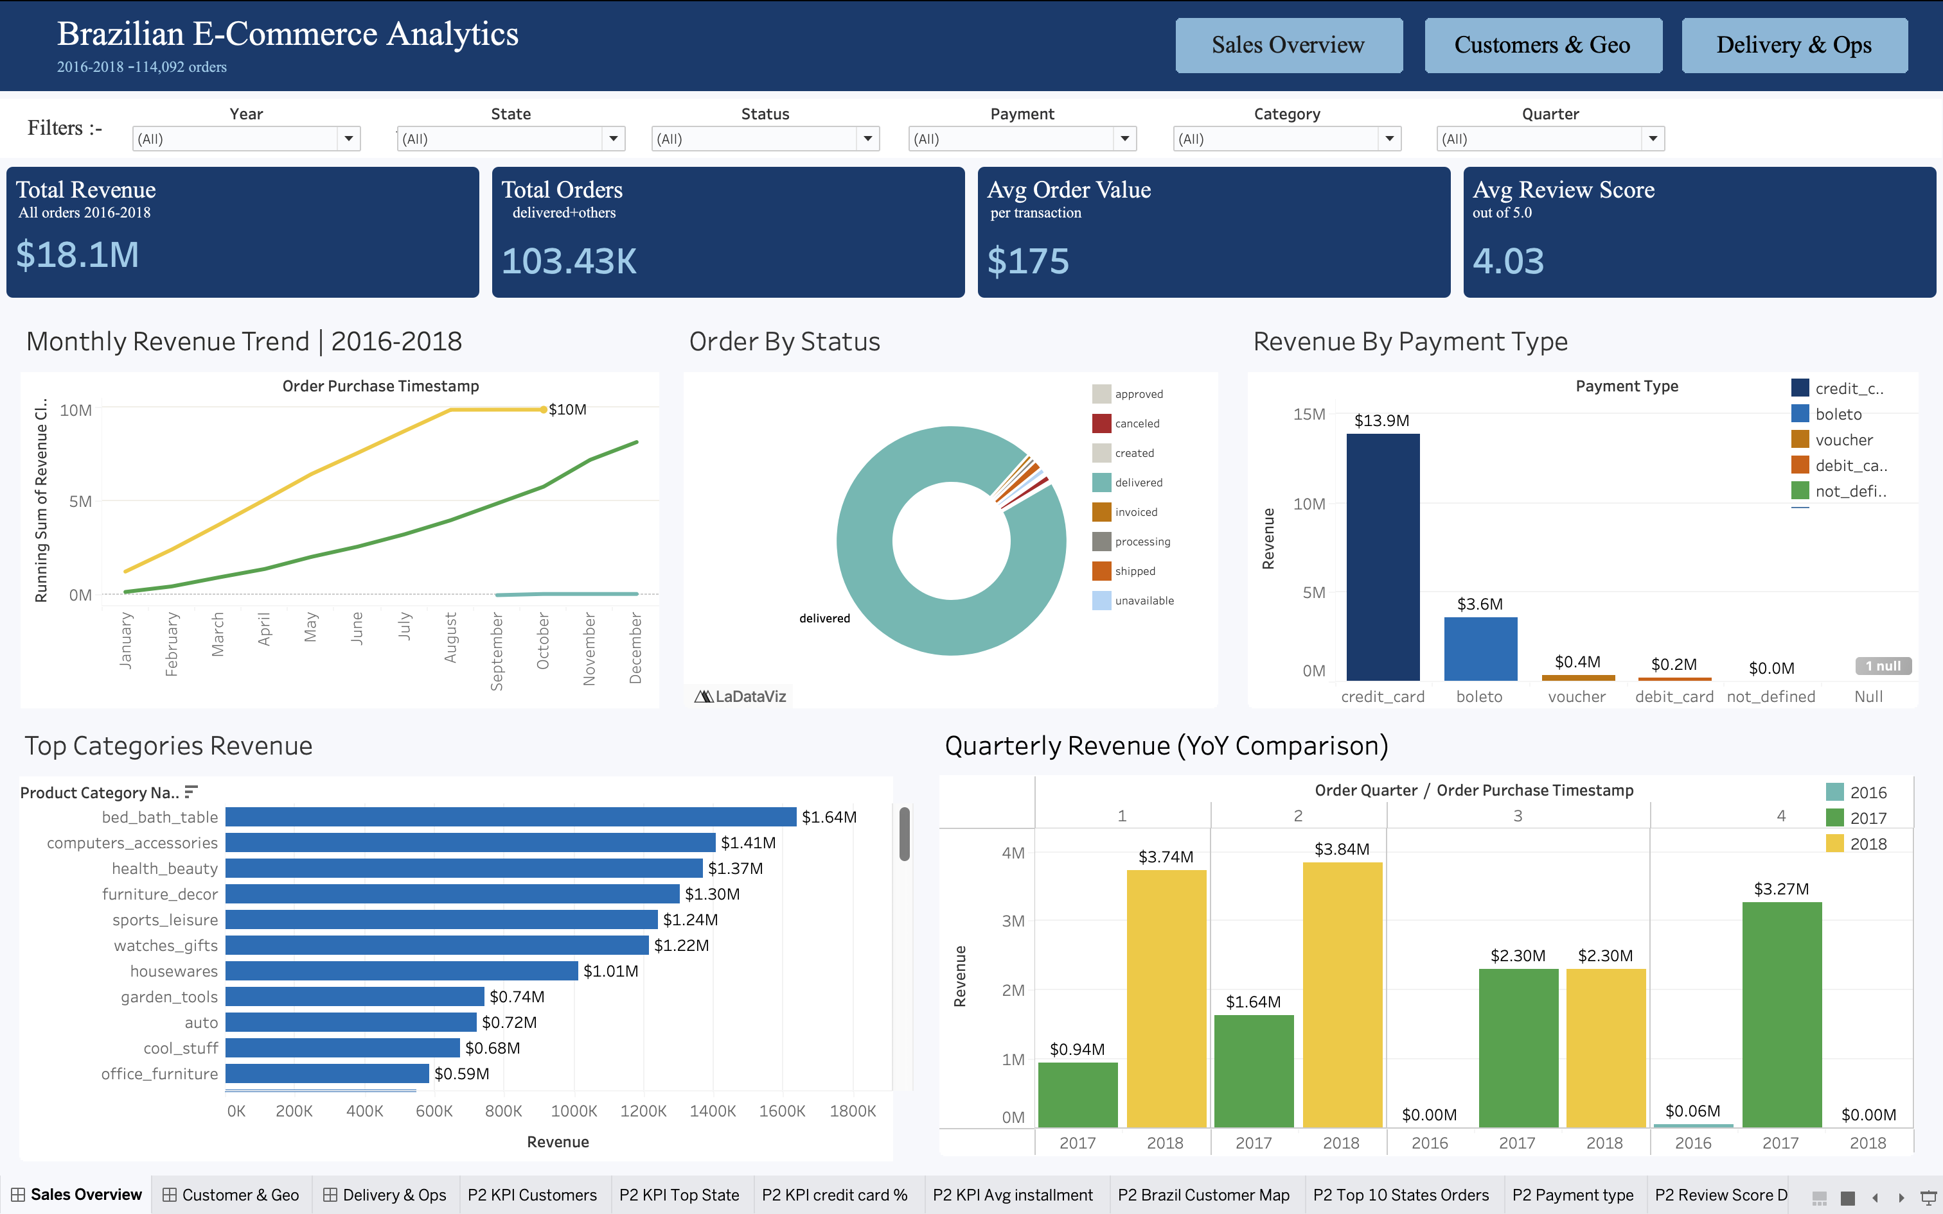
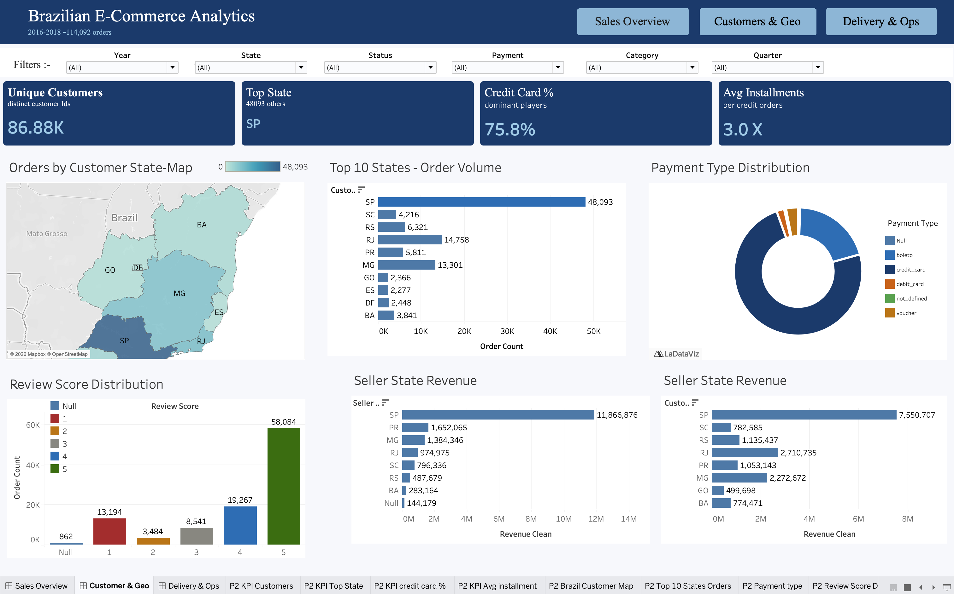
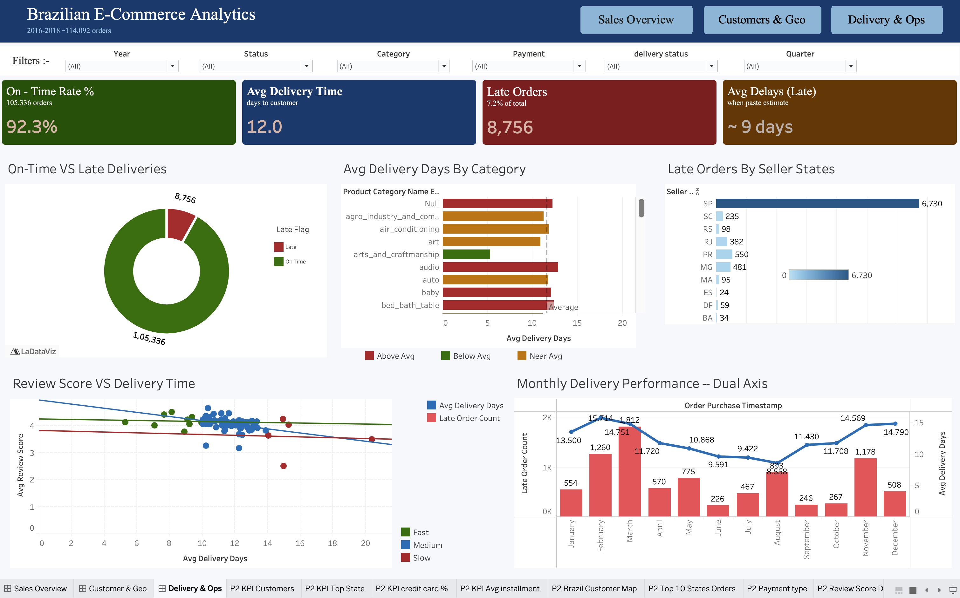
Tableau Dashboard — Walkthrough
Three pages, six global filters, KPI-driven layout for executive and operational audiences
Page 1 — Sales Overview
Page 2 — Customers & Geography
Page 3 — Delivery & Operations
Executive view: $18.1M revenue, 103K orders, monthly trend, top categories.
86.88K unique customers, SP dominance, state-level revenue, review distribution.
92.3% on-time, 8,756 late orders, delay-by-category, review vs delivery scatter.
GLOBAL FILTERS (live across all 3 pages): Year • State • Order Status • Payment Type • Product Category • Quarter
TABLEAU PUBLIC URL
[https://public.tableau.com/app/profile/saman.iqbal5804/viz/BrazillianEDA/SalesOverview?publish=yes&showOnboarding=true]
7 / 12

Slide 8
Business Recommendations
Five prioritised actions each linked to an insight and an estimated impact
SP Seller Compliance Programme
1
Insight: Insight 5: SP sellers = 76.8% of late orders.
EXPECTED IMPACT
Action: Tiered scorecard; <90% on-time triggers review; <85% × 2 months → listing restrictions.
−673 late orders/period; +0.1–0.2 review-score points
Better Delivery Estimates + Proactive Comms
2
Insight: Insight 3: ~9-day average overrun on late orders.
EXPECTED IMPACT
Action: Re-fit estimate algorithm by state×category; auto-notify customers at 80% of window.
15–20% reduction in expectation-driven 1-star reviews
Top-3 Category Logistics SLA
3
Insight: Insight 1: top-3 categories drive disproportionate revenue & delays.
EXPECTED IMPACT
Action: Dedicated carrier SLAs + regional inventory pre-positioning for those categories.
$200K–$400K at-risk revenue protected per year
1-Star Customer Recovery Campaign
4
Insight: Insight 5b: 13,194 1-star reviewers — high churn risk.
EXPECTED IMPACT
Action: 48-hour personalised recovery: apology + voucher + expedited resolution; track 90-day repurchase.
~$346K incremental revenue (15% recovery × $175 AOV)
Pre-Q2 Demand Scaling
5
Insight: Insight 6: Q2 is peak, but Jan–Mar already spike late orders.
EXPECTED IMPACT
Action: Inventory readiness check 6 weeks pre-Q2; pre-negotiated carrier capacity for Jan–Mar.
≈350 fewer late orders per Q1–Q2; on-time rate → 93.7%
8 / 12

Slide 9
Impact & Value — The 'So What?'
What the platform stands to gain and what it loses by waiting
AGGREGATE IMPACT (low–high range, conservative assumptions)
$546K+
≈1,000
+0.1–0.2
−15–20%
Combined revenue at risk
protected or recovered annually
Fewer service failures
per Q1–Q2 cycle
Points lift in average
review score
Reduction in expectation-
driven 1-star reviews
WHY ACT NOW
• Compounding churn: 1-star reviewers who don't return cost ~$175 AOV × repeat-order multiplier each and Q1 alone has ~3,000 of them.
• Concentration risk: 76.8% of late orders sit with SP sellers; without intervention, every quarter's growth re-amplifies the same bottleneck.
• Cheap wins are real: Recommendation 2 (estimate accuracy) requires zero logistics investment only an algorithm and notification fix yet captures 15–20% of expectation-driven complaints.
• Cost of inaction: Even a 0.3-point review-score drop typically halves repeat-purchase probability; on $18.1M base, the CLV exposure is in the multi-$M range over 2 years.
Numbers are approximate; logic is documented in §11–12 of the project report.
9 / 12

Slide 10
Limitations & Next Steps
What we couldn't conclude and what should come next
LIMITATIONS
NEXT STEPS
• Correlation, not causation: delivery vs review is observational; product quality, packaging, and seller comms are not controlled for.
• Repeat-purchase weakness: customer_id is per-order, not persistent robust repeat-rate computation requires deduplication via customer_unique_id.
• Seller anonymisation: no qualitative seller data (size, age, reputation) — we cannot diagnose why a seller underperforms.
• Time truncation: data ends Aug 2018 - no full-year 2018 view, no late-2018 holiday peak.
• Order-level granularity: no product-level margin or return rate unit economics out of scope.
• Single platform: findings apply to one marketplace; generalisation to Brazilian e-commerce broadly is not warranted.
• Predictive late-delivery model: logistic regression / GBM on state × category × payment × timing for risk scoring at order placement.
• Seller segmentation: K-means on (on-time rate, review, revenue, volume) → tiered support programmes.
• Review-text NLP: sentiment + topic analysis on review comments to surface specific complaint drivers.
• Real-time dashboard: API-connected pipeline → operational alerting on emerging delay spikes.
• Customer Lifetime Value: link first-delivery experience to long-term repeat behaviour; quantify CLV loss per late delivery.
10 / 12

Slide 11
Team & Contribution
Visible commits, owned phases, declared in the report's contribution matrix
Member
Data
ETL
EDA
Stats
Tableau
Report
PPT
Saumya Kumar
Owner
—
Support
Support
—
—
Owner
Saman Iqbal Ansari
Support
Owner
Owner
Owner
Owner
—
—
Arina Ali
Support
—
—
—
—
Owner
—
Yash Kumar
—
—
—
Support
Support
—
—
Ayush Sahu
—
—
—
—
—
—
—
Prakhar Srivastava
—
—
—
—
—
—
—
PROJECT METADATA
EVIDENCE TRAIL
Team Lead: Saumya Kumar
Mentor: Satyaki Das
Institute: Newton School of Technology
Section: B Group: G-7
Date: April 2026
• GitHub Insights: commit history per member
• Pull-request log: ownership of each phase
• Contribution matrix declared in §B of report
• All notebooks committed in .ipynb format
11 / 12

Slide 12
Thank You
Questions?
ONE-LINE TAKEAWAY
The Olist platform's growth story is real but operational reliability, concentrated in São Paulo sellers and a handful of categories, is the single highest-leverage decision surface for the COO over the next year.
GitHub: github.com/oksaumya/SectionB_G7_BrazilianE-Commerce
Tableau Public: https://public.tableau.com/app/profile/saman.iqbal5804/viz/BrazillianEDA/SalesOverview?publish=yes&showOnboarding=true

