Slide 1
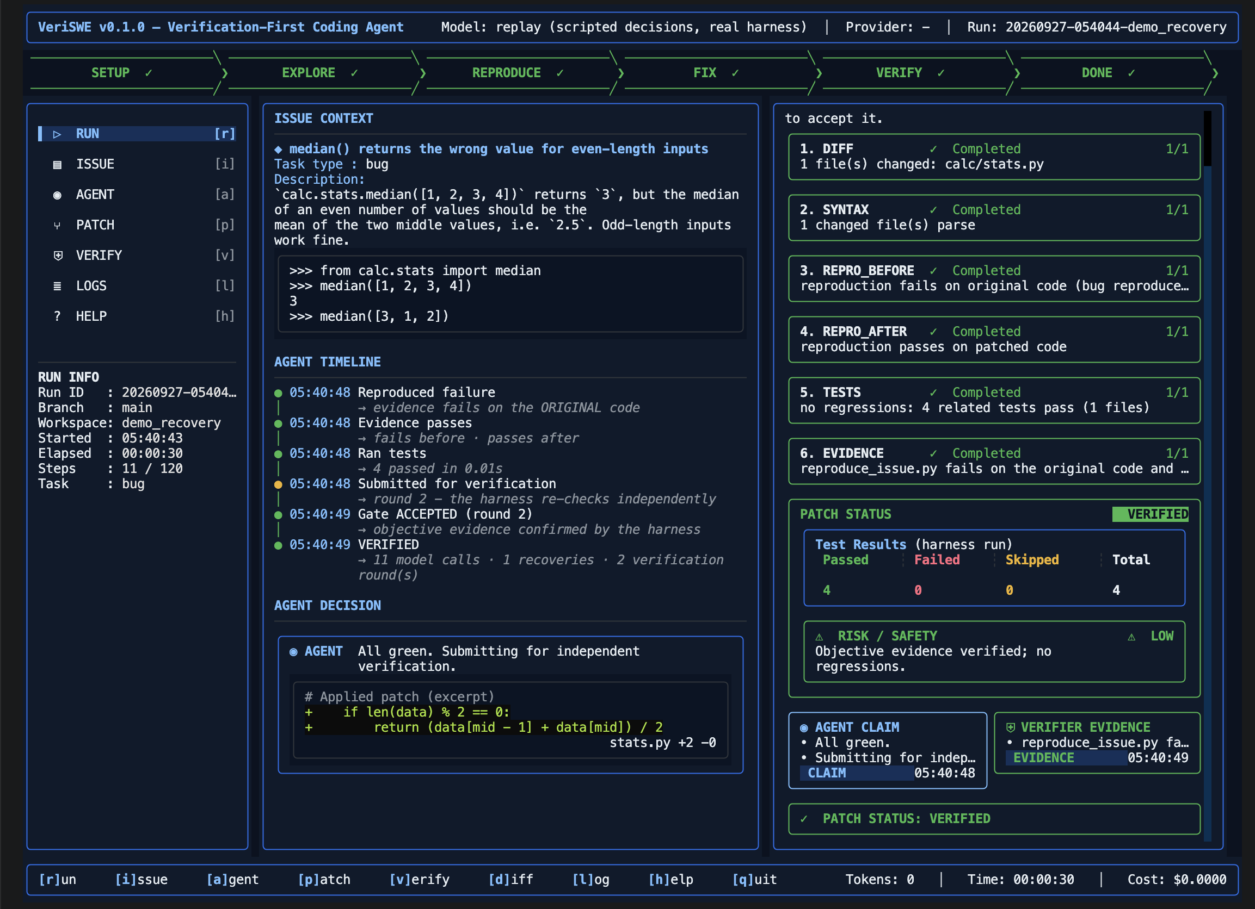
LCC × DEVCLUB · AI CODING HARNESS HACKATHON 2026
VeriSWE
The verification-first coding-agent harness
Same model. Different harness.
Evidence over claims.
DeepSeek + Qwen ready
make setup · run · test
The live terminal dashboard: a run that failed, recovered, and was VERIFIED by the harness
VERIFIED or honestly UNVERIFIED
github.com/oksaumya/veriswe
Notes:
VeriSWE is an autonomous coding-agent harness built around one principle: the model proposes, the harness decides. Every team has the same model; what differs is whether the harness can prove its result. Ours only says VERIFIED when it has objective evidence, and otherwise says UNVERIFIED — honestly.

Slide 2
Agents say “done”. Nobody checks.
The biggest failure mode of coding agents is not bad code — it is unverified claims.
45–76%
+13.7 pp
40×
of agent failures are false
“task complete” claims
on Terminal-Bench 2 from harness changes alone — mainly a pre-completion verification step
the gap in tokens per solved task between harnesses on the same model (up to)
False-success study, arXiv 2606.09863
LangChain harness engineering, 2026
“The Scaffold Effect”, arXiv 2607.22585
→ Correctness, evidence and efficiency are decided by the harness — so that is where we invested.
VeriSWE · github.com/oksaumya/veriswe
2
Notes:
Research shows most agent failures are the model claiming success without checking; verification at the harness level is the single biggest lever; and harness design changes cost by up to 40x on the same model. Those are exactly the hackathon's three criteria.

Slide 3







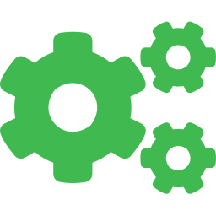
The model proposes. The harness decides.
A single disciplined loop — with an independent verification gate at the end.
›
›
›
›
›
TASK
EXPLORE
REPRODUCE
FIX
VERIFY
REPORT
issue URL · text · task
search · view (100-line windows)
evidence that fails first
lint-gated str_replace
harness re-checks independently
patch · evidence · telemetry
↺ REJECTED → the gate’s logs go back to the agent, which recovers (undo, new strategy) — up to 3 rounds
Foundation model
VeriSWE harness
Reasoning: reads code, forms hypotheses, writes the fix.
Autonomy: tools, guards, context, recovery, proof, telemetry.
VeriSWE · github.com/oksaumya/veriswe
3
Notes:
Explore, establish evidence that fails, make a minimal fix, then submit. On submit the harness — not the model — re-runs everything. A rejection sends exact logs back and the agent recovers.

Slide 4



The verification gate
VERIFIED requires objective evidence: something that fails on the original code and passes with the change.
1. DIFF
a real change exists vs. the original commit
✓
Evidence adapts to the task type
2. SYNTAX
every changed file still parses
✓
Bug — reproduction fails → passes
Feature / test-fix — new or failing test fails → passes
Refactor — related tests pass before and after
No proof — UNVERIFIED (patch kept for inspection)
3. REPRO_BEFORE
evidence FAILS on the original code (problem is real)
✓
4. REPRO_AFTER
evidence PASSES with the change
✓
Never relaxed in later rounds
5. TESTS
related tests: no regressions vs. the original results
✓
A verifier crash is NOT a submission
6. EVIDENCE
at least one fail → pass proof, never a claim
✓
Best checkpoint restored if work gets worse
VeriSWE · github.com/oksaumya/veriswe
4
Notes:
Six checks, all run by the harness on the original and the changed code. Evidence depends on the task type the agent declares. If there is no objective proof, the result is UNVERIFIED — we never present a claim as success, and a crashing verifier is an error state, not a pass.

Slide 5
Mission control, in the terminal
`make run` — every decision the harness makes is visible while it happens.
1
Phase pipeline
SETUP → EXPLORE → REPRODUCE → FIX → VERIFY → DONE; falls back to FIX on rejection
2
Agent timeline
milestones, not raw commands — including the rejected attempt and the recovery
3
Verification gate
six independent checks, live: completed · in progress · failed · pending
4
Patch status & risk
harness test results (passed / failed / total) and a LOW · MEDIUM · HIGH rating
5
Claim vs evidence
what the model said, next to what the harness proved
Notes:
This is the actual dashboard after a run: the agent's first patch broke odd-length inputs, the gate rejected it, the agent reverted and changed strategy, and round two was verified. Everything on screen comes from real harness data.

Slide 6








Failures are expected. Recovery is engineered.
Each path exists because a real provider failure hit us during live testing (Qwen and gpt-oss on Groq, OpenRouter, DeepSeek).
Rate limits
Request too large
Rejected tool call
Tool calling broken
waits exactly the provider’s Retry-After
fits the output budget, then compacts history
salvages the command from the raw generation
switches to text actions mid-run
Loops
Edit breaks syntax
Work gets worse
Credit / quota gone
detected and nudged with escalating warnings
auto-reverted by the lint-gated editor
restores the best verified checkpoint
stops fast, keeps the best patch, honest status
VeriSWE · github.com/oksaumya/veriswe
6
Notes:
Every one of these came from a real failure we hit during testing — Groq rejecting its own tool-call parse, per-request token caps, daily quotas, malformed JSON. Each is now a recovery path with a test.

Slide 7




Built for the evaluation models: DeepSeek & Qwen
Only AI_API_KEY is needed — VeriSWE works out the host, the model and the provider’s rules.
AI_API_KEY
›
Host discovery
›
Best model
›
Provider rules
DeepSeek
api.deepseek.com · deepseek-flash (V4.1) / v4-pro
Thinking enabled; reasoning_content passed back every turn (the API rejects the 2nd turn otherwise)
Qwen
Alibaba DashScope · 4 regions probed · qwen3.8-max / coder
enable_thinking errors learned & fixed on the first call; Qwen’s recommended sampling
Any host
OpenRouter · Groq · SiliconFlow · Together · …
Tool calls leaked into text (Qwen XML, DeepSeek DSML) parsed; malformed args repaired
Tested: live host discovery with a real DeepSeek key · full runs against fake servers that enforce the real DeepSeek and Qwen API rules
VeriSWE · github.com/oksaumya/veriswe
7
Notes:
DeepSeek and Qwen keys look like generic sk- keys, so VeriSWE probes the hosts in parallel and picks the strongest model the key can use. DeepSeek's thinking mode requires passing reasoning back on every turn; Qwen's open models reject non-streaming thinking calls — both handled automatically.

Slide 8
Efficient — and it proves it
Every run writes telemetry.jsonl + telemetry_summary.json. No black box.
Live run · real Qwen model · verified fix
AGENT EXECUTION
6
~13K
Task type
bug
Model calls
11
model calls
tokens in total
Tool calls
11
Files changed
1
< 1 min
~1¢
Failures
1
Recovery events
1
wall time
cost
Verification rounds
2
Observation masking in cache-stable chunks
Head/tail truncation of long outputs; context chars before / sent / reduced measured
Targeted regression tests, not whole suites
Final status
VERIFIED
make demo-recovery — failure → recovery → VERIFIED
VeriSWE · github.com/oksaumya/veriswe
8
Notes:
On a live Qwen run the harness solved and verified the task in 6 model calls, about 13 thousand tokens, under a minute, roughly one cent. Telemetry records every event and how much context was saved.

Slide 9
Engineered to be judged
The standard evaluation interface works on a fresh clone — and CI proves it on every push.
108
635
6
0
offline tests (make test)
tests incl. the full upstream suite
CI environments, all green
secrets anywhere in git history
$ make setup
uv → venv+pip → bootstraps uv; even Debian without python3-venv, or only Python 3.9
$ make run
TUI by default · HEADLESS=1 · ISSUE= / TASK= / REPO= · key only via AI_API_KEY
$ make test
offline, no key, < 1 min: gate, tools, recovery, provider rules, TUI
$ make clean
removes generated artefacts, keeps source and .env
VeriSWE · github.com/oksaumya/veriswe
9
Notes:
The Makefile is exercised in CI on Ubuntu, macOS, Debian without python3-venv, a Python-3.9-only machine and python-slim. The API key is only read from AI_API_KEY, removed from the agent's shell, and redacted from every artifact.

Slide 10
Architecture
One orchestrated loop — no multi-agent overhead — with the verifier outside the model’s control.
INTAKE
MODEL LAYER
AGENT LOOP
VERIFICATION GATE
ARTIFACTS
GitHub URL · owner/repo#N
text · @file · stdin · task
clone / local repo, base commit
host discovery from the key
capability probe, text fallback
retries · budget fitting
tools: view · search · str_replace
check_repro · undo_edit
guards · masking · loop detection
runs on ORIGINAL vs CHANGED
repro · tests · evidence
accept / reject with logs
patch.diff · report.md
telemetry.jsonl + summary
trajectory · evidence/
›
›
›
›
↺ gate rejects → logs go back to the agent loop
Built on mini-swe-agent (MIT, Princeton/Stanford SWE-agent team) — ~940 reused core lines; ~4,300 new lines of harness + ~1,300 lines of tests on top.
VeriSWE · github.com/oksaumya/veriswe
10
Notes:
We deliberately kept mini-swe-agent's small, provider-agnostic loop and added everything it leaves out: verification, editing tools, context management, recovery, model discovery, telemetry and the TUI.

Slide 11
See it run
The evaluator’s exact flow — plus an offline demo that shows failure, recovery and verification.
Demo storyline
$ git clone https://github.com/oksaumya/veriswe
$ cd veriswe
$ export AI_API_KEY="<DeepSeek or Qwen key>"
$ make setup
$ make run
# paste an issue URL or task → Ctrl+S
$ make demo-recovery # offline, no key, ~10 s
$ make test # 108 offline tests
1 TASK
2 EXPLORE
3 ACT
4 TEST
5 FAILURE
6 RECOVER
7 VERIFY
demo-recovery replays scripted model decisions through the REAL harness, tools, tests and verifier — guaranteed to show the failure → recovery → VERIFIED arc.
8 REPORT
VeriSWE · github.com/oksaumya/veriswe
11
Notes:
Live: make run with the organisers' key. Guaranteed: make demo-recovery replays scripted model decisions through the real harness — the first patch is rejected by the gate, the agent recovers, round two is verified.

Slide 12

Not an LLM wrapper.
A harness that turns a foundation model into an engineer you can trust — because it proves its work.
Try it
Foundation model
→
Reasoning
github.com/oksaumya/veriswe
Harness
→
Autonomy
Tools
→
Action
docs/hackathon/REQUIREMENTS.md
requirement → implementation → evidence
docs/hackathon/DEMO_RUNBOOK.md
the demo script
Tests
→
Feedback
Recovery
→
Resilience
Verification
→
Trust
Telemetry
→
Observability
Same model. Different harness. Evidence over claims.
Notes:
Thank you. The model reasons; VeriSWE supplies autonomy, action, feedback, resilience, trust and observability. Every claim in this deck has a test or a telemetry file behind it.

