Slide 1

MINI PROJECT MAY 2023
Smart Shoe
For Blind

Slide 2
Abstract
IoT based Smart shoe system for the blind is a system made with the help of ultrasonic sensors paired to an Arduino NANO board. Internet of things is all about making physical objects communicate with other objects or even with humans. It is an enabling technology which has a rapid development and growth in the market. In our India there are almost 40 million blind people among which 1.6 million are children. Blind people face great difficulty to walk independently. They have to depend on others in many aspects of their life.
The Major problem is when they walk on the road. With a stick in hand they cannot detect every obstacle that comes in their way. The shoe warns the user by making noise with the buzzer or a slight vibration when he/she walks in front of an obstacle.

Slide 3
Introduction
The aim of this project is to design and develop a smart shoe for visually impaired individuals that can assist them in navigating their environment and improving their overall safety, comfort, and independence.
Internet of things is all about making physical objects communicate with other objects. This IoT based Smart shoe system for the blind is a system made with the help of ultrasonic sensors paired to an Arduino NANO board. The buzzer and Vibrating motor are used to alert the user.[1]
There are broadly three stages involved in the design of the proposed blind shoe:
Input Stage
Control Stage
Output Stage
The buzzer produces sound when ever it encounters any obstacles in front and inclined position. The vibrator vibrates at the same time.

Slide 4
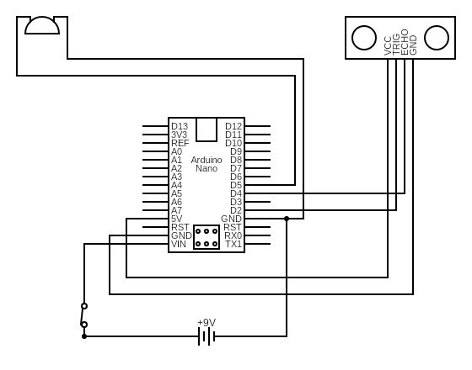
Proposed Architecture

Slide 5
Modules
There are broadly three modules involved in the design of the proposed Smart Shoe System:
● Detection Objects
● Computing Distance
● Alert Message

Slide 6
Module Description
Detection Objects:
It consist of two HC-SR04 ultrasonic sensor, the sensor is uses to detect obstacle in the path of blind person. Two HCSR-04 ultrasonic sensor is used to locate the obstacle in the path of blind person. One sensor is mounted on the front end of shoe for detecting obstacle in forward path, while second sensor is mounted on the top of shoe for detecting inclined obstacle.

Slide 7
Computing Distance:
For manipulating or processing the information as received by ultrasonic Sensor a microcontroller is used. Here we have used an Arduino Nano microcontroller. The microcontroller is programmed to receive signal from two ultrasonic sensors. The microcontroller is programmed to trigger the vibrating motor and buzzer, whenever ultrasonic sensor found obstacle within its range. The obstacle detection range of ultrasonic sensor can be set through the program written in microcontroller.

Slide 8
Alert Message:
An audio signaling device like a beeper or buzzer may be electromechanical or piezoelectric or mechanical type. The main function of this is to convert the signal from audio to sound. Vibration motor is a coreless DC motor, and the size of this motor is compact. The main purpose of this motor is to alert the user from receiving the call by without sound/vibrating.

Slide 9
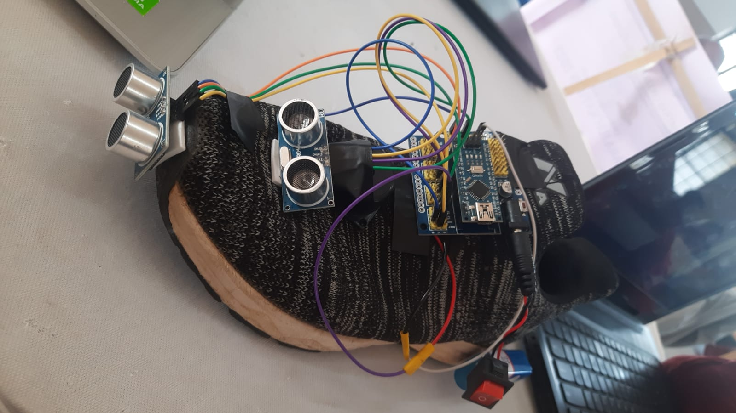
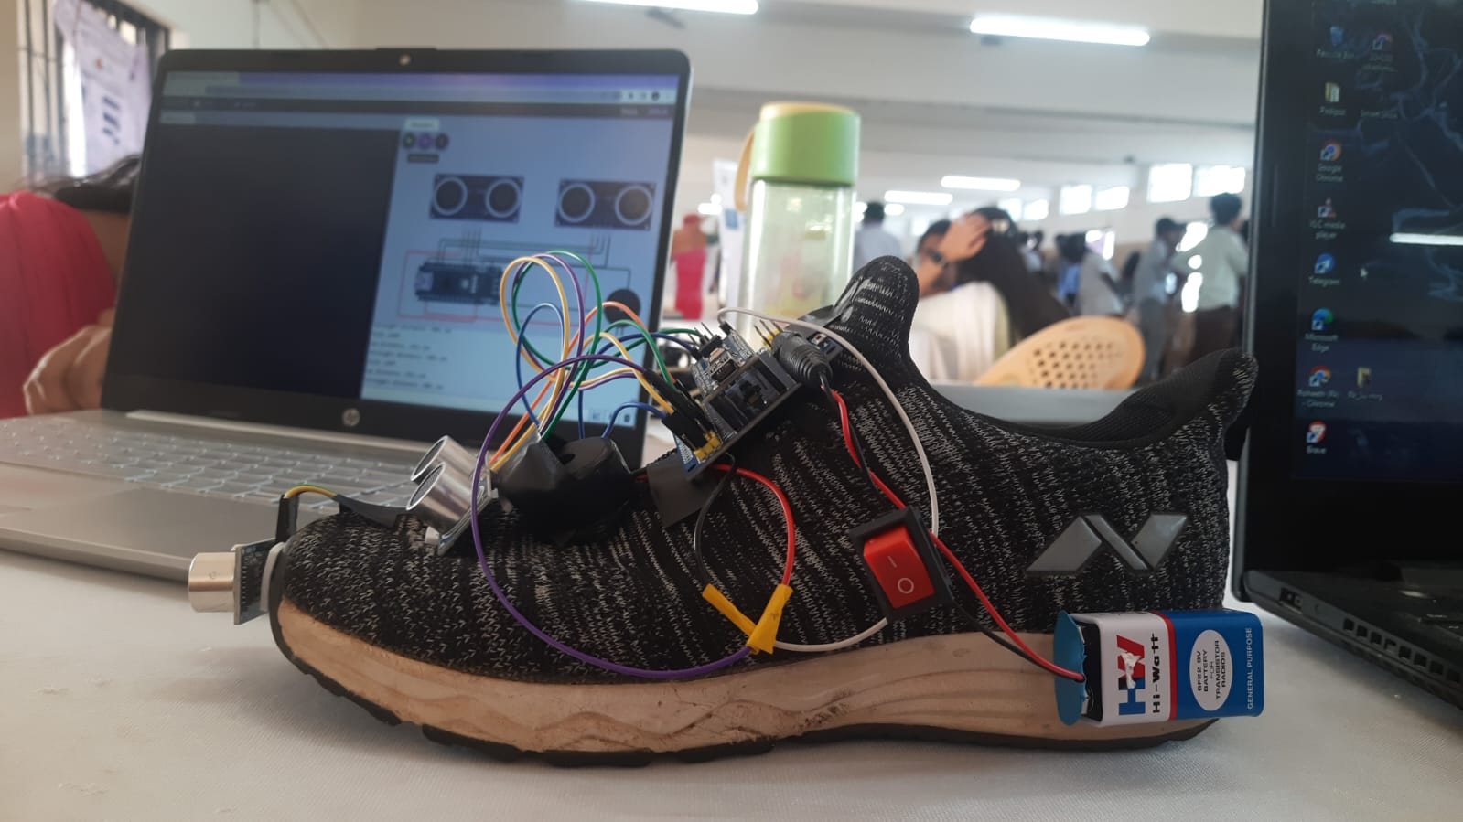
Status of project
Project has been completed

