Slide 1
BudTrack : An Expense Manager
Made By:
Aaditya Mahadevan (1811022)
Krish Parekh(1811031)

Slide 2
Outline
Project Description
Tools Used
Functionalities
Guidelines (Software Requirements)
Video Demo
Conclusion

Slide 3
Project Description
BudTrack is an expense tracker is a software or application that helps to keep an accurate record of your money inflow and outflow. Many people in India live on a fixed income, and they find that towards the end of the month they don’t have sufficient money to meet their needs. While this problem can arise due to low salary, invariably it is due to poor money management skills.
People tend to overspend without realizing, and this can prove to be disastrous. Using a daily expense manager can help you keep track of how much you spend every day and on what. At the end of the month, you will have a clear picture where your money is going. This is one of the best ways to get your expenses under control and bring some semblance of order to your finances

Slide 4
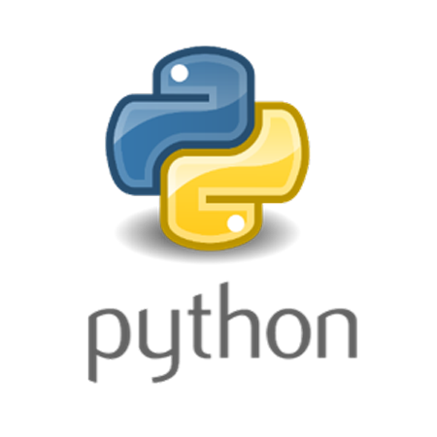


Tools Used
1.Backend : Python3
Python is an interpreted, object-oriented, high-level programming language with dynamic semantics. Its high-level built in data structures, combined with dynamic typing and dynamic binding.
2. Database: sqlite3
Sqlite 3 is a relational database management system (RDBMS) contained in a C library. In contrast to many other database management systems, SQLite is not a client–server database engine. Rather, it is embedded into the end program.
3. Frontend : Tkinter (module of Python3)
Tkinter is the standard GUI library for Python. Python when combined with Tkinter provides a fast and easy way to create GUI applications. Tkinter provides a powerful object-oriented interface to the Tk GUI toolkit.

Slide 5
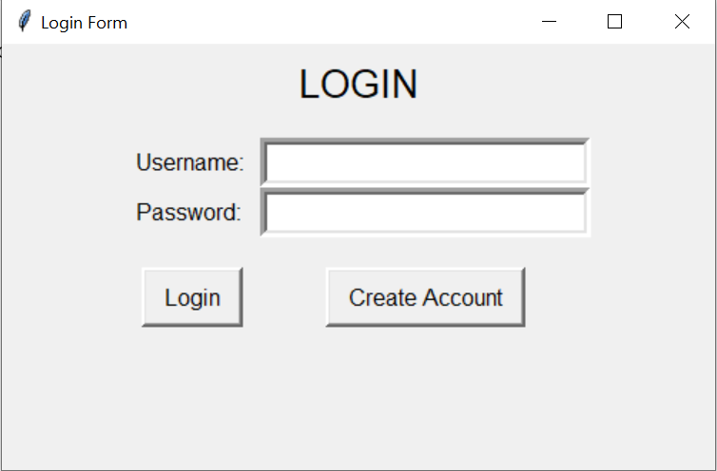
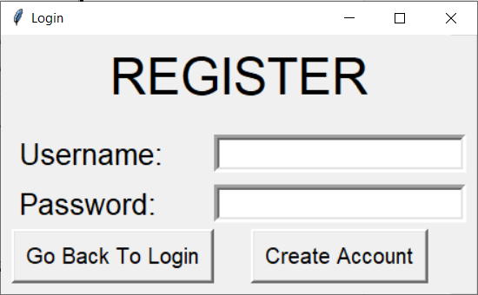
Functionalities
Login/Register:
Before using BudTrack, you need to create an account. Every time you will use BudTrack , you will be prompted to enter your login details. This feature makes your work more secure and protected.

Slide 6
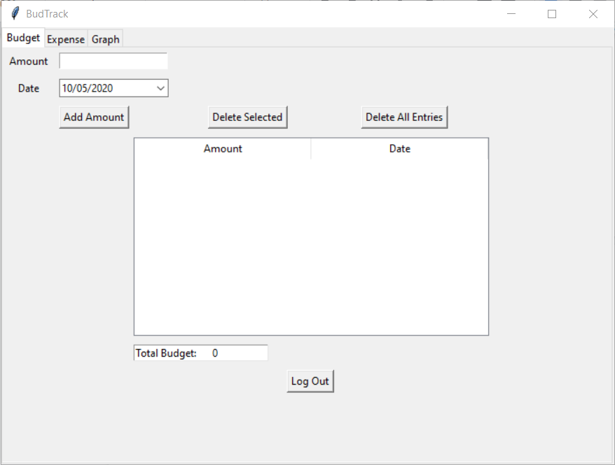
Functionalities
2. Expense Tracker
Expense tracker is a simple way to manage your spending and earnings.
Budget Tab: Basic Operations include:
Add Amount
Delete Amount
Sort By Amount
Sort By Date
Delete selected entry
Delete all entries
Logout

Slide 7
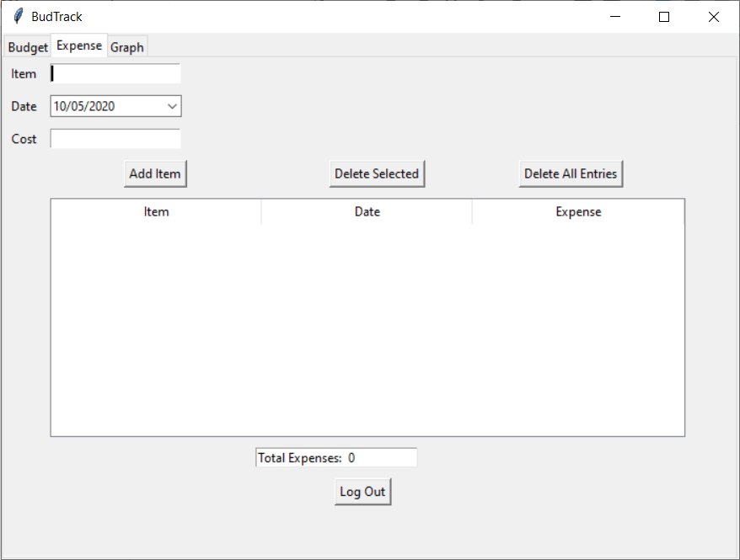
Functionalities
B) Expense Tab: Operations include the following functions:
Add Item
Delete Item
Sort By Item
Sort By Amount
Sort By Date

Slide 8
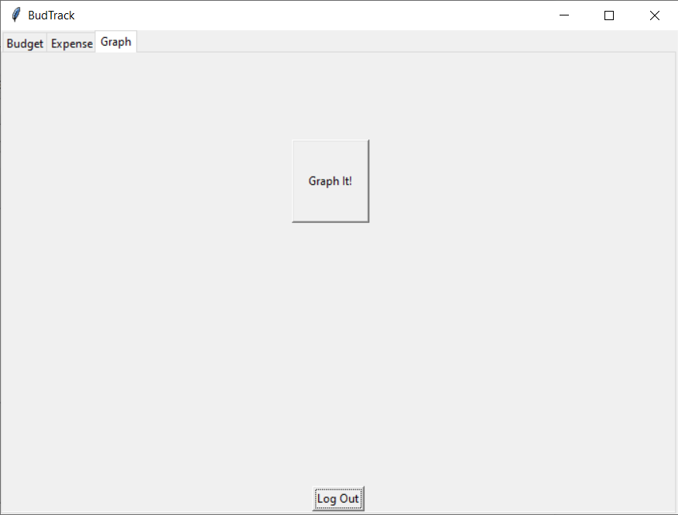
Functionalities
C) Graph Tab: View your budget and expenses as a pie chart indicating the money spent and money left
1.Chart It!
You can also export the graph for documentation purposes.
D)Logout : Logout of the application once you have finished adding/deleting/viewing your account details.

Slide 9
Guidelines
Installation:
After installing python we need to install to additional packages
1) Matplotlib which is used to display the pie chart of the money spent and money left.
Run the following command in cmd to install
pip install matplotlib
2) Tkcalendar which is used to input the dates from the user
Run the following command in cmd to install
pip install tkcalendar
3) Double click on main.py to launch the program

Slide 10

Working Demo
See the following video for more clarification on the functionalities of the application
Click on the link to view the user manual for a step by step guide with screenshots:
BudTrack User Manual

Slide 11
Conclusion
BudTrack , an expense tracker was developed with the help of python with various different functionalities which are easy to interpret for the user.
Thus while developing this we gained experience about Python, database connectivity with python using sqlite3 and GUI using Tkinter.

