Slide 1


How Our Screens Steal Our Sleep
A data story about social media, screen time, and sleep duration
Statistics for Business
pacmann.io
© 2025 – Pacmann AI

Slide 2
Introduction
Late at night, many of us reach for our phones.
Scrolling feels harmless—but does it quietly cost us sleep?
This project explores how digital behavior relates to sleep duration.

Slide 3
Dataset
Source: Kaggle – Social Media & Mental Health Indicators Dataset
5,000 users
Variables include screen time, social media usage, interactions, age, and sleep hours.

Slide 4
Statistical Test
Question: Do high social media users sleep less?
Method: t-test
Group: Low vs High social media usage

Slide 5
Statistical Result
High social media users sleep about 0.6 hours less on average.
Result is statistically significant (p < 0.001).

Slide 6
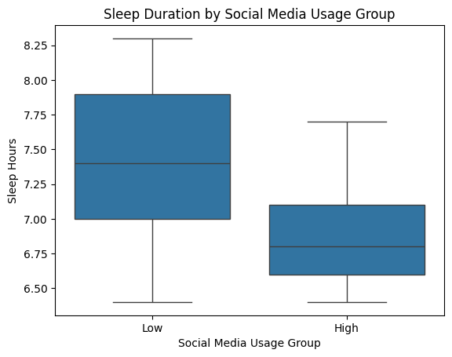

Slide 7
Regression: Social Media Only
As social media time increases, sleep duration decreases.
This confirms the pattern seen in the group comparison.

Slide 8
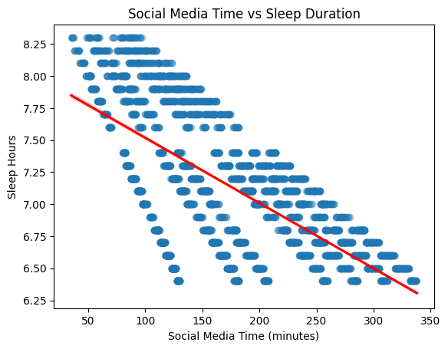

Slide 9
Regression: Full Model
When controlling for screen time, age, and interactions:
Total screen time is the strongest predictor
Social media alone becomes less dominant

Slide 10
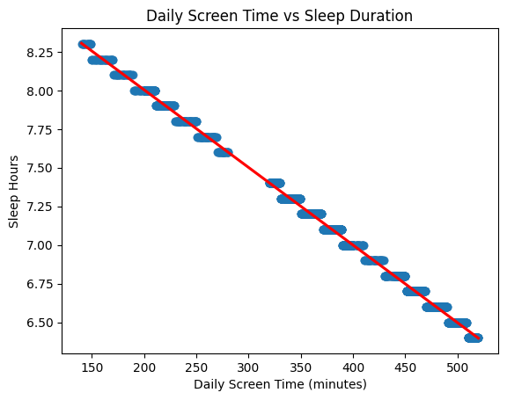

Slide 11
Conclusion
Digital habits are strongly linked to sleep duration.
Not just social media—but overall screen exposure matters.

Slide 12
Recommendation
Reduce screen exposure before bedtime.
Encourage digital well-being habits.
Future studies could examine sleep quality and long-term effects.

Slide 13
Reference
Stine, R., & Foster, D. (2013). Statistics for Business: Decision Making and Analysis, Addison-Wesley.
Gelman, A., Hill, J., & Vehtari, A. (2020). Regression and Other Stories.

Slide 14
Thank You
Notes:
Transisi antar outline

