Slide 1
HASHICORP CONSUL
Nyoman Wira Prasetya

Slide 2




Slide 3
What is Consul?
Discover services
Central registry that tracks services, updates, and health statuses in real time.
Automate networking
Reduce the operator burden by automating key networking tasks
Secure networking
all service to service communication is authenticated, authorized, and encrypted
Access services
Control access to services

Slide 4
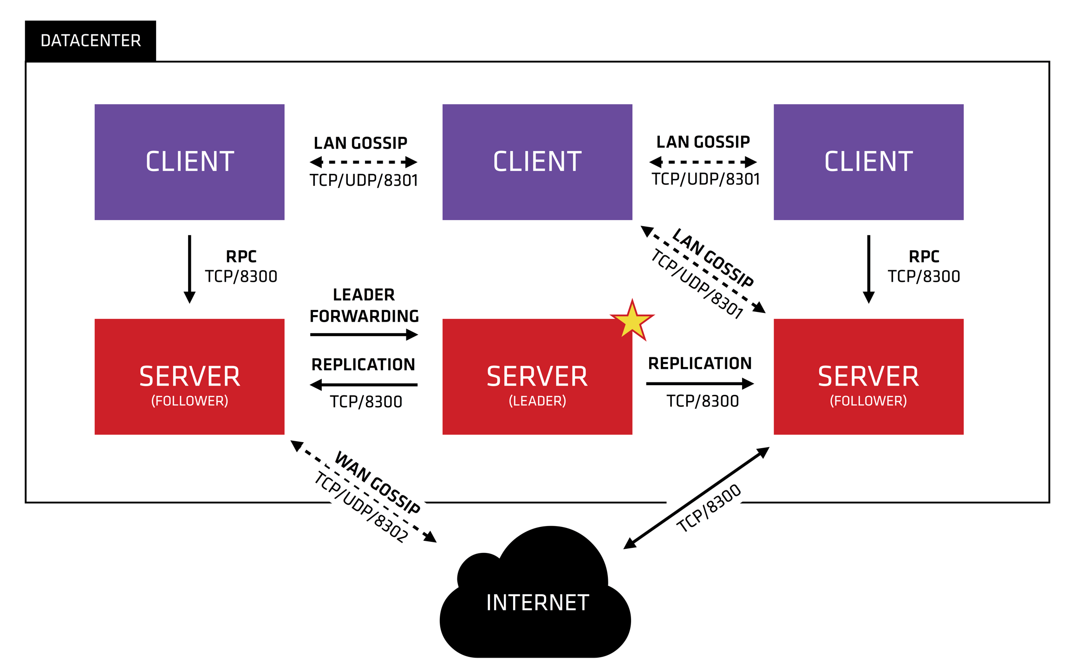

Slide 5

Hands-on (1) Deploying Consul
Installing Consul
Configuring Consul Server
Configuring Consul Client

Slide 6
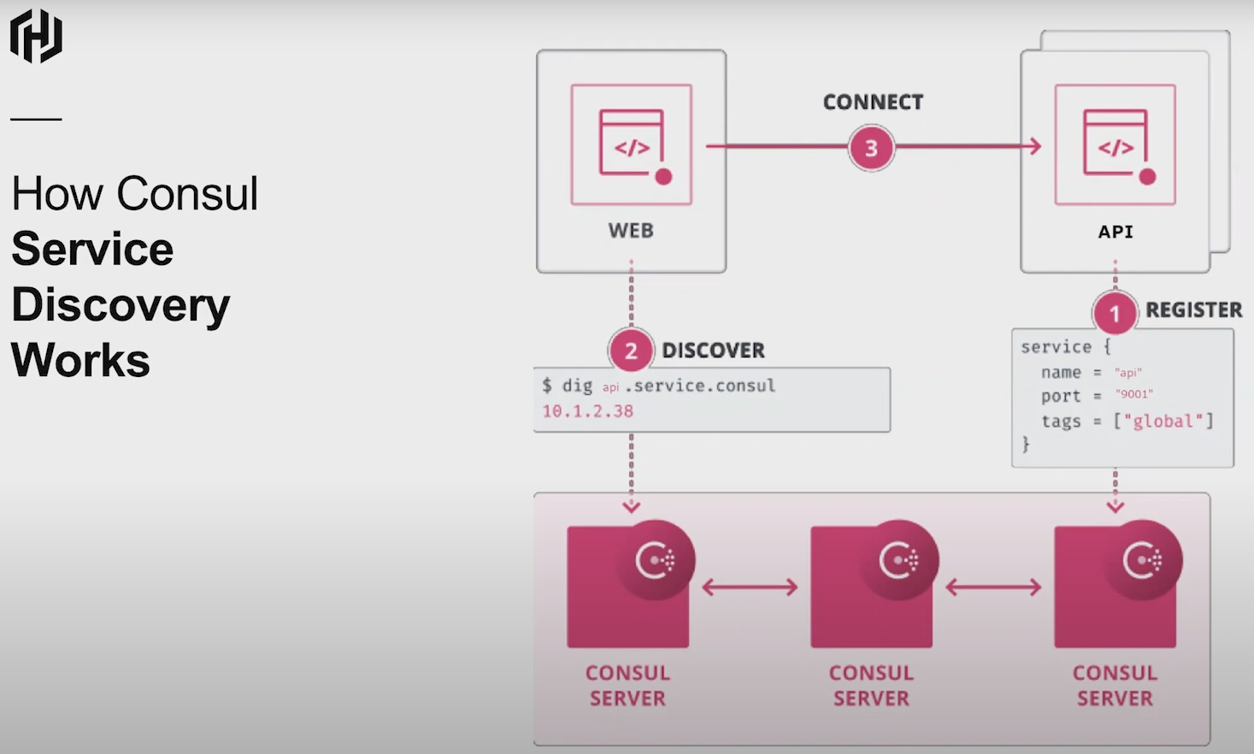

Slide 7
Hands-on (2) DNS
Install local dns (dnsmasq/bind)
Configuring local dns
Testing dns forwarding
Reference:
https://developer.hashicorp.com/consul/tutorials/networking/dns-forwarding

Slide 8
Hands-on (3) Running Services
Download frontend & backend apps
Create Systemd for apps
/etc/systemd/system/frontend.service
/etc/systemd/system/backend.service
Reference:
https://github.com/consul-up/birdwatcher/releases

Slide 9
Hands-on (4) Registering Services
Create service config
/etc/consul.d/frontend.hcl
/etc/consul.d/backend.hcl
Check Consul Catalog
Test Consul Service Discovery

Slide 10
Security
Gossip Encryption
mTLS
Access List (ACL)

Slide 11

Gossip Encryption
Reference:
https://developer.hashicorp.com/consul/tutorials/security/gossip-encryption-secure

Slide 12
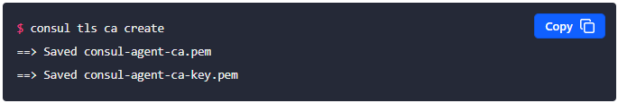

TLS Encryption (mTLS)
CA
Server CA
Reference:
https://developer.hashicorp.com/consul/tutorials/security/tls-encryption-secure

Slide 13

Access List
Initial Bootstrap Token
Using Token
Agent Token
Reference:
https://developer.hashicorp.com/consul/tutorials/security/tls-encryption-secure

Slide 14

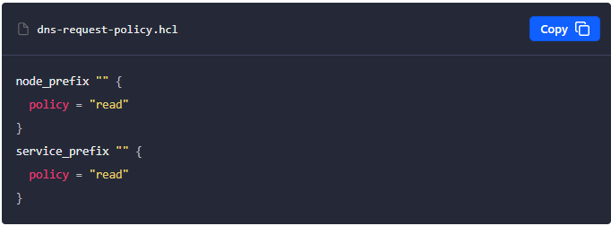
Access List (2)
Service Token
DNS Token
Policy
Reference:
https://developer.hashicorp.com/consul/tutorials/security/tls-encryption-secure

Slide 15
Hands-on (5) Security
Configure Gossip Encryption
Configure mTLS
Configure ACL

Slide 16
Service Mesh
A service mesh is an infrastructure layer that enables you to control the network communication of your workloads from a single control plane.
Sidecar Proxies
A proxy is an application that traffic is routed through on the way destination.
Control Plane
The control plane’s job is to manage and configure the sidecar proxies
Secure networking
intention

Slide 17
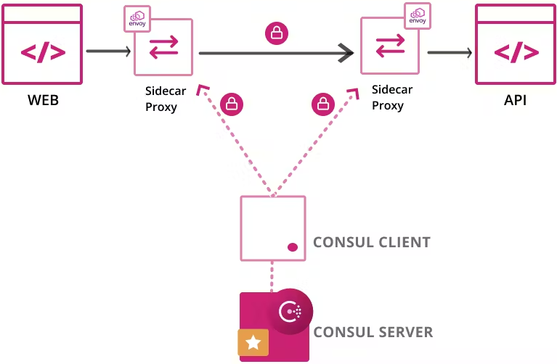

Slide 18
Hands-on (6) Service Mesh
Reconfig
/etc/consul.d/frontend.hcl
/etc/consul.d/backend.hcl
Create Intention

