Slide 1
Orchestration Using
NOMAD & CONSUL
Nyoman Wira Prasetya

Slide 2




Slide 3
What is Consul?
Discover services
Central registry that tracks services, updates, and health statuses in real time.
Automate networking
Reduce the operator burden by automating key networking tasks
Secure networking
all service to service communication is authenticated, authorized, and encrypted
Access services
Control access to services

Slide 4
What is Nomad?
Efficient resource usage
Optimizes the available cluster resources by efficiently placing the workloads onto the client nodes of the cluster
Self-healing
constantly monitors and detects if tasks stop responding and takes appropriate actions
Zero downtime deployments
supports several update strategies including rolling, blue/green, and canary deployments

Slide 5
What is Nomad?
Different workload types
Allows orchestration of Docker and other containers, as well as Java Jar files, QEMU virtual machines, raw commands
Cross platform support
allows you to orchestrate your application across macOS, Windows, and Linux clients
Single unified and declarative workflow
declarative job specification that outlines important attributes

Slide 6
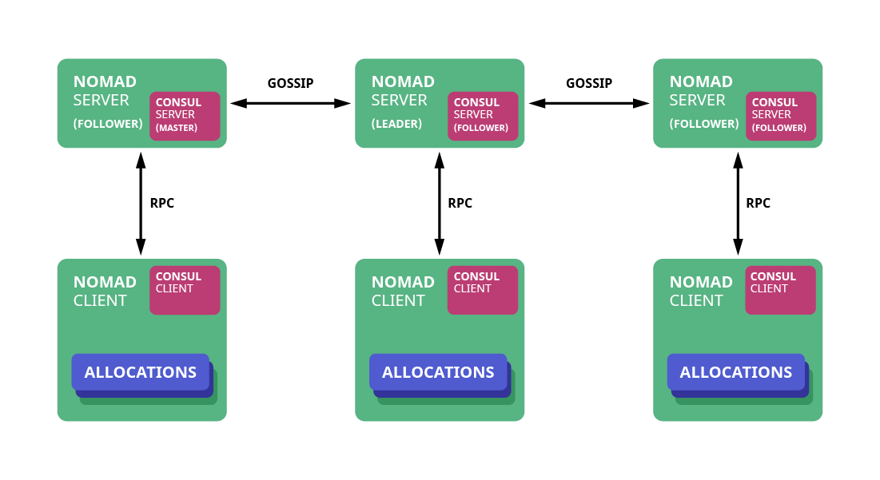
Architecture

Slide 7
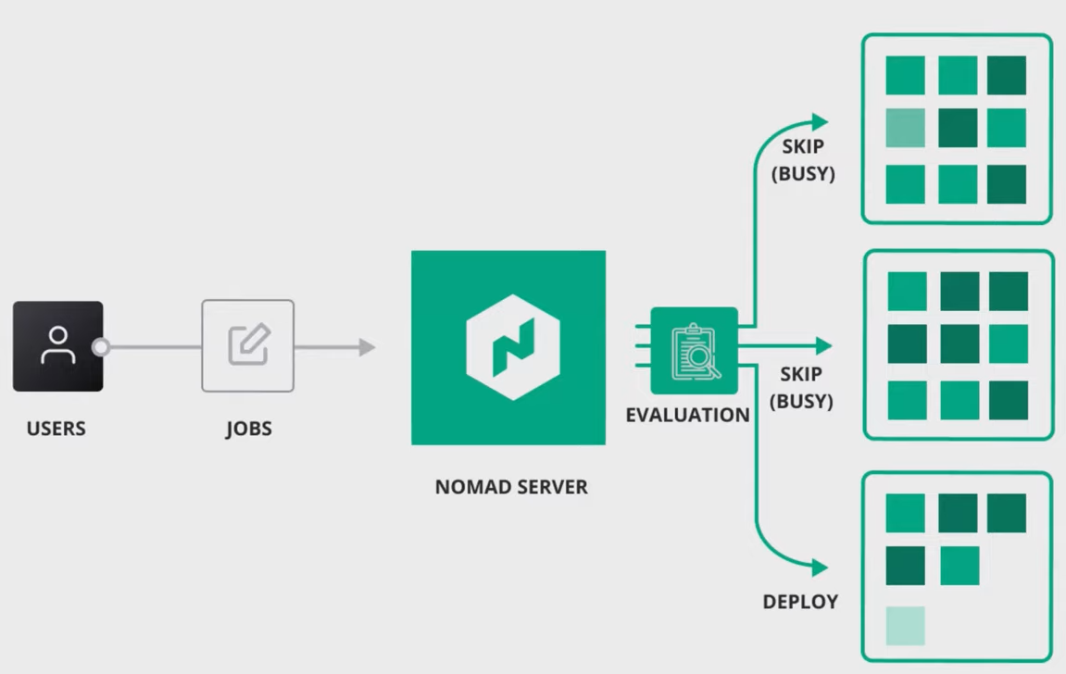
Deployment Workflow

Slide 8
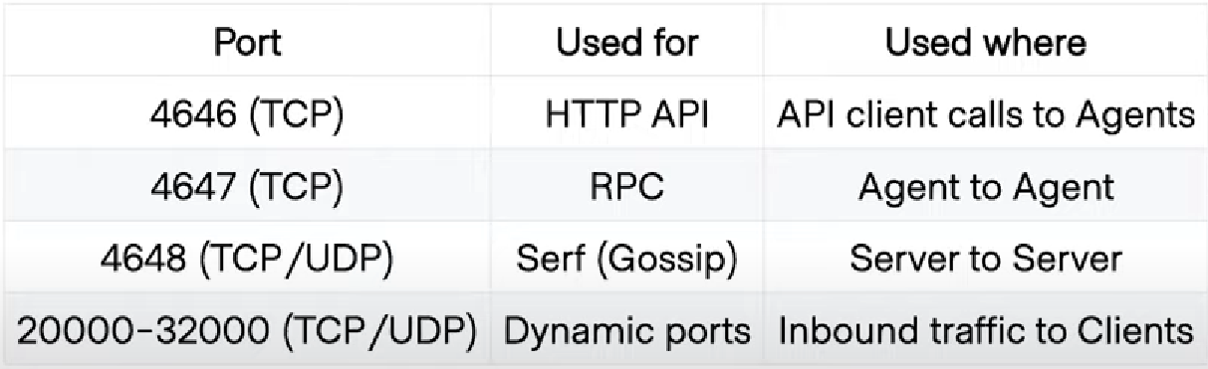
Network

Slide 9
Deployment as Code
Declarative specification HCL or JSON
Using HCL or JSON format
Stanza
Job, group, task
Requirement
declarative job specification that outlines important attributes

Slide 10
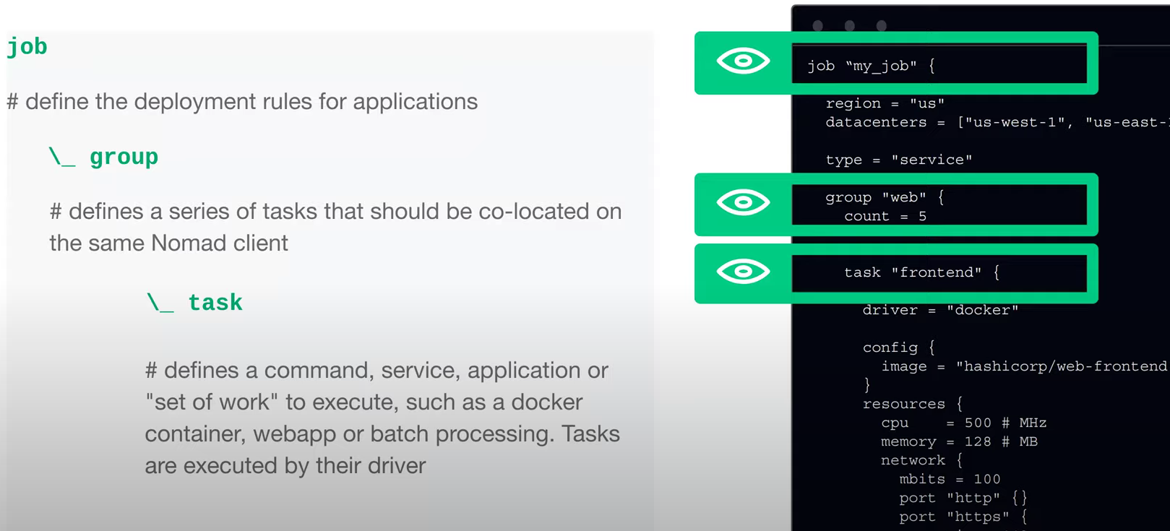
Deployment Rule

Slide 11
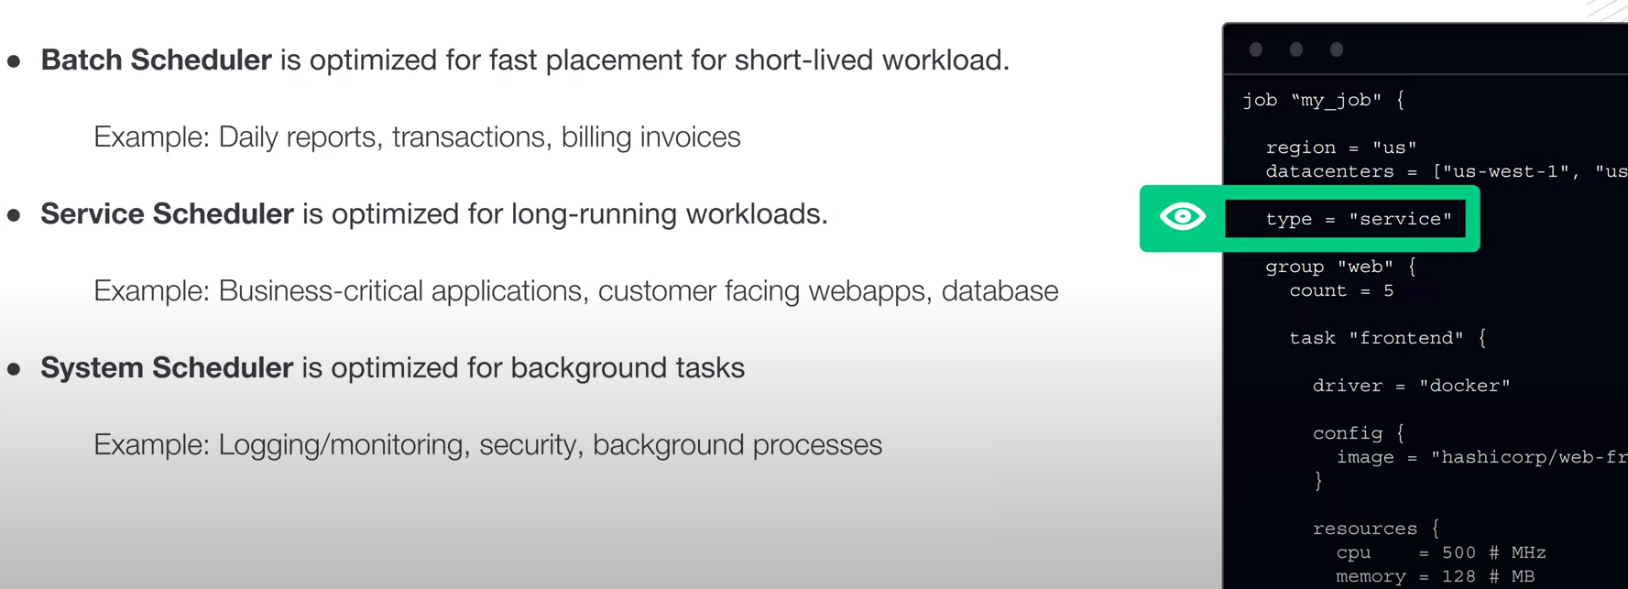
Type of Workload

Slide 12
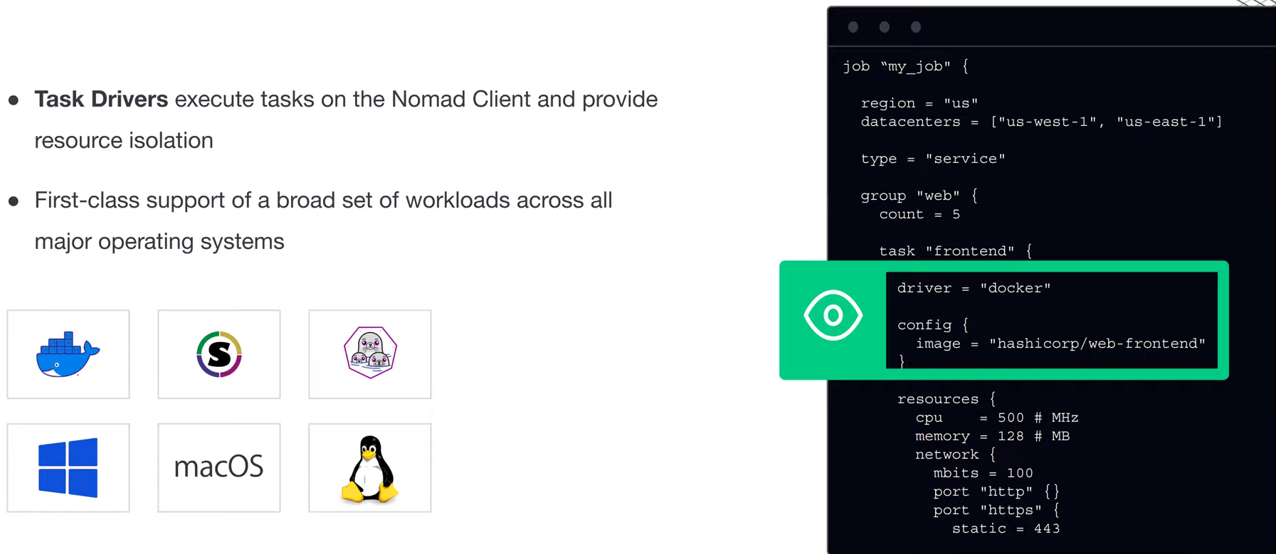
Drivers

Slide 13
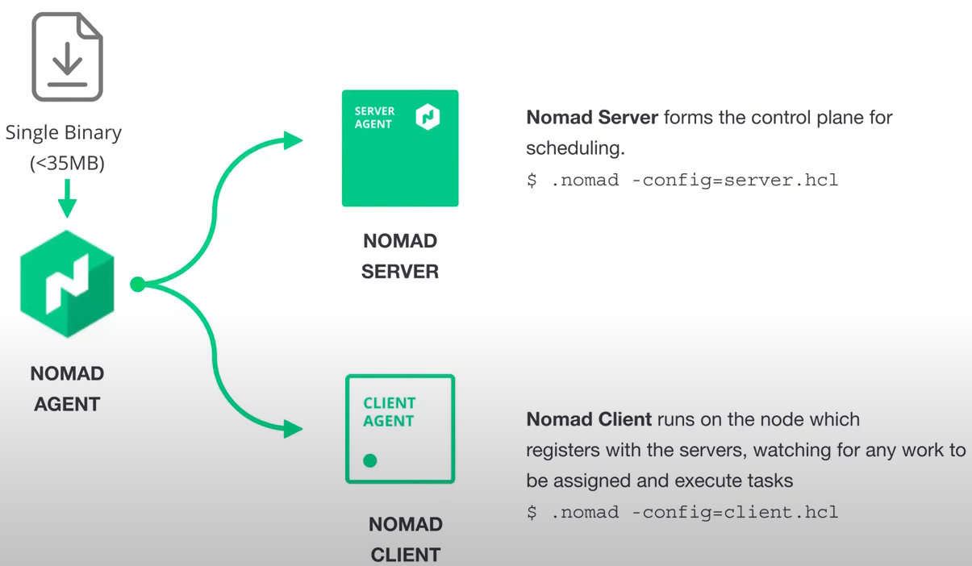
Proscess Flow

