Slide 1

Weekly Task
Database Management

Slide 2

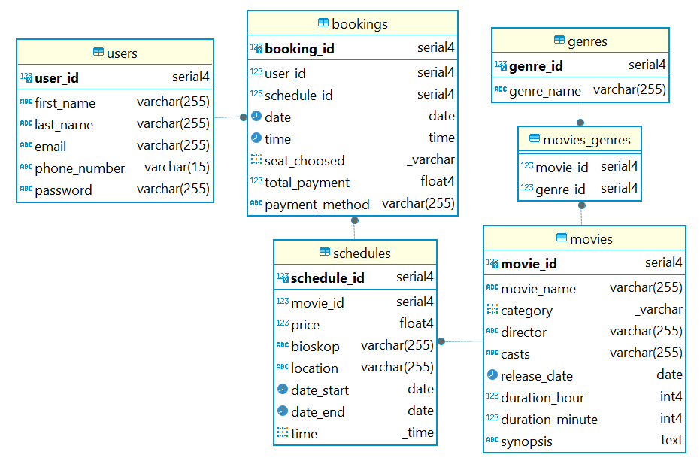
Weekly Task
Project
1.1 Create Table
Backend devops

Slide 3
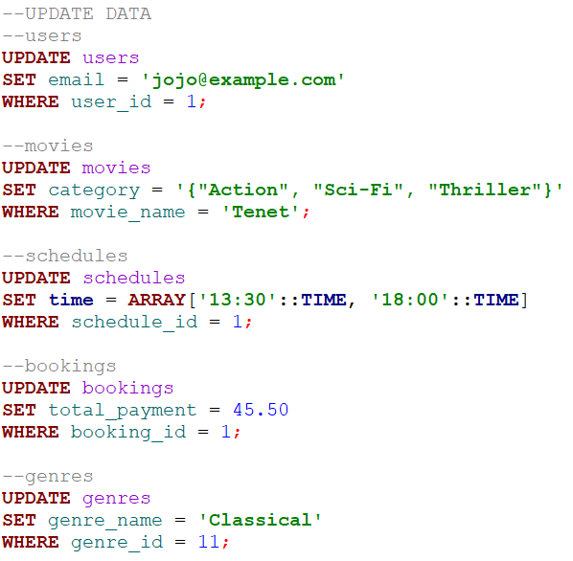
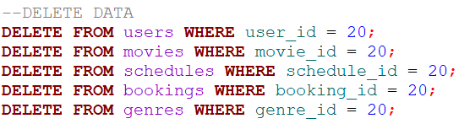
Weekly Task
Project
1.2 Delete & Update
Backend devops

Slide 4
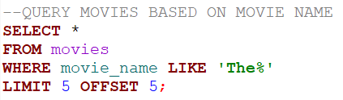
Weekly Task
Project
1.3 Read Table & Pagination
Backend devops

Slide 5
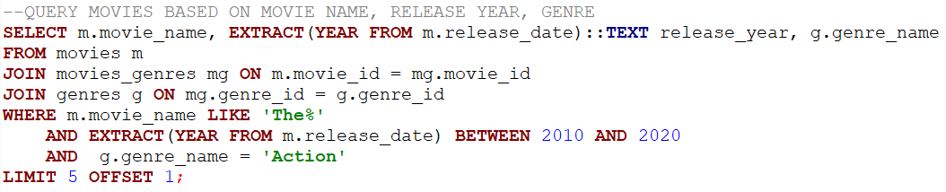

Weekly Task
Project
1.3 Read Table & Pagination
Backend devops

Slide 6
Postgresql
2. Concepts
SQL stands for "Structured Query Language", which is a domain-specific language for managing and querying relational databases.
PostgreSQL is an open-source relational database management system which uses SQL to work.
Database transaction is a sequence of one or more SQL statements treated as a single unit of work, using keyword BEGIN TRANSACTION to mark the beginning of a transaction block, COMMIT to save the changes, and ROLLBACK to discard the changes.
Backend devops

Slide 7
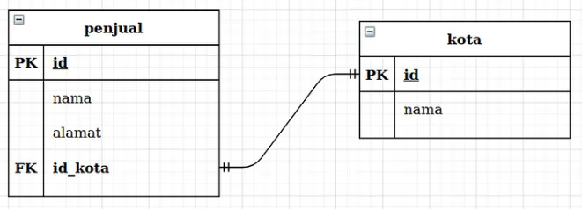
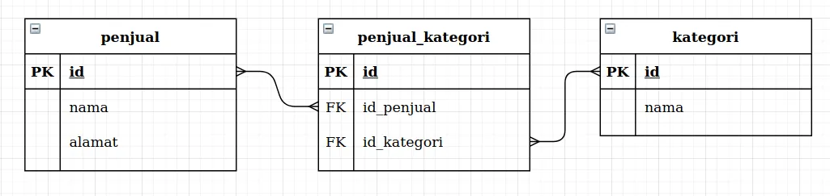
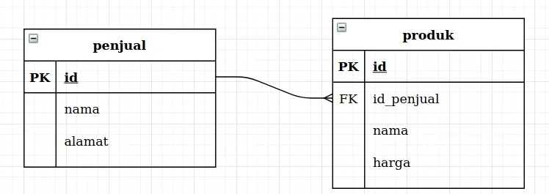
Postgresql
2. Concepts
One-to-one
Many-to-many
alamat
umur
alamat
id_alamat
One-to-many
source = https://medium.com/
Backend devops

Slide 8
Thank You

