Slide 1

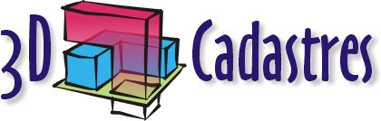
3D CADASTRE
MÜHENDİSLİK FAKÜLTESİ
GEOMATİK MÜHENDİSLİĞİ
GMT-351
OKTAY ÇAKMAK-21732991
KAZIM CAN DOĞAN-21733026

Slide 2
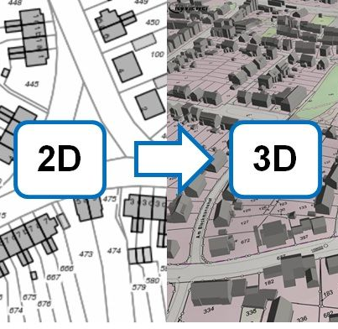
ABSTRACT
The 3D cadastre concept brings data models, which are more complex than traditional 2D cadastral data models and could be followed by a large amount of data. The 3D cadastral data should be stored in database management systems, since the cadastral data integrity and consistency have to be satisfied. Relational database management system requires a tabular structure where data are stored within predefined columns and data types, and this could be uncomfortable for 3D cadastre until relational provides full 3D support. This study examines the possibility of using NoSQL databases in the 3D cadastre domain. NoSQL database stores unstructured data, which means that it is not required to define in advance what data types and categories will be used. From the 3D cadastre point of view, the NoSQL approach provides flexibility in data types and allows easier implementation of the 3D cadastral models. The implementation is conducted by using MongoDB and 3D Cadastral Data Model, where 3D cadastral data, including both alphanumerical and geometry part of data, are prepared for importing and then stored, managed, queried, and updated within NoSQL database. Furthermore, data stored in MongoDB are visualized and queried inside a web browser by using Cesium library.

Slide 3
INTRODUCTION
During the last century, rapid urbanization created significant environmental changes that are mostly reflected by increases in densely populated urban areas. As a result, a space below and above the ground level is occupied and used by complex constructions. These changes have caused a greater importance for representation of the ownership. Traditional cadastral registration systems face many difficulties in representing complex and multilevel property situations on 2D maps .As a result, these maps cannot be used as a base for registration of complex situations and interlocked rights in urban areas. Therefore, a system which allows easy recording and representing of all possible property situations is necessitated and such a system is called “3D cadastre”. A 3D cadastre contains data of land, buildings, building parts, other construction objects, and data of the owners of such objects - including rights, restrictions, and responsibilities. There are many reasons why the idea of the 3D cadastre is becoming increasingly widely recognized. Nowadays, more than half of the world’s population lives in urban areas , which has resulted in an increased number of interlocked properties, complex constructions, buildings above roads, tunnels, pipelines, etc. Additionally, a rapid development of new technologies, especially 3D technologies, brought new possibilities of storing, manipulating, and visualizing 3D data. This initiated and enabled the development of the 3D cadastre technical approaches as well. 3D Cadastre, together with 3D city models, can improve land tax estimation and the land market by using visibility analysis.
The 3D cadastre can be viewed from two aspects, technological and legal one. From the legal point of view, the 3D cadaster, or a system which will enable to unequivocally register rights on 3D properties, is very important. In our study, we consider only the technical and technological aspects of the 3D cadastre. According to, geo-database management systems (DBMS) should be the starting point for storing and maintaining data on 3D cadastre. DBMS guarantee the consistency of the data (both geometric and alphanumeric), which provides that data are modified only in allowed ways. This is very important for the cadastral data, especially for the legal part of data.
The hybrid and full 3D cadastre models, it could be concluded that 3D cadastral models are much more complex than the traditional 2D cadastral models and could result in large and complex datasets. 3D data manipulation, such as storing, processing and analyzing, presents challenges to relational database management system (RDBMS) due to the lack of full 3D support.
The objective of this study is to explore an alternative way of storing 3D cadastral data. Starting from the notion that 3D cadastral data should be stored in a DBMS and due to the limited 3D support in RDBMS including issues with large datasets, we analyze the use of alternative database systems called NoSQL in 3D cadastre domain. NoSQL databases are database management softwares that can handle massive data storage and they follow the base rules.

Slide 4
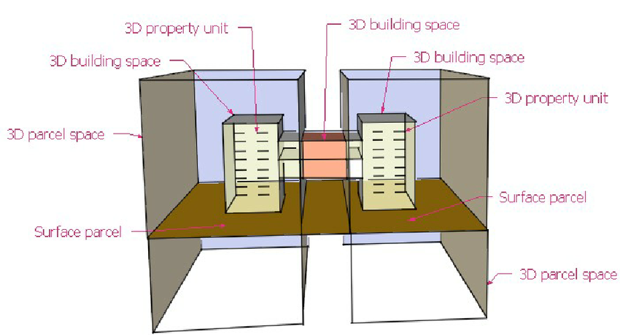
3D CADASTRE AND RDBMS
The 3D cadastre could be implemented in different ways from a full 3D cadastre, which includes 3D volumes, to the current 2D Cadastre models with tags leading to the external 3D models. DBMS play a central role when it comes to storing 3D cadastral data. Within the RDBMS architecture, the spatial and non-spatial data are maintainedrules that provide a reliabl system and data consistency. Certain standards, such as CityGML, are very useful for the visualization and exchange of 3D models including topological relationships between different geometric aggregates. However, they are still only XML schemas that can be easily corrupted or modified and this is not acceptable from the data consistency point of view. Therefore, the 3D cadastral data should be stored in a DBMS.
The Oracle Database Release , three-dimensional spatial data that include 3D points, 3D lines, 3D polygons, 3D surfaces, and solids can be stored with built-in datatypes. Also, PostGIS supports 3D data types such as points, lines, surfaces, TIN and solids. When it comes to topological relations, no geo-DBMS can provide support in maintaining 3D topological models. This means that the 3D spatial functionality, regarding complex 3D spatial data types, must be further defined. These advances should be developed (or extended), in order to maintain 3D objects in the database. The authors have also proposed that as soon as 3D geometry and topological models are supported, a DBMS should support functions and operations for analysis, conversion, and validity. According to these statements, there is currently no RDBMS which fully supports all 3D cadastre requirements. Furthermore, relational databases were created for business data processing needs during the time when interfaces and hardware were different.

Slide 5
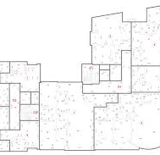
NOSQL DATABASES
Main advantages of NoSQL databases are flexibility and not strict data models which enables easy storage of different data types and allows the system to change and evolve. NoSQL databases have capabilities to store structured, semi-structured, and even unstructured data, unlike RDBMS where data have to fit into the predefined table structure. It means that it is possible to store data based on two or more data models within the NoSQL database, and this is very suitable for hybrid models. NoSQL databases are primary designed to handle big data, compared to RDBMS, where large amount of data may slow down their performance. NoSQL databases have implemented methods that improve the performance of storing and retrieving data .

Slide 6
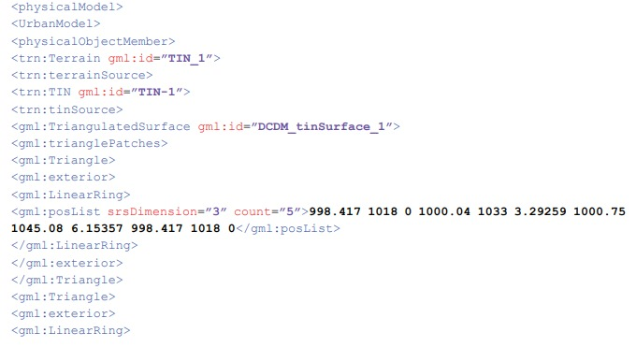
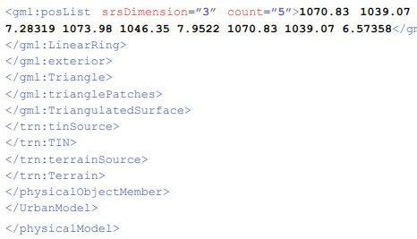
3D CADASTRE DATA IN NO-SQL DATABASES
We used three 3DCDM modules including: Building, Terrain and Utility modules. To elaborate, we used eight building units (including two underground units), TIN terrain model and data on two utility networks (water supply and hot water network). An example of a physical model (XML document) for two TIN triangles is as follows:

Slide 7
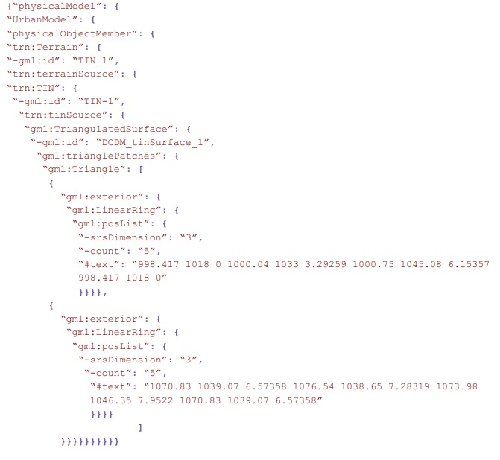
The first step was converting the case study data from XML schema to JSON. The conversion was performed for all case study data: the terrain model and eight building units including two basements and two utility networks. An example of converted data (two TIN triangles) is as follows:

Slide 8
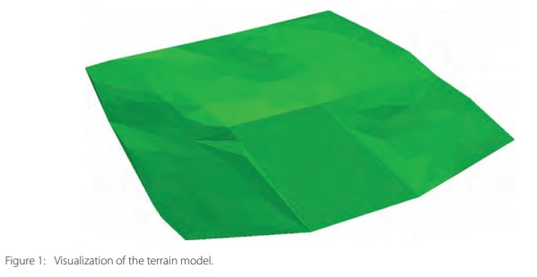
Hereafter, as the input data, we used data from the terrain model, building units and utilities converted to JSON documents. Figure 1 shows the terrain model which has a small valley prepared for building infrastructure and which is built from the 237 triangles.

Slide 9
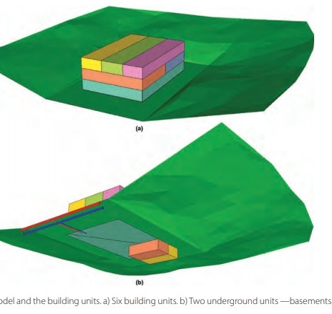
Figure 2 shows the terrain model and the building units. Figure 2a portrays six building units of six owners above ground whereby every building unit is colored to represent a different property holder. Figure 2b shows two underground building units — basements, and they are also colored according to property holder. Additionally, the water supply network (blue) and hot water network (red) are represented in Figure 2b. Both of them contain the main pipe and connecting pipe between the building and the main pipe.

Slide 10
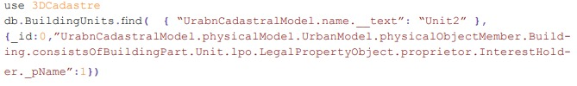
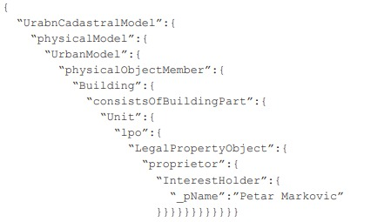
The second step was to import data (JSON documents) to the MongoDB database. Imported documents are stored in the database called “3DCadastre” and within collections called “Terrain”, “BuildingUnits” and “Utilities”. Collections in MongoDB represent the set of documents grouped together. A collection may store documents that are not the same in structure and it can be seen as an analogy to a table of an RDBMS.
By using just this simple syntax, many documents and 3D cadastral data can be easily imported and stored within the MongoDB database. Once imported, it is ready for querying, managing, and processing. Similar to RDBMS, data can be queried to define the conditions that need to be satisfied by returning documents.
The query returns the following JSON document:

Slide 11
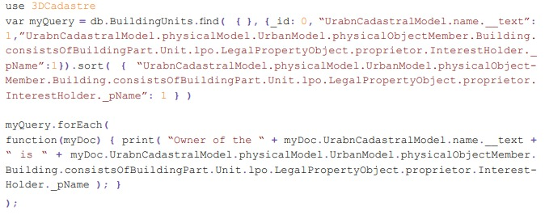
The query can be modified to return only the value, with additional options, including logic operators andsorting options.
Regarding spatial queries, MongoDB supports the following GeoJSON objects:
— Point
— LineString
— Polygon
— MultiPoint
— MultiLineString
— MultiPolygon
— GeometryCollection

Slide 12
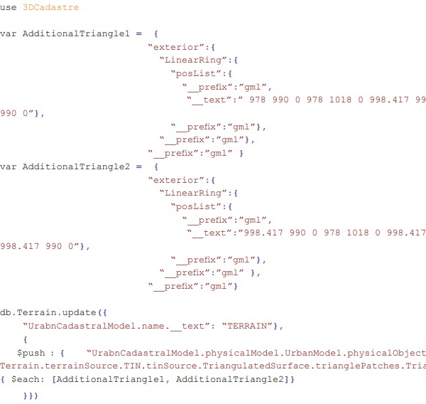
It supports inclusion queries that allow the selection of documents with geospatial data within a specified shape. Intersection queries are also supported and the near operator is very useful for returning documents from “nearest to farthest” with regards to a specified point. MongoDB supports 2D geospatial indexes for both 2D plane data and geometries on a sphere. MongoDB does not currently support 3D geospatial indexing and 3D geospatial querying. However, some applications, such as 3DRepo, use the MongoDB database for storing their 3D models.The 3D geometry data can still be updated as coordinate pairs. The next query updates the terrain model by extending the existing TIN with inserting two additional triangles.

Slide 13
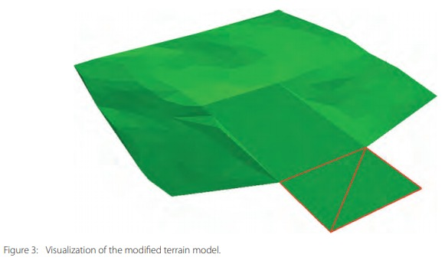
The “valley” of the terrain model is extended by inserting these two additional triangles. Figure 3 shows the modified terrain model and the edges of the inserted triangles are represented in red. Since MongoDB stores data as JSON documents, it can be easily integrated with Java Scrip libraries for 3D visualization or even for 3D operations. In this study, 3D Cadastral data stored in MongoDB are visualized and queried inside a web browser by using Cesium Java Script library. MongoDB provides REST (Representational State Transfer) API, and together with JSONP enables returning JSON objects from the database (server) based on client query. The received JSON object represents TIN data used in the case study. Furthermore, received data are provided to Cesium library which visualizes interactive 3D primitives. Figure 4 shows a representation of an interface of a web application based on Cesium, for which query and read data are from MongoDB.

Slide 14
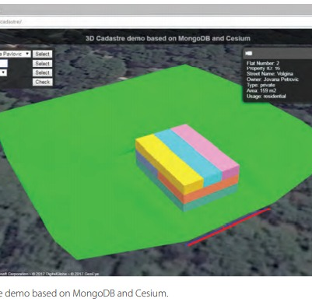
MongoDB can be used for storing 3D cadastral data. Due to the schema that allows varying sets of fields, with different types selected for each field, MongoDB easily store 3D models in many different formats such as CityGML or 3DCDM model presented in this study. Merging those models with 2D cadastral data, it is possible to implement hybrid 3D cadastral models.

Slide 15
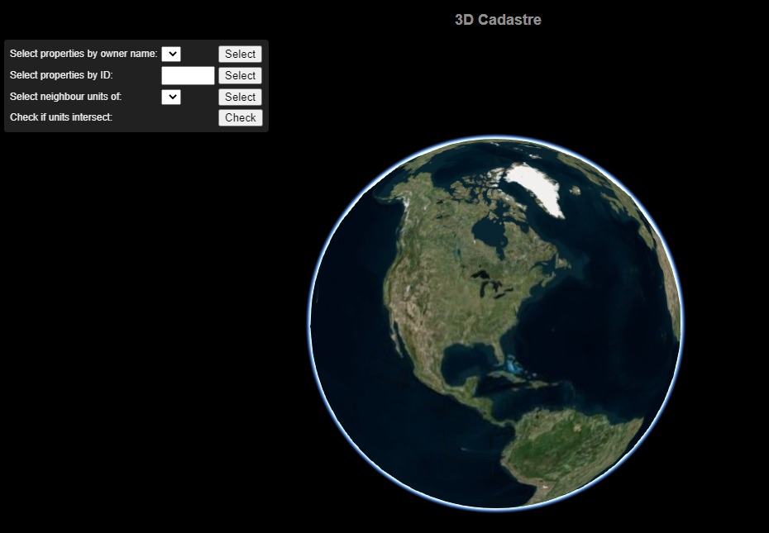
CONCLUSİON
The transition from traditional cadastral systems to 3D cadastre brings new issues on the management of spatial data and it could result in very large datasets. On one hand, some of the relational database management systems support storing 3D objects and 3D operations. Whereas, on the other hand, they still do not fAnalogous to RDBMS, the NoSQL database requires long-term development to fully support all 3D cadastre requirements such as 3D spatial indexing, 3D queries, and 3D topology.ully support all 3D cadastre requirements.

Slide 16
References
Aien, A., Kalantari, M., Rajabifard, A., Williamson, I., Wallace, J. (2013). Towards integration of 3D legal and physical objects in cadastral data models. Land Use Policy, 35, 140–154. DOI: http://dx.doi.org/10.1016/j.landusepol.2013.05.014
Chandra, D. G. (2015). BASE analysis of NoSQL database. Future Generation Computer Systems, 52, 13–21. DOI: http://dx.doi.org/10.1016/j.future.2015.05.003
Gröger, G., Plümer, L. (2012). CityGML – Interoperable semantic 3D city models. ISPRS Journal of Photogrammetry and Remote Sensing , 71, 12–33. DOI: http://dx.doi.org/10.1016/j.isprsjprs.2012.04.004
Tauro, C. J. M., Aravindh, S, Shreeharsha, A. B. (2012). Comparative Study of the New Generation, Agile, Scalable, High Performance NOSQL Databases. International Journal of Computer Applications, 48, 1–4.
Stonebraker, M., Madden, S., Abadi, D., Harizopoulos, S., Hachem, N., Helland, P. (2007). The End of an Architectural Era (It’s Time for a Complete Rewrite). Proceedings of the 33rd international conference on Very large data bases, VLDB pp(1150–1160)

