Slide 1
Perception: Map Building
RoyalPotato
Om Kukunuru (Team Lead)
Sam Kysar
Sphurti More

Slide 2
Tasks:
Build a map of the world ‘project3’ by exploring as quickly as possible
Make sure that Jackal motion is smooth without any sudden movements
Implement a have control strategy to achieve this motion
Get the time required to build the map
Display this three instances of map during building

Slide 3
Building a Map
Using Lab2 code modifications were made as necessary to follow wall
Max speed was increased
Wall distance and speed set as parameters
Ignore closer ranges on opposite side of wall following to be able to make it through narrow gap
Adjusted motion control as needed from testing

Slide 4
Control Strategy for Motion Control
cmd_vel
Change in velocity
FIR Filter
-
Distance from the wall
Averaging filter to smooth motion
Required distance from the wall

Slide 5
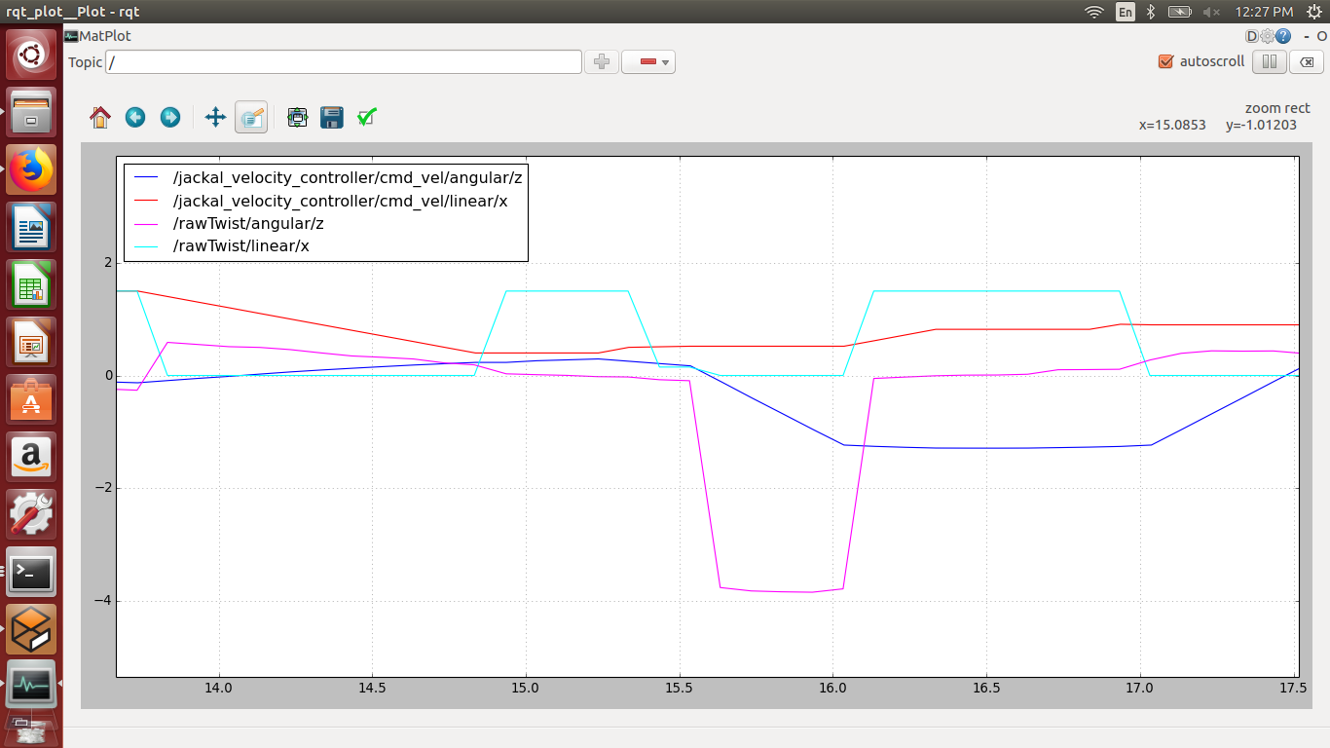
Control Strategy for Motion Control

Slide 6
Video Demo
Time taken for the jackal to scan the world: 150 - 180 secs for complete map

Slide 7
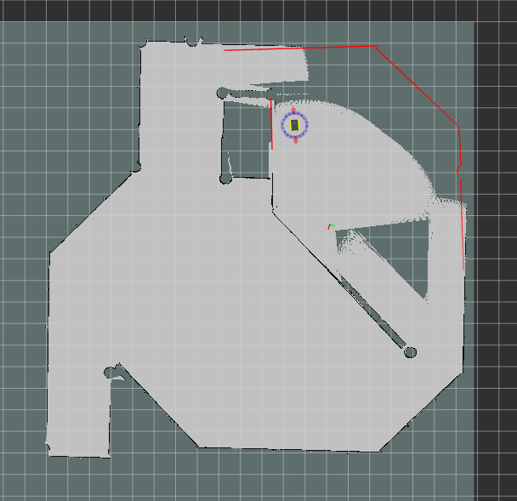
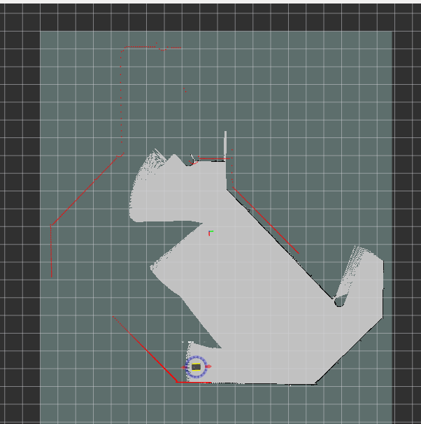
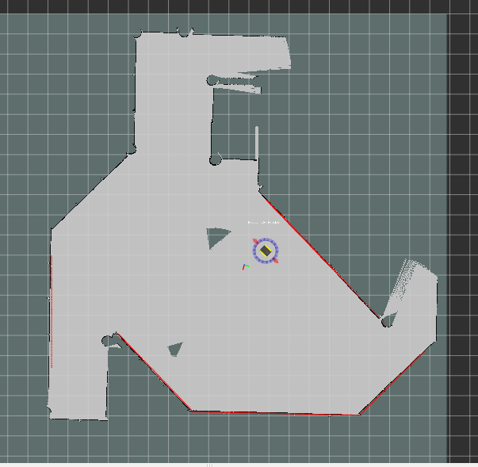
Maps
Step 3
Step 1
Step 2

Slide 8
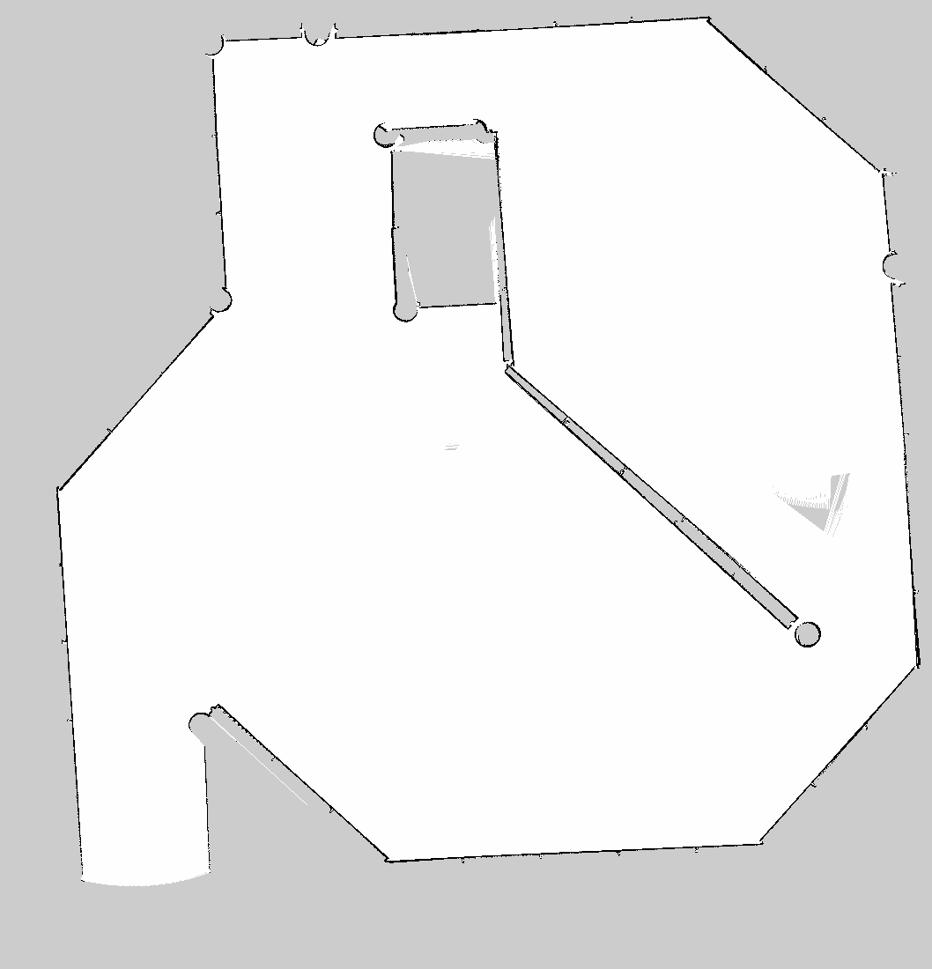
Maps
Full Map

Slide 9
Contributions
Om Kukunuru: Navigation, Controls and Presentation
Sam Kysar: Navigation and Controls
Sphurti More: Mapping, Navigating

Slide 10
Questions?
Thank You

