Slide 1
Exploring the correlation between types of venues in an area and average income of residents
Denis rakhmanov
October 2019

Slide 2
Analysis is valuable for sociologists and politics
sociological correlation between types of venues and people living near them
What types of venues can improve socio-economic values of a community

Slide 3
Data acquisition and cleaning
average income and hardship index per community, available in .csv file
geojson file for creating the map and getting the coordinates of communities
Foursquare API
In total 77 communities from Chicago Website and 3545 venues from over 360 categories
Highly similar venues were combined into wider categories leaving us with 106

Slide 4
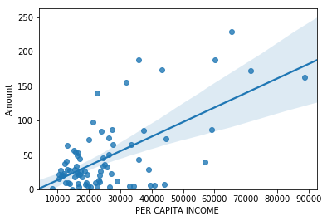
Using linear regression
 | PER CAPITA INCOME | HARDSHIP INDEX | Amount
PER CAPITA INCOME | 1.000000 | -0.849167 | 0.629972
HARDSHIP INDEX | -0.849167 | 1.000000 | -0.483058
Amount | 0.629972 | -0.483058 | 1.000000

Slide 5
Most common types of venues
COMMUNITY AREA NAME | PER CAPITA INCOME | 1st Most Common Venue | 2nd Most Common Venue | 3rd Most Common Venue | 4th Most Common Venue | 5th Most Common Venue
SOUTH LAWNDALE | 10402 | Daily Conveniences | Mexican Restaurant | IT | Sports | Nightlife
FULLER PARK | 10432 | Religious Place | Daily Conveniences | Fast Food | Food | Parks and Rec
WEST GARFIELD PARK | 10934 | Food | Religious Place | Daily Conveniences | Beauty | Tea and Desserts
WEST ENGLEWOOD | 11317 | Religious Place | Daily Conveniences | Professional Places | Post Office | Education
ENGLEWOOD | 11888 | Healthcare | Beauty | Fast Food | Business Service | Gym
COMMUNITY AREA NAME | PER CAPITA INCOME | 1st Most Common Venue | 2nd Most Common Venue | 3rd Most Common Venue | 4th Most Common Venue | 5th Most Common Venue
NEAR NORTH SIDE | 88669 | Professional Places | Healthcare | Landmark | selfimprovement | Arts Venue
LINCOLN PARK | 71551 | Bar | Daily Conveniences | Landmark | Professional Places | Fast Food
LOOP | 65526 | College and Univercity | Bar | Professional Places | Landmark | Fast Food
LAKE VIEW | 60058 | Bar | Professional Places | Landmark | Daily Conveniences | Entertainment
NEAR SOUTH SIDE | 59077 | Landmark | Gym | Professional Places | Healthcare | Parks and Rec

Slide 6
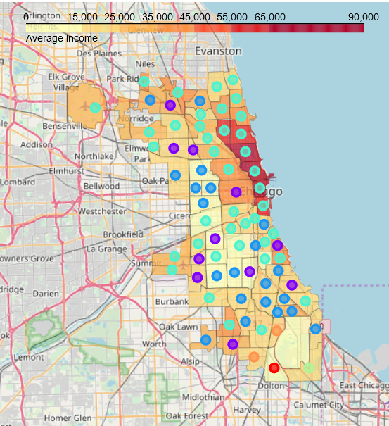
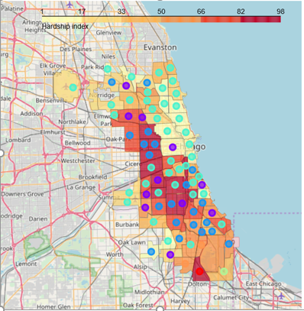
Clusterisation

Slide 7
Conclusion and future directions
We have shown that there's a positive correlation between average Income in the neighborhood and the amount of venues. Even though the R2 Score is pretty low we also saw that the most common venues in wealthy and poor neighborhoods are different.
We can look into how different categories correlate with income, maybe we got low R2 Score because we also included some categories that just add noise to our picture.
Our dataset consists of 77 communities of Chicago, and while we decreased the amount of categories of venue in our set it is still greater that the set itself which creates bigger errors in our calculations.
To be more certain we need bigger set: either to split communities of Chicago into smaller areas, but this would require access to income data not available in public access, or to include other cities into the set, but this can lead to bigger errors due to possible cultural differences between cities.

