Slide 1
Project 1 Pointers
CSE490-590 Fall 2026
Source: From prior semesters of CSE490/590 offerings

Slide 2
Project 1
Design an 16-bit microprocessor using Verilog HDL by using Structural Verilog modelling.
The individual components can be designed using behavioral modelling

Slide 3
Brief Overview
Verilog control flow keywords are always @(...), begin/end, case/endcase, initial, if/else, and assign
Verilog datatypes can be declared as input/output, reg/wire, array with [MSB:LSB]
Modules in Verilog can be created by declaring a module with a port list of inputs and outputs.
Behavioral Verilog is used to describe a module at a high level (think of writing a program in C).
Structural Verilog is used to describe a module at a low level by using primitive types (and/or/not...) and can be used to connect modules together.
The datapath of a MIPS CPU is described in detail here.

Slide 4
Verilog Resources
Verilog manual: https://cse.buffalo.edu/~rsridhar/cse490-590/lec/verilog_manual.pdf
"Digital Systems Design Using Verilog" by Charles Roth , Lizy K. John, Byeong Kil Lee
IEEE Standard Verilog Hardware Description Language (Manual for Verilog) (https://ieeexplore-ieee-org.gate.lib.buffalo.edu/stamp/stamp.jsp?tp=&arnumber=954909)

Slide 5
Important Verilog Keywords/ Concepts / Usages
always @
assign
case
reg
wire
initial
if else
arrays
Blocking vs non-blocking
Module instantiations
Port connections

Slide 6
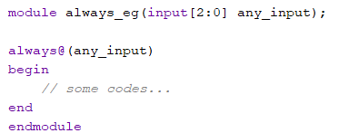
Control Flow: always@
If there is any change in the sensitivity list (event) the code inside the block will be executed. Code inside an always block is executed sequentially.
Syntax:
always@(<sensitivity list>)
begin
// code to be executed
end
Notes:
Can you change the definition of always block
If there is any change in the sensitivity list(event) the code inside the block will be executed

Slide 7
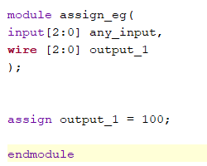
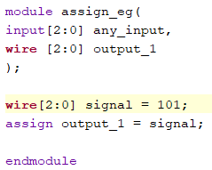
Control Flow: assign
An assign statement can drive wires or other similar wire data-types continuously with a value. However, the assign statement can’t assign value to reg data-types.
Syntax:
assign <signal> = <expression of different signals or constant value>
Notes:
Add that assign cannot be used with reg datatypes

Slide 8
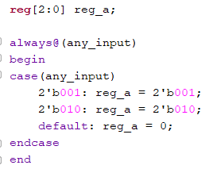
Control Flow: case
The case statement is similar to the if-else statement; it will check if the value of the expression matches one of the case items in the list. The statement in the matched expression will be executed.
Syntax:
case(<expression>)
<case item1>: <statement>
<case item2>: <statement>
default: <statement>
endcase
Notes:
it will check if the expression matches the case item in the list

Slide 9
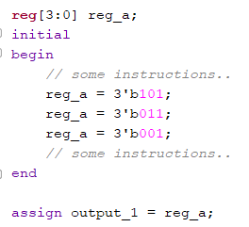
Control Flow: initial
There are 2 types of procedural blocks: always and initial. Statements in both these types of blocks are executed sequentially. However, unlike the always block, statements in the initial block will only execute once.
The initial block will be executed sequentially.
Eventually reg_a = 3’b001

Slide 10
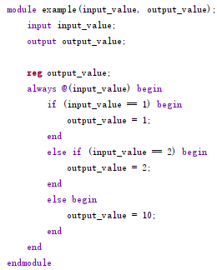
Control Flow: if-else
Similar to other programming languages.
Syntax:
if (<conditional statement>) begin
……;
end
else if (<conditional statement>) begin
……;
end
else begin
……;
end

Slide 11
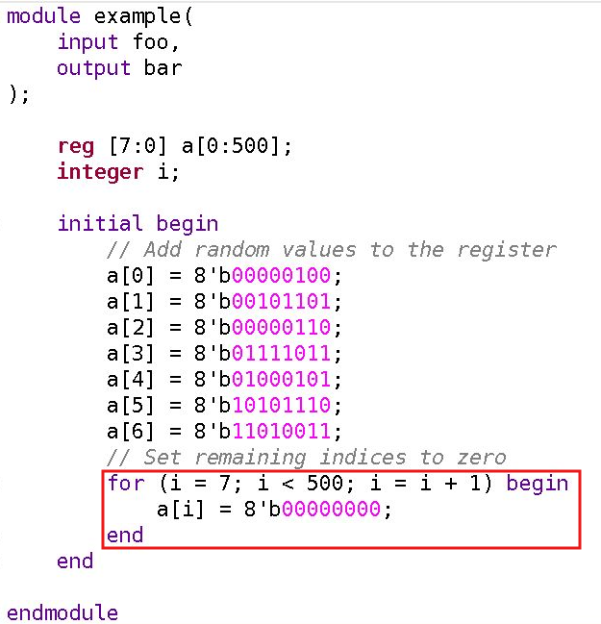
Control Flow: for
Similar to C.
Syntax:
for (
<initial_condition>;
<condition>;
<step_assignment>
) begin
………;
end

Slide 12
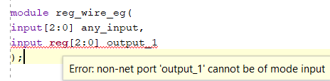

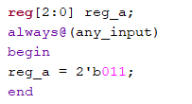
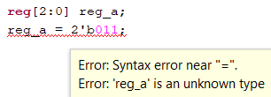
Data Types: reg
reg is the most common variable data type, it stores information.
A reg type cannot be used for inputs to a module
A reg type can be used for the outputs of module
a reg type on the left-hand side (LHS) of an assignment is only legal in always and initial blocks:
Notes:
Remove “like registers”

Slide 13

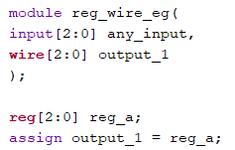
Data Types: reg (Continued)
a reg type on the LHS not legal in an assign statement (continuous assignment):
a reg type on the Right Hand Side (RHS) is legal in an assign statement

Slide 14
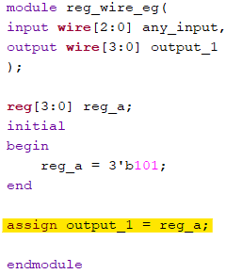

Data Types: wire
wire can used to connect the input ports and output ports between different modules.
wire is the only legal type on the LHS in an assign statement
wire can be used with both the inputs and outputs of a module

Slide 15
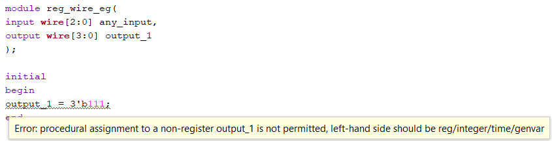
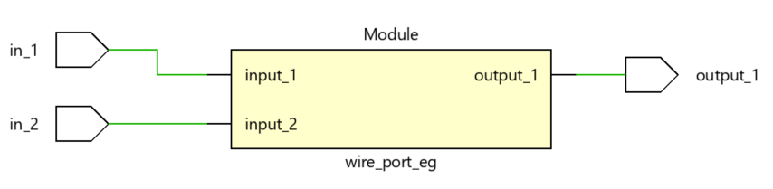
Data Types: wire (Continued)
wire is stateless and doesn’t store data
Mostly used in combinational logic design
Notes:
Its stateless and doesn’t store
Mostly used in combinational logic design
Refer to port connection example to see the usage of wire in port connections

Slide 16


Data Types: Arrays
Syntax:
Declare an array:
<data-type> <array>[<range>]
Update an element:
<array>[<index>] = <new value>
Access an element
<array>[<index>]

Slide 17
Data Types: Arrays (continued)
Other types of array indexing:
reg [7:0] memory [0:3]; // declare of an array with length of 4 and 8-bit width
Mostly used for holding values:
memory[0] = 8’hA0; // assign hex-value 0xA0
memory[1] = 8’b10001000; // assign binary value 1000 1000
……
Note: [0:7] (0 to 7) and [7:0] (7 down to 0). Both can hold 8-bit width data, but the indices order are different.

Slide 18
Blocking and Non-Blocking Assignments
Syntax:
In blocking, the statements are executed sequentially.
In non-blocking, the statements are executed simultaneously
For example:
initially: a = 1, b = 0
run: a <= a + 2
b <= a
We have a = 3, and b = 1. Each operation takes two steps to finish.
Compute the RHS
Assign value of LHS to RHS
In both a and b, the statements compute the RHS simultaneously, and assign the RHS value to LHS simultaneously.
Blocking | Non-blocking
A = 1 | A <= 1

Slide 19
Blocking and Non-Blocking Assignments (continued)
Consider the following set up:
Initially a = 1, b = 2, c = 3. Execute the following statements twice:
Result:
Blocking | Non-blocking
a = c, b = a, c = b | a <= c, b <= a, c <= b
Blocking | Initial | 1st | 2nd
a | 1 | 3 | 3
b | 2 | 3 | 3
c | 3 | 3 | 3
Non-blocking | Initial | 1st | 2nd
a | 1 | 3 | 2
b | 2 | 1 | 3
c | 3 | 2 | 1

Slide 20
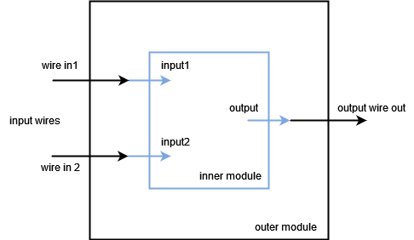
Modules: Instantiation
Instantiating another module inside a module by connecting their interfaces with wires.
This hierarchy structure allows the outer module to pass through input(s) to the inner module and to get output(s) from it.

Slide 21
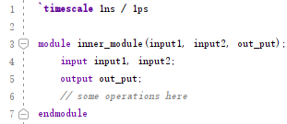
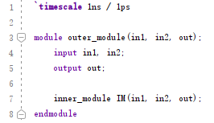
Modules: Instantiation (continued)
Inner module(left) and outer module(right).
There are two instantiation methods:
by position(above): corresponding variables must be at the correct positions.
by name: positions doesn’t matter. Different syntax.
inner_module IM(.input1(in1), .input2(in2), .out_put(out))

Slide 22
Modules: Port Connections
Recall from the last section, multiple modules can be instantiated in the same module.
Modules have input and output interfaces. Different modules can be connected by linking the interfaces with wires.
Once you have finished designing and implementing all the modules, you need to connect them together to simulate the MIPS processor.
Notes:
Rephrase this

Slide 23
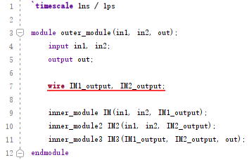
Modules: Port Connections (continuous)
Using the example in module instantiations section with 2 additional inner modules. For simplicity, these two are the same as the first module but with different names.
module 1 and module 2 take inputs in1 and in2
module 3 takes output from module 1 and module 2, producing the output for the outer module
We need 2 wires to connect module 3’s input ports with module 1’s and 2’s output port, which is IM1_output and IM2_output in the code.

Slide 24
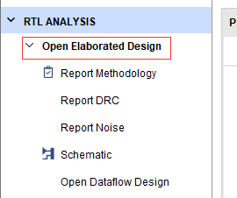
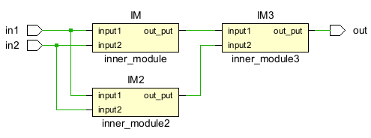
Modules: Port Connections (continued)
You can use the function ‘open elaborated design’ in the Vivado IDE navigator window to view your schematic and compare it with your project design.

Slide 25
Behavioral vs Structural Verilog

Slide 26
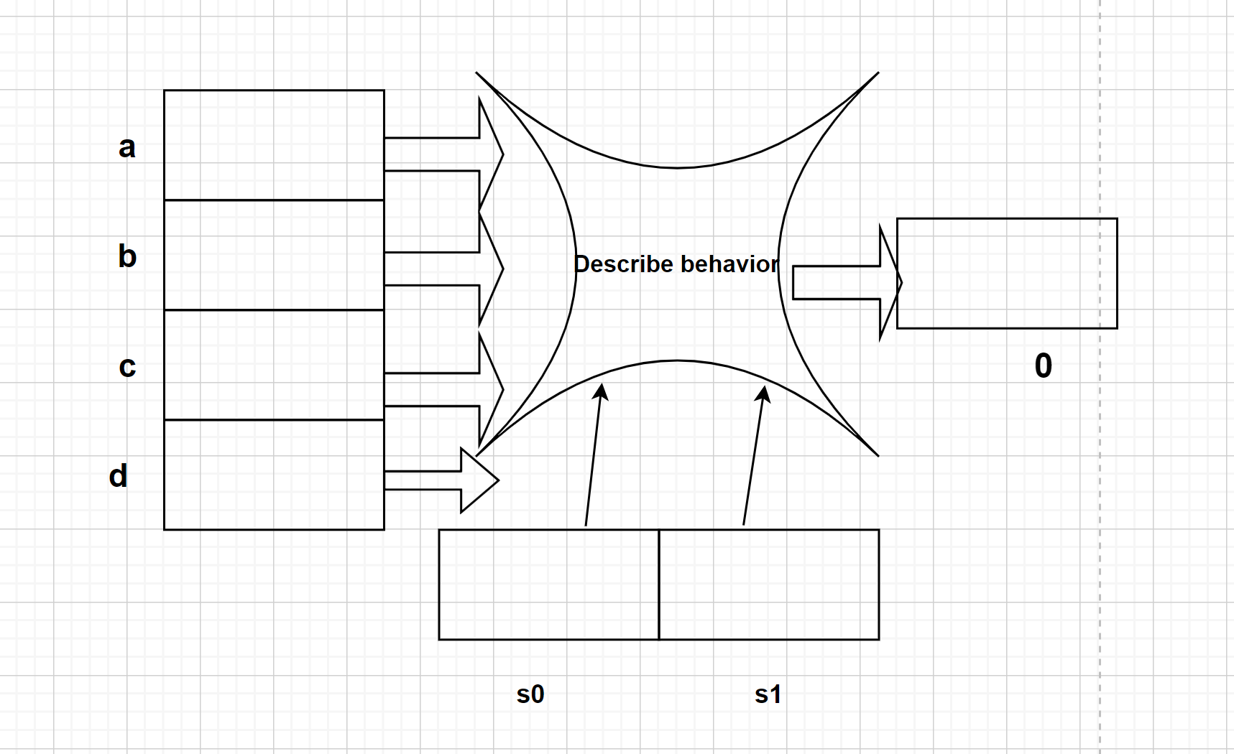
Behavioral Verilog
module mux_4to1 ( a, b, c, d, s0, s1, out);
    input wire a, b, c, d;
    input wire s0, s1;
    output reg out;
    always @ (a or b or c or d or s0, s1)
    begin
    case (s0 | s1)
    2'b00 : out <= a;
    2'b01 : out <= b;
    2'b10 : out <= c;
    2'b11 : out <= d;
    endcase
    end
endmodule

Slide 27
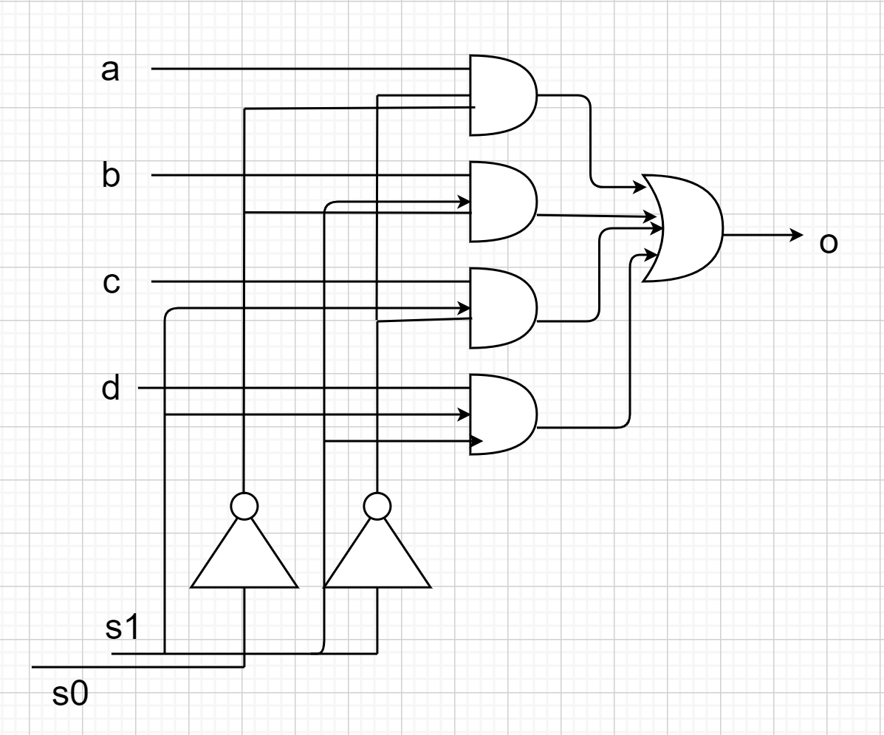
Structural Verilog
module mux_4to1(out, a, b, c, d, s0, s1);
output out;
input a, b, c, d, s0, s1;
wire s0bar, s1bar, T1, T2, T3;
not u1(s1bar, s1);
not u2(s0bar, s0);
and u3(T1, a, s0bar, s1bar);
and u4(T2, b, s0, s1bar);
and u5(T3, c, s0bar, s1);
and u6(T4, d, s0, s1);
or u7(out, T1, T2, T3, T4);
endmodule
Notes:
Q = ^a^bA + a^bB + ^abC + abD

Slide 28
Datapath Diagram

Slide 29
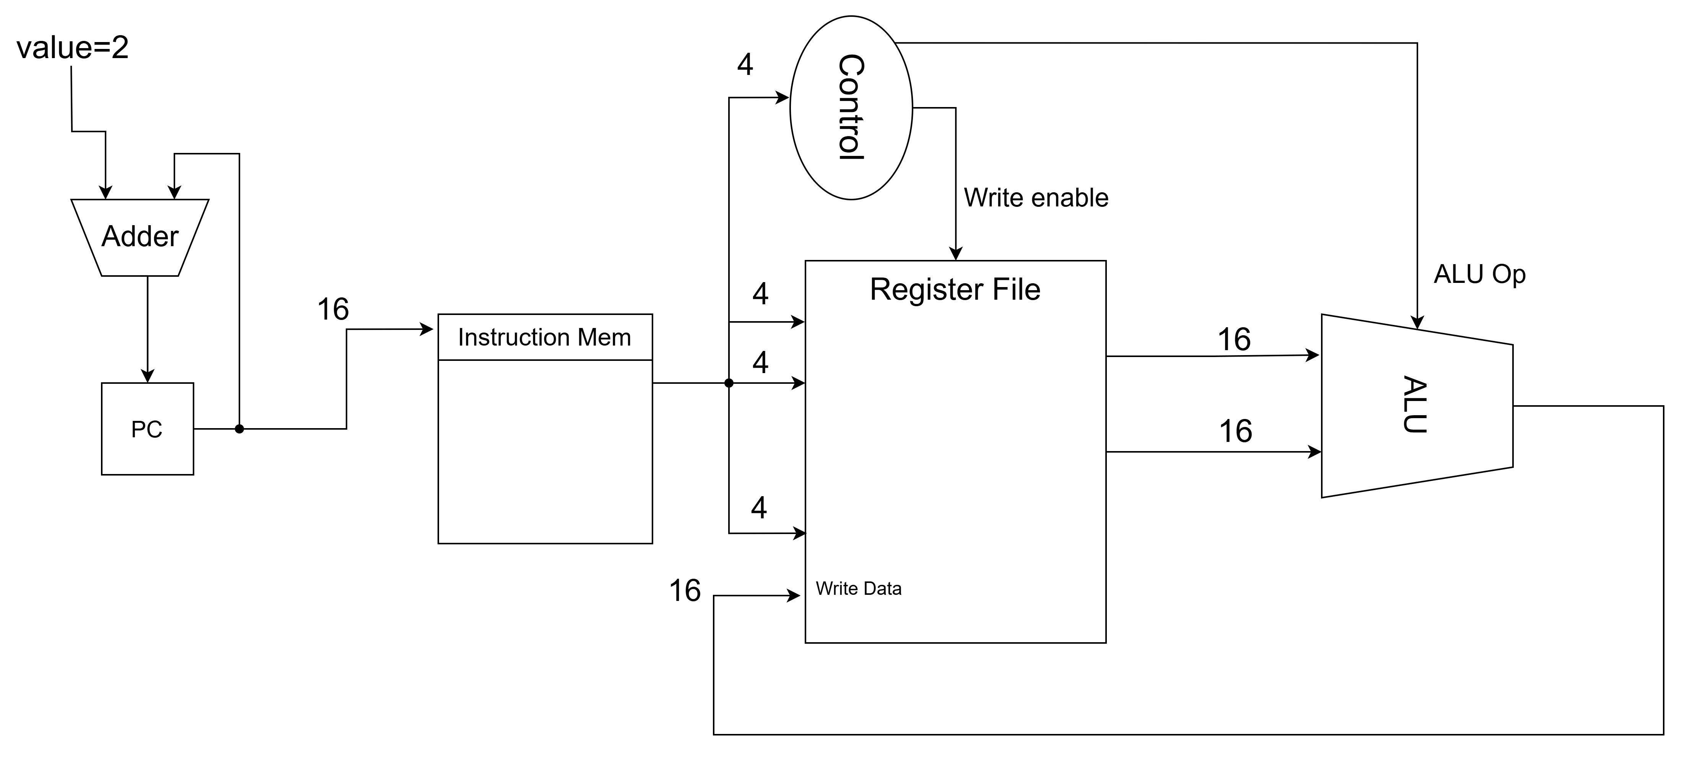
MIPS Datapath: add

Slide 30
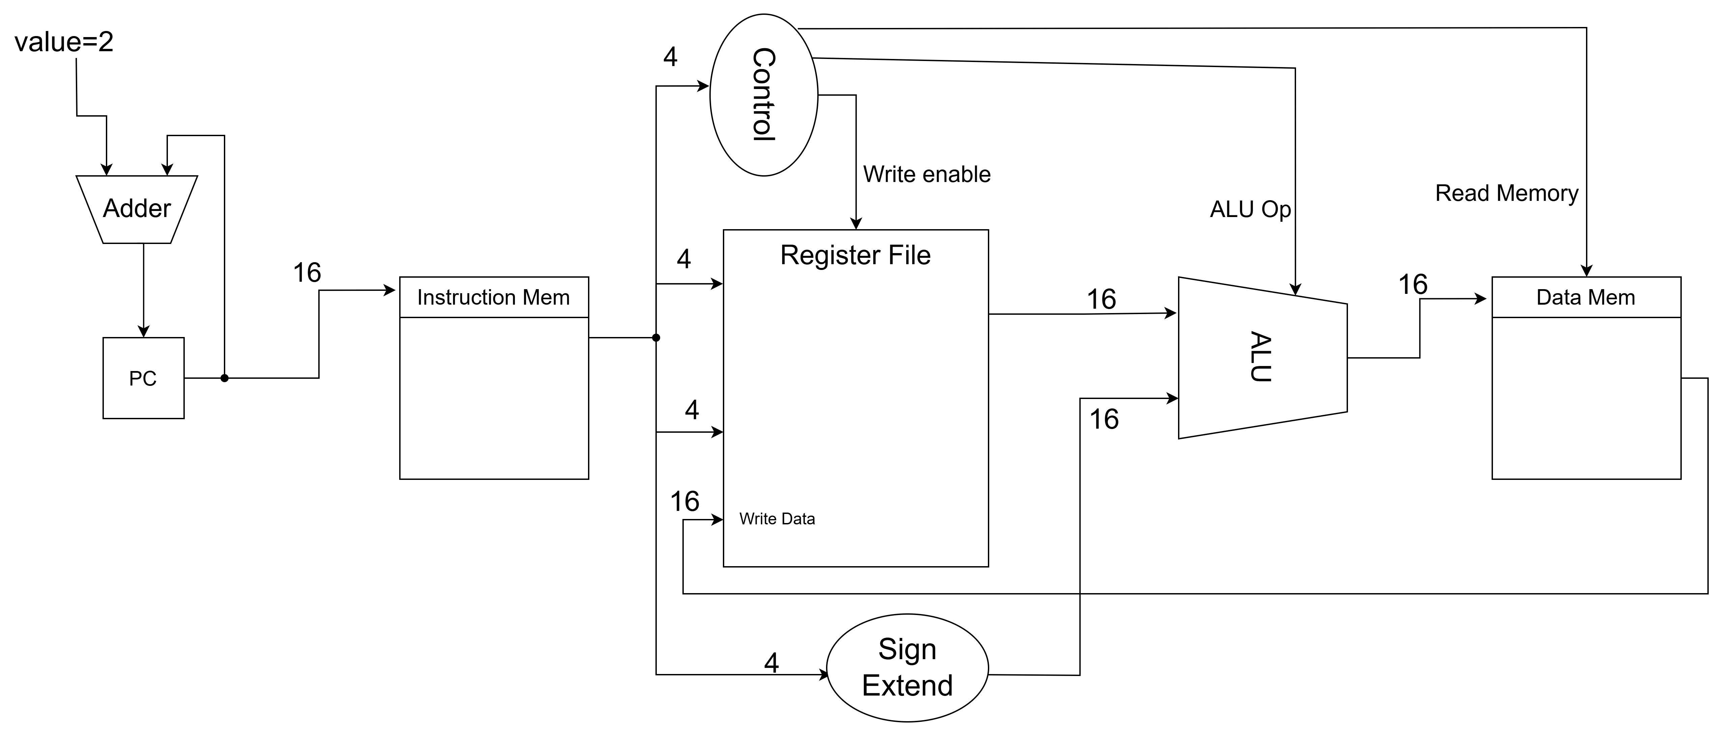
MIPS Datapath: lw

Slide 31
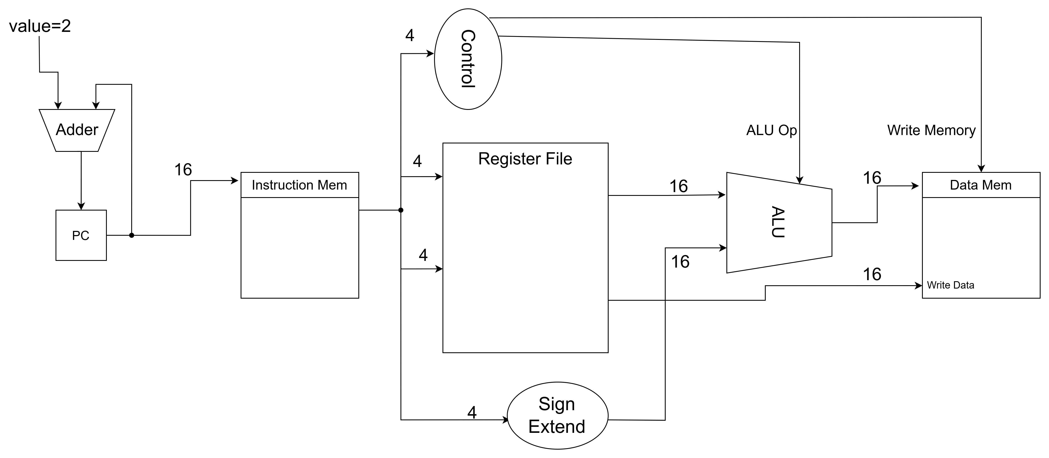
MIPS Datapath: sw

Slide 32
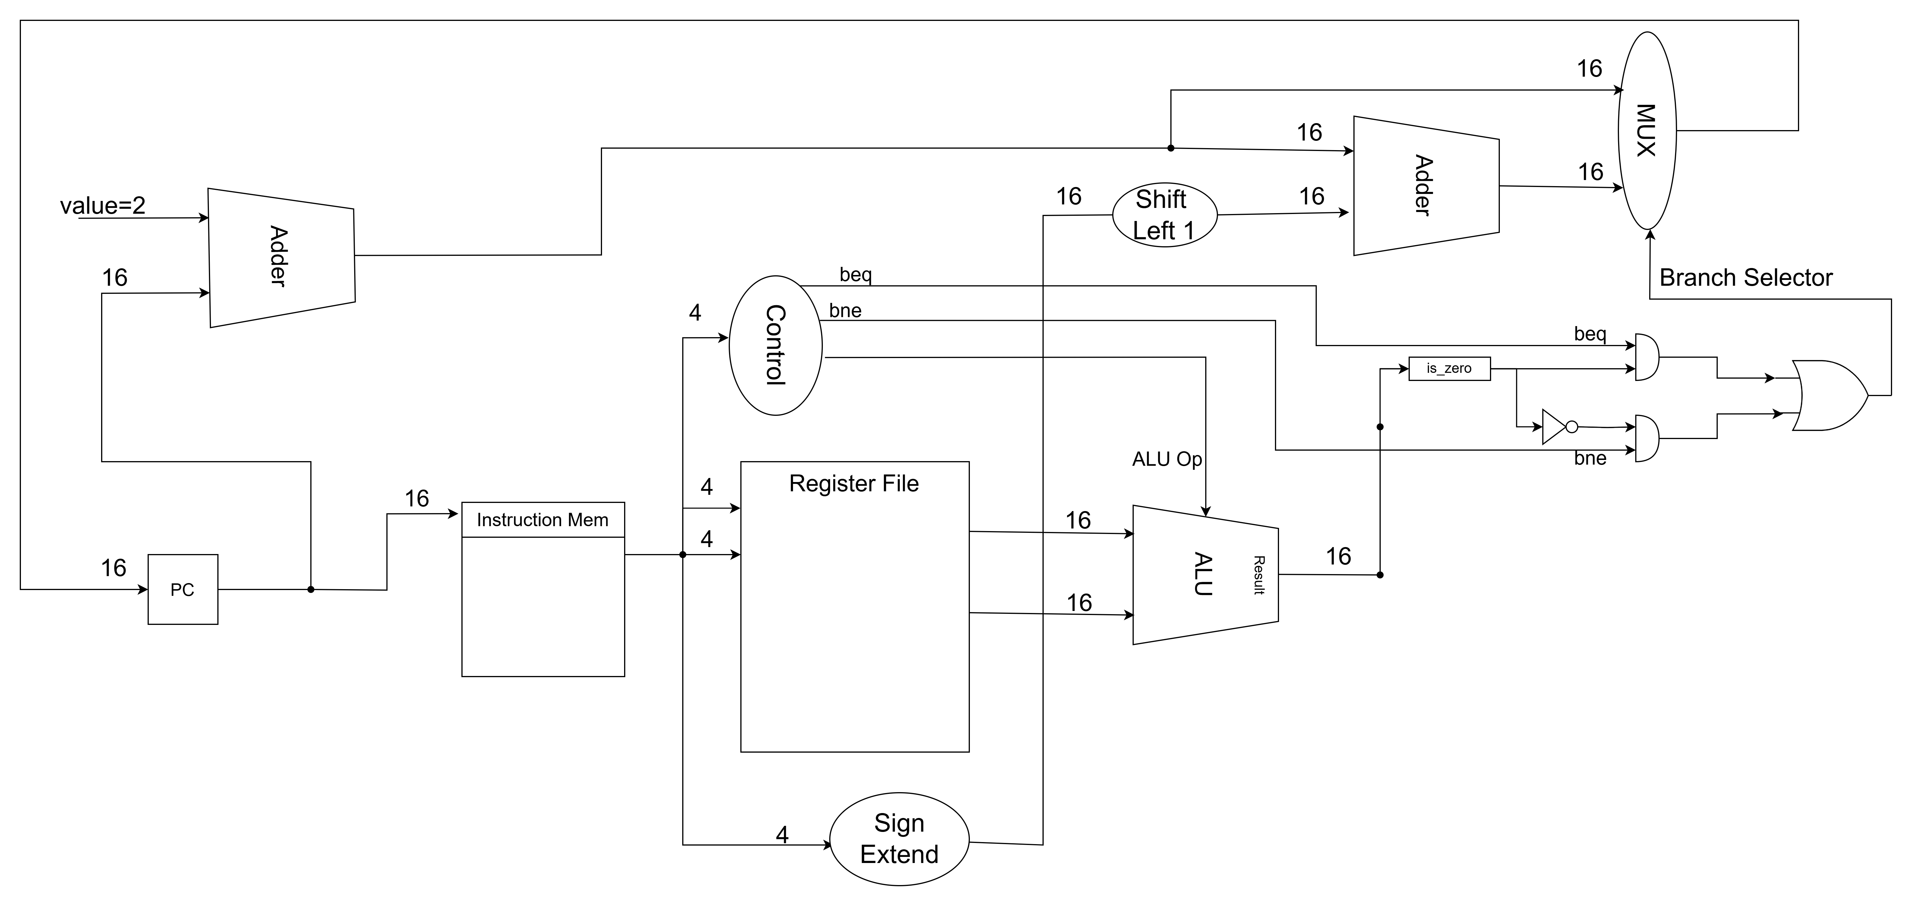
MIPS Datapath: beq and bne

Slide 33
Design Ideas of Individual Components

Slide 34
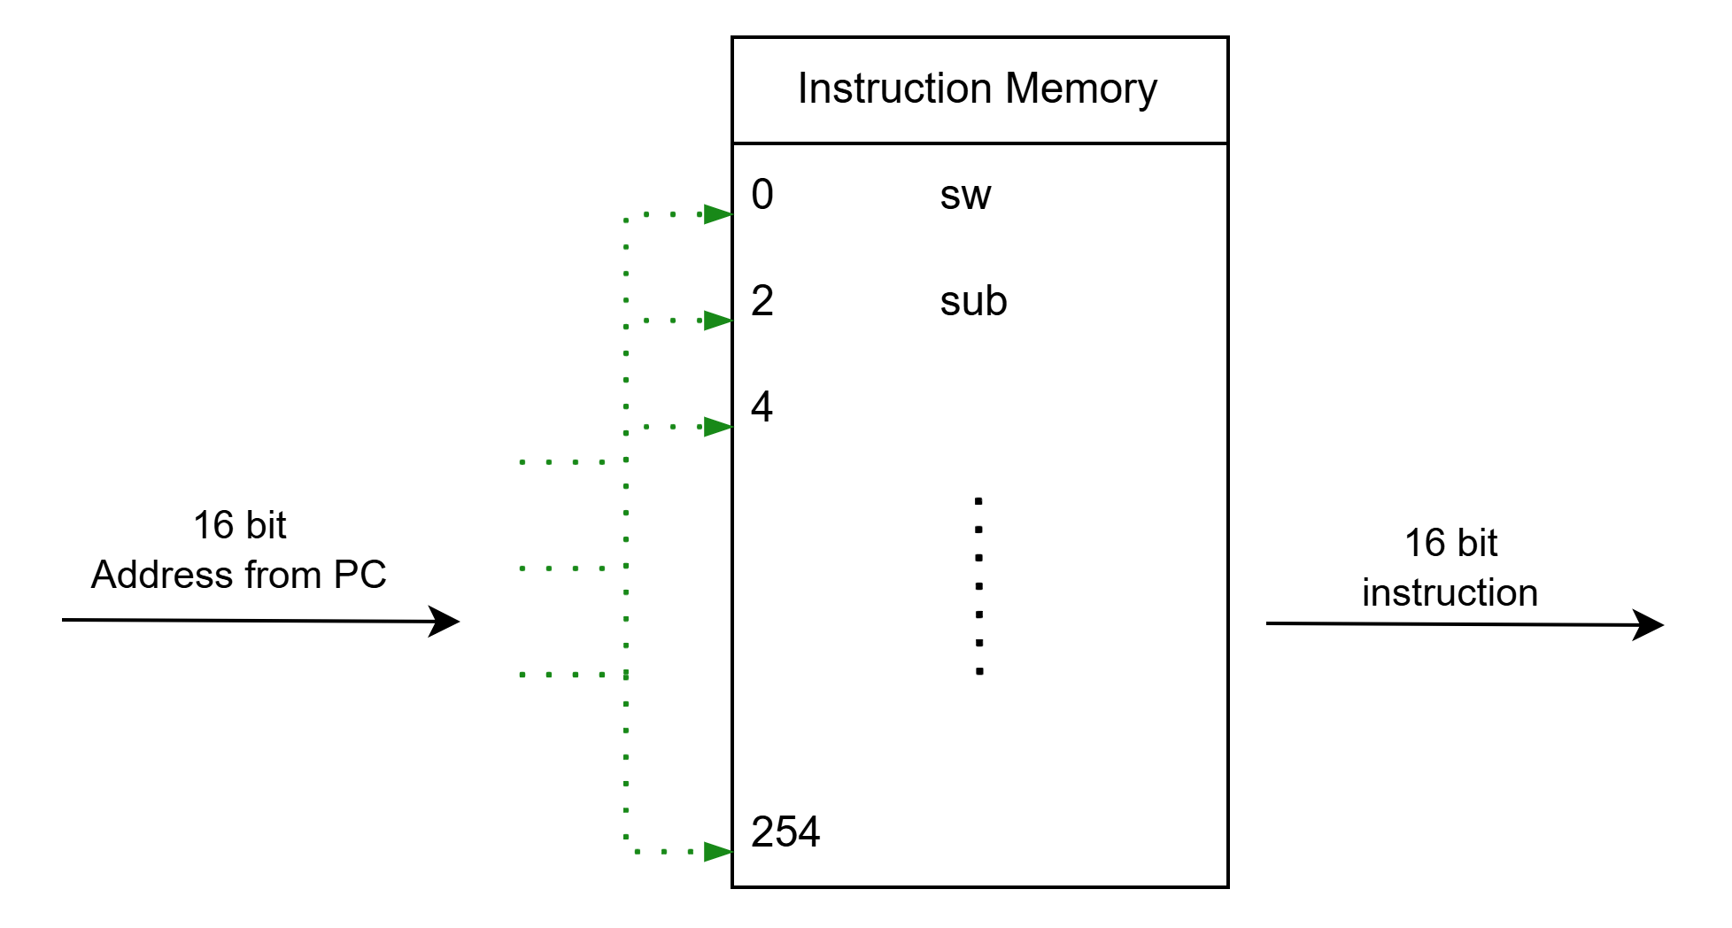
DATAPATH

Slide 35
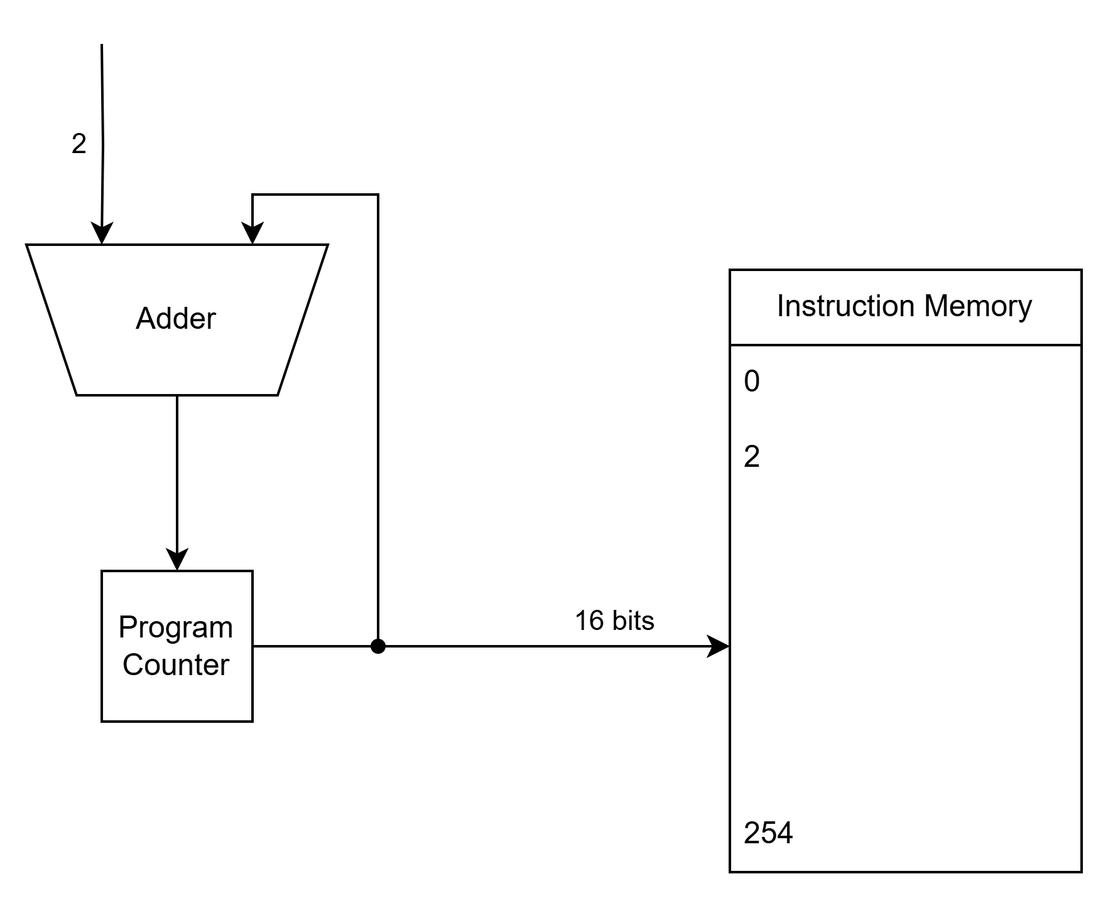
DATAPATH

Slide 36
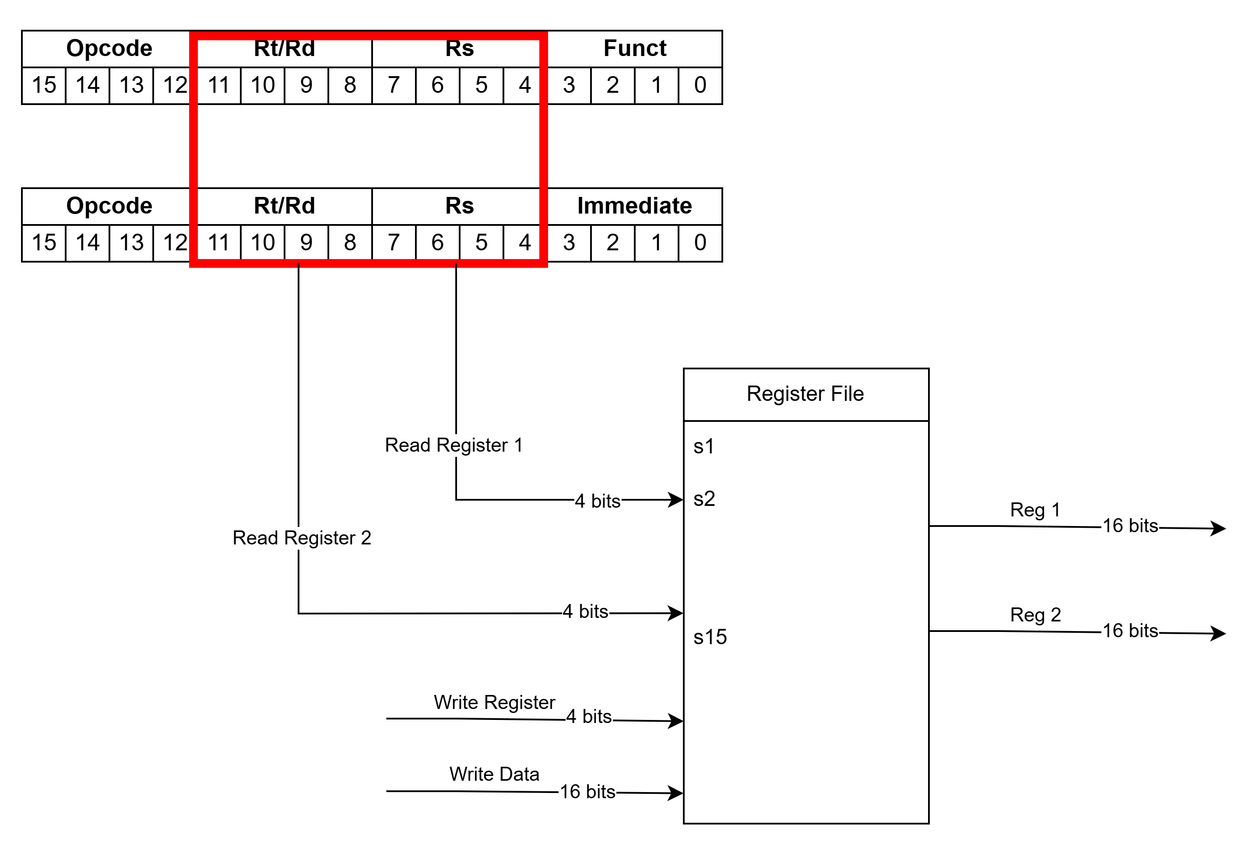
DATAPATH

Slide 37
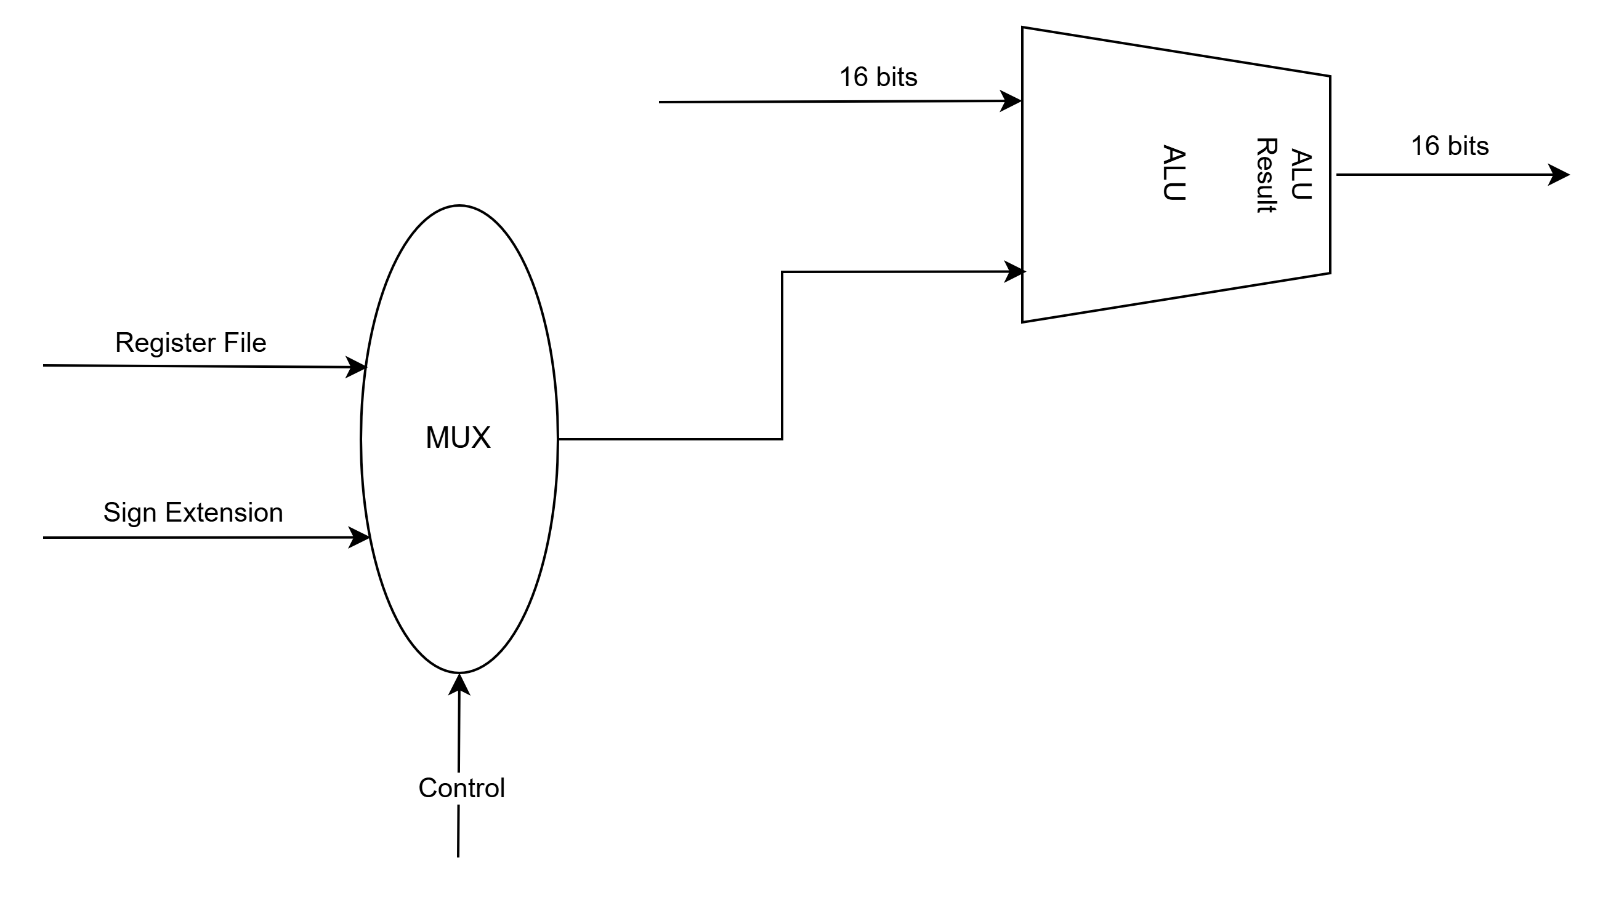
DATAPATH

Slide 38
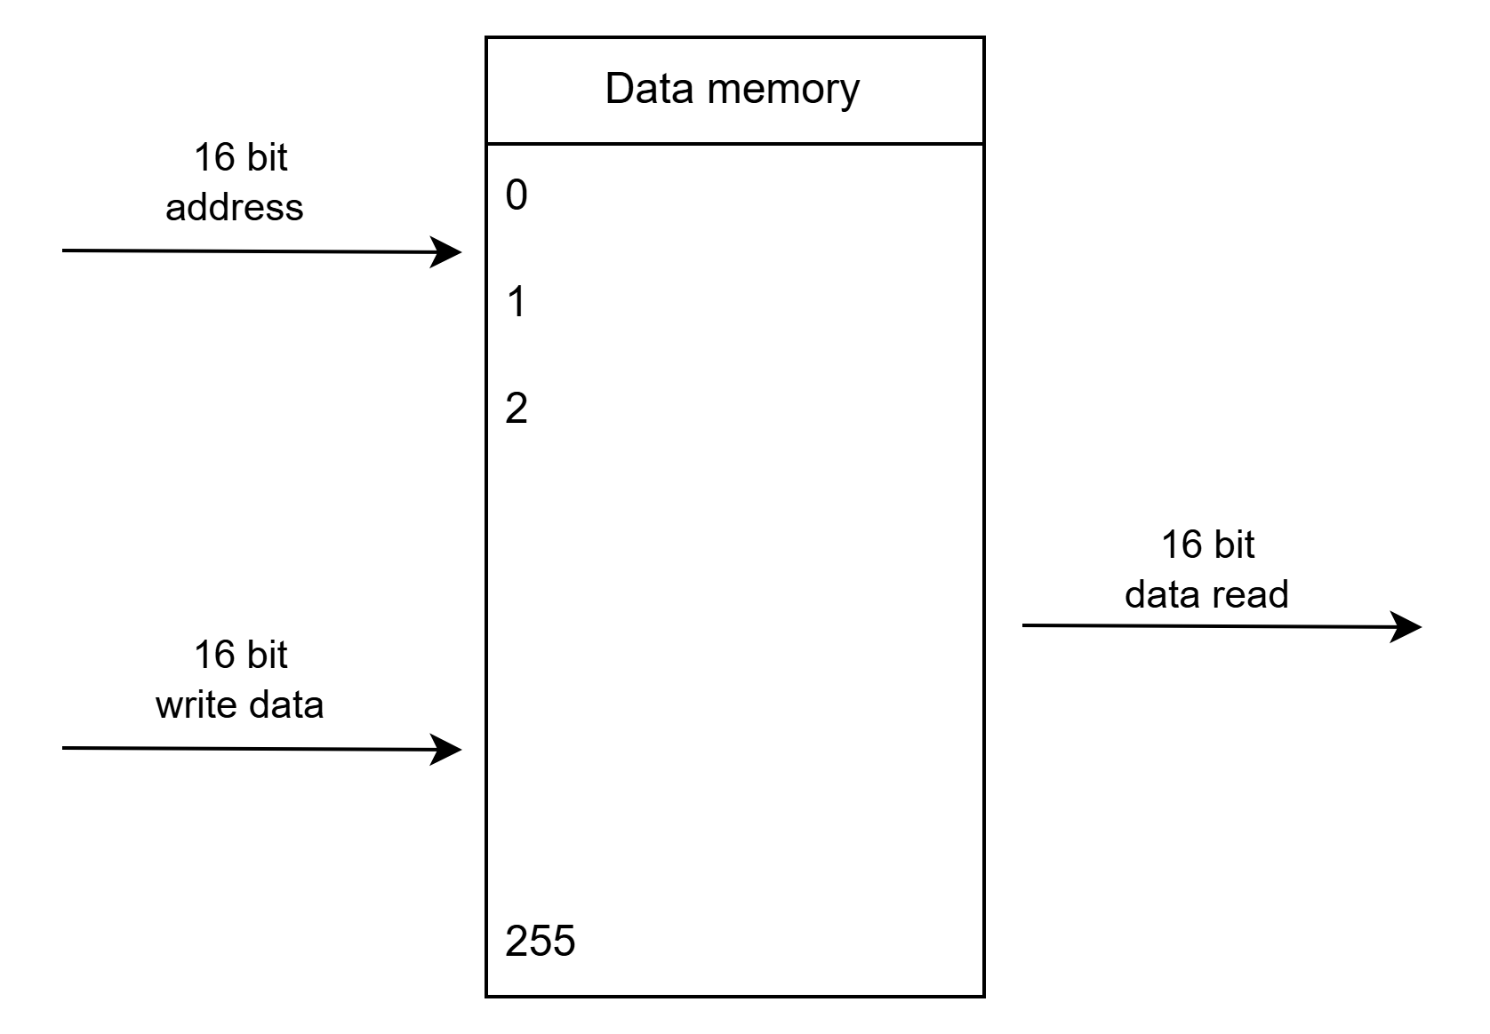
DATAPATH
2 Modes – Read from Memory (lw)
– Write into Memory (sw)

Slide 39
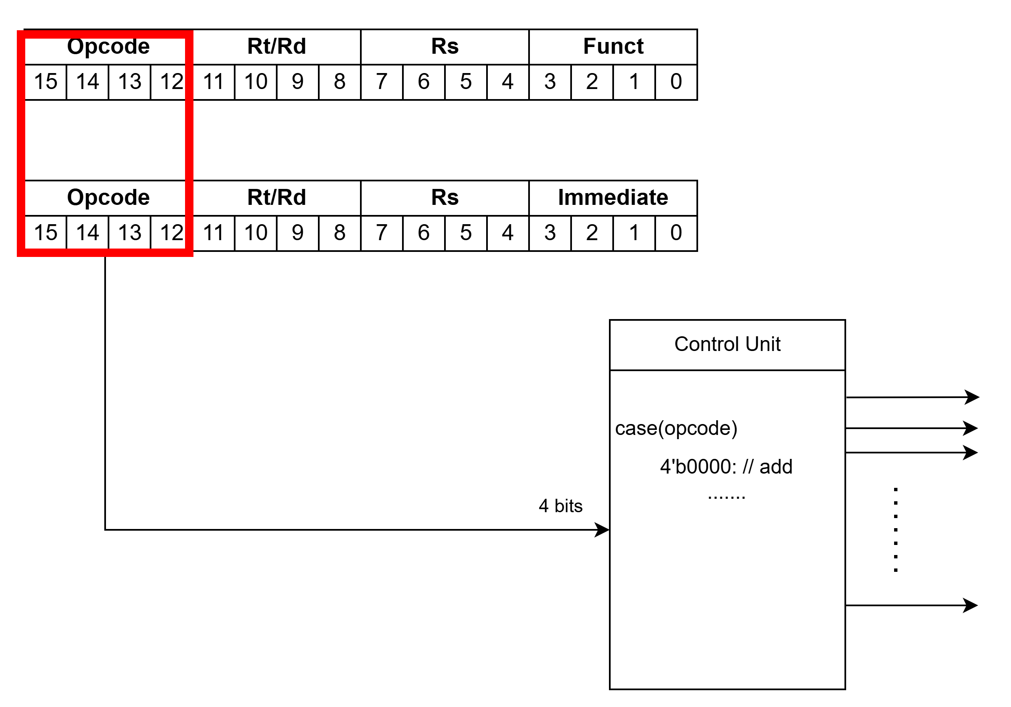
CONTROL UNIT

Slide 40
Where to Start
Refer to FAQ in project description
Partial Credits – Individual Modules will be graded
  Test each module
Start with PC, ALU and build from there
Attend TA Office Hours
DO NOT COPY!!!
  We have access to src code from previous years, Github and other online materials as well
  We use multiple plagiarism check resources, such as MOSS to check for academic integrity violations

