Slide 1
Singapore REIT ETF forecasting with fuzzy experts
01
Zou Runze (Ryan) · Ngeow Shan Yong Destin
Can learned sequence features support a small, interpretable fuzzy predictor?
SRT.SI next-day raw close return • 20 trading days • SRT, SORA and STI inputs
Frozen test: Fuzzy2 RMSE 0.006349 vs unchanged price 0.006377
Trading wealth after 10 bps costs: 0.999 vs cash 1.000
The error gain is small; the rules do not form clear market specialists.
Notes:
Project source: docs/experiment_protocol_lstm_fuzzy_local_experts.md; docs/final_results_2026-11-04.md.

Slide 2
Data and chronological evaluation
02
SRT.SI is a traded Singapore REIT ETF. The target is its next raw closing-price log return.
Inputs available after close t
Forward-time splits
SRT return, five-day momentum, 20-day volatility
Three expanding development folds: 378 target days
Published SORA level and change
Final holdout: 251 days, Oct 2025–Sep 2026
STI return aligned to available date
All scalers fit on each training segment only
One missing SRT open (24 Oct 2025): carry cash and shares; make no trade at that open.
Notes:
Sources: data/source_manifest.json; docs/experiment_protocol_lstm_fuzzy_local_experts.md; output/development/final_configuration_pretest.json.

Slide 3
LSTM features feed two fuzzy local experts
03
20 × 6 history
LSTM encoder
3D projection
Gaussian rules
Affine experts
SRT · SORA · STI
32 hidden units
tanh latent z
two soft weights α
two returns e₁,e₂
ŷ = α₁e₁(z) + α₂e₂(z)
Centers start at ±0.25 on the first latent coordinate; scales are learned.
AdamW minimizes global MSE; no attention, ARIX, K-means or auxiliary rule loss.
Notes:
Model source: src/models.py and docs/experiment_protocol_lstm_fuzzy_local_experts.md. The original proposal deck mentions K-means and auxiliary losses; the frozen implementation uses fixed initial centers and global MSE.

Slide 4
Matched models and frozen training choices
04
Reference / model | What it isolates | Final epochs
Z0 | Unchanged closing price | —
LSTM32 | Ordinary LSTM head | 1
LSTM3 | Three-dimensional bottleneck | 6
Fuzzy2 | Gaussian two-rule head | 3
Gate2 | Non-Gaussian two-expert gate | 4
All models use the same six inputs, 931 pretest training windows and seeds 11, 23 and 37.
Epochs were fixed from nine development fits per model before opening the final 251 days.
Notes:
Sources: docs/development_results_2026-11-03.md; output/development/final_configuration_pretest.json; output/development/run_resources.csv.

Slide 5
Final forecast error: a small RMSE difference
05
Model | RMSE | MAE
Fuzzy2 | 0.006349 | 0.004595
Gate2 | 0.006353 | 0.004582
LSTM3 | 0.006355 | 0.004593
Z0 | 0.006377 | 0.004547
LSTM32 | 0.006384 | 0.004651
Fuzzy2 vs Z0
0.44% lower RMSE
Z0 still has lower MAE.
Fuzzy2 direction accuracy: 49.0% on nonzero-return days.
One held-out period; seeds share the same days.
Development RMSE did not favor Fuzzy2 over Z0 or LSTM3.
Notes:
Sources: output/final/forecast_summary.csv; output/final/forecast_by_seed.csv; docs/final_results_2026-11-04.md. RMSE/MAE are raw log returns, averaged across seeds for learned models. Z0 is deterministic.

Slide 6
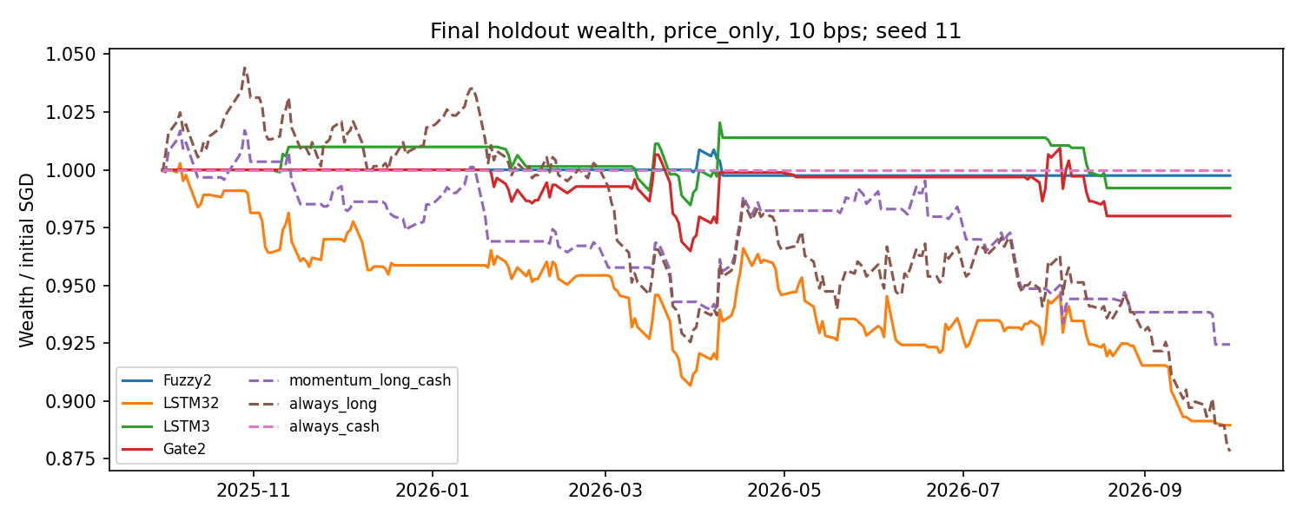
Trading: mostly cash, no gain after costs
06
End wealth, price-only
Cash 1.000
Fuzzy2 0.999
Momentum 0.924
Always long 0.878
Two Fuzzy2 seeds made no trades. Seed 11 traded four times.
Gross-distribution and 0/20-bps results are in the Notebook.
Notes:
Sources: output/final/wealth_comparison.csv; output/final/fuzzy_position_summary.csv; output/final/wealth_paths_price_only_10bps.png. The chart shows seed 11; table values are means over seeds. 10 bps per side; price-only wealth.

Slide 7
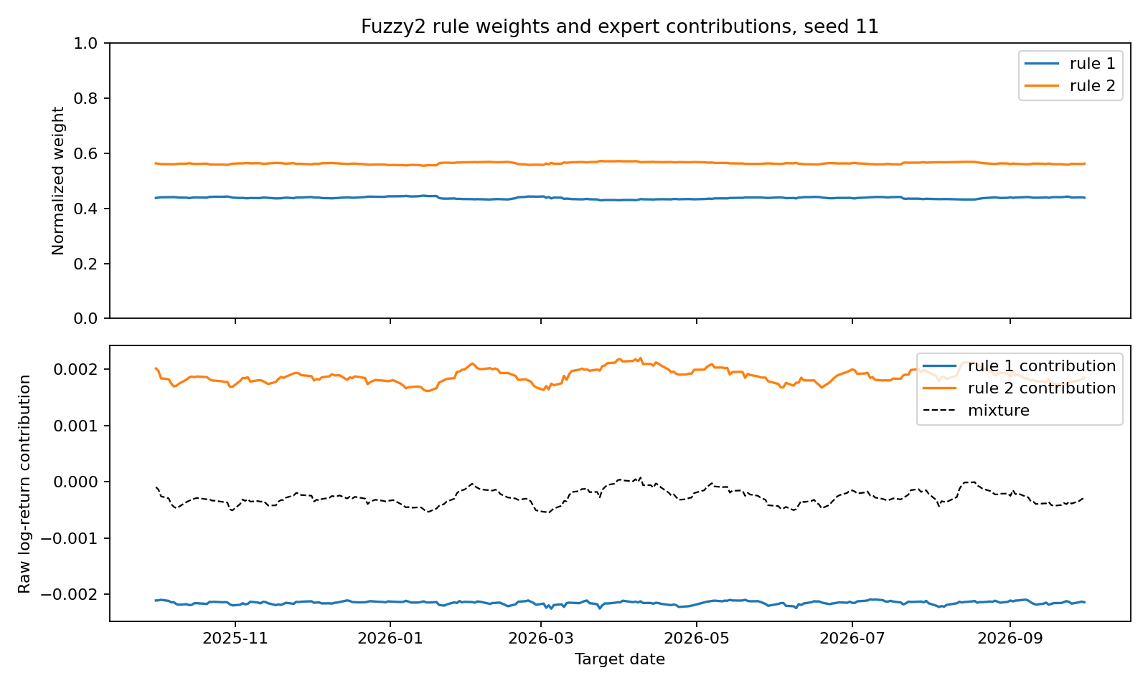
Fuzzy rules remain close to an even split
07
Final rule evidence
Mean maximum weight: 0.51–0.56
No day exceeds weight 0.8
One rule has zero high-activation cases in one seed
Contributions are traceable. Bull, crash or rate labels are unsupported.
Notes:
Sources: output/final/fuzzy_rules_contributions_seed11.png; output/final/fuzzy_local_checks.csv; output/final/fuzzy_case_examples_seed11.csv. The figure is a saved scientific plot for seed 11.

Slide 8
What the simplified study establishes
08
Fuzzformer (2025)
This course adaptation
S&P 500, multi-horizon prices; LSTM + attention; 16 Gaussian rules; ARIX local models; local and clustering losses.
SRT ETF, one-day returns; one LSTM; two Gaussian rules; affine experts; global MSE. Small RMSE gain, no clear rule specialization.
Next research question
Can local expert losses create stable, meaningful rule regions without harming accuracy?
Test on new periods or instruments; a building-demand application is specified in the Notebook.
Notes:
Sources: https://arxiv.org/html/2510.00960v1; docs/literature_review_draft_en.md; docs/final_results_2026-11-04.md. The cited Fuzzformer study uses a different market, horizon, target and architecture; numeric RMSE values are not directly comparable.

