Slide 1

SMART INDIA HACKATHON 2026
Problem Statement ID – 26045
Problem Statement Title- IP-SAKTI Sahayak a multilingual, RAG-based (source-cited) AI assistant for Intellectual Property and regulatory guidance in Ayurveda, across national and international regimes
Theme- MedTech / BioTech / HealthTech
PS Category- Software
Team ID-
Team Name (Registered on portal)

Slide 2
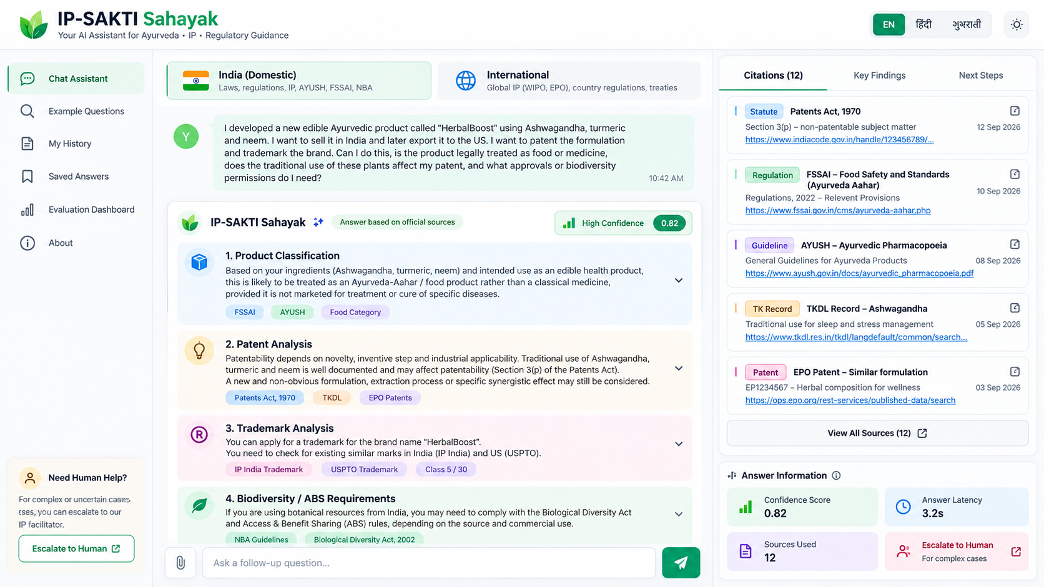
IP-SAKTI Sahayak
The Akashik Nodes
Cited, jurisdiction-clean guidance on Ayurveda IP, drug regulation and ABS.
Every claim links to a statute, rule or treaty article. Abstains when unsure.
TECHSTACK
PROTOTYPE
Frontend: Next.js, React, Tailwind CSS
Backend: Python, FastAPI
GenAI: LLM, LangGraph, RAG
Agents: Query Understanding, Research Planner, Evidence Reasoner, Answer Synthesis
Tools: AYUSH, FSSAI, TKDL, India Code, IP India, EPO, WIPO, NBA, Country Regulations | ALL CITES AS TOOLS
Database: PostgreSQL, pgvector, tsvector
Search: Hybrid Search, BM25, Vector Search, Reranker
Cache & Queue: Redis, Async Job Queue
Translation: Bhashini, LLM Fallback
Streaming: Server-Sent Events (SSE)
Security: Authentication, Rate Limiting, CDN/WAF
Monitoring: Latency, Token Usage, Cost, Citation Precision, Abstention Rate
Human Review: IP Facilitator Escalation
Deployment: Docker, Nginx, Cloud/Container Infrastructure

Slide 3
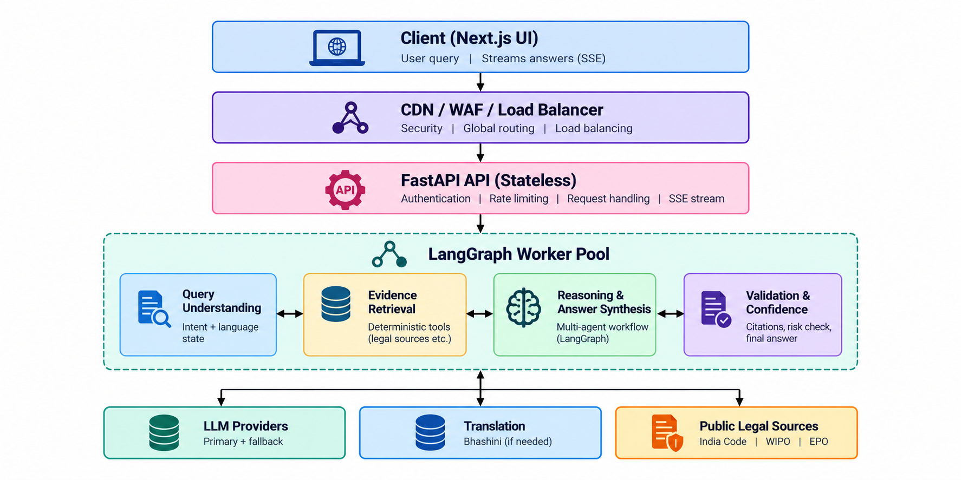
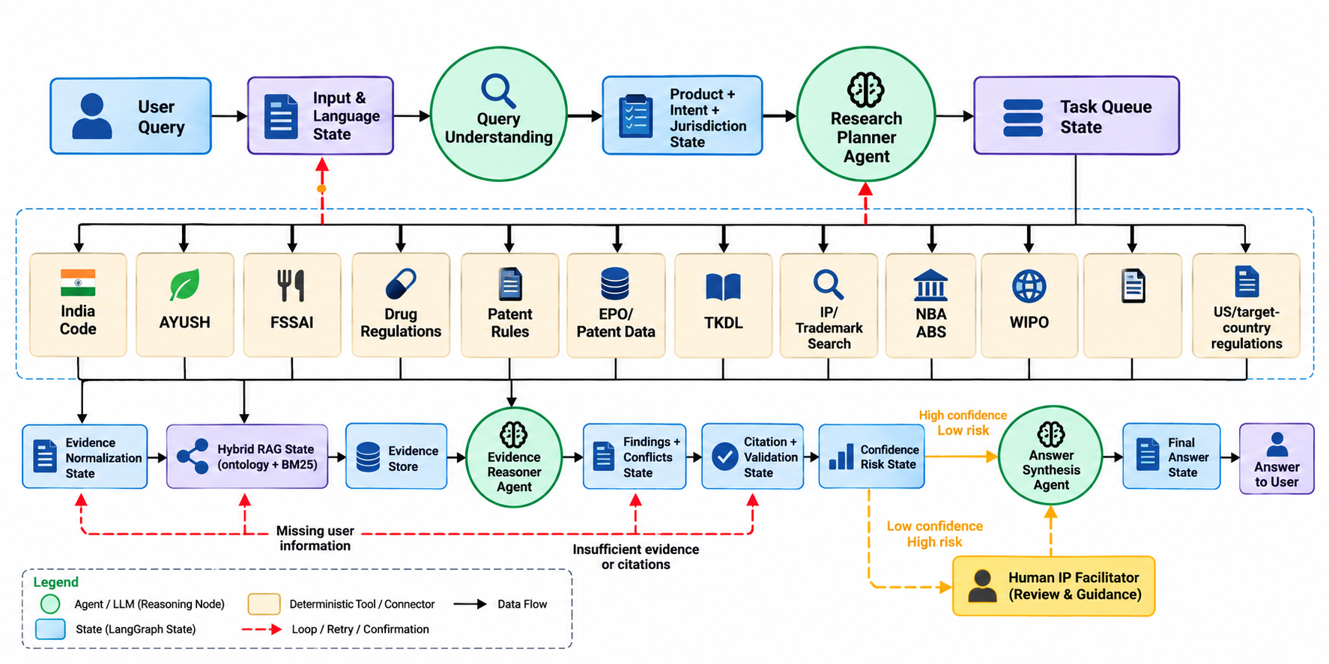
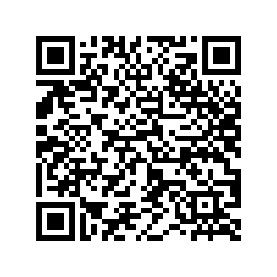
TECHNICAL APPROACH
The Akashik Nodes
BACKEND ARCHITECTURE
LANGGRAPH MULTIAGENT ORCHASTRATOR
SCAN THIS QR TO KNOW ARCHITECTURE DIAGRAMS, EXPLAINATIONS & OTHER COMPONENTS IN DETAIL. | TAP HERE!

Slide 4
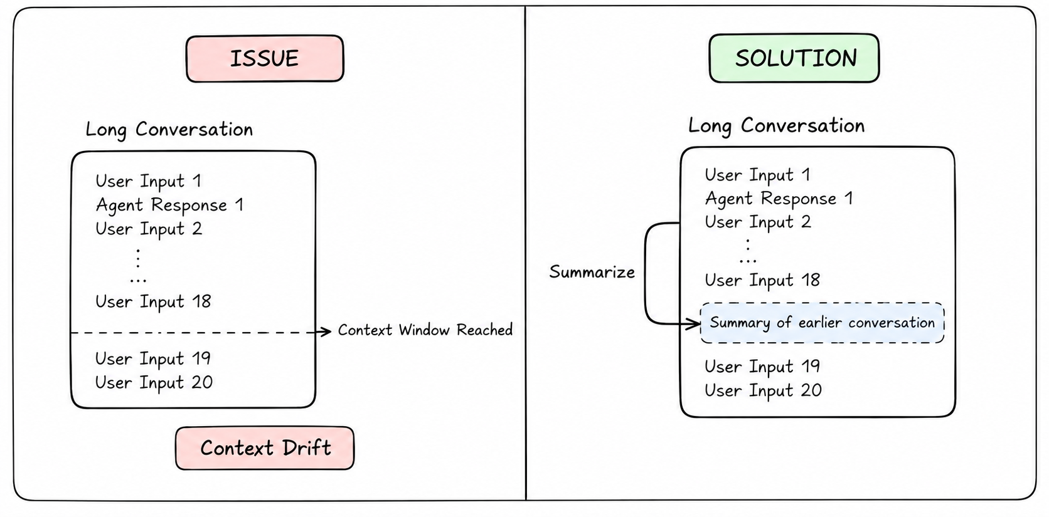
FEASIBILITY AND VIABILITY
The Akashik Nodes
MAJOR ISSUE: CONTEXT DRIFT
FEASIBILITY
Technical: Proven AI stack + trusted legal sources.
Operational: Helps MSMEs find the right rules and next steps.
Economic: Low-cost through caching + efficient AI models.
Regulatory: Source-backed guidance + human review for complex cases.
Market: Useful for Ayurvedic businesses, startups & innovators.
Sustainable: Regularly updates changing laws and regulations.
CHALLANGES & MITIGATION
CONTEXT DRIFT: In Long Conversations System slowly loses the original topic, such that AI hallucinates & gives wrong outputs
SOLUTION: Before reaching context window of an LLM, it will get summary of past workdone & use it for further communication.
Challenge | Mitigation
Wrong legal information | Source verification + human review
Outdated laws | Regular source updates
Language barriers | Bhashini + AI fallback
AI failure/slow response | Cache + backup model
Wrong country rules | India / International separation
Uncertain answer | Confidence score + human escalation

Slide 5
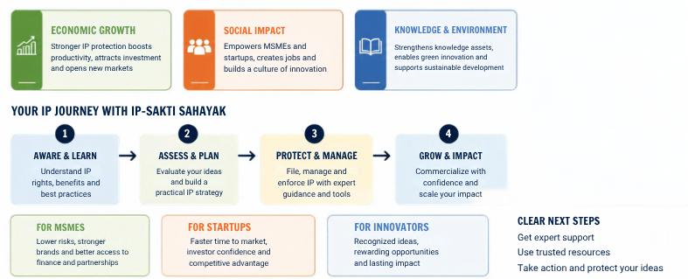
IMPACT AND BENEFITS
Your Team Name
Economic Growth
Stronger IP protection boosts productivity, attracts investment and opens new markets
Social Impact
Empowers MSMEs and startups, creates jobs and builds a culture of innovation
Knowledge & Environment
Strengthens knowledge assets, enables green innovation and supports sustainable development
Your IP Journey with IP-SAKTi Sahayak
Aware & Learn
Understand IP rights, benefits and best practices
Assess & Plan
Evaluate your ideas and build a practical IP strategy
Protect & Manage
File, manage and enforce IP with expert guidance and tools
Grow & Impact
Commercialize with confidence and scale your impact
For MSMEs
Lower risks, stronger brands and better access to finance and partnerships
For Startups
Faster time to market, investor confidence and competitive advantage
For Innovators
Recognized ideas, rewarding opportunities and lasting impact
Clear Next Steps
Get expert support
Use trusted resources
Take action and protect your ideas
1
2
3
4

Slide 6
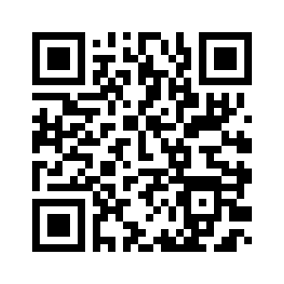
RESEARCH & REFERENCES
Your Team Name
Legal & Regulatory Corpus
India: Patents Act & Rules, Biological Diversity Act/Rules, Drugs & Cosmetics Act, Drugs & Magic Remedies Act
International: TRIPS, Nagoya Protocol, PCT, WIPO GRATK
Traditional Knowledge: TKDL (patent-office access only; open sources used)
Technology References
AI: LangGraph, LLMs, RAG
Backend: FastAPI, PostgreSQL + pgvector
Search: Hybrid Search + Reciprocal Rank Fusion
Language: Bhashini
Existing Systems Studied
Generic LLMs → Weak source/section verification
IP Portals → Information available, limited guided support
Government Portals → Information distributed across multiple sources
Market Research
2L+ DPIIT-recognised startups in India → Potential innovation & IP user base.
TAP HERE!
OR SCAN ABOVE QR
MVP OF THIS PROJECT
TAP HERE!
OR SCAN ABOVE QR FOR DETAILED DOCUMENTATION

