Slide 1
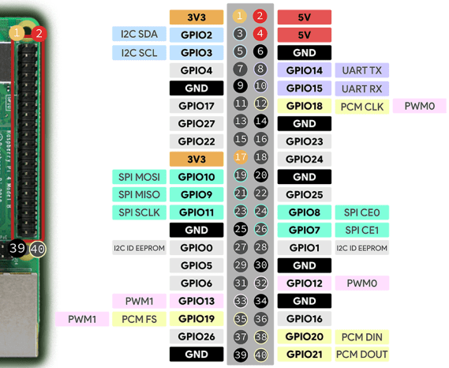
Sensors
Sensor | Pins
BH1750; Brightness | <GND, ADD, SDA, SCL, VCC> <GND, GND, GPIO2, GPIO3, 3.3V>
DHT11; Temperature & Humidity | <VCC, Data, GND> <5V, GPIO25, GND>
GT-U7; GPS | <USB>
ICQUANZX 5V; Relais | <+, s, -> <5V, GPIO23, GND>

