Slide 1
Hello Guys

Slide 2
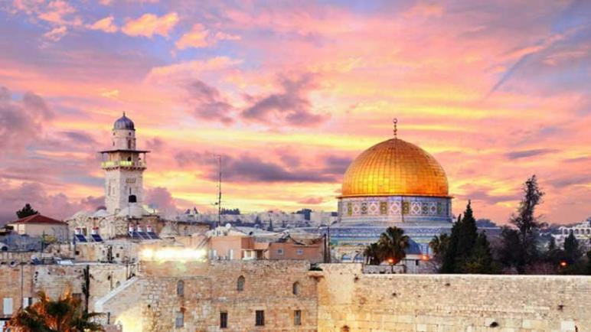
Jerusalem

Slide 3
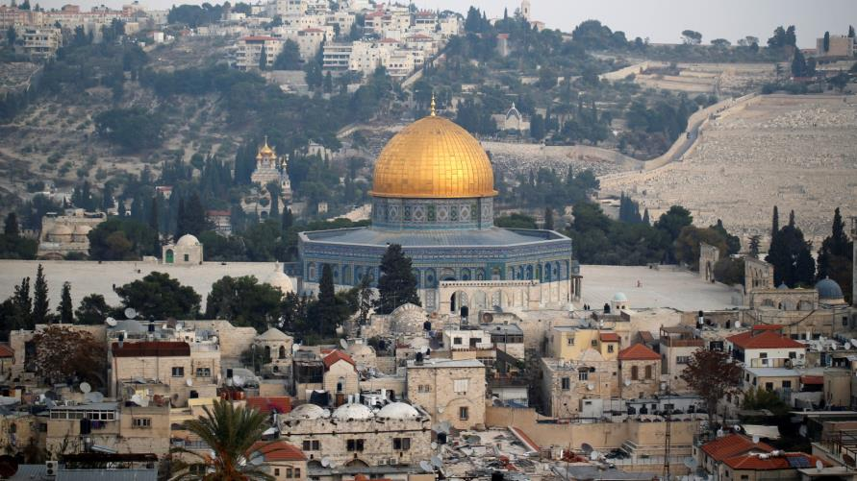
3
3
Jerusalem Is The Third holiest city

Slide 4
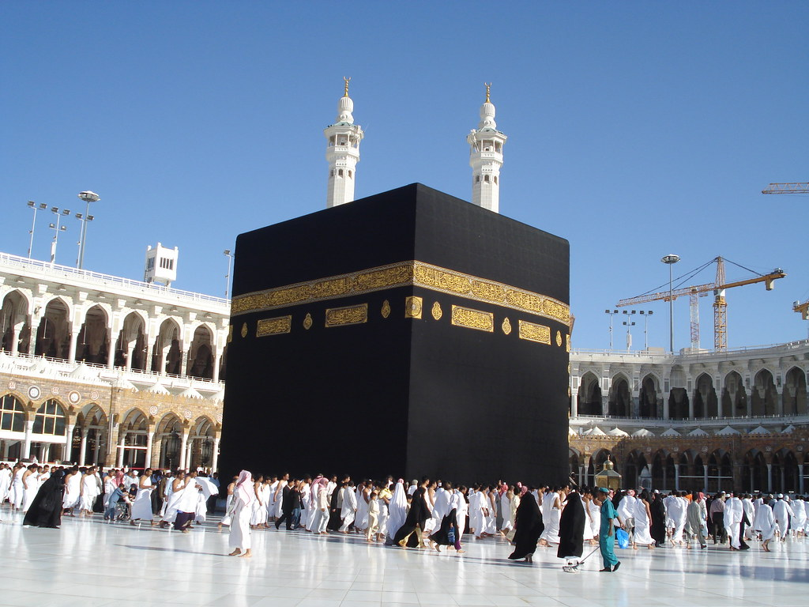
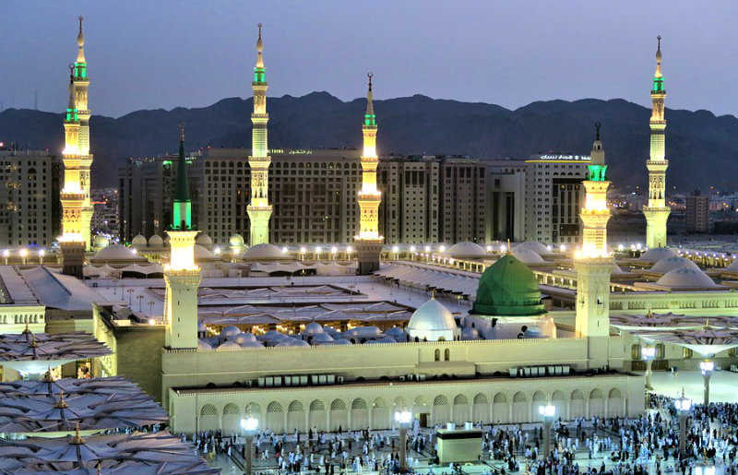
2
1

Slide 5
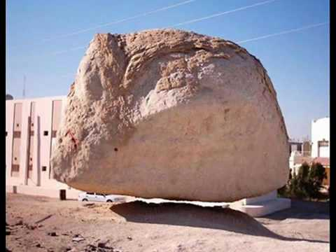
Our prophet Mohammad is said to have gone up to heaven form rock in Jerusalem

Slide 6
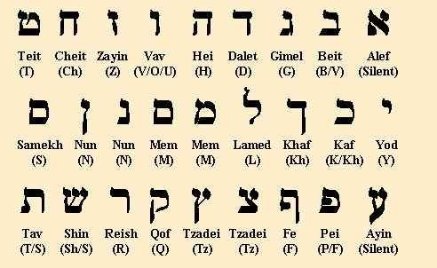
Hebreu

Slide 7
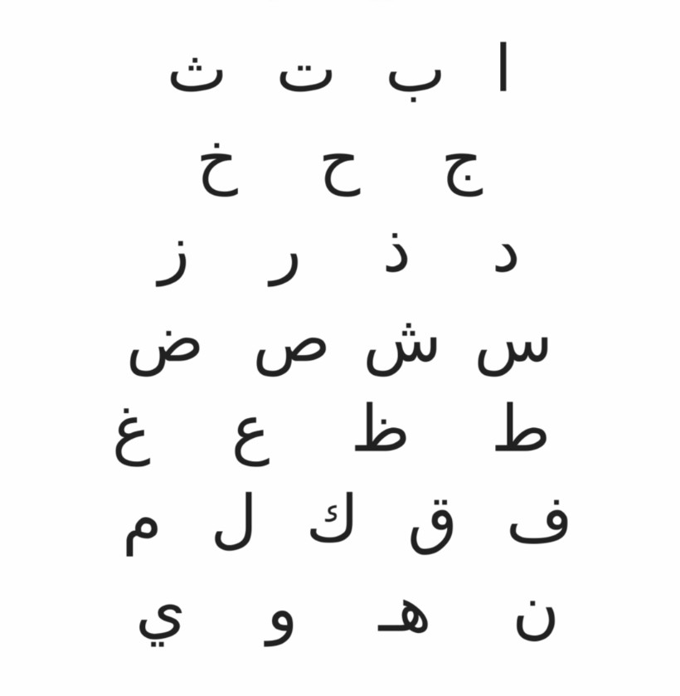
Arabic

Slide 8
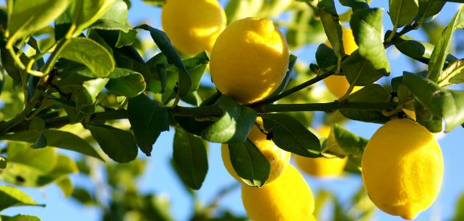
Almonds

Slide 9
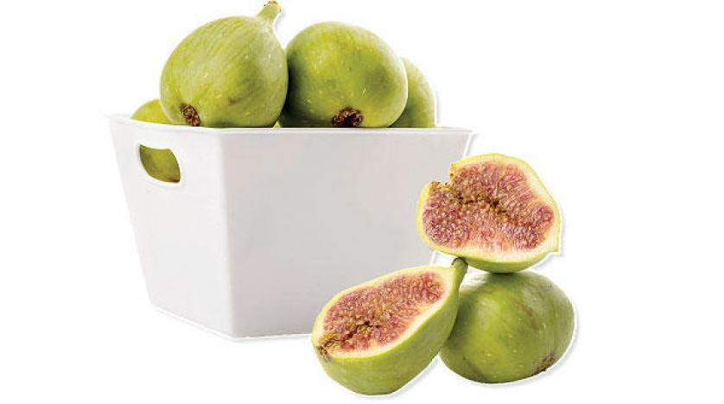
Figs

Slide 10
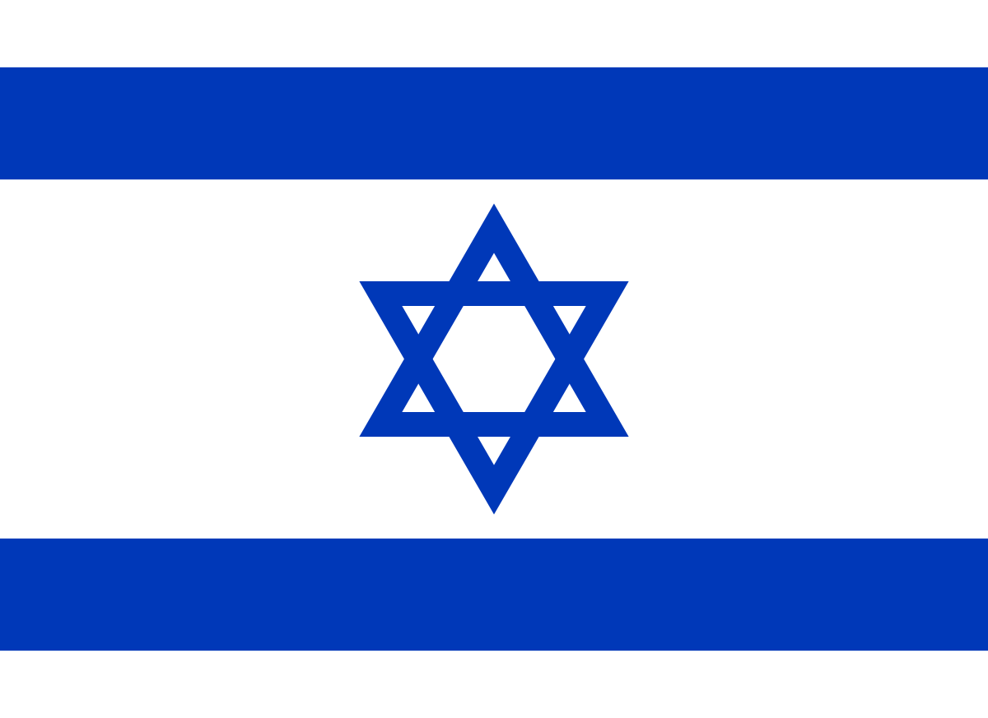
To End
Israel consider Jerusalem their capital

Slide 11
united nation
Arab
consider Jerusalem a Palestinion right

Slide 12
The End

