Slide 1
ANA 212 PRESENTATION LECTURER IN CHARGE: MR TOKUNBO TOPIC: FEMALE EXTERNAL GENITALIA
NAMES | MATRIC NUMBER
MORADEYO OLUSEYI ABIGAEL | 2022/38632
ADEROJU AISHA KOFOWOROLA | 2022/41573
OLAWUYI GRACE OMOBOLADE | 2021/34480
OLAWALE GBEMISOLA DEBORAH | 2021/34479
OGUNYANJU GOODNESS MERCY | 2022/40661
OTABOR CHRISTABEL VICTORIA | 2022/38275
ATOFARATI OLUWOLE AYOBAMI | 2022/38193
OKONKWO GRACE OLUFUNMILAYO | 2022/38841
OLADEPO DEBORAH OYINDAMOLA | 2022/38431
BADMUS MERCY FEYITOLA | 2021/34044
TAIWO CHRISTIANAH BOLUWATIFE | 2023/49942

Slide 2
INTRODUCTION
The female external genitalia is fascinating due to the fact it is made up of both urinary tract and reproductive structures. These structures collectively fall under the term vulva. The definition of "vulva" is covering or wrapping. It does appear to be covered or wrapped by skin folds. These skin folds are called the labia majora and labia minora. The components of the entire vulva are the mons pubis, labia majora, labia minora, clitoris, urethra, vulva vestibule, vestibular bulbs, Bartholin's glands, Skene's glands, and vaginal opening. The external female genitalia serves the purposes of reproduction and urination.
STRUCTURE AND FUNCTION
Mons Pubis: The mons pubis is a tissue mound made up of fat located directly anterior to the pubic bones. The mons pubis functions as a source of cushioning during sexual intercourse. The mons pubis also contains sebaceous glands that secrete pheromones to induce sexual attraction.
Labia Majora: The word "labia majora" is defined as the larger lips. The labia majora forms the folds that cover the other external genitalia. The anterior part of the labia majora folds comes together to form the anterior labial commissure directly beneath the mons pubis. While the posterior part of the labia majora comes together to form the posterior labial commissure. The labia majora engorges with blood and appears edematous during sexual arousal.
Labia Minora: The "labia minora" is defined as the smaller lips. The labia minor are a pair of small cutaneous folds that begins at the clitoris and extends downward. The posterior ends of the labia minora terminate as they become linked together by a skin fold called the frenulum of the labia minora. The labia minora will encircle the vulva vestibule and terminating between the labia majora and the vulva vestibule. With sexual arousal, the labia minora will become engorged with blood and appear edematous.
Clitoris: The clitoris (which is homologous to the glans penis in males) is a sex organ in females that functions as a sensory organ. The clitoris can be divided into the glans clitoris and the body of the clitoris. The underlying tissue that makes the clitoris is the corpus cavernous. The corpus cavernous is a type of erectile tissue that merges together and protrudes to the exterior of the vulva as the glans clitoris. While proximally, the two separate ends of the tissue will form the crus of the clitoris (legs of the clitoris) and the body of the clitoris. The glans clitoris is the only visible part of the clitoris.
Vestibular bulbs: The vestibular bulbs (homologous to the bulb of the penis in males) are structures formed from corpus spongiosum tissue. The vestibular bulbs are believed to function closely with the clitoris. During sexual arousal, the vestibular bulbs will become engorged with blood.

Slide 3
STRUCTURE AND FUNCTION [cont’d]
Vulva Vestibule: The area between the labia minora is the vulva vestibule. The borders of the vulva vestibule are formed from the edge of the labia minora. There is a demarcation between the vulva vestibule and the labia minora called Hart's lines. Hart's lines identify the change from the vulva vestibule to the labia minora. This change of skin appearance is visible by the smoother transitional skin appearance of the vulva vestibule to the vulvar appearance of the labia minora.
Bartholin's Glands: The Bartholin's glands also known as the greater vestibular glands (homologous to the bulbourethral glands in males) are two pea-sized glands located slightly lateral and posterior to the vagina opening. These two glands function to secrete a mucus-like substance into the vagina and within the borders of the labia minora. This mucus functions as a lubricant to decrease friction during intercourse and a moisturizer for the vulva.
Skene's Glands: The Skene's glands, which are also known as the lesser vestibular glands (homologous to the prostate glands in males), are two glands located on either side of the urethra. These glands are believed to secrete a substance to lubricate the urethra opening. This substance is also believed to act as an antimicrobial. This antimicrobial is used to prevent urinary tract infections. The function of Skene's gland is not fully understood but is believed to be the source of female ejaculation during sexual arousal.
Urethra: The urethra is an extension of a tube from the bladder to the outside of the body. The purpose of the urethra is for the excretion of urine. The urethra in females opens within the vulva vestibule located inferior to the clitoris, but superior to the vagina opening.
Vagina: The vagina is an elastic, muscular tube connected to the cervix proximally and extends to the external surface through the vulva vestibule. The distal opening of the vagina is usually partially covered by a membrane called the hymen. The vaginal opening is located posterior to the urethra opening. The function of the vagina is for sexual intercourse and childbirth. During sexual intercourse, the vagina acts as a reservoir for semen to collect before the sperm ascending into the cervix to travel towards the uterus and fallopian tubes. Also, the vagina also acts as an outflow tract for menses.

Slide 4
BLOOD SUPPLY, LYMPHATICS, INNERVATION AND MUSCLES
ARTERIAL: The internal pudendal artery perfuses the majority of the external female genitalia. The internal pudendal artery is a branch of the internal iliac artery. Once the pudendal artery branches from the internal iliac artery, it descends towards the external genitalia. The internal pudendal artery will then become the dominant blood supply to the female external genitalia. The labia majora also received blood from the superficial external pudendal artery. The superficial external pudendal artery is a tributary of the femoral artery.
VENOUS: The venous drainage of the external female genitalia is via the external and internal pudendal veins. The external pudendal vein will drain towards the great saphenous vein. The saphenous vein will drain back into the femoral vein. As the femoral vein ascends pass the inguinal ligament, it becomes the external iliac vein. While the internal pudendal vein drains back into the internal iliac vein. Both the external and internal iliac veins will ascend and merge to form the common iliac veins. The common iliac veins from both sides of the body will ascend to about the level of the fourth lumbar vertebra. At the level of the fourth lumbar vertebra, the common iliac veins merge to drain venous blood back into the inferior vena cava. The inferior vena cava will ascend towards the heart. Upon reaching the heart, the inferior vena cava drains its venous blood back into the right atrium.
LYMPHATICS: The lymphatic drainage of the external female genitalia drains toward the superficial inguinal lymph nodes except for the clitoris. The lymph from the clitoris will drain towards the deep inguinal lymph nodes. The lymph from the superficial and deep inguinal lymph nodes will ascend toward the common iliac lymph nodes. All of this lymph will ascend towards the distant part of the thoracic duct called the cisterna chyli. Once at the cisterna chyli, the lymph will drain into the thoracic duct and ascends toward the angle formed from the left subclavian vein and the left internal jugular vein. All of the lymph from the external female genitalia will drain back into the central circulation via the thoracic duct.
NERVES: The pudendal nerve is made up of the second, third, and fourth sacral spinal roots. The PUDENDAL NERVE will enter the pelvis via the lesser sciatic foramen. Once pass the lesser sciatic foramen, the pudendal nerve will travel in the pudendal canal towards the ischial spines. The pudendal nerve then encircles the ischial spine and form branches that innervate the perineum and the external genitalia. The pudendal nerve will branch into three main branches: the dorsal nerve for the clitoris, the perineal nerve for the external genitalia, and the inferior rectal nerve. The dorsal nerve of the clitoris provides the afferent part for clitoral erection. In addition to the dorsal nerve of the clitoris, the clitoris's cavernous tissue is innervated by the cavernous nerves from the uterovaginal plexus. As for the perineal nerve branch, it will provide sensory to the external genitalia via the posterior labial nerves. The perineal nerve also gives off a branch that provides motor innervation to the external urethral sphincter. The perineal nerve also gives off muscular nerve branches that innervate the muscles of the perineum.
MUSCLES: Many muscles act on the external female genitalia either by forming and supporting the perineum or the pelvic floor. They include: Bulbospongiosus muscle, Ischiocavernosus muscle, Deep transverse perineal muscle, Superficial transverse perineal muscle, Perineal body, External anal sphincter External urethral sphincter

Slide 5
PHYSIOLOGIC VARIANT
Due to the amount of estrogen influence during development: If there is more estrogen, these structures tend to be larger and thicker, while the lack of estrogen can lead to the external genitalia being thinner and smaller.
The labia majora and labia minora tend to be the structures that vary greatly in size, color, and length when comparing females: Some females have more prominent labial folds visually. In some females, the clitoris and the clitoris hood may be larger and more prominent visually. While many of these structures can vary greatly. In general, the functionality of these structures is unchanged.
These variations in the female external genitalia can be due to aging and the lack of estrogen also. During menopause, women start to have a decrease in the production of estrogen. This decrease in estrogen causes the female external genitalia to atrophy.
SURGICAL CONSIDERATIONS
In surgery, knowledge of the anatomy of the female external genitalia is crucial when it comes to repairing, reconstructing, or preventing undesirable defects to the genitals. Some common procedures done to the female external genitalia are episiotomy, labioplasty, and vaginoplasty.
CLINICAL SIGNIFICANCE
Urinary Tract
Foley Catheter: One common procedure that is routinely due in healthcare is the catheterization of the female urethra. This procedure involves the introduction of a flexible tube into the urethra and securing it in place with a saline-filled balloon. This procedure is done to assist in the excretion of urine from the bladder. This method can be used to collect urine for surveillance monitoring of the amount of urine produced or to collect urine used for the analysis of other pathologies.
Urinary Tract Infection: One common pathology that involves the urethra is a urinary tract infection (UTI). In urinary tract infections, the patient classically complains of dysuria, increased urination, foul-smelling urination, and cloudy urine. This condition commonly affects females due to their urethrae are shorter than males' urethrae. The short urethra in females allows the bacteria to ascend the urethra more readily, and the anatomical location of the urethra, vagina, and anus allows for cross-contamination between the vaginal and anal bacteria into the urethra.
Sexually Transmitted Infections
Haemophilus ducreyi: Infection of the vulva region may manifest as a rash or ulcer-like lesion. One bacteria that present as an ulcerative lesion is Haemophilus ducreyi (chancroid). This bacteria causes painful ulcerative lesions described as having irregular, jagged borders with exudative drainage.
Klebsiella granulomatis: Infection with the bacteria Klebsiella granulomatis causes lesions similar to Haemophilus ducreyi. But the main difference is that these lesions appear as a painless, beefy red ulcer that bleeds with touching, and it lacks inguinal adenopathy. Treatment of this condition involves macrolides, tetracyclines, fluoroquinolones, or Bactrim.
Chlamydia trachomatis: Infection with chlamydia is a common, sexually transmitted infection. In most individuals, this infection is asymptomatic, but some individuals may present with cervicitis, urethritis, and vaginal discharge.

Slide 6
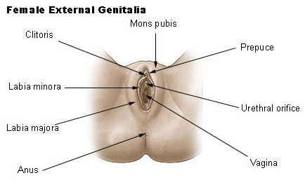

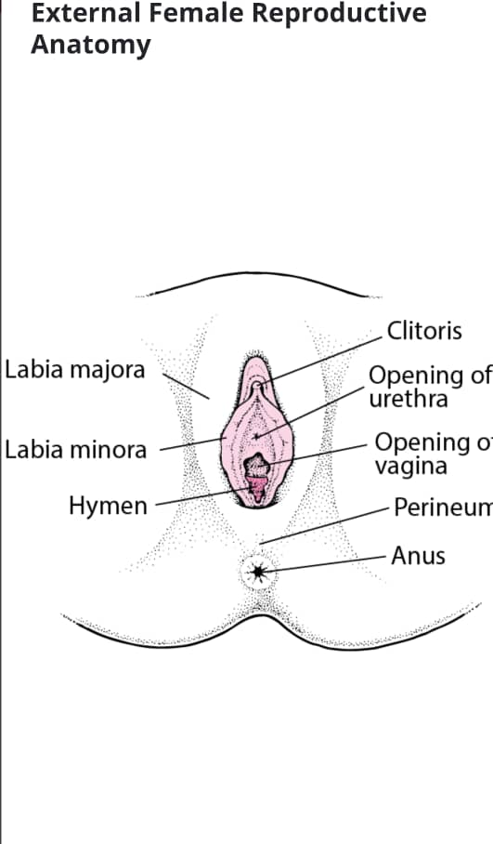
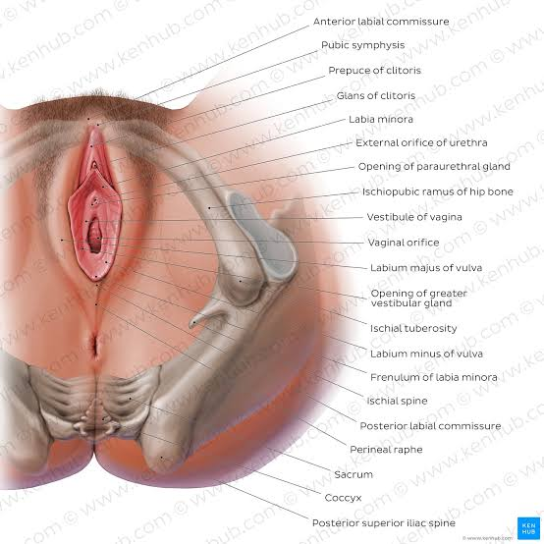
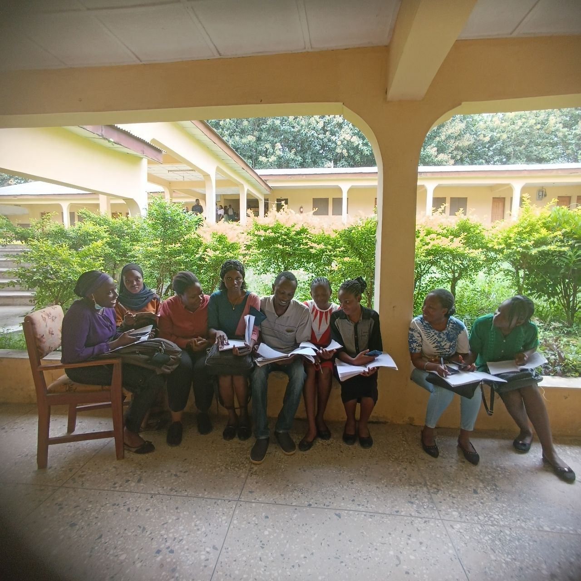
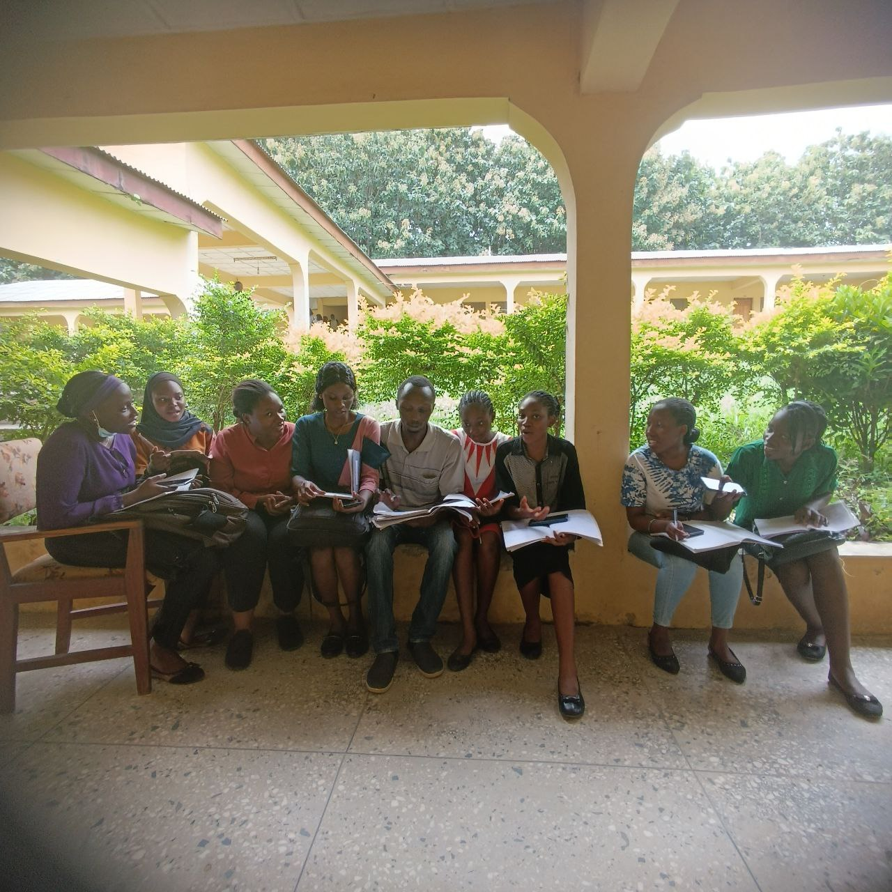
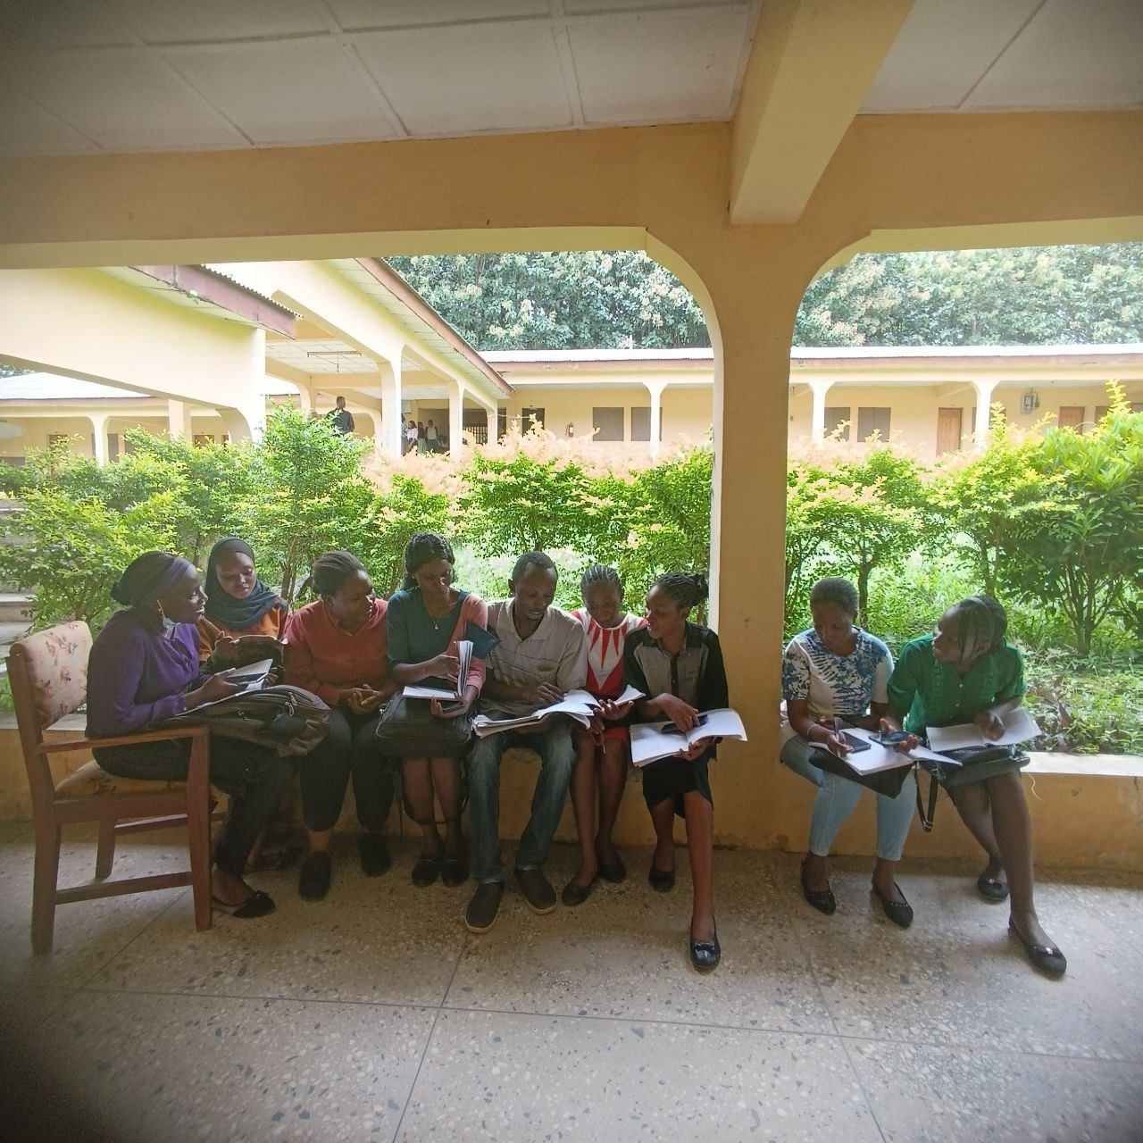
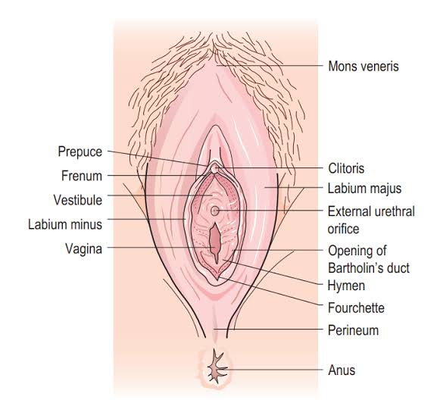

Slide 7


Slide 8
THANK YOU

