Slide 1
Opening the Archives:
OLAC, TRACTOR and the OTA
Martin Wynne
Oxford Text Archive
martin.wynne@ota.ahds.ac.uk

Slide 2
Outline
Why did I want to join in with OLAC?
What is TRACTOR?
What is the Oxford Text Archive?
The experiment
The results

Slide 3
Standards
I don’t like them;
But some level of interoperability of metadata is necessary for a centralised resource discovery mechanism;
Resource encoding standards and metadata standards;
There are good standards and bad standards.
Notes:
Some people were surprised that I wanted to get involved with OLAC, because I have expressed scepticism about international standards initiatives. But, I wanted to make the things in the TRACTOR and OTA archives as accessible as possible, and if there is to be a catalogue of resources from different

Slide 4
Bad standards
Devise elaborate standards in the abstract without reference to practicalities;
Make complex standards with many obligatory categories;
Use technologies with which the community is not familiar or which are arcane.

Slide 5
Good standards
Easy to implement, especially making migration from other formats easy;
Provide tools and support for migration and implementation;
Make validation easy;
Give immediate rewards, e.g. a working search engine;
Use or relate to existing community (and wider) standards.

Slide 6
Portals
UK:
Resource Discovery Network
HUMBUL Humanities Hub
Arts and Humanities Portal
International:
Internet search engines
Subject-based meta-archives (e.g. OLAC)
Notes:
One good thing about OLAC is that once you get your OAI server working, you can plug into other portals and search engines and metaarchives

Slide 7
An alternative: IMDI
More detailed metadata set
DC is only the lowest common denominator: need more detailed set for describing language resources properly
But what categories for what sort of resources?
IMDI really for linguistic field data, not corpora
Can now be migrated to OLAC

Slide 8
Conclusions so far
Need a meta-archive so that resources in different archives can more easily be discovered
OLAC seems to offer a potentially viable model
Let’s try it out with an archive (or two!)

Slide 9
TRACTOR
A key part of TELRI II
www.tractor.de
Resources in Bulgarian, Croatian, Czech, Dutch, English, Estonian, French, German, Greek, Hungarian, Italian, Latvian, Lithuanian, Romanian, Russian, Serbian, Slovak, Slovenian, Swedish, Turkish, Ukrainian, Uzbek.
Mostly corpora; some lexicons and tools
c. 100 resources

Slide 10
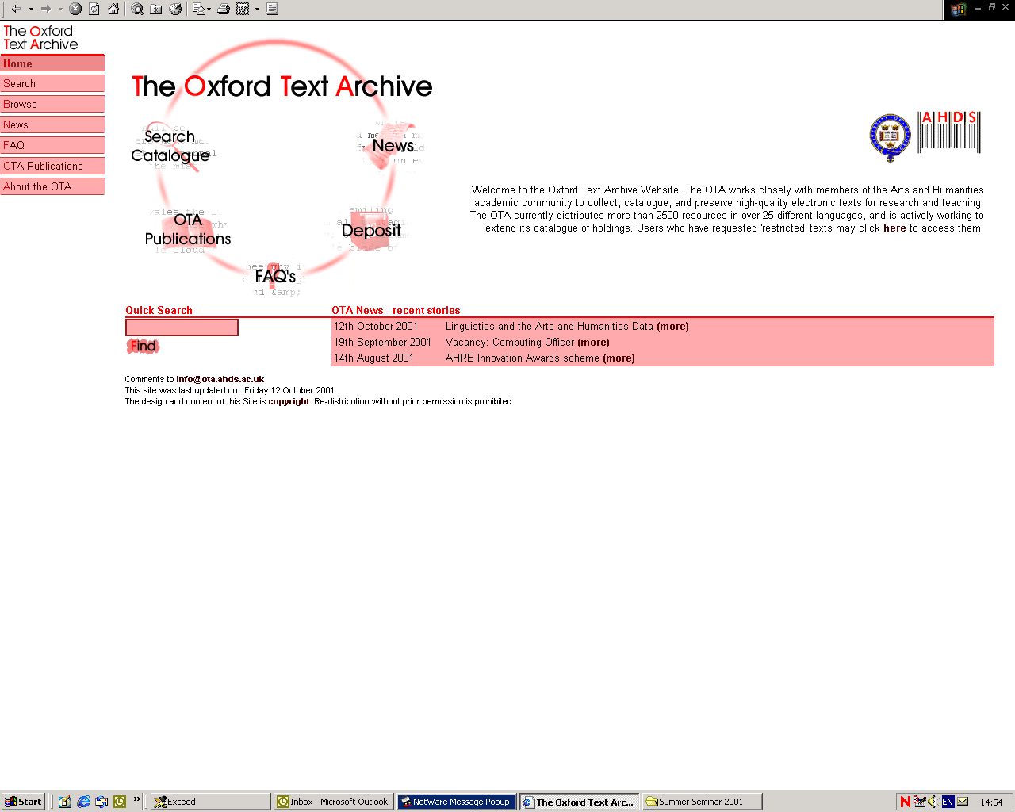

Slide 11
Arts and Humanities Data Service structure and services
AHDS
Executive
King’s College London
ADS
York
HDS
Essex
OTA
Oxford
PADS
Glasgow
VADS
Farnham
http://ahds.ac.uk

Slide 12
Oxford Text Archive: Holdings
25+ languages, c. 2,500 titles
  Literary texts
  Reference works, dictionaries, Bibles
  Corpora (50+)
Catalogue (TEI SGML and XML, library cataloguing guidelines followed)
Full text retrieval in various formats
  HTML, TEI-Lite, ASCII, RTF, original(?)
Mirror sites

Slide 13
The experiment: prerequisites
Structured metadata
Access to standards and ability to migrate
Validation tools
Harvest mechanism
Notes:
Metadata more or less formal and structured, but sorting it out was a GOOD THING anyway, so I didn’t mind putting a bit of work into this.

Slide 14
Opening TRACTOR and the OTA to OLAC (1)
Two different archives:
TRACTOR: 99 records, corpora, designed for LE, not much metadata
OTA: 2500 records, mostly literature, some corpora, metadata well-structured but partial
Common points: variable quality of resources and metadata

Slide 15
Process
Sed, awk, commands and scripts and perl programs to migrate to OLAC-conformant metadata records
Hack XML file of records
Validate records
Send XML file to OLAC

Slide 16
Conversion of TRACTOR metadata (1)
Parse (reasonably well-structured) HTML file to get metadata categories;
Re-order (in Excel) and edit to fit OLAC categories (and export to tab-separated text);
Hack OLAC-conformant XML file from the text.

Slide 17
Conversion of TRACTOR metadata (2)
<hr>
<h2>
<a NAME="Bulgarian"></a><i>Bulgarian</i></h2>
<ul>
<p><li><h3>
POS tagged corpus</h3>
2460 Bulgarian sentences marked-up with part of speech information (BTB-POS Corpus I). The corpus
is in XML format, non-standard with respect to TEI or CES, DTD is included. Available in three
different encodings of cyrillic letters: ISO 8879:1986, MS Windows, and Unicode.
<p><i>Resource provider:</i> <a href="mailto:kivs@bgcict.acad.bg">Kiril Iv. Simov</a>, Linguistic Modelling Laboratory, Bulgarian
Academy of Sciences, Sofia.
<p><a href="/tractor/resources/SOF2/BTB-POS/">Browse the files</a>

Slide 18
Conversion of TRACTOR metadata (3)
SOF2001 2001-10-31 "Kiril Iv. Simov, Linguistic Modelling Laboratory, Bulgarian" 2460 sentences unknown 2001 "2460 Bulgarian sentences mar
ked-up with part of speech information (BTB-POS Corpus I). The corpus is in XML format, non-standard with respect to TEI or CES, DTD is included. Ava
ilable in three different encodings of cyrillic letters: ISO 8879:1986, MS Windows, and Unicode. " text ISO 8879:1986 XML with DTD
http://tractor.bham.ac.uk/tractor/resources/SOF2/BTB-POS/ Bulgarian www.tractor.de TRACTOR User Agreemen
t BTB-POS Corpus I corpus
SOF2002 2001-10-31 "Kiril Iv. Simov, Linguistic Modelling Laboratory, Bulgarian" 2460 sentences unknown 2001 "2460 Bulgarian sentences mar
ked-up with part of speech information (BTB-POS Corpus I). The corpus is in XML format, non-standard with respect to TEI or CES, DTD is included. Ava
ilable in three different encodings of cyrillic letters: ISO 8879:1986, MS Windows, and Unicode. " text Windows XML with DTD
http://tractor.bham.ac.uk/tractor/resources/SOF2/BTB-POS/ Bulgarian www.tractor.de TRACTOR User Agreement
BTB-POS Corpus I corpus
SOF2003 2001-10-31 "Kiril Iv. Simov, Linguistic Modelling Laboratory, Bulgarian" 2460 sentences unknown 2001 "2460 Bulgarian sentences mar
ked-up with part of speech information (BTB-POS Corpus I). The corpus is in XML format, non-standard with respect to TEI or CES, DTD is included. Ava
ilable in three different encodings of cyrillic letters: ISO 8879:1986, MS Windows, and Unicode. " text Unicode XML with DTD
http://tractor.bham.ac.uk/tractor/resources/SOF2/BTB-POS/ Bulgarian www.tractor.de TRACTOR User Agreement
BTB-POS Corpus I corpus

Slide 19
Conversion of TRACTOR metadata (4)
<?xml version="1.0" encoding="UTF-8" ?>
<!DOCTYPE OLAC-Repository SYSTEM "olacrep.dtd">
<OLAC-Repository>
<identity>
<repositoryIdentifier>tractortest</repositoryIdentifier>
<repositoryName>TRACTOR Test Archive</repositoryName>
<adminEmail>martin.wynne@ota.ahds.ac.uk</adminEmail>
<collectionDescription>A test set of metadata records from TRACTOR (TELRI Research Archive of Language Resources and Tools</collectionDescription>
</identity>
<sets>
<set>
<setSpec></setSpec>
<setName></setName>
</set>
</sets>
<records>
<record>
<header>
<recordId>olac:tractor:SOF2001</recordId>
<datestamp>2001-10-31</datestamp>
</header>
<metadata>
<olac lang="en">
<contributor>"Kiril Iv. Simov, Linguistic Modelling Laboratory, Bulgarian"</contributor>
<coverage>2460 sentences</coverage>
<creator>unknown</creator>
<date>2001</date>
<description>"2460 Bulgarian sentences marked-up with part of speech information (BTB-POS Corpus I). The corpus is in XML format, non-standard with respect to TEI or CES, DTD is included. Available in three different encodings of cyrillic letters: ISO 8879:1986, MS Windows, and Unicode. "</description>
<format>text</format>

Slide 20
Conversion of OTA metadata (1)
<!DOCTYPE TEI.2 PUBLIC "-//TEI//DTD TEI Lite 1.0//EN" "teilite.dtd">
<TEI.2>
<TEIHEADER TYPE='ISBD(ER)'>
<FILEDESC>
<TITLESTMT>
<TITLE TYPE="main">Erec [Electronic resource]</TITLE>
<AUTHOR>Chr&eacute;tien, de Troyes, 12th cent.</AUTHOR>
<RESPSTMT><RESP>creation of machine-readable version</RESP>
<NAME>Lusignan, Serge</NAME>
</RESPSTMT>
</TITLESTMT>
<EXTENT>
<SEG TYPE="designation">Text data</SEG>
<SEG TYPE="size">(1 file : ca. 206 kilobytes)</SEG>
</EXTENT>
<PUBLICATIONSTMT><AUTHORITY ID='LUSSE1'>Deposited by
<NAME TYPE="PERSON">Lusignan, Serge</NAME>
<NAME TYPE="ORG">Inst. d'Etudes Medi&eacute;vaux Universite de Montreal</NAME>
<ADDRESS><ADDRLINE>Inst. d'Etudes Medi&eacute;vaux</ADDRLINE>
<ADDRLINE>Universite de Montreal</ADDRLINE>
<ADDRLINE>CP 6128 Succ A</ADDRLINE>
<ADDRLINE>H3C 3J7 Montreal PQ</ADDRLINE>
<ADDRLINE>Canada</ADDRLINE>
</ADDRESS>
<DATE></DATE>
</AUTHORITY>
<DISTRIBUTOR>
<NAME KEY="ota" TYPE="organisation">Oxford Text Archive</NAME>
<NAME TYPE="place">Oxford</NAME>
<ADDRESS>
<ADDRLINE><NAME KEY="oucs" TYPE="organisation">Oxford University Computing Services</NAME>
</ADDRLINE>
<ADDRLINE>13 Banbury Road</ADDRLINE>
<ADDRLINE>Oxford</ADDRLINE>

Slide 21
Conversion of OTA metadata (2)
<?xml version="1.0" encoding="UTF-8" ?>
<!DOCTYPE OLAC-Repository SYSTEM "olacrep.dtd">
<OLAC-Repository>
<identity>
<repositoryIdentifier>otatest</repositoryIdentifier>
<repositoryName>Oxford Text Archive</repositoryName>
<adminEmail>martin.wynne@ota.ahds.ac.uk</adminEmail>
<collectionDescription>A test set of metadata records from the Oxford Text Archive
(OTA)</collectionDescription>
</identity>
<sets>
<set>
<setSpec></setSpec>
<setName></setName>
</set>
</sets>
<records>
<record>
<header>
<recordId>olac:ota:0001</recordId>
<datestamp>2001-11-6</datestamp>
</header>
<metadata>
<olac lang="en">
<contributor></contributor>
<coverage>(1 file : ca. 97.6 kilobytes)</coverage>
<creator></creator>
<date></date>
<description></description>
<format></format>
<format.cpu></format.cpu>
<format.encoding></format.encoding>
<format.markup></format.markup>

Slide 22
Validation
XMetaL (or any XML parser) to check for well-formedness and conformance to the DTD (olacrep.dtd)
http://www.w3.org/2001/03/webdata/xsv?docAddrs=http%3A%2F%2Fusers.ox.ac.uk%2F~martinw%2Folac%2Fota.xml&warnings=on&keepGoing=on&style=offline to check against XML Schema

Slide 23
Harvest
Done manually by Steven Bird and Eva Banik from the XML file I supplied;
In principle can be harvested from a perl script at the archive website which reads the metadata and looks for updates.

Slide 24
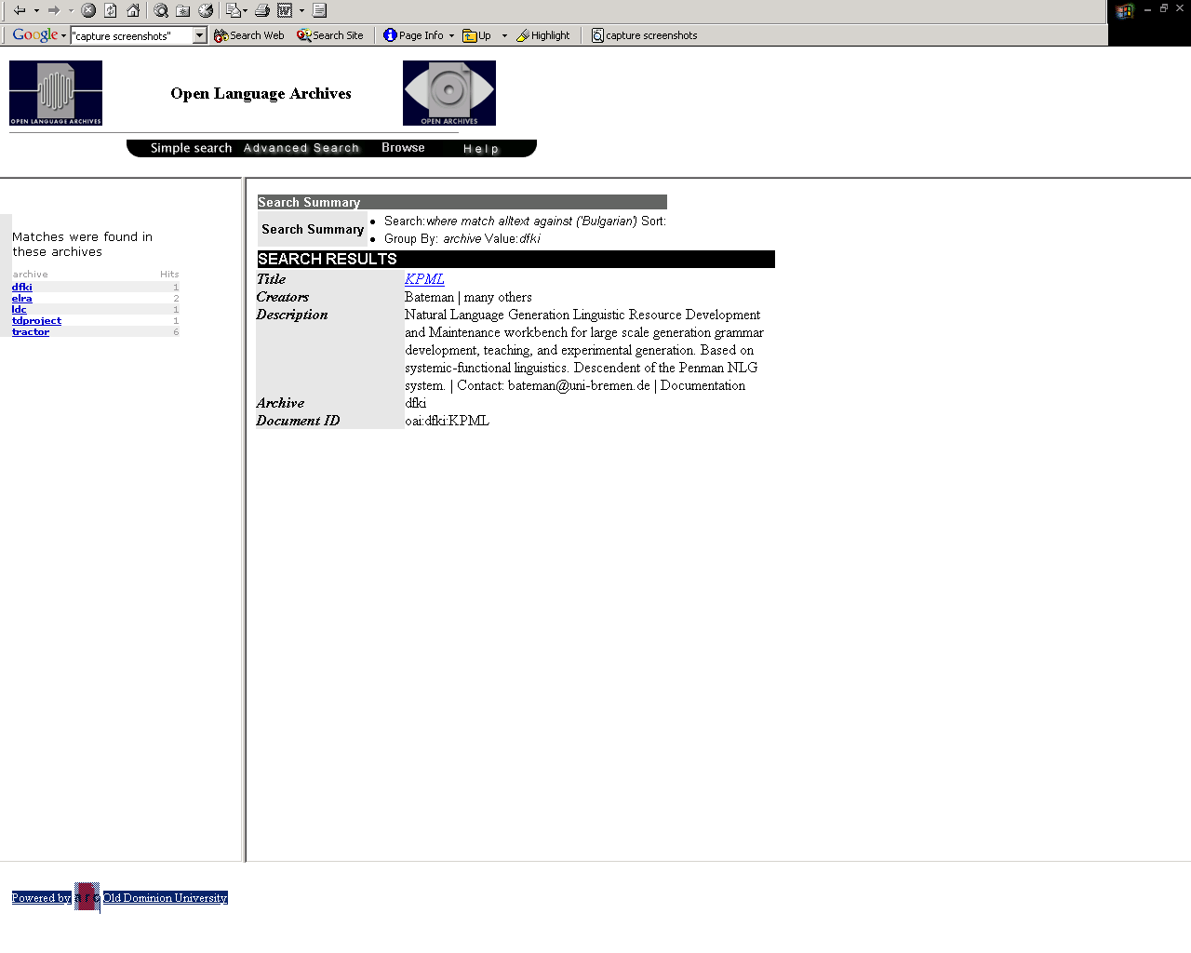

Slide 25
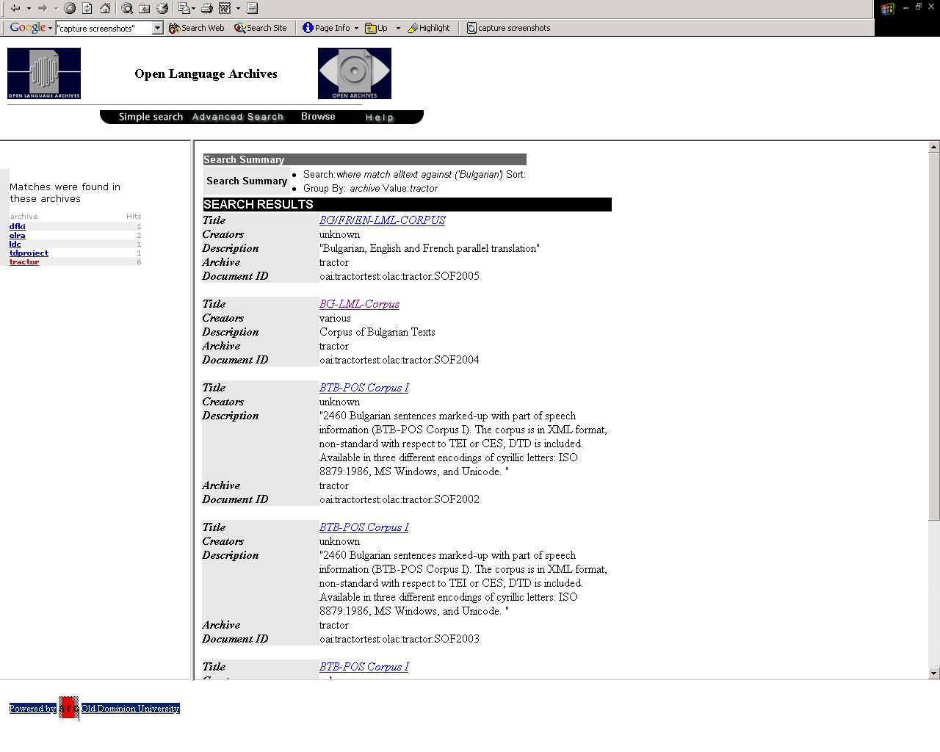

Slide 26
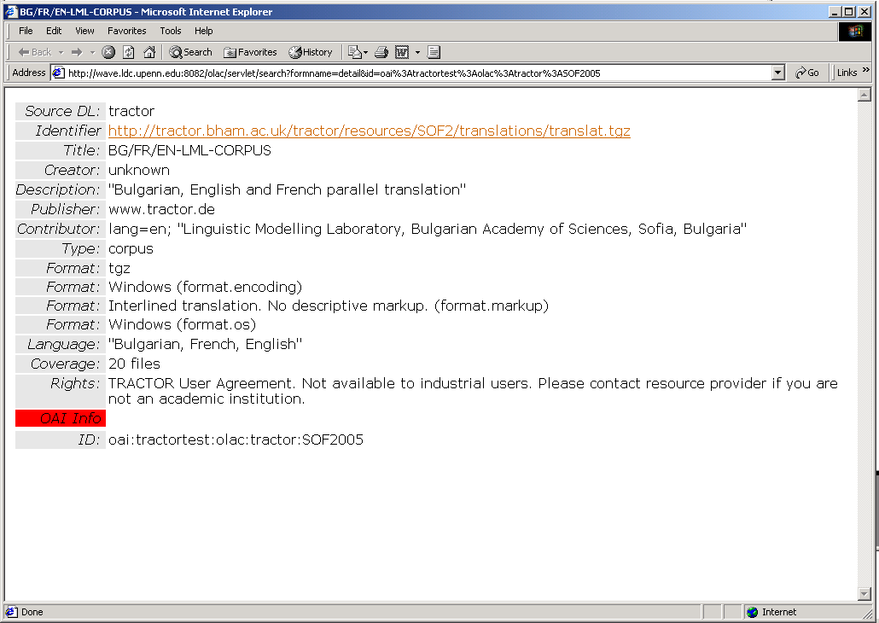

Slide 27
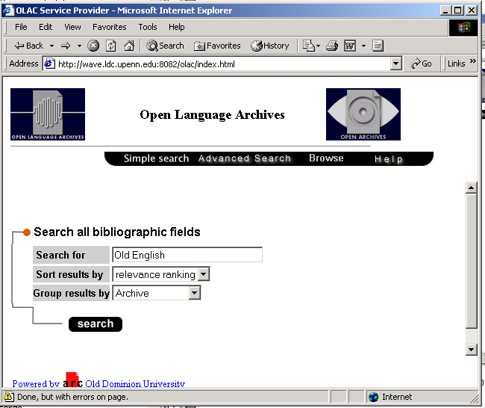

Slide 28
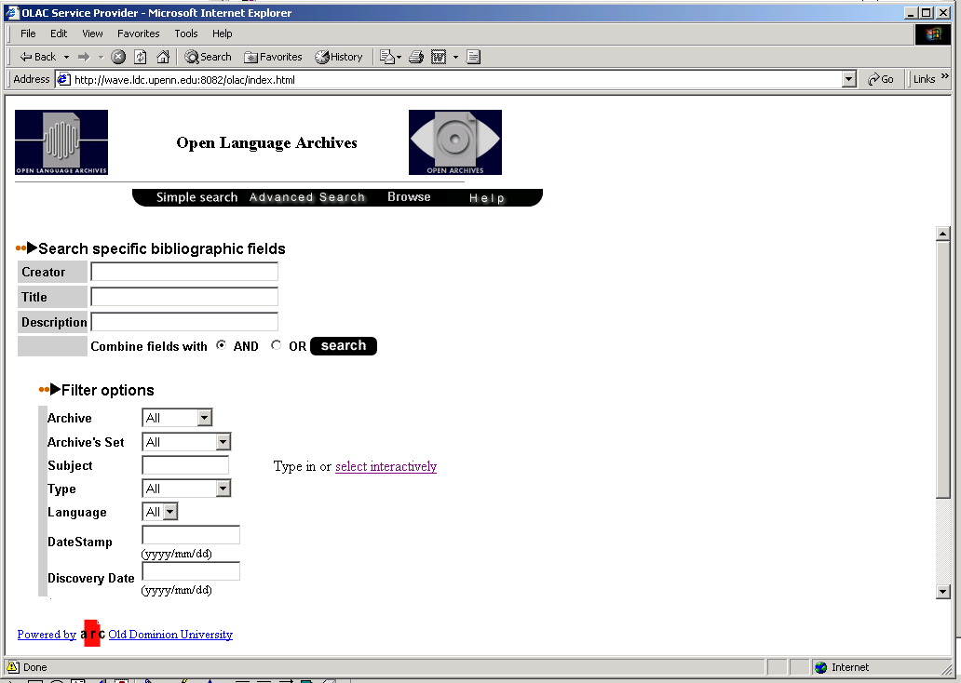

Slide 29
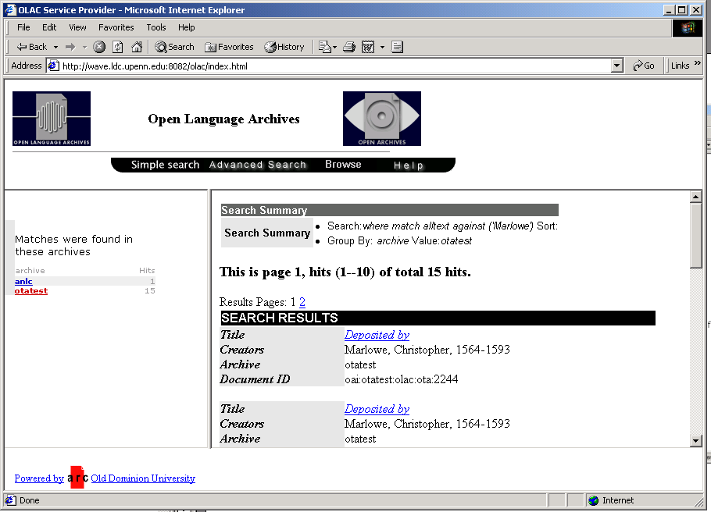

Slide 30
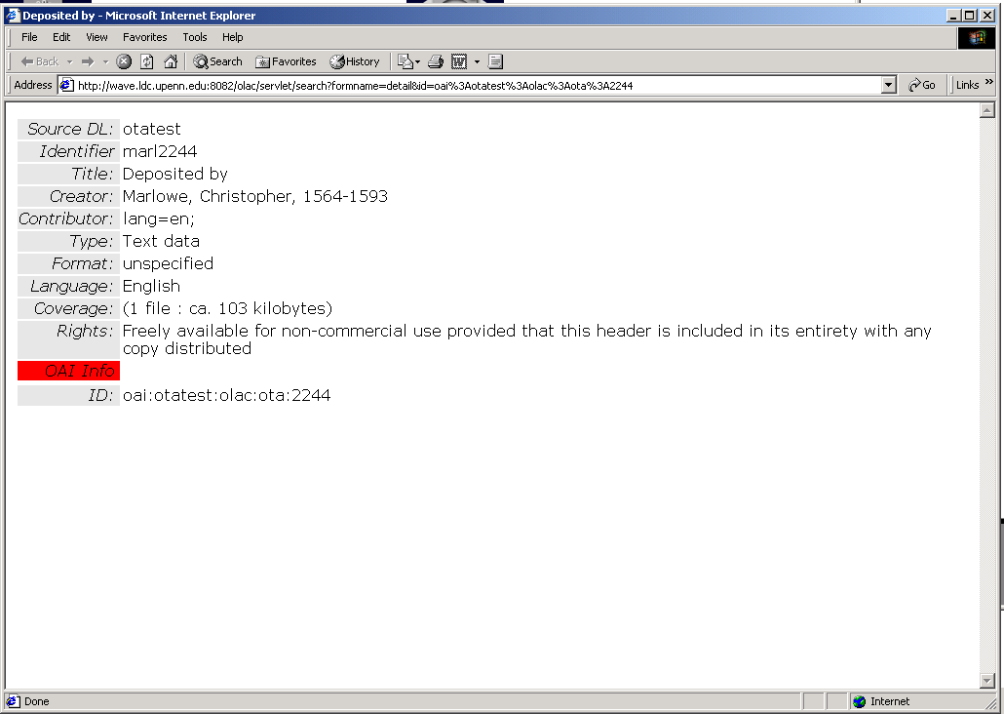

Slide 31
Results
Metadata successfully harvested, and the virtual data provider accesses the records
Recall imperfect
Metadata imperfect
Migration tools imperfect
But the future is bright!

Slide 32
Acknowledgements
Thanks for their help to:
Steven Bird (OLAC and LDC) plus Eva Banik and the ARC people (at Old Dominion University) as developers of the OLAC prototype
TRACTOR people in Birmingham (esp. Everita Milconoka, Andrius Utka, Wolfgang Teubert)
OTA people (John Leedham, Michael Popham and Alan Morrison)

Slide 33
Archives and Organisations
http://www.tractor.de
http://ota.ahds.ac.uk
http://www.open-archives.org
http://www.language-archives.org
http://www.mpi.nl/ISLE
http://www.wave.ldc.upenn.edu:8082/olac/
http://www.linguistlist.org

Slide 34
Documentation
Warner, S, Exposing and Harvesting Metadata Using the OAI Metadata Harvesting Protocol: A Tutorial, http://library.cern.ch/HEPLW/4/papers/3/
Simons & Bird (2001), OLAC Metadata Set, http://www.language-archives.org/OLAC/olacms-20011022.html
Bird & Simons (2001), The OLAC metadata set and controlled vocabularies. ACL Workshop on sharing tools and resources for research and education, http://arXiv.org/abs/cs/0105030

