Slide 1
Language Technology WG Work In Progress Report

Slide 2
Agenda
Remit
Per CV and Schema Review
Current CV and Schema Status
WG Formation
Timetable
Issues

Slide 3
Remit: Vocabularies and Schemas
Subject.Functionality
Format
Format.OS
Format.CPU
Format.Source-Code
All are resource type independent

Slide 4
Subject.Functionality
“the function of a resource” (doing-ness)
LT domain focus
Relocated from Type.Functionality
CV and Schema
3 level CV hierarchy

Slide 5
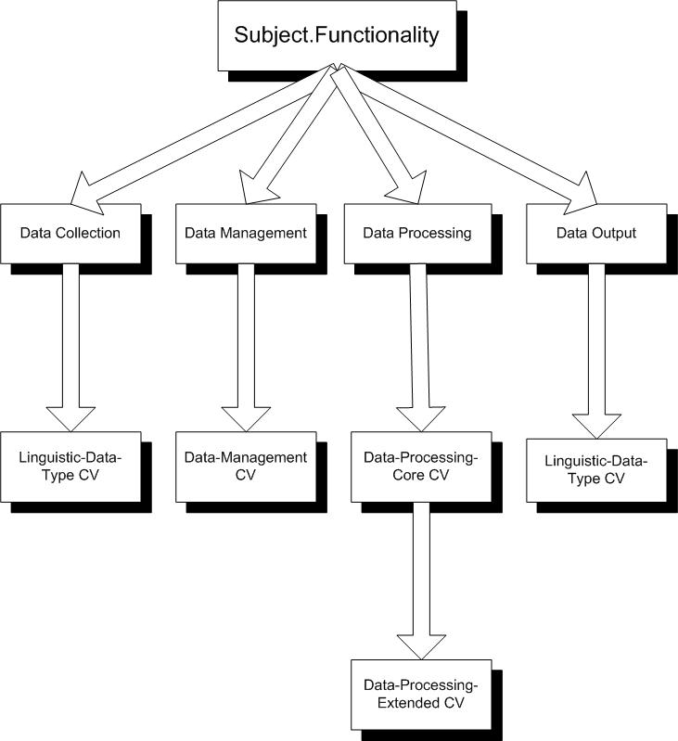
Subject.Functionality Structure

Slide 6
Format
“the physical or digital manifestation of a resource”
eg. text/xml
Domains beyond LT
CV and Schema
2 level “Content Type” + “Subtype”
Based on IETF RFC 1521/2077

Slide 7
Format.OS
“the OS required to use a resource”
eg. unix/linux
LT domain focus
CV and Schema
re-usable by higher level ontologies

Slide 8
Format.CPU
“the CPU required to utilise a resource”
eg. cpu/i386
CV and Schema
reusable by higher level ontologies

Slide 9
Format.Source-Code
“the programming language of a resource”
eg. sourcecode/perl
CV and Schema
reusable by higher level ontologies

Slide 10
CV and Schema Status
CV/Schema | Status
Subject.Functionality | Editorial Process
Format | Under Development
Format.OS | Draft
Format.CPU | Draft
Format.Source-Code | Draft

Slide 11
WG Formation
>3 Core Members
OLAC WG web page
WG document workspace
LANGTECH Mailing List

Slide 12
Timetable ?
Dec 2002: develop draft CV/Schema
Jan 2003: review draft CV/Schema
Feb 2003: proposals ?
April 2003: recommendations ?

Slide 13
Issues
Cross CV compatibility
  Linguistic-Data-Type
  Extensions for HLT Survey
Orphan CV and Schema
  Format.Encoding
  Format.Markup
  Format.Source-Status

