Slide 1

Integrating ELRA/LDC Metadata into
OLAC Repository
Andrew W. Cole
andrew.cole@ldc.upenn.edu
Linguistic Data Consortium
University of Pennsylvania
www.ldc.upenn.edu
Khalid Choukri
choukri@elda.fr
ELRA/ELDA
55 Rue Brillat-Savarin
F-75013 Paris, France
http://www.elda.fr

Slide 2
Net-DC
Net-DC : Networking Data Centers, an initiative funded by NSF and EC to coordinate activities of data providers – specifically LDC and ELRA but in ways that should encourage other centers to join
Included a task for joint LDC/ELRA dissemination of information on resources being distributed
LDC/ELRA concluded having NetDC fund the integration of their catalog into OLAC was the best solution.
In the division of tasking, LDC agreed to write the converters for both LDC and ELRA/ELDA catalogs.

Slide 3
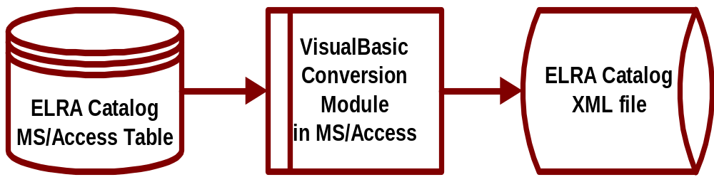
ELRA Architecture
System Overview
Access Table Match
OLAC OLAC/ELDA
Subject.language Subject.language
Type Type
Type.linguistic Not in ELDA Catalog
Coverage Not in ELDA Catalog
Date Not Applicable

Slide 4
LDC/ELRA Code
Coding/Knowledge Problems
  Error in ELDA OLAC program, link to online description is between an <identifier> tag, <description> would be better.
Nonetheless Access System is Simple and Robust
  MS/Access Visual Basic Module of 280 lines.
  Single MS/Access Table Converted to Single XML file.

Slide 5
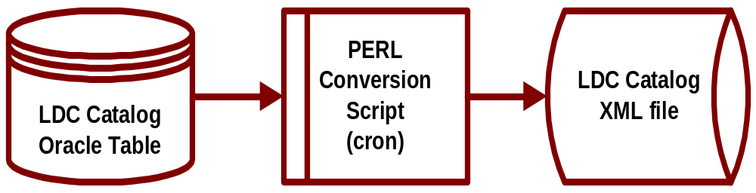
LDC Architecture
System Overview
Oracle Table Problems
ldc_catalog_id: LDC94S17
name: OGI Multilanguage Corpus
language: English, Farsi, French, German, Hindi, Japanese, Korean, Chinese, Spanish, Tamil, Vietnamese,

Slide 6
LDC PERL Coding
Coding/Knowledge Problems
Nonetheless System is Simple and Robust
  PERL Script of 150 lines (lots of comments).
  Single Oracle Table converted to Single XML file.
  Repairs taking less than a day, done by non-experts.
<record spec="lexicon">
<header>
<recordId>olac:ldc:LDC94L2</recordId><datestamp>2002-10-16</datestamp>
</header>
<metadata>
<olac>
<identifier>LDC94L2</identifier>
<title>*COMLEX English Syntax Lexicon</title>
<type>lexicon</type>
…

Slide 7
OLAC Issues/Links
OLAC Issues.
  Existing OLAC vocabulary assumes that linguistic data is for traditional linguistic research (ie. linguistic field) and that language technology developers are only interested in software not data.
  Difficult to determine/find the correct or applicable type and vocabulary from OLAC web site with unknowledgeable staff (eg., me, Andy).
  Need OLAC vocabularies encode information about pricing.
  Providers ramp-up to full meta-data compliance.
Web Links
  ELDA ECI http://www.elda.fr/cata/text/W0004.html
  LDC ECI http://www.ldc.upenn.edu/Catalog/CatalogEntry.jsp?catalogId=LDC94T5
  OLAC LDC/ECI http://saussure.linguistlist.org/cfdocs/new-website/LL-WorkingDirs/olac/olac-search3.cfm?id=112715
    (Bulgarian)
  OLAC ELDA/ECI http://saussure.linguistlist.org/cfdocs/new-website/LL-WorkingDirs/olac/olac-search3.cfm?id=58000
    (Turkish)

