Slide 1
LSA Archiving Tutorial
January 2005
Archives, linguists, and language speakers

Slide 2
Credits
Peter K. Austin, Endangered Languages Academic Programme, School of Oriental and African Studies (SOAS)
Robert Munro, Endangered Languages Archive, SOAS
David Nathan, Endangered Languages Archive, SOAS
www.hrelp.org

Slide 3
Overview
What is archiving of language materials?
What kinds of language archives are there?
Who uses language archives?
Why should you work together with a language archive?
What can a language archive offer you?
What can you archive and how do you archive your materials?
Archives Networks and resources

Slide 4
What is a archiving of language materials?
Preparing materials in a structured form for long-term preservation
Archiving is not backup
Archiving is not publication
Beware: “I’ll archive my data on the web”
Archiving pays attention to intellectual property rights, and cultural, social, religious and individual restrictions - access and distribution are separate from preservation

Slide 5
What is a language archive?
A trusted repository created and maintained by an institution with a commitment to permanence and the long-term preservation of archived resources
Will have clear policies for materials acquisition, cataloguing, dissemination, quality assurance, forward migration to new digital formats, disaster recovery

Slide 6
Kinds of language archives
Many cross-cutting classifications:
Indigenous vs outsider, eg. Squamish Nation
Regional vs international, eg. AILLA, Paradisec; DoBeS, ELAR
Associated with research institute, eg. AIATSIS, UCB California Survey, ANLC
Granter-funded, eg. DoBeS, ELAR, OTA
Physical vs digital vs mixed, eg. DoBeS vs Vienna Sound Archive, British Library

Slide 7
Who uses language archives?
Speakers and their descendants - 95% of users of AIATSIS and UCB are community members
Individual linguists or teams (depositors) - to create or renew materials
Other researchers - comparative/historical linguists, typologists, theoreticians, anthropologists, historians, musicologists etc etc
Journalists - wanting copy and images, sounds
General public - interested in exotic languages

Slide 8
Why work with a language archive?
To ensure long-term preservation of your work
To ensure long-term accessibility to the data
For the potential benefit of the language community now and in the future
For safekeeping your own work and establish-ing your intellectual property rights
To make your data available to other interested people

Slide 9
What can a language archive offer you?
Security - keep your electronic materials safe
Preservation - store your materials for the long term
Discovery - help others to find out about your materials
Protocols - respect and implement any sensitivities or restrictions
Sharing - share the results of your work with others, if appropriate
Acknowledgement - create citable acknowledgement of your research
Mobilisation - help to create usable language materials for communities
Quality and standards - advice for assuring your materials are of the highest quality and robust standards

Slide 10
What can you archive?
Any linguistic materials, including:
Media - sound and video
Graphics - pictures and images
Documents, including fieldnotes, grammars, description and analysis
Structured data, eg. time-aligned annotated transcriptions, databases
Metadata, including structured data about your materials, typically in written text form

Slide 11
How can you archive?
Contact a relevant archivist before you begin your project and ask for advice - if they can’t help you they will suggest someone who can
The archive will want you to prepare your materials in an appropriate informative and explicit format (encoded and stored in a particular way), record relevant metadata, and specify intellectual property and protocol issues including conditions on access and use

Slide 12
Archives Networks
Several networks of archives exist:
Digital Endangered Languages and Archives Network (DELAMAN) - see www.delaman.org
Open Language Archives Community (OLAC) - see Gary Simons presentation to follow
Archivists are nice friendly people and working together with them from the beginning of your project can have all sorts of benefits

Slide 13
Any questions or comments?

Slide 14
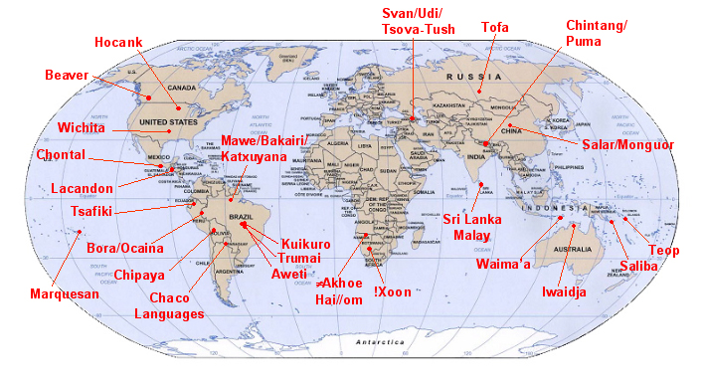
DoBeS - Volkswagen Foundation

Slide 15
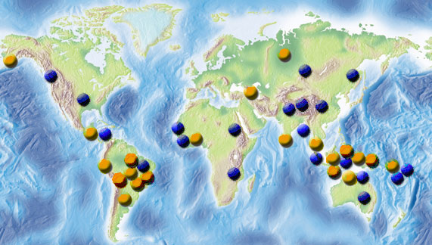
SOAS - ELAR

