Slide 1

The Open Language Archives Community:
Building a worldwide library of digital language resources
Gary Simons, SIL International
LSA Tutorial on Archiving and Linguistic Resources
6 Jan 2005, Oakland, CA

Slide 2
Unprecedented opportunity
Digital archiving of language documentation and description on the World-Wide Web offers:
  Minimal cost multimedia publishing
  Maximal access by the citizens of the world
This holds the promise of unparalleled access to information.

Slide 3
Or, Unprecedented chaos?
Pursuing digital archiving of language documentation in isolation will result in:
  Resources that are as good as lost since others won’t be able to find them.
  Resources that are not usable by others due to the proliferation of idiosyncratic formats and practices.
This holds out the specter of unparalleled frustration and confusion.

Slide 4
The vision
Fulfill the promise (and avoid the specter) by acting in community to define and follow best common practice
A gap analysis:
  What users want—the ideal
  What users actually get —the gap
  What it would take to bridge the gap—
  a community infrastructure

Slide 5
What users want
The individuals who use and create language documentation and description are looking for three things:
  Primary and secondary data about languages
  Computational tools to create, view, query, or otherwise use language data
  Advice on how best to do the above

Slide 6
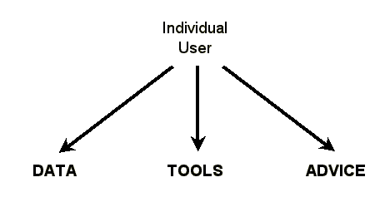
The ideal situation

Slide 7
What users actually get
The data are archived at hundreds of sites
  Some are on Web and user finds them
  Some are on Web but user can’t find them
  Some are not even on Web
The tools and advice are at different sites than the data

Slide 8
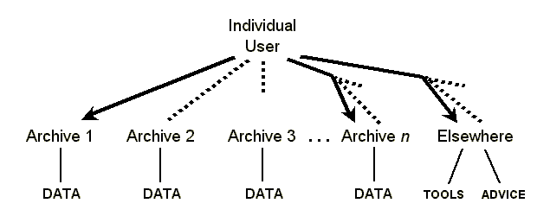
The gap

Slide 9
It’s even worse
The user may not find all existing data about the language of interest because different sites have called it by different names.
The user may not be able to use an accessible data file for lack of being able to match it with the right tools.
The user may locate advice that seems relevant but then has no way to judge how good it is.

Slide 10
What a community could provide
In order to bridge the gap, the individuals who use and create language documentation and description need a community with standards that define:
  Uniform metadata for describing resources
  A single gateway for finding resources
  A process to review practices and standards

Slide 11
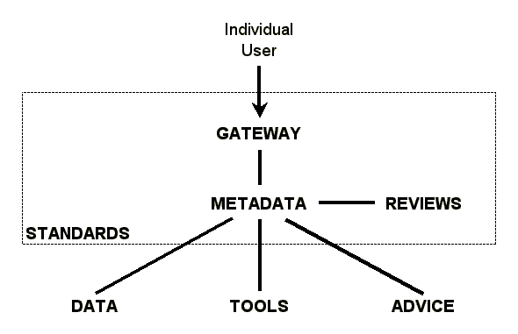
A community infrastructure

Slide 12
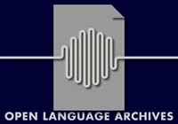
Open Language Archives Community
OLAC is an international partnership of institutions and individuals who are creating a worldwide virtual library of language resources by:
  Developing consensus on best current practice for the digital archiving of language resources
  Developing a network of interoperating repositories and services for housing and accessing such resources

Slide 13
Participating Archives
Aboriginal Studies Electronic Data Archive (ASEDA)
Academia Sinica
Alaska Native Language Center
Archive of Indigenous Languages of Latin America (AILLA)
ATILF Resources
CHILDES Data Repository
Cornell Language Acquisition Laboratory (CLAL)
Dictionnaire Universel Boiste 1812
Digital Archive of Research Papers in Computational Linguistics
Ethnologue: Languages of the World
European Language Resources Association (ELRA)
LACITO Archive
LDC Corpus Catalog
LINGUIST List Language Resources
Natural Language Software Registry
Oxford Text Archive
PARADISEC
Perseus Digital Library
Rosetta Project 1000 Languages
SIL Language & Culture Archives
Surrey Morphology Group Databases
Survey for California and Other Indian Languages
TalkBank
Tibetan and Himalayan Digital Library
TRACTOR
Typological Database Project
Univ. of Bielefeld Language Archive
Univ. of Queensland Flint Archive

Slide 14
Metadata standard
Based on Dublin Core metadata standard:
  Contributor, Coverage, Creator, Date, Description, Format, Identifier, Language, Publisher, Relation, Rights, Source, Subject, Title, Type
OLAC adds extensions (with controlled vocabularies) specific to our community:
  Language Identification, Linguistic Data Type, Linguistic Field, Participant Role, Discourse Type

Slide 15
Gateway standard
Based on a Digital Library Federation standard
  Open Archives Initiative Protocol for Metadata Harvesting
  Service providers use the protocol to harvest metadata from data providers
OLAC has four ways to become a data provider
  Implement a dynamic interface to existing database
  Map existing database to a static XML document
  Use web forms of OLAC Repository Editor service
  Under development: Install an E-prints server

Slide 16
Process standard
Defines how OLAC is organized:
  Coordinators, Advisory Board, Council, Archives, Services, Working Groups, Participating individuals
Defines three types of documents:
  Standards, Recommendations, Notes
Defines how a document moves from one life-cycle status to another.
  Draft, Proposed, Candidate, Adopted, Retired

Slide 17
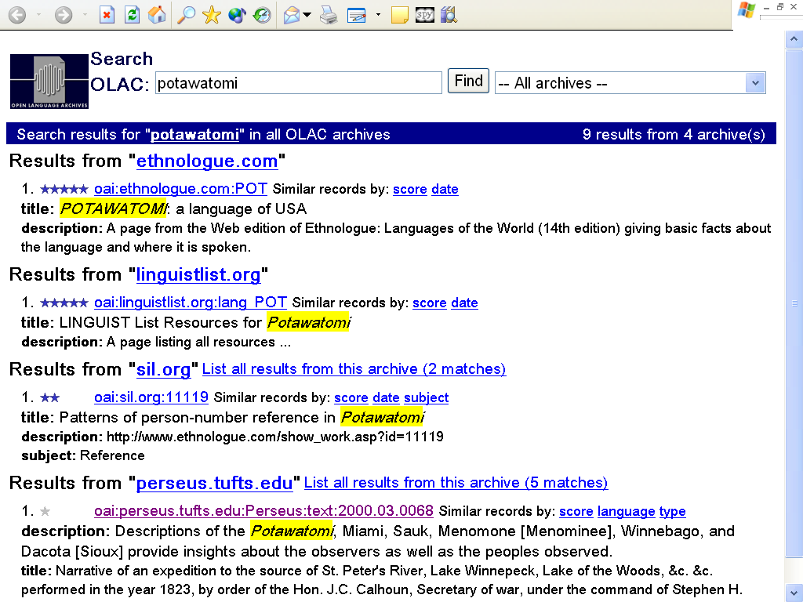

Slide 18
Call for participation
All institutions and individuals with language resources to share are enthusiastically invited to participate.
Visit www.language-archives.org to:
  Try our two search services
  Read workpapers and published articles
  Subscribe to the OLAC-General mailing list
  Learn how to become a data provider

