Slide 1
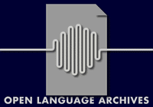
Accessing Distributed Resources Information: An OLAC perspective
Steven Bird Gary Simons Chu-Ren Huang
Melbourne SIL Academia Sinica
ENABLER/ELSNET Workshop
International Roadmap for Language Resources
Paris, 28th-29th August 2003

Slide 2
Open Language Archives Community
Advisory Board:15 members
Coordinators: Steven Bird & Gary Simons
Council: 7 members
Over 25 Archives and Services www.language-archives.org

Slide 3
OLAC Aims
The Open Language Archives Community is an international partnership of institutions and individuals who are creating a worldwide virtual library of language resources by:
  developing consensus on best current practice for the digital archiving of language resources;
  developing a network of interoperating repositories and services for housing and accessing such resources.

Slide 4
Two Challenges
Posed by Distributed Resources
Resource discovery
  How does a user find a resource?
  How does a user judge its relevance?
  How does a user find associated tools?
Resource creation
  How to choose among proliferating formats?
  How to create resources that are portable across platforms and over time?

Slide 5
Three Kinds of Infrastructure
In support of three kinds of interaction
Technical Machine-to-machine
Usage People-to-machine
Governance People-to-people

Slide 6
Technical Infrastructure
Machine-to-machine
How can a user find relevant resources when those resources are hosted on a variety of web sites?
-A ‘Union Catalogue’ is needed
OLAC builds on the Open Archives Initiative of the Digital Library Federation
www.openarchives.org

Slide 7
Problem 1: A common way to describe resources
OAI uses Dublin Core metadata:
OLAC adds elements specific to community:
  olac:linguistic-type:
  lexicon, primary_text, language_description
  olac:language
  And defines controlled vocabularies

Slide 8
Solving the Language Identification Problem
olac:language
  Provides codes for identifying all known languages, both living and extinct, includes three sets of unique codes
  Unambiguous ISO 639-1 Codes ex. en
  Unambiguous ISO 639-2 Codes ex. tur
  Ethnologue Codes ex. x-sil-TRK
  Note: ISO 639 is a subset of Ethnologue codes

Slide 9
Problem 2: How to share language resource information
An OAI strategy
Data provider publishes metadata behind a CGI interface that returns XML documents
Service provider runs a metadata harvester that sends HTTP requests and inserts results into a pooled database

Slide 10
Usage Infrastructure:
OAI Protocol for
Metadata Harvesting
An OAI search simply “pulls” out the relevant information saved in the pooled repository
Distributed Resources (managements)
Pooled (and Sharable) Language Resource Description

Slide 11
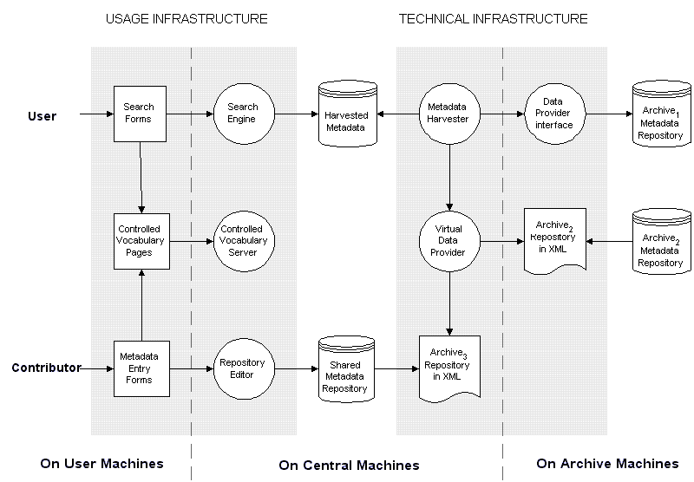
Data provider approach 1:
Implement CGI interface

Slide 12
Data provider approach 2:
Export to XML repository

Slide 13
Data provider approach 3:
Use a forms-based editor

Slide 14
Search all OLAC repositories: www.linguistlist.org/olac/

Slide 15
Controlled vocabulary servers: e.g. www.ethnologue.com

Slide 16
OLAC Compliant vs.
OLAC Registered
OPEN: Being OLAC compliant does not necessarily mean OLAC registered
In theory, any OLAC compliant language resources can return the expected result to a search engine following OAI MHP
Asian Language Resources Catalogues
Collected by Asian Language Resources Committee
http://www.cl.cs.titech.ac.jp/ALR/

Slide 17
Conclusion:
Call for participation
The OLAC Process document is now adopted as the first OLAC standard by the OLAC Advisory Board. The process document summarizes the governing ideas of OLAC and describes how OLAC is organized and how it operates, including the document process and working group process. .
All institutions and individuals with language resources and best practice recommendations to share are enthusiastically invited to participate:

Slide 18
http://www.language-archives.com
Use the combined catalog
http://linguistlist.org/olac/
The OLAC-General mailing list
http://www.language-archives.org/
Become a data provider
http://www.language-archives.org/docs/implement.html

