Slide 1
An Overview of OLAC:
The Open Language Archives Community
Gary Simons and Steven Bird
Workshop on The Digitization of Language Data: The Need for Standards
21-24 June 2001

Slide 2
The vision: a gap analysis
What users want—the ideal
What users actually get —the gap
What it would take to bridge the gap—
a community infrastructure

Slide 3
What users want
The individuals who use and create language documentation and description are looking for three things:
  Data
  Tools
  Advice

Slide 4
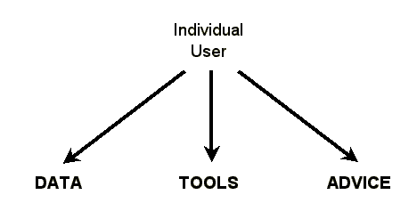
The ideal situation

Slide 5
What users actually get
The data are archived at hundreds of sites
  Some are on Web and user finds them
  Some are on Web but user can’t find them
  Some are not even on Web
Other problems
  Sites use different names for same language
  Tools and advice are on different sites than data
  Don’t know which tools go with which data

Slide 6
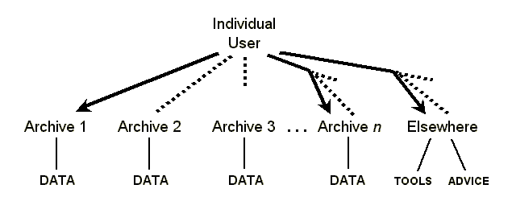
The gap

Slide 7
What a community could provide
In order to bridge the gap, the individuals who use and create language documentation and description need a community that provides four things:
  A single gateway
  Uniform metadata
  A review process
  Standards

Slide 8
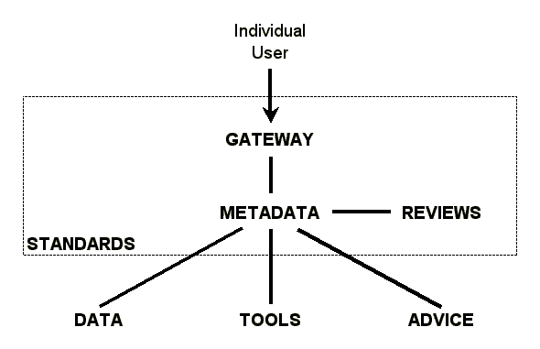
Proposed community infrastructure

Slide 9
Open Language Archives Community
An international partnership of institutions and individuals who are creating a worldwide virtual library of language resources by:
  developing consensus on best current practice for the digital archiving of language resources
  developing a network of interoperating repositories and services for housing and accessing such resources

Slide 10
Participating Archives
  Alaska Native Language Center
  Comparative Bantu Online Dictionary
  Deutsche Forschungszentrum für Künstliche Intelligenz
  European Language Resources Association
  Langues et Civilisations à Tradition Orale
  Linguistic Data Consortium
  Perseus Project
  SIL International

Slide 11
Prospective Participants
Aboriginal Studies Electronic Data Archive
Academia Sinica
American Indian Studies Research Institute
American Philosophical Society American Indian Manuscript Collections
Institut National de la Langue Française
Language and Culture Atlas of Ashkenazic Jewry, EYDES
The LINGUIST List
Max Planck Institute
National Anthropological Archives
Oxford Text Archive
Rosetta Project
Tibetan and Himalayan Digital Library
Typological Research Center

Slide 12
Going deeper
Visit the Web site
  http://www.language-archives.org
The foundational standards
  Open Archives Initiative metadata harvesting protocol
  OLAC Metadata Set
  OLAC Process
Join the community by self-subscribing
  http://lists.linguistlist.org/archives/olac-general.html

