Slide 1

The Seven Pillars of Open Language Archiving: A Vision Statement
Gary Simons and Steven Bird
Workshop on Web-based Language Documentation and Description
12 December 2000

Slide 2
Overview: a gap analysis
What users want—the ideal
What users actually get —the gap
What it would take to bridge the gap—
a proposed community infrastructure

Slide 3
A building metaphor
The infrastructure is erected on seven pillars:
  Data
  Tools
  Advice
  Gateway
  Metadata
  Review
  Standards

Slide 4
What users want
The individuals who use and create language documentation and description are looking for three things:
  Data
  Tools
  Advice

Slide 5
1. Data
Information that documents or describes a language of interest
A wide variety of formats: print publications, computer data files, sound recordings, hand-written index cards, and so on
A wide variety of content: word lists, paradigms, texts, annotations, lexicons, grammar descriptions, and so on

Slide 6
2. Tools
Computational resources that facilitate creating, viewing, querying, or otherwise using language data
These include: application programs, components, fonts, style sheets, document type definitions, and so on

Slide 7
3. Advice
Information that users would typically solicit when they need help
For instance,
  What data sources should I rely on?
  What software tools should I use?
  What practices should I follow when creating data? When using data?

Slide 8
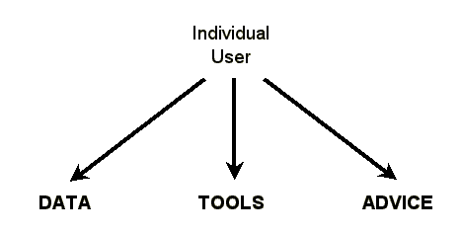
The ideal situation

Slide 9
What users actually get
The data are archived at hundreds of sites
  Some are on Web and user finds them
  Some are on Web but user can’t find them
  Some are not even on Web
The tools and advice are at hundreds of other sites

Slide 10
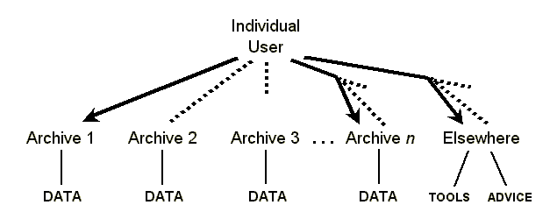
The gap

Slide 11
It’s even worse
The user may not find all existing data about the language of interest because different sites have called it by different names.
The user may not be able to use an accessible data file for lack of being able to match it with the right tools.
The user may locate advice that seems relevant but then has no way to judge how good it is.

Slide 12
What a community could provide
In order to bridge the gap, the individuals who use and create language documentation and description need a community that provides four things:
  A single gateway
  Uniform metadata
  A review process
  Standards

Slide 13
4. Gateway
A single portal through which users gain access to all available data, tools, and advice
The actual data, tools, and advice are
located on hundreds of sites all over the Internet—the gateway stores links to them.
By accessing the single gateway site, the user gains access to all available data,
tools, and advice.

Slide 14
5. Metadata
Uniform descriptions of all available data, tools, and advice
Not the data itself, but data about the data; thus it works for digital and non-digital holdings.
Use specialized metadata elements to meet requirements specific to language archives:
  uniformly identifying languages
  matching data formats to the appropriate tools

Slide 15
6. Review
Peer evaluation of available data, tools, and advice
Peer review is an important function of any academic community.
Review by individuals (with responses)
Review by community to establish some advice as recommended best practice

Slide 16
7. Standards
The framework that allows the core infrastructure to function:
  Gateway—governed by a protocol for harvest- ing metadata from participating archives
  Metadata—governed by an XML schema that ensures uniformity across all archives
  Review—governed by a process that promotes draft to candidate and then to best practice

Slide 17
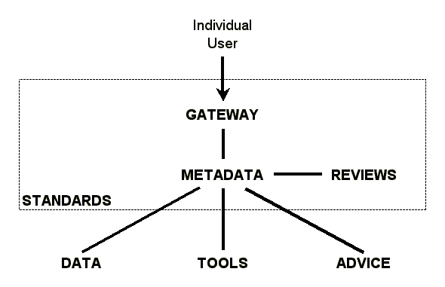
Proposed community infrastructure

Slide 18
Open Language Archives Community
A community of on-line archives and services that meet the needs of the language documentation community by:
  Implementing the Open Archives Initiative protocol for harvesting metadata
  Maintaining a community-specific metadata set
  Maintaining a review process for the community

Slide 19
Going deeper
A mockup of the OLAC gateway
The Open Archives Initiative
Prototypes based on OAI
A trio of documents:
  Requirements
  Survey
  White paper

