Slide 1
White Paper on Establishing an Infrastructure for Open Language Archiving
Steven Bird and Gary Simons

Slide 2

The Open Archives Initiative
Began with e-prints
Now covers digital repositories of scholarly materials, regardless of type
Each participating archive implements a repository:
Item: identifier + metadata
Specifies entry point
www.openarchives.org
WP:1

Slide 3
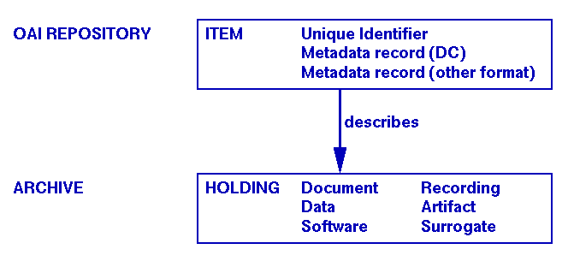
OAI Repositories and Archives
WP:1

Slide 4
Built on Two Standards
The OAI shared metadata set: Dublin Core
  core set of 15 metadata elements
  represent a broad, interdisciplinary consensus
  widely useful for resource discovery
OAI Metadata Harvesting Protocol
  software services can query a repository
  retrieve item identifiers and metadata records
WP:1

Slide 5
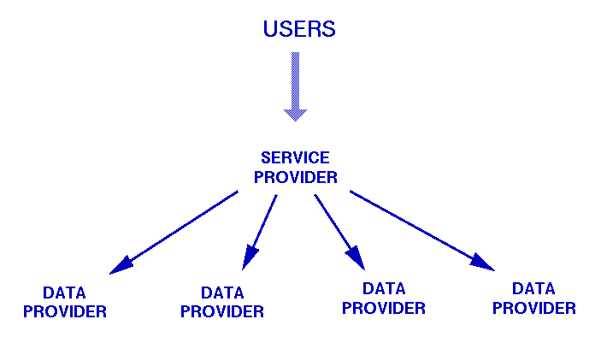
OAI Service and Data Providers
WP:1

Slide 6
Definition of the OAI Community
The OAI is a community of archives which:
  supply Dublin Core metadata
  support the OAI Metadata Harvesting Protocol
  register with the OAI
Any compliant repository can register
No other notion of community membership
WP:2

Slide 7
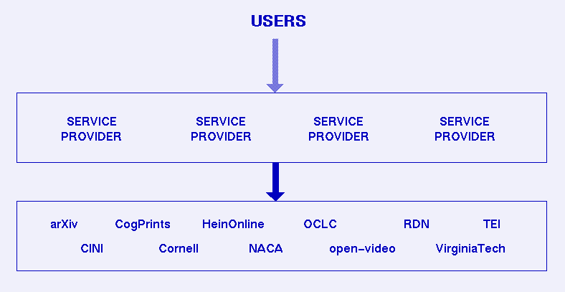
The OAI Community
WP:2

Slide 8
OAI Supports Specialist Communities
The community can define metadata formats other than Dublin Core
  Specific to a particular domain
  DPs serve the new format
  SPs harvest the new format
Result: an OAI subcommunity
WP:2

Slide 9
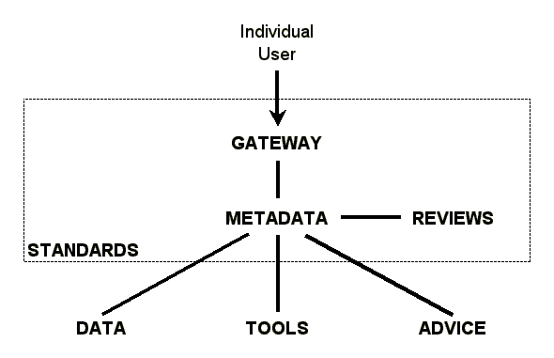
What does OAI provide us?
Community-specific metadata
Service Provider
Data Providers
WP:2

Slide 10
Proposed OLAC Metadata Set
Metadata is what makes OLAC a distinct subcommunity of the OAI
  Through metadata, our community describes the resources which are fundamental to the enterprise of language documentation
  Minimally extend Dublin Core to express what is fundamental about:
    Open
    Language
    Archiving
  But how?
WP:3

Slide 11
Back to the Requirements
Identify the languages that archived items relate to
Identify how open or restricted an item is
Identify format and encoding details for digital resources
Identify other resources required for using an item
Match data resources with appropriate software tools
WP:3.2

Slide 12
OLAC metadata elements
Subject.language
Rights.openness
Format.openness
Format.encoding
Format.markup
Type.data
Relation.requires
Rights.openness
Format.language
Type.functionality
Type.os
Type.osversion
Type.cpu
WP:3.2-3

Slide 13
Controlled vocabulary servers
Many elements have a restricted range of values:
    Rights.openness: open, published, restricted, unknown
    Subject.language: 6000+ Ethnologue codes
Controlled vocabulary server:
    Network-accessible service
    Maintains and documents a vocabulary
    SIL has agreed to be a C.V.S. for language id
WP:3.5

Slide 14
Subcommunities with richer metadata standards
Just as OLAC is a subcommunity of the OAI, there are other subcommunities in the scope of OLAC
  Language data centers (LDC, ELRA, GSK)
  ISLE Meta Data Initiative – detailed metadata for describing recorded speech events
These subcommunities would support DC and OLAC metadata, plus their own set
  Specialized service provider
  Focussed searching based on richer metadata
WP:3.6

Slide 15
Founding the Open Language Archives Community
Standards
OLAC definition
OLAC Gateway
Primary OLAC service provider
Peer review
Defining recommended best practice
WP:4

Slide 16
Standards
The framework that allows the core infrastructure to function:
  Gateway—governed by a protocol for harvest- ing metadata from participating archives
  Metadata—governed by an XML schema that ensures uniformity across all archives
  Review—governed by a process that promotes draft to candidate and then to best practice
WP:4.1

Slide 17
OLAC Definition
Definition: The Open Language Archives Community (OLAC) is the community of language archives and associated services which implement the OLAC standards.
Purpose: to support the language documentation community, by fostering the sharing of language resources.
Advisory council: each OLAC archive will be asked to select a representative to serve on an advisory council.
WP:4.2

Slide 18
OLAC Gateway: www.language-archives.org
This site will host information for the community of people:
    OLAC standards documents
    index of service providers
    collection of best practice recommendations
…plus information for the community of machines:
    OLAC metadata schema
    registry of data providers
    controlled vocabulary servers (local or remote)
WP:4.3

Slide 19

Primary OLAC Service Provider
Qualifications:
  foremost electronic network of linguists, with over 13,000 members worldwide
  a decade of experience
  worldwide mirrors
Roles:
  Provides a complete union catalog
  Institutes an informal, open, peer-review process
WP:4.4

Slide 20
Peer Review
How can you judge the quality of a digital resource?
    scale, quality, openness of the resource / support
    information may be misleading, outdated, erroneous
    access delayed/blocked by unadvertised restrictions
    problems with data, tools, formats, best practices
An informal, open, peer review process
    Users of a data or service provider can report their experience using a form on the OLAC Gateway
    Review forwarded to the provider, post a response
    Visitors to the Gateway could peruse them
WP:4.5

Slide 21
Defining recommended best practice
Anyone could submit an RFC, posted on Gateway
  RFC: existing practice; experience; case for wider adoption
  RFCs would be reviewed by the community and the advisory council
  Accepted RFCs promoted to the status of “Recommended Best Practice”
Not standards, but recommendations
  To limit the needless incompatibilities of format
  Encourage genuine innovation
WP:4.6

Slide 22
Next steps: This week
Working group discussions, leading to revised requirements
Working group discussions, leading to a revised white paper
Identify alpha test group
Endorsement and announcement
WP:5

